Slide 1
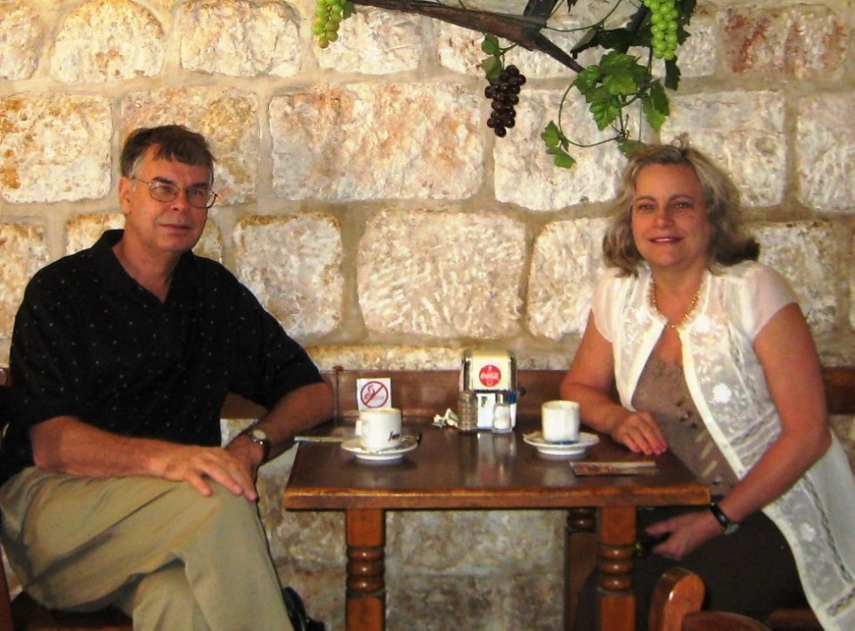

Slide 2

America, the UK, Russia, Germany, and France in
Bible Prophecy
Dr. Gavin Finley
EndTimePilgrim.org
Dr. Gavin Finley
EndTimePilgrim.org

Slide 3
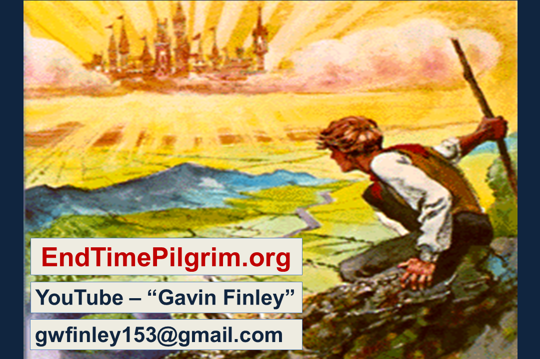

Slide 4
The big question American Christians ask is simply this. Is the USA in Bible Prophecy? And how about the modern superpowers? Most of our Bible prophecy teachers will say, “No!” But as we unveil the Scriptures and connect the dots we are going to uncover some very telling evidence to the contrary. This video will present some things
that not many people will have heard before.

Slide 5
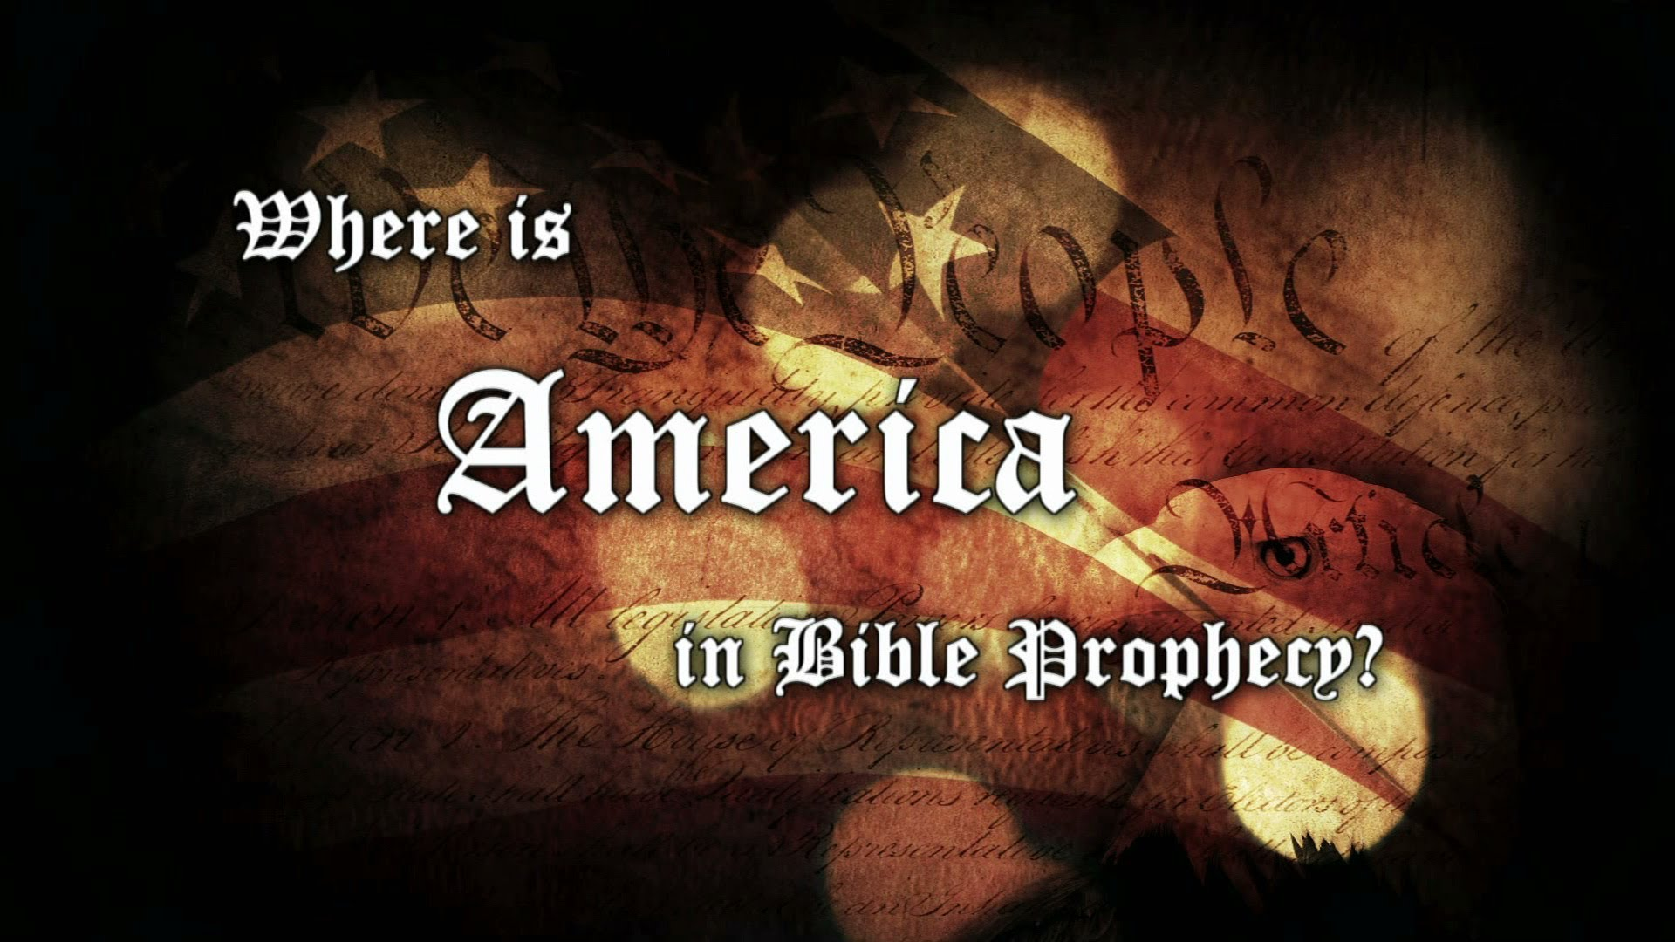

Slide 6
The history of the West is the story of the rise and fall of a succession of nations in Western Christendom. A series of economic and shooting wars marked the transitions between them. As we see, there is just one more nation left to reach its peak and come to its appointed climax in world history. That nation is the USA.

Slide 7


Slide 8
And how about these prominent nations? These members of the
G-8 nations are superpowers past and present. They remain major players on the world scene today. Could it be that a number of these are featured in Bible prophecy?

Slide 9
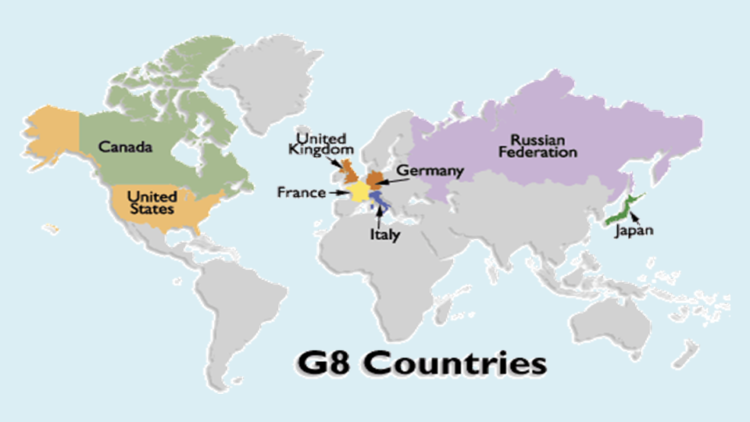
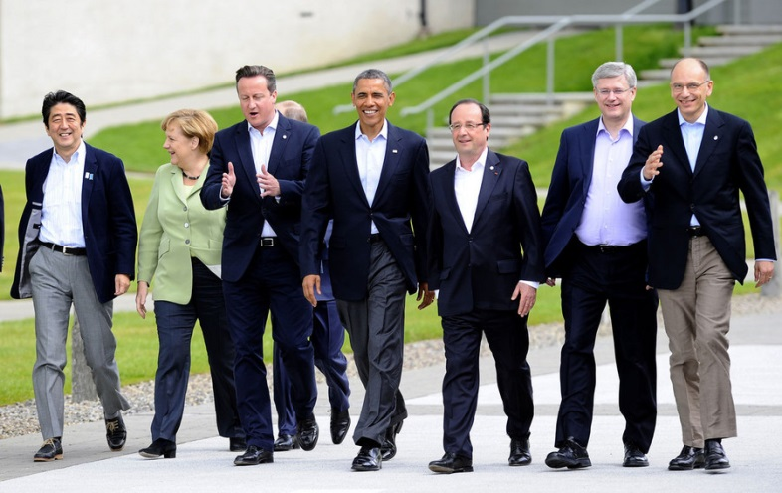

Slide 10
Yes, how about the Brits, the Germans, the French, and the Russians? Do they get a mention in Holy Scripture?
And just how prominent is the USA
in end-time events? As we go forward in this video we shall discover that all 5 of these are referred to in Daniel 7, tagged by their iconic symbology.

Slide 11
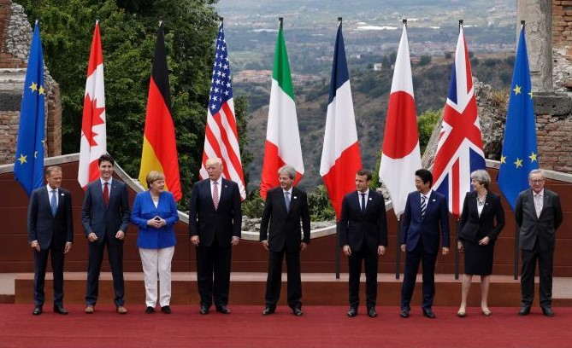
G-7 Summit

Slide 12
Let’s see if we can get a broad overview of America as a world power. Here is a listing of nations with the top military expenditures. As we see, Russia, the UK, France, Germany are in the top 7. Notice the one at the top of the list. The USA spends more money on its military than all the other nations in the world combined!
The United States of America is enormously powerful both economically and militarily.

Slide 13
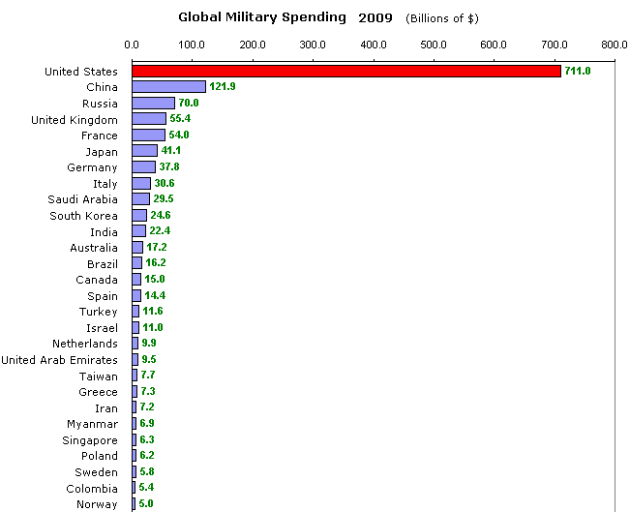
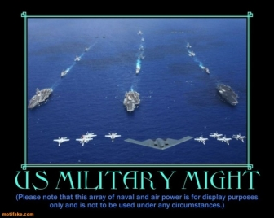

Slide 14
Take a look at this map of air travel across this world. Look at the regions where most of the world’s air traffic is coming from and going to. Americans travel by air more than any other people. Their dominion in this world, in war and in peace, is based upon air power, air travel, and now man-made orbiting satellite technology.

Slide 15
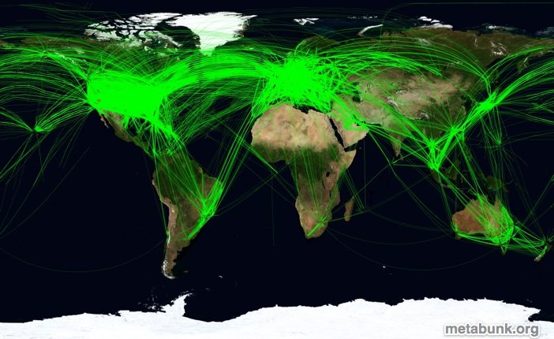
Air traffic across the world

Slide 16
In fact there are many places in Holy Scripture that refer to the USA. As we shall discover, a big slam-dunk proof of this is sitting there right in front of us in Daniel chapter 7. It is hidden in plain sight. But are our popular Bible prophecy teachers looking into this matter? Are they giving this issue the diligence it deserves? Are we as Christian believers even interested?

Slide 17
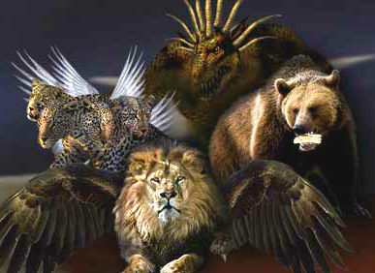

Slide 18
Let us look very specifically at the prophecy of Daniel 7. Daniel saw the four beasts in his dream. It was the fourth beast, the fierce one with the ten horns that startled him to the core.

Slide 20
Daniel received this vision in the first year of Belshazzar king of Babylon. This would have been around 550 B.C.. In verse 1 we read,
“Daniel had a dream and visions
of his head upon his bed:”

Slide 21
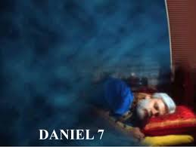
In the first year of Belshazzar king
of Babylon Daniel had a dream and visions of his head upon his bed:

Slide 22
And fortunately for us
“He wrote down
the dream,
and told the sum
of the matters.”

Slide 23
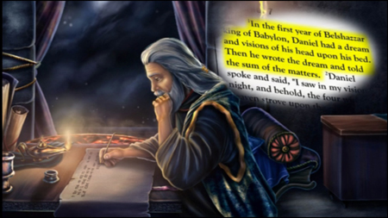

Slide 24
² Daniel spoke and said,
“I saw in my vision by night,
and, behold, the four winds of the heaven strove upon the great sea.”

Slide 25
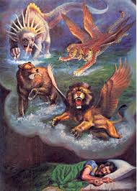

Slide 26
³ And four great beasts
came up from the sea,
diverse one from another.

Slide 27
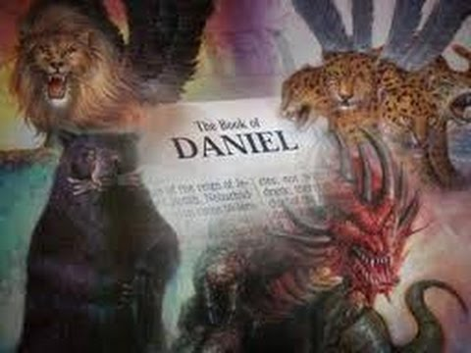

Slide 28
⁴ The first was like a lion,
and had eagle's wings:

Slide 29
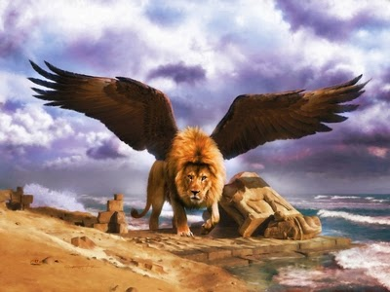

Slide 30
I beheld til the wings
were plucked thereof and it was lifted up from the earth.
When does this plucking of the wings happen?

Slide 31
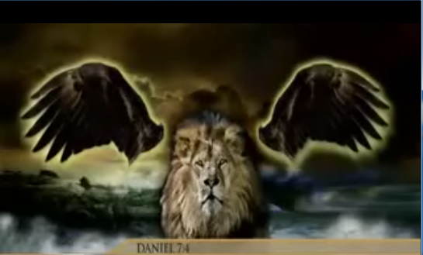

Slide 32
After the eagle’s wings are plucked off the lion Daniel then sees it stand up on two feet to become rampant. The lion is then given the heart of a man. When do these events happen? Which of these have already happened? And which
are yet to unfold in future history?
Just what is this prophecy telling us?

Slide 33
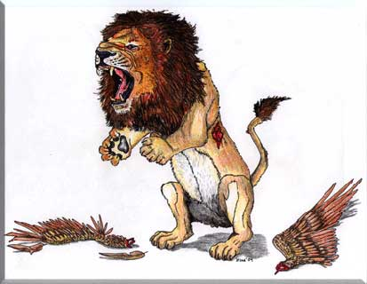
When does this occur?
In the past?
Or is it yet to unfold in a future history?

Slide 34
After the eagle’s wings are plucked off the lion are they alienated from each other and gone forever?

Slide 36
Will the eagle’s wings be seen again? Is it possible that they will be seen again in the latter days? Will the eagle’s wings be seen operating harmoniously together one more time, perhaps under a different agency and for a higher holy purpose? The answers to these questions lie hidden in the mystery.

Slide 37
?

Slide 38
Daniel then sees a bear rising up on one side.

Slide 39
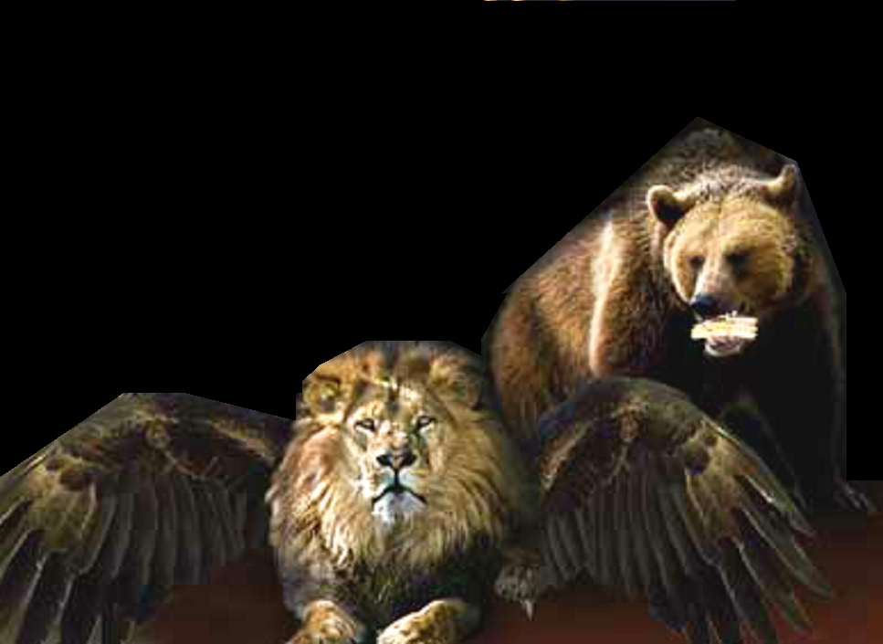

Slide 40
⁵ And behold another beast, a second, like to a bear,
and it raised up itself on
one side, and it had three ribs in the mouth of it
between the teeth of it:

Slide 41
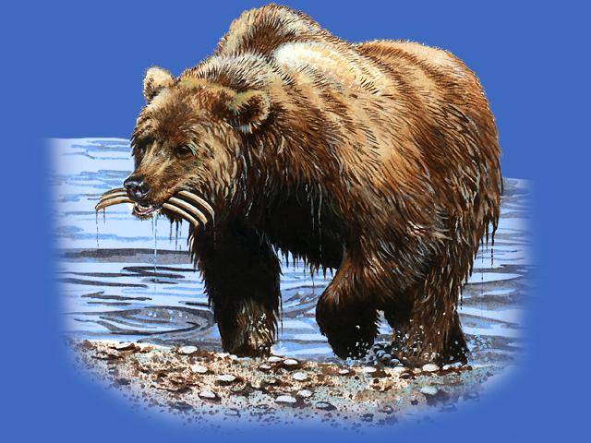
⁵ And behold another beast,
a second, like
to a bear, and
it raised up itself on one side, and it had three ribs in the mouth of
it between the teeth of it:

Slide 42
The bear had
three ribs in its mouth.
and they said thus unto it,
”Arise, devour much flesh.”

Slide 43
  ARISE,
  DEVOUR MUCH
  FLESH!

Slide 44
What great superpower has taken the lives of millions, in wars, and even in “peacetime”, devouring its own people?

Slide 45
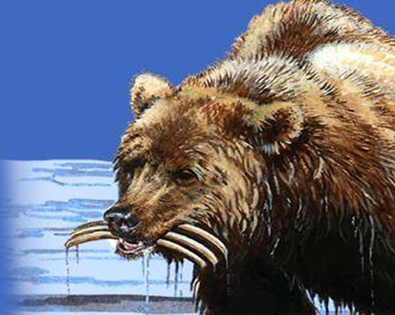
What great superpower has taken the lives of millions, . .
. . . in wars,
and even in “peacetime”, devouring its own people?

Slide 46
Daniel then sees another beast, one like a leopard, which had upon the back of it four wings of a fowl; the beast had also four heads; and dominion was given to it.

Slide 47
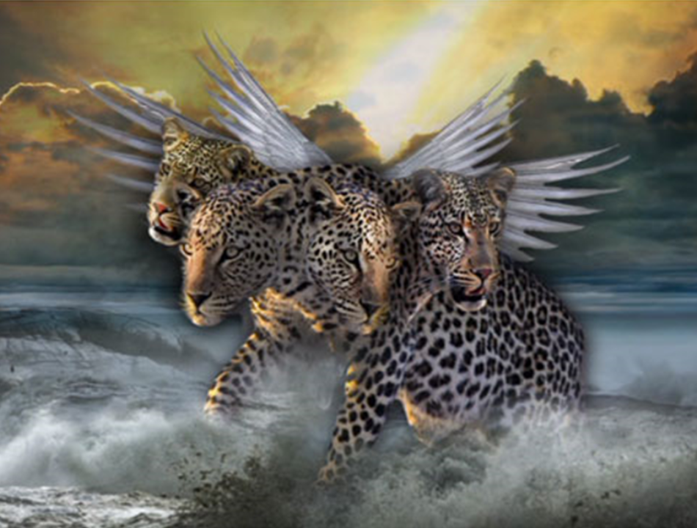
⁶ After this I beheld, and lo another, like a leopard, which had upon the back of it four wings of a fowl;

Slide 48
the beast had also
four heads;
and dominion
was given to it.

Slide 49
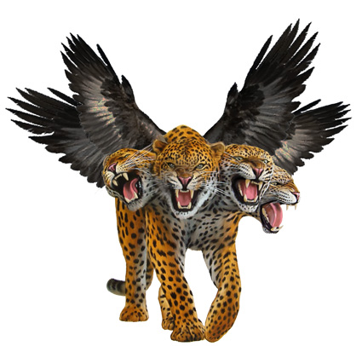
the beast
had also
four heads;
and dominion
was given
to it.

Slide 50
So as we survey the four beasts of Daniel chapter 7 here are the three beasts we have seen so far. Then we go on to the key verse in our study, Daniel 7 verse 7. Daniel says,

Slide 51
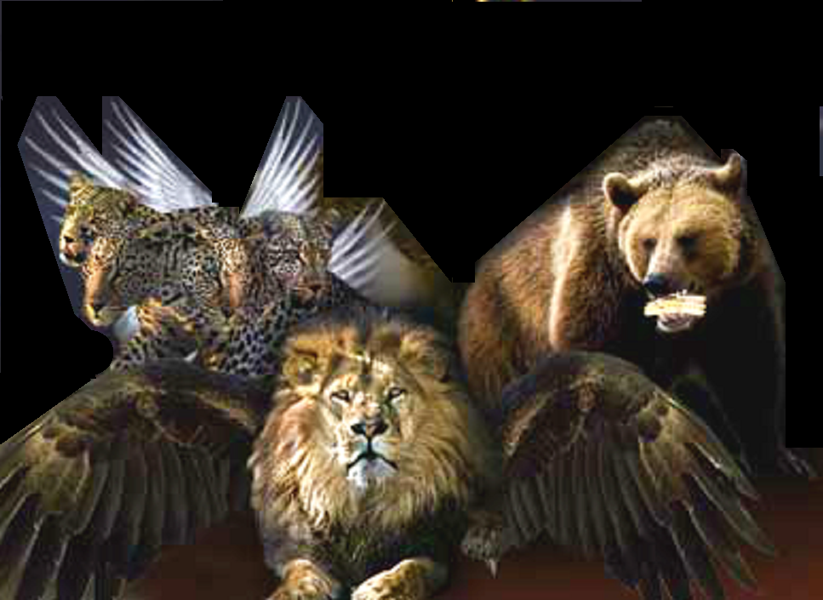

Slide 52
⁷ After this I saw in the night visions,
and behold a fourth beast, dreadful and terrible, and strong exceedingly; and it had great iron teeth: it devoured and brake in pieces, and stamped the residue with the feet of it: and it was diverse from all the beasts that were BEFORE IT; and it had ten horns.

Slide 53
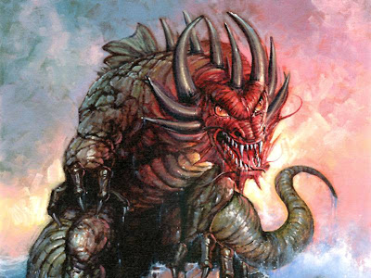
⁷ After this I saw in the night visions, and behold a fourth beast, dreadful and terrible, and strong exceedingly; and it had great iron teeth:
It devoured and brake in pieces, and stamped the residue with the feet of it.
It was diverse from all the beasts that were BEFORE IT; and it had ten horns.

Slide 54
After this Daniel sees a fourth beast. It was diverse from all the beasts that were BEFORE IT; and it had ten horns. Take special note of that word, “BEFORE”. It is the key to this study. We‘ll be taking a very close look at that word shortly.

Slide 55
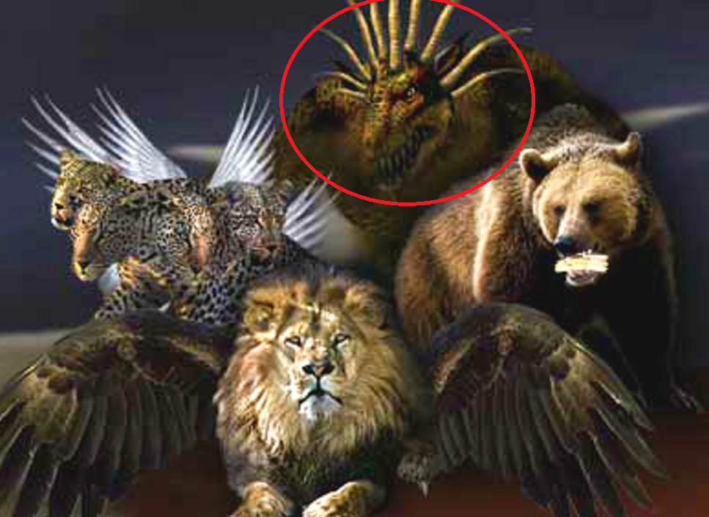

Slide 56
We now move on to the late first Century and the two related visions of the apostle John. Exiled on the Island of Patmos John sees in vision the very same seven headed ten horned beast that the prophet Daniel had seen well over 600 years before!

Slide 57
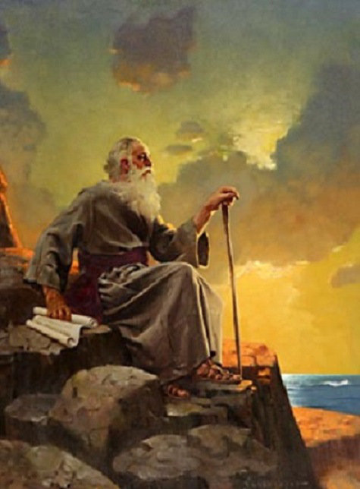
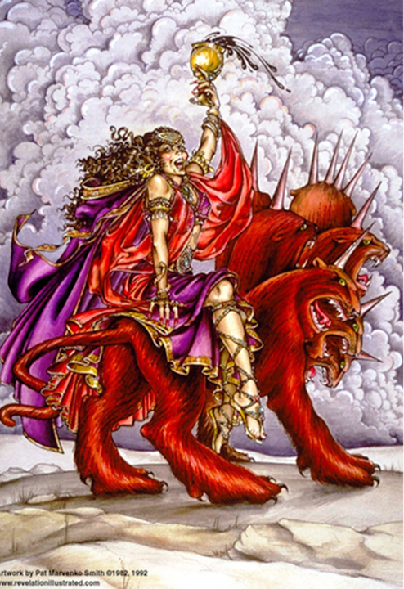
REVELATION 17

Slide 58
In this end-time vision from Revelation chapter 17 John saw
the beast with a red body with a blaspheming character. This is an early vision of the New World Order with a harlot woman of compromise riding the beast, (or trying to ride it).

Slide 59
3 I saw a woman sit upon a scarlet colored beast, full of names of blasphemy, having seven heads and ten horns.
4 And the woman was arrayed in purple
and scarlet color, and decked with gold and precious stones and pearls, having a golden cup in her hand full of abominations and filthiness of her fornication: 5 And
upon her forehead was a name written, MYSTERY, BABYLON THE GREAT,
THE MOTHER OF HARLOTS AND ABOMINATIONS OF THE EARTH.
6 And I saw the woman drunken with
the blood of the saints, and with the
blood of the martyrs of Jesus:
REVELATION 17

Slide 60
John has another vision of the same ten horned beast. In this vision, recorded in Revelation 13, John sees the beast coming up out of the sea of nations. This appears to be a later time period after the harlot has been thrown off. Because harlot is no longer riding. We know from Daniel 9:27 that at the midweek abomination of desolation the false messiah is revealed for the 666 beast he really is. In this end-time vision John saw the blaspheming character and name was now situated on the heads of the beast.

Slide 61
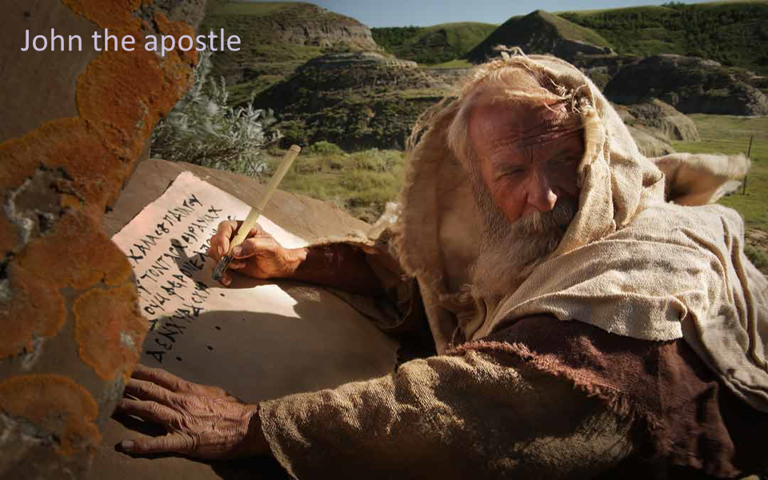
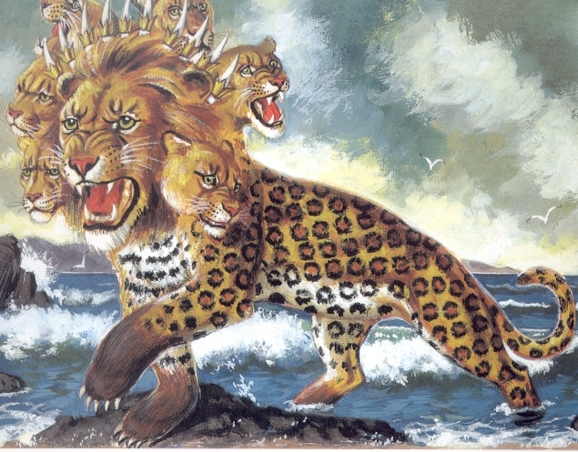
“And I stood upon the sand of the sea, and saw a beast rise up out of the sea, having seven heads and ten horns, and upon his horns ten crowns, and on his heads a blasphemous name.” - Revelation 13:1

Slide 62
In this vision from Revelation 13 John also sees something very curious. The beast he saw had certain body parts of the leopard, the bear, and the lion, the first three beasts that Daniel had seen and had written about in Daniel chapter 7 over 600 years earlier.

Slide 63
Daniel’s vision of
the three beasts
in 550 B.C. from
Daniel 7
John’s vision of
ten horned beast
around 95 A.D.
Revelation 13

Slide 64
In Revelation 13 John writes, “Now the beast which I saw was like a leopard, his feet were like the feet of a bear, and his mouth like the mouth of a lion. The dragon gave him his power, his throne, and great authority.”

Slide 65
“Now the beast which I saw was like a leopard,
his feet were like the feet of a bear, and his mouth
like the mouth of a lion. The dragon gave him his
power, his throne, and great authority.” - Rev. 13:

Slide 66
So the ten horned beast John saw was like a leopard, his feet were like the feet of a bear, and his mouth like the mouth of a lion. These are three body parts of the very same three beasts Daniel had seen. But where are the wings of an eagle and wings of a fowl? We shall be looking into that matter shortly.

Slide 67
Daniel’s vision of
the three beasts
in 550 B.C. from
Daniel 7
John’s vision of
ten horned beast
around 95 A.D.
Revelation 13

Slide 68
So now the question arises, what do those ten horns represent?

Slide 69
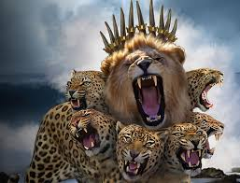

Slide 70
Bible commentators relate the ten horns on the fourth beast of Daniel 7 to the ten toes on the image from Daniel chapter 2.
This is a valid interpretation.
So what do they symbolize?

Slide 71
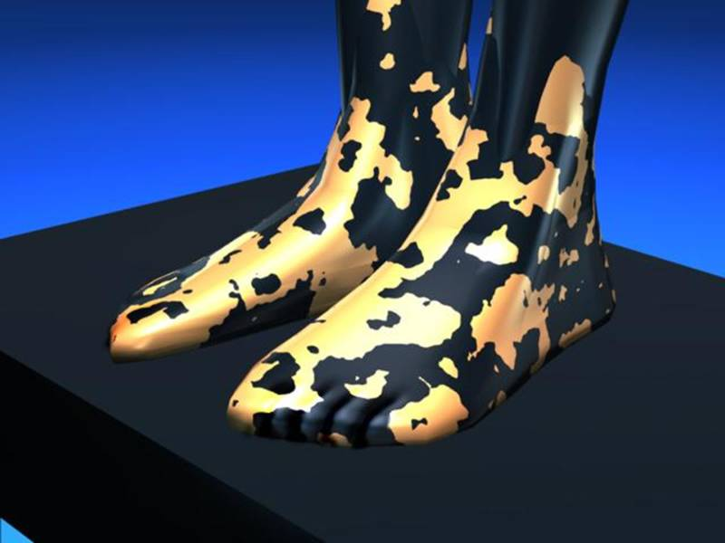
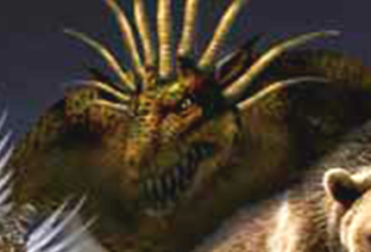
Ten Toes
Daniel 2:33-34
Ten Horns
Daniel 7:7
Revelation 13:1
Revelation 17:3

Slide 72
Bible prophecy teachers in times past speculated that these ten horns and ten toes were the nations of the European Union. Of course this was back when there were just ten of them.

Slide 73
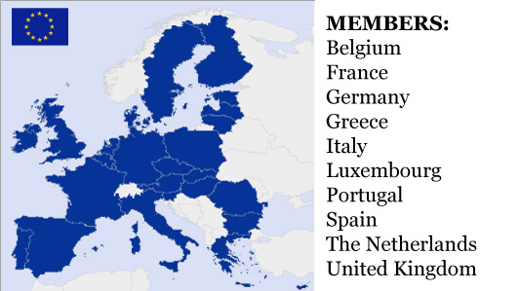

Slide 74
But since the EU now includes 28 nations, or after Brexit 27 nations, this interpretation is falling short. Then
too the fourth beast appears to be
a global entity. So the idea that the
ten horns are ten nations boxed up in Europe is dated and seriously flawed.

Slide 76
But the idea still persists of the fourth beast of Daniel 7 being a Revived Roman Empire, and limited to an end-time ten nation confederation based in Europe. Some are even saying it will be an Islamic global empire further to the east involving Turkey or Iraq complete with an Islamic Antichrist. This would seem to be highly unlikely.

Slide 78
So what do the ten horns or ten toes really signify? The fact is, ten geo-political economic and banking regions, (future kingdoms in embryonic form), are already unfolding right now, before our eyes. This New World Order Map dates back to 1941. As we see they had already planned for NAFTA and the African Union. Right now these ten global bio-regions do not yet have sovereignty. They have no kings, or political rulers over them.

Slide 79
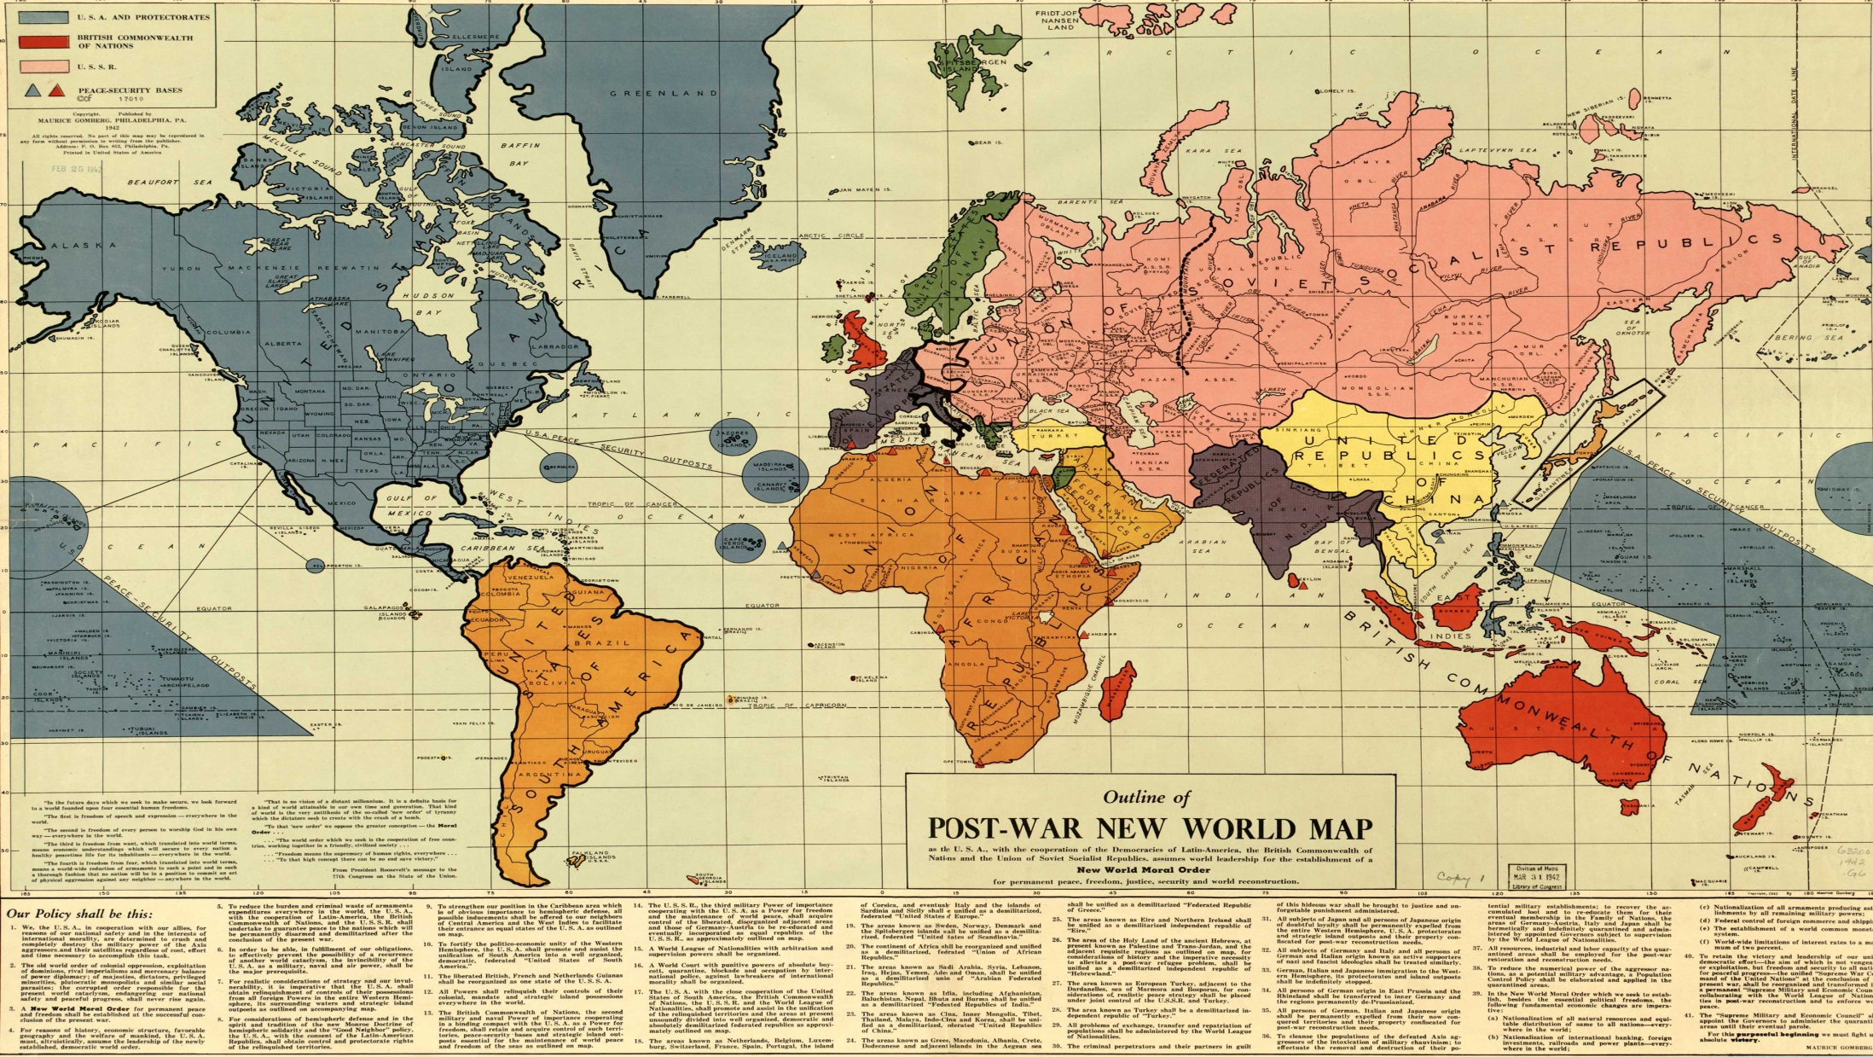

Slide 80
But as John saw and recorded for us
in Revelation 13:1 these ten powers, shown to us as ten horns, will be given ten crowns. From this we can surmise that these ten global regions will attain sovereign status. Ten kings will rule over them in a time and history yet to come.

Slide 81
“And I stood upon the sand of the sea, and saw a beast rise up out of the sea, having seven heads and ten horns, and upon his horns ten crowns, and upon his heads the name of blasphemy.” - Revelation 13:1

Slide 82
So the harlot John saw in Revelation 17 appears to precede the specter of the ten horned beast coming out of the sea he saw in Revelation 13. At some point the harlot will lose her reigning power. Her rule over the ten horned beast will end. John
is then told what will happen to those
ten horns or ten regional world powers.

Slide 83
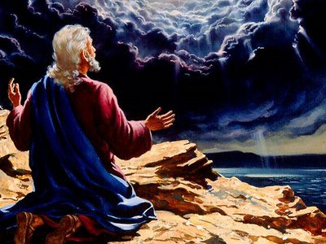
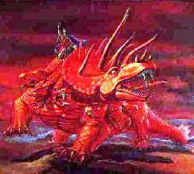
“And the ten horns which thou sawest are ten kings, which have received no kingdom as yet; ”
- Revelation 17:1

Slide 84
John is told“. . the ten horns which you saw are ten kings, which have received no kingdom as yet; but receive power as kings for one hour with the beast.”
- Revelation 17:1

Slide 85
HARLOT RULE
ANTICHRIST
666
BEAST
RULE
Midpoint
of 70th
Seven
“And the ten horns which thou sawest are ten kings, which have received no kingdom as yet;
but receive power as kings for one hour
with the beast.”- Revelation 17:1

Slide 86
So the ten horns are given ten crowns to rule for a short time along with the emerging, blaspheming, 666 beast-phase Antichrist. He is revealed for who he truly is when he commits the abomination of desolation at the midpoint of the 70th Week, the midpoint of the final 7 years.

Slide 87
“And I stood upon the sand of the sea, and saw a beast rise up out of the sea, having seven heads and ten horns, and upon his horns ten crowns, and upon his heads the name of blasphemy.” - Revelation 13:1

Slide 88
So after the harlot loses her reigning power over the beast the ten horns, the ten economic regions into which the world has been divided, are given ten crowns. Ten kings will arise over those ten global bio-regions and be given ruling power along with the beast.

Slide 89

“And I stood upon the sand of the sea, and saw a beast rise up out of the sea, having seven heads and ten horns, and upon his horns ten crowns, and upon his heads the name of blasphemy.” - Revelation 13:1

Slide 90
So the ten horns, who have presumably been “under submission” to the harlot, will attain ruling power of their own and ten kings will arise. This will happen when the 666 Beast is revealed for who he really is which is at the midpoint of the final 7 years of this age. The rule of these ten kings must only be for a short time. John reports that will receive power for
“one hour” along with the beast.

Slide 91
HARLOT RULE
ANTICHRIST
666
BEAST
RULE
Midpoint
of 70th
Seven
“And the ten horns which thou sawest are ten kings, which have received no kingdom as yet;
but receive power as kings for one hour
with the beast.”- Revelation 17:1

Slide 92
Now let’s go back to Daniel’s dream in Daniel ch. 7. Here are the four beasts that Daniel saw in that night vision 2550+ years ago. We see a lion, a bear, and a leopard. Most students of Bible prophecy consider that the fourth beast with the ten horns represents the future New World Order due to open up in the 70th Week of Daniel, the final 7 years of this age. This interpretation is Biblically well founded. So it is extremely important that we study the first three beasts, the time window of their power and influence in world history, and the relationship they have with this fourth NWO beast.

Slide 93
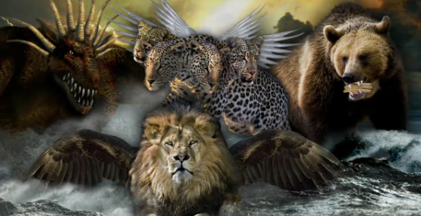
NWO
Beast

Slide 94
So what can we say about the first three beasts, the ones we see here? What major powers might they represent? Well, as we shall discover, there are actually five nations involved here. And in this study we are going
to find out just who they are.

Slide 96
The first great commentary on the English Bible was published by Matthew Henry back in 1710. Matthew Henry’s conclusion was that the first three beasts had to be great empires of the past.

Slide 97
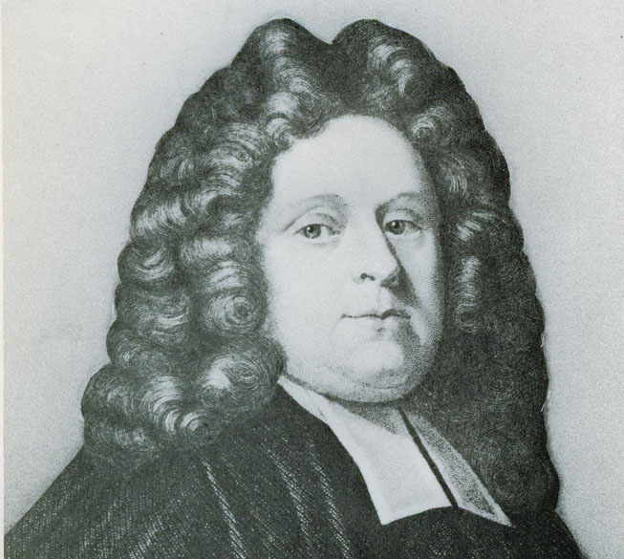
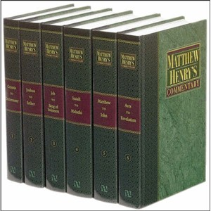
Matthew Henry English Bible commentator
1662- 1714
Matthew Henry
1662 - 1714

Slide 98
He identified the beasts of Daniel 7 as a repeat showcasing of the former empires of Babylon, Medo-Persia, Greece, and Rome, precisely as seen on the statue from King Nebuchadnezzar’s dream in Daniel 2.

Slide 99
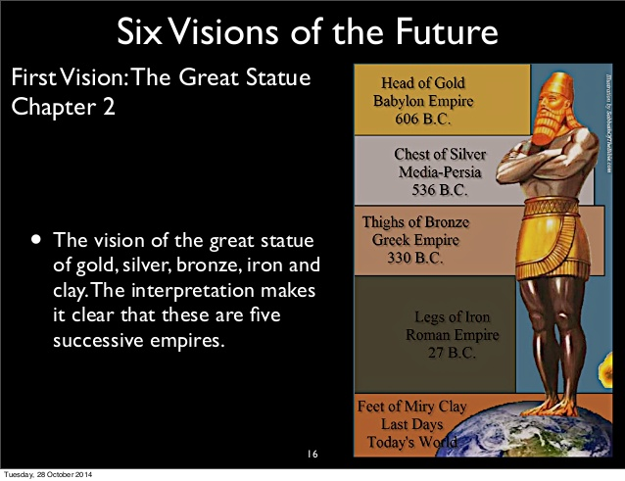
Matthew Henry English Bible commentator
1662- 1714
Matthew Henry
1662 - 1714

Slide 100
This was the world map in the early 1700’s, the time of Matthew Henry. The unifications of Western nations by men like Bismarck, and Mazzini had yet to occur. And modern super-powers such as the French under Napoleon, the British Empire, the Germans in the two World Wars, the Russians in the cold war, and the present day Pax Americana had not yet emerged onto the world scene. Bible commentators back in times past looking for major empires to fit the Daniel 7 prophecy would have seen none. Perhaps they did not consider the possibility that big unified super-powers were yet to emerge in the future. And even if they had, the modern world powers were clearly beyond their view.

Slide 101
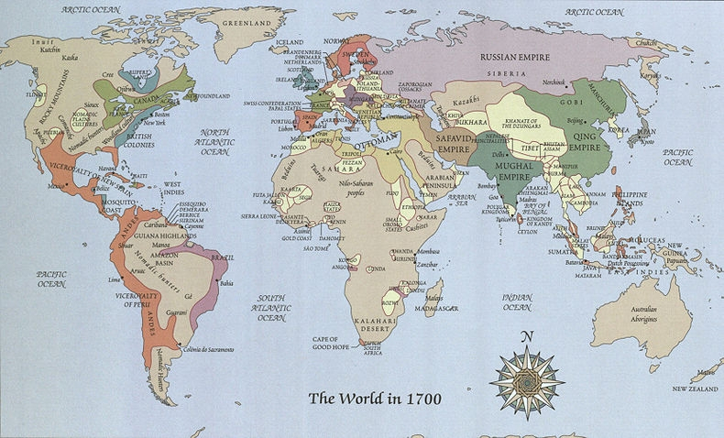

Slide 102
Perhaps this was why Matthew Henry and practically all Bible commentators since him have been inclined look back in time and speculate that the first three beasts symbolized the ancient empires of Babylon, Medo-Persia, Greece, and Rome, with a Revived Roman Empire at the end of each.

Slide 103
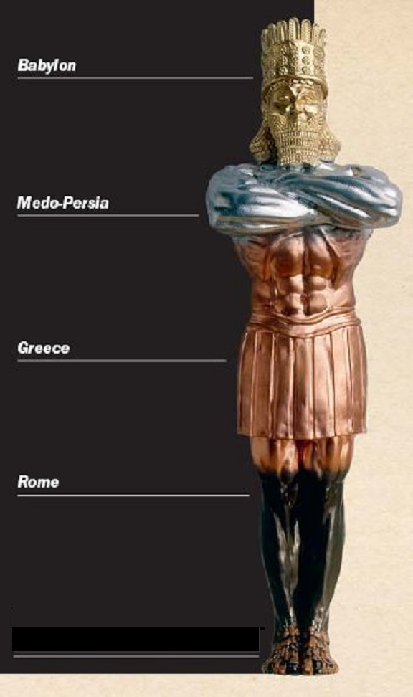
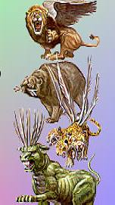
DANIEL CHAPTER 2
DANIEL CHAPTER 7
BABYLON
MEDO-PERSIA
GREECE
Matthew Henry
1662 - 1714
ROME
?
REVIVED ROMAN EMPIRE
REVIVED ROMAN EMPIRE

Slide 104
Bible prophecy teachers quite rightly saw the connection between the ten toes on the image in Daniel 2 and ten horns on the fourth beast of Daniel 7. They surmised, quite correctly, that in each vision the ten toes and ten horns symbolized gentile powers of the latter days. So there was indeed a valid connection here, but only at the tail end of each vision.

Slide 105
Ten Toes
Daniel 2:33-34
Ten Horns
Daniel 7:7
Revelation 13:1
Revelation 17:3

Slide 106
However, there is no Biblical reason to affirm that the dream of King Nebuchadnezzar in Daniel 2 and the dream of Daniel in Daniel 7 are parallel at ALL levels. Nevertheless, modern commentators continue with Matthew Henry’s interpretation. In fact the vast majority of Bible prophecy teachers to this day continue to insist that the two dreams are telling the very same story but using different imagery.

Slide 107
DANIEL CHAPTER 2
DANIEL CHAPTER 7
BABYLON
BABYLON
MEDO-PERSIA
GREECE
ROME
?
REVIVED ROMAN EMPIRE
REVIVED ROMAN EMPIRE

Slide 108
In Daniel 2 we also see the Smiting Stone representing the coming Kingdom of Messiah. He will put an end to the destructive man-centered humanistic New World Order. He will terminate the rule of the Antichrist and False Prophet. All this will unfold in the Apocalypse, the Revelation, or the unveiling of Christ as Messiah at the close of the age.

Slide 109
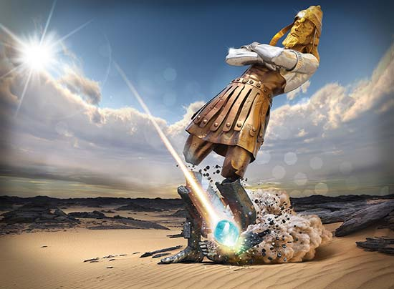
Daniel 2:34. Thou sawest till that a stone was cut out without hands, which smote the image upon his feet that were of iron and clay, and brake them to pieces. 35 . . . . . . . . and the stone that smote the image became a great mountain, and
filled the whole earth.
605 B.C.
538 B.C.
332 B.C.
165 B.C.
21st Century.

Slide 110
The symbology of the iron in the feet and ten toes certainly typify hard relentless dictatorial Roman elements of Rome we saw in past times and in Europe in more recent times. But there is also the matter of the miry clay. This is a huge new lead for us as we look into the dual nature of the politics of the coming New World Order. But this will have to wait for a future video.

Slide 111
Feet and Toes of Iron and
Miry Clay - Daniel 2:33-34

Slide 112
So here we see the commonly held interpretation of the four beasts of Daniel chapter 7. But is this a valid interpretation based upon a good solid Biblical foundation?
And the answer is no.

Slide 113
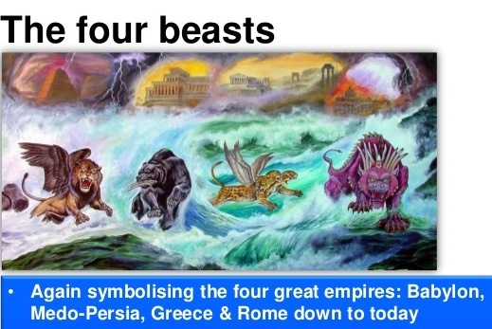
(But is it true?)
?
?
?
BABYLON
MEDO-PERSIA
GREECE
REVIVED ROMAN EMPIRE
?
?

Slide 114
The two dreams are vastly different
in scope. Daniel chapter 2 gives us a wide angle view of history. It extends from Babylon in the 6th Century B.C. and across 26 centuries right on up to the New World Order in the latter days.

Slide 115
605 B.C. Babylon
538 B.C. Medo-Persia
538 B.C.
2600
Years
332 B.C. Greece
332 B.C.
27 B.C. Rome
21st Century NWO
21st Century.

Slide 116
As we shall discover, Daniel chapter 7 is a much narrower 21st Century view of history nestled in the end-time drama right at the close of the age.

Slide 118
As the book of Daniel ends in chapter 12 the angel Gabriel tells Daniel to “seal up the book” (in secret) “until the time of the end”. Gabriel told him that the message he was given, cloaked in mystery as it was, was to remain sealed. The prophesies in the book would be unsealed as the covenant people of God came into ”the time of the end”. This would be in
the time of a seven year “famine of the hearing of the Word of God”. At that time many would be “running to and fro”, searching for the truth but not finding it.

Slide 119
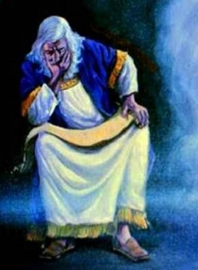
" But you, Daniel,
shut up the words and seal the book, until the time of the end.
Many shall run to
and fro, and knowledge shall increase.”
- Dan. 12:28

Slide 120
In effect, Daniel was told that there was a time delay
on the prophecies he was given. This is certainly true in the case of the beasts of Daniel 7. Because, as we can appreciate, the superpowers of the modern era had not yet emerged into history to be recognized in their animal symbology. They simply were not in view back in 1708 when Matthew Henry published his commentary. The animal caricatures of the prominent modern nations can be recognized today. But Matthew Henry could not be expected to see them in the early 1700’s. How could he?

Slide 121
If these turn out to be modern nations that became major superpowers in the 20th and the 21st Centuries then how could we expect
earlier commentators to have identified them?
Matthew Henry famous Bible commentator
1662- 1714
Matthew Henry
His Commentaries.
Published in 1708

Slide 122
Today we have Bible Commentaries of many different flavors. Virtually all of them, along with today’s Bible prophecy teachers have followed Matthew Henry’s earlier interpretation of
Daniel 7 being a recap of Daniel 2. The world
has changed a lot in the past 100 years. But sadly, our prominent Bible teachers have not seen fit to revise this earlier interpretation. Nor has anyone yet published a correctly updated commentary.

Slide 123
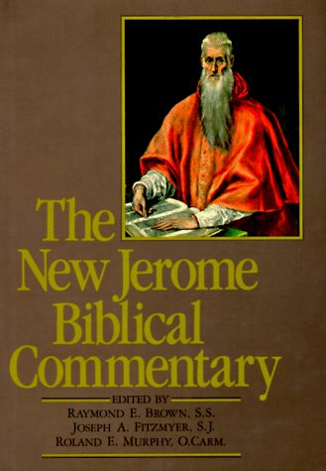
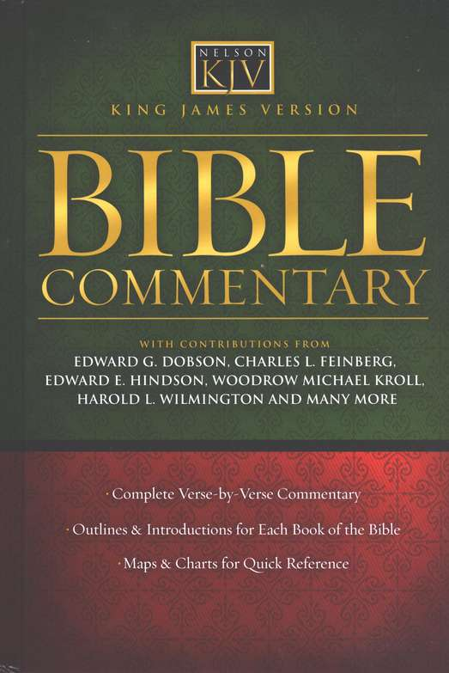
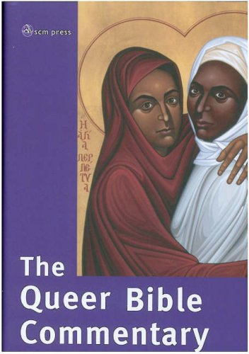
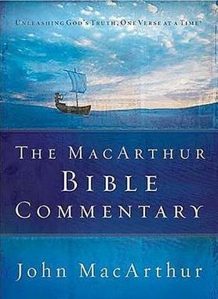





Slide 124
So we now return to our original question. Can we find the USA featured in Bible prophecy? Is it possible for us to take a fresh look at the first three beasts of Daniel 7?

Slide 126
Might we have reason to suspect that these animal caricatures do not represent ancient empires at all but symbolize some rather modern ones? And if so, then just who are these prominent nations represented by the lion, the eagle’s wings, the bear, and the leopard, and the wings of a fowl? What nations are represented by these first three beasts of Daniel chapter 7? We are going to come back and look into that matter shortly.

Slide 128
But first let us look into a very curious matter. What if
we were discover in Daniel chapter 7 something that
our Bible commentators have missed? What if there
is a single word which has been translated out of the Aramaic into English and that word is a homograph,
that is, a word that is ambiguous with more than one meaning? What if our English word “before” can have two meanings? And if there is a homograph lurking in Daniel 7:7 is it possible that our Bible prophecy teachers have been focusing on the wrong meaning of that word?

Slide 129


Slide 130
Let us bring up our scripture passage Daniel 7:7 and take
a look. We are going to home
in on that one word “before”.

Slide 131
Daniel 7
⁷ After this I saw in the night visions, and behold a fourth beast, dreadful and terrible, and strong exceedingly; and it had great iron teeth: it devoured and brake in pieces, and stamped the residue with the feet of it: and it was diverse from all the beasts that were BEFORE it; and it had ten horns.

Slide 132
What if the English word “before” into which this Aramaic word is translated is actually a homograph with two possible meanings. A homograph is a an ambiguous word that is spelled the same, but can have different meanings.

Slide 133

The word “before” is like the word “bat”.
It is is a HOMOGRAPH.
A homograph is a word that is spelled
the same, but has different meanings.

Slide 134
Following our translators and commentators we think that the word “before” means X.
But what if the correct meaning is actually Y?

Slide 135
The word
“BEFORE”
Meaning “X”
Meaning “Y”

Slide 136
Is it possible that an missed translation from the Aramaic rendering it merely as this ambiguous word “before”, a word which has two meanings, has caused us to miss the true and correct meaning of what God is telling us in Daniel 7:7?

Slide 137
The word
“BEFORE”
WRONG!
Meaning “Y”
(correct)
(but hidden from view)
Meaning “X”

Slide 138
Let’s get specific here.
The word “BEFORE” can actually
have these two meanings. It can mean
A. ”preceding in time”
or it can mean
B. ”in the presence of”

Slide 139
“BEFORE”
Meaning “X”
Meaning “Y”
“Before” as
“before
in time”
“Before” as
“in the
presence of”

Slide 140
So it seems we have some serpentine duplicity going on here. The word
“before” can have two meanings. If our Bible translators have given us the word “BEFORE” and that word can have two meanings then where does that leave us? Does it not leave us in a state of confusion?

Slide 141

Which meaning of
the word, “before”
would you like?
“in the
front of”
“preceding
in time?”

Slide 142
We are left with the question; Just what did the angel Gabriel wish to convey to us through the message he gave to the prophet Daniel in Daniel 7:7?

Slide 143

“The fourth beast . . . . . . . was diverse from all the beasts that were
BEFORE it;
and it had
ten horns.”
- Dan. 7:7

Slide 144
Reading the various English Bible versions
of Daniel 7:7 most still just give us the word “before”. Some even dodge the whole phrase entirely. Reading that English word “before” in our Bibles we have NO IDEA in which sense the word should be taken. Not a clue.

Slide 145
King James Bible
After this I saw in the night visions, and behold a fourth beast, dreadful and terrible, and strong exceedingly; and it had great iron teeth: it devoured and brake in pieces, and stamped the residue
with the feet of it: and it was diverse from all the beasts that were before it; and it had ten horns.
New American Standard Bible
"After this I kept looking in the night visions, and behold, a fourth beast, dreadful and terrifying
and extremely strong; and it had large iron teeth. It devoured and crushed and trampled down the remainder with its feet; and it was different from all the beasts that were before it, and it had ten horns.
English Standard Version
After this I saw in the night visions, and behold, a fourth beast, terrifying and dreadful and exceedingly strong. It had great iron teeth; it devoured and broke in pieces and stamped what was left with its feet.
It was different from all the beasts that were before it, and it had ten horns.
Berean Study Bible
After this, as I watched in my vision in the night, suddenly a fourth beast appeared, and it was terrifying —dreadful and extremely strong—with large iron teeth. It devoured and crushed; then it trampled underfoot whatever was left. It was different from all the beasts before it, and it had ten horns.

Slide 146
Is it meaning “X”
or meaning “Y”?

Slide 147
“BEFORE”
Meaning “X”
Meaning “Y”
“Before” as
“preceding
in time”
“Before” as
“in the
presence of”

Slide 148
Are those first three beasts ancient empires way back in the centuries before Christ and as such “preceding in time” the latter day fourth NWO beast? Or are these first mentioned beasts “before” as “in the presence of”
the end-time NWO beast?

Slide 149
Where are those first three beasts on the timeline?
Is it “before” as in
“Preceding
in time”
like this?
2600 B.C.
or “before”
as in
END-TIME
“In the presence
of” like this?

Slide 150
It seems apparent that Bible translators have been OK using this ambiguous word “before”. Then Bible commentators, almost to a man, have gone right on with this and interpreted that word “before” as “preceding in time”. So they identify the first three beasts as ancient empires.

Slide 151
(But is it true?)
?
?
?
BABYLON
MEDO-PERSIA
GREECE
REVIVED ROMAN EMPIRE
?
?

Slide 152
BUT! What if we discovered that
the correct meaning of the word
“BEFORE”
was not “preceding in time”
at all but rather
“in the presence of”?

Slide 153
“BEFORE”
Meaning “Y”
Meaning “X”
“Before” as
“in the
presence of”
“Before” as
“before
in time”

Slide 154
We know that the fourth beast, the New World Order beast, will be in existence in the latter days
at the end of the age. So then, if those first three beast kingdoms are ”in the presence of” that
fourth beast then all of them would have to be
in the latter days as well. All four beasts would have to be contemporaneous and on the scene together. This would then actually FORCE us to locate these three beast superpowers right here and now in the present day post-modern era.

Slide 155
END-TIME
IF the first three are
“in the presence of” the END-TIME beast
Then the first three beasts are
CONTEMPORANEOUS
IN THE LATTER DAYS
WITH
THE FOURTH BEAST
2550 B.C.

Slide 156
OK, let’s get to the crux of the matter. Here is our scripture verse again in Daniel 7:7.
We see that the first three beasts
were “before” the fourth beast.

Slide 157
Dan. 7:7
”The fourth beast
was diverse from all the
beasts that were before it;
and it had ten horns.”

Slide 158
What is being hidden from us here? What does the word “before” mean?

Slide 159
Which meaning of
the word, “before”
would you like?
“in the
front of”
“preceding
in time?”

Slide 160
Perhaps the native American Indians were right about us. If we should turn out to be the lost tribes of Israel are
we at this point, just shifty Jacob?

Slide 161


Slide 162
So what is being hidden from us here? What does the word “before” mean? And how can we find out?

Slide 163
At this point we open up the Brown, Driver, Briggs Hebrew Lexicon. Or we access this from the Blue Letter Bible freely provided online or the Bible Study Tools or other Internet resources. When we do our homework we discover that the word “before” in Daniel 7:7 is Strong’s H6925.
It is the Aramaic word “qodam”.

Slide 164


Slide 165
As we see here in the Lexicon the Aramaic word “qodam”, Strong’s H6925, which has been translated ambiguously as “before” actually has a very specific meaning.
The word “qodam”, means
”in front of” or “in the presence of”.
It very definitely does NOT mean
“preceding in time”!

Slide 166

“in front of”
“in the presence of”

Slide 167
Bible study is not a side interest for religious nerds. It is part of the spiritual war we fight as witnesses to others on behalf of our Messiah. And all wars are information wars. Sometimes we have to go in and push back the denizens of darkness, -- like the trolling evil spirit that doesn’t want us to discover the truth behind the word “qodam”.

Slide 168

How dare you
come here and ask about the word
“qodam”!

Slide 169
How is the word “qodam” used in other places where the Aramaic is to be found in the Bible, namely Daniel and Ezra? Here in Daniel 2:25 we see that the prophet Daniel went “before” the king. The word “before” turns out to be the Aramaic word “qodam”. This clearly conveys the meaning that Daniel was ”in
the presence of” or ”in front of” the king.

Slide 170

In Daniel 2:25 we
see that Daniel was
”qodam”, or “in
the presence of”
the king.
²⁵ Then Arioch brought in Daniel ”qodam”, before the king in haste, and said thus unto him, I have found a man of the captives of Judah, that will
make known unto the king the interpretation.

Slide 171
In Ezra 7:28 again we
encounter Strong’s H6925,
the Aramaic word “qodam” which is again translated
as the word, “before” .

Slide 172

In Ezra 7:28 we
see that Ezra
was ”qodam”, or
“in the presence
of” the king.
(God) hath extended mercy unto me (qodam), before the king, and his counsellors, and (qodam), before all the king's mighty princes. And I was strengthened as the hand of the LORD my God was upon me, and I gathered together out of Israel chief men to go up with me.

Slide 173
Here again, the plain meaning of the word “before” is simply this. Ezra was “in the presence of” or “in front of” the king. In these cases, (unlike Daniel 7:7), there is no ambiguity of meaning. Because in the context Daniel and Ezra were quite clearly “in front of”, or “in the presence of” the king.

Slide 174
Ezra before
(in the presence of)
King Artaxerxes

Slide 175
Strong's Number H6925, the Aramaic word קֳדָ qodam, occurs 42 times in 38 verses in the Hebrew concordance of the KJV. IN EVERY SINGLE CASE the use of the word “qodam” translated as “before” is used in the sense of being “in front of” or “in the presence of”. This can readily be seen as we access the Hebrew Lexicon of the Blue Letter Bible

Slide 176



Slide 177
The Aramaic word “Qodam”
Strong’s H6925 means “in front of”
or “in the presence of”. IT NEVER EVER
MEANS “preceding in time”. So what can we say? The true disposition of the first three beasts with respect to the fourth beast of the New World Order is now
very definitively laid bare before us.

Slide 178
“Qodam” : Aramaic.
Strong’s H6925
Def. “in front of”
“in the presence of”

Slide 179
So the three beasts of Daniel 7 are, in fact, “standing in front of” the fourth beast. The three beasts and the fourth ten horned New World Order beast are CONTEMPORARIES. We can expect that they will be engaged with each other before and during the final 7 years of this age, perhaps in a number of co-operative or non-co-operative ways. For those who believe what is clearly written down in Holy Scripture this is not a matter of conjecture.
It is a proven fact. It is an inescapable conclusion.

Slide 180
All in together

Slide 181
So with all that now established and just as an interesting
aside let us go to the Bible Hub and look at how the two International translations, have translated the word “qodam”. Both of these translations are absolutely notorious for redactions, inaccuracies, and obfuscations. As we have seen, the word “qodam” very definitely means “in front of” or “in the presence of”. But as we can see the translators are going beyond the ambiguous word “before” to use words like “former” and “previous”. They are very deliberately and erroneously choosing words that present the first three beasts as preceding the fourth beast in time.

Slide 182
New International Version
"After that, in my vision at night I looked, and there before me was a fourth beast--terrifying and frightening and very powerful. It had large iron teeth; it crushed and devoured its victims and trampled underfoot whatever was left. It was different from all
the former beasts, and it had ten horns.
International Standard Version
"After this, I continued to observe the night visions. And look!—there was a fourth awe-inspiring, terrifying, and viciously strong animal! It had large, iron teeth. It devoured and crushed things,
and trampled under its feet whatever remained. Different from
all of the other previous animals, it had ten horns.

Slide 183
So as we see, most of our modern Bible translation committees have deliberately ignored the true meaning of the Aramaic word “qodam”. They are not keen to clarify the matter but seem happy to continue with the commonly translated but ambiguous English word “before”, allowing it to continue to convey the wrong sense of the word. They have deliberately ignored the Aramaic text and trotted out a translation that opens the door to a wrong meaning, namely, that the first three beasts “precede in time” the fourth beast. But the International versions have gone over the top. They are flat-out declaring the three first mentioned beasts as “former beasts” or “previous animals”.
At best, this is scholarly neglect. At worst it is bringing a false
witness to the Holy Scriptures of Yehovah-God Most High.

Slide 184
New International Version
"After that, in my vision at night I looked, and there before me was a fourth beast--terrifying and frightening and very powerful. It had large iron teeth; it crushed and devoured its victims and trampled underfoot whatever was left. It was different from all
the former beasts, and it had ten horns.
International Standard Version
"After this, I continued to observe the night visions. And look!—there was a fourth awe-inspiring, terrifying, and viciously strong animal! It had large, iron teeth. It devoured and crushed things,
and trampled under its feet whatever remained. Different from
all of the other previous animals, it had ten horns.

Slide 185
The committee members translating these International versions were highly intelligent and very learned men. They were scholars in Greek and Hebrew. Why did they deliberately avoid translating the word “qodam” faithfully and unambiguously in a straightforward way as “in the presence of” or “in front of?
This is very strange, even surreal.

Slide 186



Slide 187
So finally, after all that, here we have the true latter day situation of the first three beasts. They are standing there “in front of” or “in the presence of” the ten horned beast of the New World Order. They are right there in the same latter day time period, and in company with that fourth beast.

Slide 188
The first three beasts, symbolizing five nations are standing there “in front of” the fourth beast.
The Lion
are
“in
front
of“
Eagle’s wings
The Fourth
NWO Beast
The Bear
The Leopard
Wings of Fowl

Slide 189
Yes, they are
“in company with”
the fourth beast. Just what sort of relationships are involved here is still in the mystery. We will find out as holy history unfolds.

Slide 190
Heb. “qodam”
Strong’s H6925
New World Order
4th Beast System
4
2
3
1
The first three powers of Daniel 7 are “qodam”
i.e. “in the presence of” the fourth beast.

Slide 191
So if the first three beast kingdoms are “in the presence of” that fourth beast, the latter day New World Order beast, then there is only
one conclusion we can draw.
These three superpowers are
MODERN DAY NATIONS! HELLO!

Slide 192
The 4th Beast, the
End-time NWO
4
2
3
1
The lion, the eagles wings, the bear, and the leopard
must be in existence today as MODERN NATIONS.

Slide 193
So from our study we are bound to conclude that these three beasts representing major nations must be in existence today. The lion with the eagle’s wings, the bear, and the leopard with the four wings of a fowl must also continue on into the Apocalypse. They must be present at the Unveiling, the Revelation of Messiah at the consummation of the age.

Slide 194
The End-time NWO
4th Beast System
The lion, the eagles wings, the bear, and the leopard must be in existence today, continuing on to the end of the age.

Slide 195
In Daniel 12:4 the angel Gabriel tells Daniel that the prophecies he had been given were to be closed up and sealed until the time of the end. Presumably they will be unsealed and understood in the latter days. Is this a little too spooky for us to take in? Just how prepared are we for these portions of the book of Daniel to be unsealed before our eyes, in our time, even after it was sealed up for over 2550 years!?

Slide 196

Daniel 12:9 - “Go thy way Daniel,
for the words are closed up and
sealed until the time of the end.

Slide 197
Well, what we have discovered so far has put
us into a bit of a strait. We are in fact forced to conclude that the first three beast kingdoms, which may be five nations, are major modern powers. So that means that we ought to be able to recognize them. In fact we MUST identify them as prominent players on the world stage today. Tracking down a list of prime suspects we could do well by checking out the G-8 powers.

Slide 199
So let’s take a look around and see. Can we find prominent modern nations that fit the animal caricatures Daniel saw 2550+ years ago? Can we find major nations represented by a lion, eagle’s wings, a bear, and a leopard? Can we ask God to unveil His Holy Scriptures and by His Holy Spirit point out to us the superpower nations symbolized in those first three beasts? Could they even be showcasing five nations?

Slide 200
four wings
of a fowl.
New World Order
4th Beast System
A bear with three
ribs
A leopard
The eagle’s
wings
The lion
What modern nations are these?

Slide 201
Have we seen modern superpowers characterized by these animals? If we look around us at world history and at current events do the first three beasts described in Daniel 7 match any of the commonly recognized iconic animal images we see
used to symbolize modern world powers?

Slide 202



Slide 203
OK, with all of that rather involved but very necessary introduction, let’s cut to the chase. If we do a Google image search of the iconic symbology of major nations what might we see? Let’s rattle them off. How about this one? Have
we seen this caricature of the lion associated with Great Britain before?

Slide 204


Slide 205
And along with and in close relationship with the British lion are we not also aware of the American eagle? Is this not the nation which emerged from Great Britain, then crossed the Atlantic to establish
a new nation in the New World?

Slide 206


Slide 207
Have we seen this caricature of the USA as an eagle nation before?
Is this a nation that emerged into prominence in the latter half of the 20th Century era of air power and air travel? Does this ring a bell with us?

Slide 208


Slide 209
Here we see the leopard, which is renowned for its lightning-fast surprise attacks across the ground. What prominent superpower
might this represent?

Slide 210


Slide 211
Is there a nation famous for employing the surprise attack, a tactic it called blitzkrieg or lightning-war? World War 2 saw German history come to its climax with its attempt
to bring in a global Pax Germanica.

Slide 212


Slide 213
The soldiers in the Wehrmacht Panzer divisions were able to sustain their lightning fast offensives without sleep for an unheard of two or three day push.

Slide 214


Slide 215
Is it not now becoming well known that the German military was providing amphetamines, to keep their soldiers moving forward and
very fast, . . a drug called “speed”?

Slide 216



Slide 217
Just as an interesting side note, here is a photo of the very excellent modern German Battle Tank, called “the Leopard”.

Slide 218

The German Leopard Battle Tank

Slide 219
And what are we to think about the spots on this beast, the leopard. In Scripture do we not see spots as representative of sin? If the leopard is indeed Germany do we not see a fine orderly civilized nation with a superb well co-ordinated sense of unity of purpose and action and yet with somewhat of a spotted past, perhaps due to the holocaust?

Slide 220


Slide 221
And how are we to view the four heads of the leopard? History has so far seen only three with the third Reich being Nazi Germany. Are we not now seeing a fourth Reich emerging in the EU to dominate Europe? In the EU are we not seeing the Germanification of Europe through treaties, the mandating a host of banking and other regulations, along with new international laws?

Slide 222
the beast
had also
four heads;
and dominion
was given
to it.

Slide 223
The four wings of a fowl at the back
of the leopard are still in the mystery. Might they possibly incorporate France? This is a nation situated geographically behind Germany and separate. But in their EU dealings together do we not see France and Germany functioning politically in a close relationship with each other to dominate the European Union.

Slide 224
⁶ After this I beheld, and lo another, like a leopard, which had upon the back of it four wings of a fowl;

Slide 225
We see this closeness in past history going back into the Dark Ages. As the western Roman Empire crumbled the Franks began to established themselves in western Europe. They were an amalgam of Germanic and French tribal groupings. They went on to become distinctive nations occupying the geographical regions we now recognize as both Germany and France.

Slide 226

The Kingdom
of the Franks
Independent
between
481 A.D.
and
843 A.D.

Slide 227
If we are looking for wings of a fowl has not France been represented
in caricature by a fowl, a rooster?

Slide 228



Slide 229
As history has unfolded Germany emerged as a people of order by rigid unification. With that came superb skills in metalwork, watchmaking, and engineering. It was Johannes Gutenberg who crafted finely machined movable type to give us the printing press that brought the Holy Scriptures to the common man to bless not only individuals in Europe but people throughout the whole world. It was Martin Luther who stood up against the corruption and disorder
of the Roman Church. A German respect for order also
gave rise to superior military capabilities.

Slide 230





Slide 231
France brought us an ethic of manners
such as eating with a knife and fork and also fashions. They entrained a sense of “espirit de corps” and gallantry in warfare. But they were more inclined to favor diplomacy and French became the language of diplomacy. Resolving conflicts in these non-confrontational ways sometimes involved questionable dealings and untoward liaisons behind closed doors.

Slide 232






Battle of the Nile
The French set standards
in fashions and manners.
The French finishing school.
French gallantry

Slide 233
In spite of flowery oratory by men like Robispierre the French Revolution failed to establish a viable stable republic. The French attempt at democracy descended into mobocracy and the Reign of Terror. The printing of fiat currency caused hyperinflation. The ensuing economic chaos led to martial law, dictatorship, and the spilling of French and European blood in the Napoleonic Wars.

Slide 234




The best
French oratory ends up in the Reign of Terror
Mob rule at the storming of the Bastille

Slide 235
So the question now arises, what do the wings represent, specifically, the eagle’s wings and the wings we see on the leopard, wings of a fowl? Is it possible that they might symbolize the political realm might the wings typify the legislative structures of a republic?

Slide 237
Is it possible that, represent the political left
and right of republics? As we survey these great nations, America, Germany, and France minus
the UK and Russia have these three not cast off their kings and are now “winging it” as democracies or republics? Are they not supported rather tenuously by the spiritual and political flows that provide lift and bilateral stability for the left and right wings of a legislature?

Slide 238


House of
Commons
LEFT WING
RIGHT WING

Slide 239
Western history has been graced by a balanced legislative power , typically a left wing and a right wing. These provide a basis for civil discourse and stability in government. Might the absence of wings indicate the absence of any legislative power in the New World Order? Will democracy be gone during this latter day seven year time period?

Slide 240
House of
Commons
LEFT WING
RIGHT WING

Slide 241
We might ask this question as well. Given that there is to be
a prophesied apostasy, an end-time rebellion by worldly mankind against the Judeo-Christian God and His Messiah how long can we expect the right wing and the left wing of Western republics and democracies to stay together and function harmoniously? Will there not be chaos and a breakdown of the republics? Is this how globalism comes in? Can we expect man-centered and predominantly godless humanistic democracies of the West to retain the necessary civility in discourse to continue to function? Or will the end-time drama see the collapse of Western democracies as we have known them?

Slide 242

Can the right wing and the left wing of a republic be expected to be civil and work together without God?

Slide 243
Daniel in vision also saw the bear. The bear is a quite unpredictable earthy creature, and hardly a noble beast. The bear was told to “Go forth and devour much flesh”. Is this a nation that does not cherish human life? As we see, there are no wings to be seen on the bear as there was on the lion and on the leopard. So if the wings represent legislatures for citizens to air and resolve issues is it possible that this bear superpower with no wings has no history of ever having had a viable democracy such as we have in the West? If so, then what major modern superpower might this be?

Slide 244


Slide 245
Identifying the superpower by its iconic imagery of the bear seems to be quite obvious. Most would immediately recognize the caricature of the Russian bear. A Google image search of the phrase “Russian bear” presents a plethora of political cartoon images.

Slide 246


Slide 247
When we open up, (let’s say), Time magazine or the Economist and we see the bear in a political cartoon do we not immediately make the connection to Russia
and get the message?

Slide 248



Slide 249
As we open our Bible to Daniel 7:7 is it really too difficult for us to connect the dots here? Or is all this just a bit too amazing? Is it too much to believe that God has hidden this message for 2,500 plus years only to then suddenly reveal it to Bible readers as they came into
the 20th and 21st Century?

Slide 250


Slide 251
We see superpowers characterized as certain animals all the time. But we put them in boxes in our mind which we then label as “political”. We would not usually think of these animal caricatures as symbols of today’s major powers
written about in Bible prophecy.

Slide 252







Slide 253
For many, interpretations like these run up against our personal incredulity. The fact that these animal caricatures of modern nations were written down by the prophet Daniel writing 2550+ years ago seems way too improbable to be real. It simply boggles the mind to think that from the Bible we can identify major modern powers inside todays
G-8 nations along with specific details that very accurately and precisely tell their story.

Slide 254



Slide 255
This image here might be categorized in our mind as just a political cartoon or perhaps something pretty funny. But as Christian believers we wouldn’t usually view this as a pointer to the Bible prophecy or a key to unlock
Daniel chapter 7 now would we?

Slide 256


Slide 257
As Westerners we were run through the Greek culture 2300 years ago. Our Hellenized thinking enabled us to think in abstract ideas. This is all very wonderful in mathematics, physics, logic, science, and in many other disciplines. But without revealed truth coming to us from God by His Grace, by His Holy Word and by His Holy Spirit all our best reasoning cannot fully comprehend, own, or get a handle on the things of God.

Slide 258


Slide 259
And even as rationalistic thinkers we
are still emotional creatures subject to cognitive dissonance. So we only allow into our minds, the beliefs we hold dear. We build up, redact, and then categorize our ideas in our mind.
Then they become “my truth”.

Slide 260

Cognitive Dissonance

Slide 261
Of course, the devil is in the details. Concepts and ideas are all neatly filed away in boxes in our minds. We have a bit of trouble thinking outside those boxes. We have left-brain and right-brain issues to deal with as well. And because of cognitive dissonance due to fear, the herd instinct, and Orwellian group-think we are reluctant to open up our hearts and minds to step out into new avenues. We are just not connecting the dots to discover the truths that would lead us into
a deeper understanding of what God is showing us.

Slide 262


Slide 263
This is a news magazine picture. If we were spiritually discerning we might view it in terms of Bible prophecy. But we don’t. Instead we have a laugh and file the image away in the category of “world politics”. Our religious mental box confines us to a religious mode of thinking. Bible prophecy may be showcased in the news magazine and staring us in the face on the TV news. But we just don’t see it. Our churchmen or rabbis have not authorized us to make these connections. Our mind
is closed. We are just not connecting the dots.

Slide 264

From,
“Voices from Russia”
The caption reads:
Russian Bears
on the Attack!

Slide 265
So are the USA and nations of the West involved in end-time Bible prophecy?

Slide 267
In the Olivet Discourse in Luke 21 and Matthew 24 Jesus informed us about the call to the end-time witness. He told us that it would be difficult but that He would be with us right through to the end of the age.

Slide 268


The Great Commission
18 “I have been given complete authority in heaven and on earth. 19Therefore, go and make disciples of all the nations, baptizing them in the name of the Father and the Son and the Holy Spirit. 20 Teaching them to observe all that I have commanded you.”
. . And be sure of this:
I am with you always,
even to the end of the age”
- Matthew 28:18-20

Slide 269
So then, was it really God who told our church leaders that we, the evangelical Christians of America and the West were
not in the picture?
Are we really, that irrelevant?

Slide 270



The Call to
End-Time
Witness

Slide 271
Jesus also brought us a special word
of warning about all this. He said,
“See that you are not deceived.” We
are being told that we are not included
in God’s grand purposes in the latter days.
Is this true? We had best make doubly sure that we have the right information here, and be absolutely certain about it.

Slide 272
See that
you are
not
deceived.
- Luke 21:8

Slide 273
The nations of Europe are clearly exhausted. They suffer from crippling sovereign debt and are now in serious decline. The lamps are sputtering. The lights are going out all over Western Christendom. Something has to happen soon. And when it does this will involve all of the nations of the West and with them all the nations of the world

Slide 274



Slide 275
History has seen all of the great present day Western nations rise and fall, save one. The Pax Americana will be the last superpower to come to its climax in the West. The New World Order will open up in some future Fall season with the seven year covenant of Daniel 9:27.

Slide 277
Yes, even if our religious leaders do not want to talk about it the hymn-writers were correct. American history very definitely abuts into the latter days.
As much as they deny it the facts seem to indicate that American Christians
will play a vital role in end-time events.

Slide 278



Slide 279
So our God knows all about us and modern world history. 2550+ years ago He even knew the character and the animal logos of the leading nations of the world, the ones we are seeing right now. He gave the vision to the prophet Daniel. He instructed Gabriel to give Daniel a prophetic key to identify those modern superpowers we see today. The key unlocking the Daniel 7 prophecy came with a time delay. The identification of these animal caricatures was the key. The vision was set to
be unsealed in the latter days. And that time is NOW!

Slide 280
NWO Beast
France?
Germany
Russia
USA
Right Wing
USA
Left Wing
Great
Britain

Slide 281
So here in Daniel chapter 7 we see the unfolding of an awesome latter day drama. A future time will see it open up before our eyes. Five great superpowers will be standing in the presence of the fourth NWO beast system as we approach the close of the age. And
what happens to each in this face-off? Are all these prominent nations destined to be incorporated into the New World Order? Will they all remain there, sharing sovereignty in covenant with the fourth beast?

Slide 282
The first three beasts, symbolizing five nations are standing there “in front of” the fourth beast.
The Lion
“in
front
of“
Eagle’s wings
The Fourth
NWO Beast
The Bear
The Leopard
Wings of Fowl

Slide 283
As we view the beast in Daniel 7 and Revelation 17 and 13 we might well ask, “What has happened to the two eagle’s wings and the four wings of a fowl?” Are these nations going to back out? Will their legislatures be pushed aside? What happens to these wings in the end-time NWO politics after that?

Slide 284
What if the eagle’s wings back out and the
lion, bear, and leopard are left standing there?
The Lion
Eagle’s wings
“in
front
of“
The Fourth
NWO Beast
The Bear
The Leopard
Wings of Fowl

Slide 285
Well, as we have seen in Revelation 13, John gives us a further clue. He saw elements of the lion, the bear, and the leopard incorporated in the fourth ten horned beast. “Now the beast which I saw was like a leopard, his feet were like the feet of a bear, and his mouth like the mouth of a lion. The dragon gave him his power, his throne, and great authority.”

Slide 286
“Now the beast which I saw was like a leopard,
his feet were like the feet of a bear, and his mouth
like the mouth of a lion. The dragon gave him his
power, his throne, and great authority.” - Rev. 13:

Slide 287
What is interesting is that in his description of the ten horned beast of Revelation 13 John made no mention of the eagle’s wings, nor the wings at the back of the leopard. Like the wings on the lion, the wings of a fowl are gone!

Slide 289
What has happened
to the eagle’s wings?

Slide 290
?

Slide 291
And what has happened to the wings at the back of the leopard, the wings of a fowl? There must be an answer here. If the wings of a fowl involve the democratic organs of the nations of France and Germany then are we looking at the end of democracy in Europe and the beginning of a global regime? Whatever happens to them lies deep within the end-time mysteries. It is yet to unfold in those awesome times up ahead.

Slide 293
As we alluded to previously, in the vision John saw in Revelation 17 he sees the same ten horned New World Order beast as in his other vision from Revelation 13. But this appears to be in an early time period. The blasphemy is on the body of the red colored beast with the ten horns. The beast is starting out the first 3.5 years of its NWO globalist career being ruled by a woman with a cup of defilement full of abominations. Is this a specter of militant neo-Marxist multicultural feminism? In this phase the body of the beast is colored red. Might this signify a disposition towards international socialism?

Slide 294

The Harlot
of Revelation 17

Slide 295
The earthbound beast is ridden by a harlot / porno woman. She sits in her seat of power holding a cup full of abominations. From the words she spoke and from what John heard this is a woman who has achieved her earthly dominion through a haughty narcissistic life of dreaming, seduction, and compromise. But as we see her she seems to be in a rather precarious position as she tries to ride the beast. Again, there is no mention of eagle’s wings or any wings at all. So this may be the NWO global regime coming to power.

Slide 296

Revelation 17
1 And there came one of the seven angels which had the seven vials, and talked with me, saying unto me, Come hither; I will shew unto thee the judgment of the great whore that sitteth upon many waters: 2 With whom the kings of the earth have committed fornication, and the inhabitants of the earth have been made drunk with the wine of her fornication. 3 So he carried me away in the spirit into the wilderness: and I saw a woman sit upon a scarlet coloured beast, full of names of blasphemy, having seven heads and ten horns. 4 And the woman was arrayed in purple and scarlet colour, and decked with gold and precious stones and pearls, having a golden cup in her hand full of abominations and filthiness of her fornication: 5 And upon her forehead was a name written, MYSTERY, BABYLON THE GREAT, THE MOTHER OF HARLOTS AND ABOMINATIONS OF THE EARTH. 6 And I saw the woman drunken with the blood of the saints, and with the blood of the martyrs of Jesus: and when I saw her, I wondered with great admiration.
The Harlot Woman
of Revelation 17

Slide 297
Both Daniel and John give descriptions of the ten horned New World Order beast in both its phases, the first half and second half of the final 7 years. Why are there no wings at all in these visions of the end-time beast? Does the loss of those wings mean the
end of Western style democracy?

Slide 298
The Ten Horned Beast
of Revelation 17
The Ten Horned Beast
of Revelation 13

Slide 299
The woman riding the beast in the lap of luxury, self indulgence, and pride of dominion John saw in Revelation 17 is in stark contrast to the other woman, the woman of travail John saw in Revelation 12. The book of Revelation can be viewed as the story of these two women as they emerge into world history in the latter days.

Slide 300

The
Woman
of Revelation
Chapter
12
The Harlot Woman
of Revelation 17

Slide 301
Things may appear to be pretty bad for the woman in travail with the crown of 12 stars John saw in Revelation 12. But as we shall see, she is given some very wonderful help, and from a very intriguing source. She is “given two wings of a great eagle”. Now for the big question. Where did those two eagle’s wings come from? Who gave them to her? And for what purpose?

Slide 302


Slide 303
In Daniel 7 we see those eagle’s wings plucked off the lion. By whom or by what principality or power are the wings plucked off? Is this the action of a revolutionary political movement? Is this part of a raging of nations, an emerging mob rule, and perhaps this chaos leading to some sort
of collusion with the 666 Antichrist?

Slide 305
As we have seen, there is a nation that has enjoyed wonderful unity and blessing symbolized by the eagle’s wings. American history extends right on up into the latter days to the time-frame of the New World Order. What will happen to the USA, the superpower represented by the eagle’s wings as we come into the latter days? Who owns the eagle’s wings? And who gave the eagle its wings to fly way back at the beginning?

Slide 307
Do those eagle’s wings just fade away and vanish from history? Do we see eagle’s wings in Bible prophecy? What is the ultimate destiny of the eagle’s wings as we see them showcased in
the end-time drama?

Slide 308
?

Slide 309
In the first exodus the Scriptures tell of God’s people being ”carried on eagle’s wings”. This marvelous deliverance was celebrated by Miriam. She took up a tambourine to give praise to God for this great deliverance. Will this miraculous support from above, be seen again? Do the prophetic scriptures speak of another great deliverance, a second exodus even as the covenant people of God find themselves in a dire straits once again? Will they once again be carried across a threshold on eagle’s wings?

Slide 310


Slide 311
We find our answer in Revelation 12. John saw the end-time woman of travail given the wings of a great eagle. We might speculate as to what nation might be involved here.

Slide 313
This is a very strange and wonderful turn of events. The eagle’s wings that were on the lion are now given to the woman of Revelation 12!

Slide 314
The eagle’s wings that were on the lion are now given to the woman of Rev. 12.

Slide 315
The woman in travail then flies off “into the wilderness” to “her place”, “away from the face of the dragon”, where she is nurtured or fed for 3.5 Biblical years or the 1260 days of the Great Tribulation. John describes her flight and exile twice, first in Revelation 12:6 then in Revelation 12:14.

Slide 317
If this is a miraculous provision of God then it has a precedent. At the first exodus at the crossing of the Red Sea the children of Israel were said to be carried “on wings of eagles”. It seems that “wings of eagles” is a Biblical metaphor alluding to a divine intervention that delivers the covenant people of God during an epic time of crisis.

Slide 318


Slide 319
This would have to be good news for the covenant people of God, saints of the end-time witness. Because just as they enter into the Tribulation period they are “given the wings of a great eagle”. They are provided passage to a place where they can be fed or nurtured. No Bible prophecy teacher dares to speak of this. But it is an established fact written down in Holy Scripture. So we can take it to the bank.

Slide 321
There are many poetic and prophetic allusions to the wings of an eagle in Holy Scripture. Some of them intrigue us. Some are very inspiring. They lift us into a spiritual realm beyond the beastly realms of earth-bound politics. Here are just a few of them.

Slide 322


Slide 323
In Exodus 19:4 (KJV) God
reminds His covenant people of what He did in the First Exodus.
”Ye have seen what I did unto
the Egyptians, and [how] I bare
you on eagles' wings, and
brought you unto myself.”

Slide 324

Exodus 19:4 (KJV)
”Ye have seen what I did unto the Egyptians, and [how] I bare you
on eagles' wings, and brought
you unto myself.”

Slide 325
The inspired Word of God tells of God’s covenant people being lifted up as by eagle’s wings in a miraculous deliverance. This happened during the first exodus at the crossing of the Red Sea. They had come down towards the Red Sea along a narrow pass, the Wadi Watir. There they had run up against a wrenching political crisis. They were trapped in what seemed an impossible situation.

Slide 326


Slide 327
The chariots of Pharaoh were racing through the wadi behind them and bearing down on them rapidly. They found that they were “hemmed in by
the wilderness”. Then, to make matters worse, they found that they were trapped on a beach with their backs to the sea.

Slide 328

Wadi Watir
Nuweiba Beach

Slide 329
Nuweiba Beach is half way up the west coast of the Gulf of Aqaba adjacent to a shallower area of the gulf. Its large size can be appreciated on Google earth.

Slide 330


Slide 331
That beach could certainly accommodate
a huge number of people. And as we
can see, they can’t go anywhere.

Slide 332
Wadi Watir
Nuweiba Beach

Slide 333
We know the rest of the story. Moses lifted up his staff over the sea and the waters parted.
This led to a great miracle.
And an awesome deliverance.

Slide 334


Slide 335
Even in this strait place and
in this great tribulation God’s covenant people were said to
be lifted up on eagle’s wings.
So then;
Is it possible that the God
of Israel will do this again?

Slide 336


The First Exodus
- from Egypt

Slide 337
The prophet Jeremiah does in fact speak about this Second Exodus. It seems that there will be an epic regathering of all of God’s scattered and called out people. His Ekklesia, His Elect will come together from out of all the nations as this age comes towards its appointed consummation. Jeremiah tells us that this massive regathering will eclipse the former exodus when the children of Israel came out of Egypt under Moses.

Slide 338

Jeremiah 16
14) “Therefore behold, days are coming,” declares the LORD, “when it will no longer be said,
‘As the LORD lives, who brought up the sons of Israel out of the land of Egypt,’
15) but, As the LORD lives, who brought up the sons of Israel from
the land of the north and from all the countries where He had banished them.’ For I will restore
them to their own land which I gave to their fathers.”

Slide 339
There are twin references in Revelation 12:6 and 12:14 to the woman with the crown of 12 stars and clothed with the sun in the glory of the Father. She is given the wings of a great eagle where she flies off to “her place”. Is this another reference to this second exodus?

Slide 341
The first reference to the flight and exile of the woman is here in Revelation 12:6. The woman in travail is fleeing. The time period here is very definitely the Great Tribulation period. She is given the wings of a great eagle. By her own choice she flies off to “a place prepared of God” where “they feed her there” during the 1260 days of the Great Tribulation Period.

Slide 342

Flight of the woman
Rev. 12:6 &14
Revelation 12:6 (KJV)
And the woman fled into the wilderness, where she hath a place prepared of God, that they should feed her there a thousand two hundred and threescore (1260) days.
Micah 2:12-13
Flight to Mystery Bozrah

Slide 343
The second reference comes eight verses later and mirrors the first. It is given in Revelation 12:14. The woman in travail is given the wings of a great eagle. She flies into the wilderness to her place where she is nourished for a time, and times, and half a time, (3.5 Biblical Years)
(away) from the face of the serpent.

Slide 344
Flight of the woman
Rev. 12:6 &14
Revelation 12:14 (KJV)
… to the woman were given two wings of a great eagle, that she might fly into the wilderness, into her place, where she is nourished for
a time, and times, and half
a time, (away) from the
face of the serpent..
Micah 2:12-13
Flight to Mystery Bozrah

Slide 345
Those two verses in Revelation 12 referring to the
flight and exile of the woman are two of the seven Scriptures giving various descriptions of the Tribulation period in the time frame of the second half of the 70th Week of Daniel. The 3.5 Biblical years, (of 360 days), the 42 months (of 30 days), and the 1260 days are identical. As we see, these seven verses describe the Tribulation Period, the scattering of the power of the holy people, the flight and exile of the woman, the ministry of the two witnesses, the trampling of Jerusalem, and the reign of the Antichrist.

Slide 346
The second half of the 70th Week of Daniel
1. The Great Tribulation – 3.5 years. Dan.7:25
2. The scattering of the power of the holy people.
3.5 years. Dan.12:7
3. The flight and exile of the Woman.
1260 days. Rev. 12:6, Micah 2:12-13
4. The flight and exile of the Woman.
3.5 years. Rev. 12:14, Micah 2:12-13
5. The ministry of the two witnesses.
1260 days. Rev. 11:2
6. The trampling of Jerusalem.
42 months. Rev. 11:3
7. The reign of the Antichrist.
42 months. Rev. 13:5

Slide 347
For what reason, and under whose authority are the wings of a great eagle providing airlift for the woman of Revelation 12? How is it that she is given liberty to fly off “into the wilderness” to “her place”? Where might that be? What is meant by “away from the face of the serpent”? How is that possible during the tribulation period? This is amazing! We are told she will be fed
or nourished for those final 3.5 years of this age. Is
this a spiritual feeding, a physical feeding, or both?

Slide 348
Flight of the woman
Rev. 12:6 &14
Revelation 12:14 (KJV)
… to the woman were given two wings of a great eagle, that she might fly into the wilderness, into her place, where she is nourished for
a time, and times, and half
a time, (away) from the
face of the serpent..
Micah 2:12-13
Flight to Mystery Bozrah

Slide 349
Her place, a place for nurturing, is in a wilderness and “away from the face of the serpent”. Where might that be? Where will the dragon’s face be in the latter days? Where will he be poking his nose? And if the dragon and kings of the east are coming to the Middle East how likely is it that Petra, right there in the end-time war zone, is Mystery Bozrah, the wilderness refuge and safe place of end-time?

Slide 350


Slide 351
Does the flight of the woman in travail of Revelation 12 cross-reference with Micah’s prophecy of the sheepfold of Mystery Bozrah spoken of in Micah 2:12-13? And how is it that the Breaker is coming to break them out of the sheepfold in a magnificent deliverance? We can take comfort from this. But the
details still remain in the realm of mystery.

Slide 352



Slide 353
The prophet Micah speaks very specifically of God’s covenant people being gathered as a full-on total regathering of unrefined Jacob on their way to becoming Israel, “prince and contender with God.” They are gathered out at the sheepfold of Mystery Bozrah. We are told that they will “make great noise” because of this concentrated multitude of people. What could possibly be going on there in this camp meeting? Could it be a Revival?

Slide 354

Micah 2 - KJV
12 I will surely assemble,
O Jacob, all of thee; I will surely gather the remnant
of Israel; I will put them together as the sheep of Bozrah, as the flock in the midst of their fold: they
shall make great noise
by reason of the
multitude of men.

Slide 355
In Jeremiah 49:22 we see reference to the wings
of an eagle in what appears to be a final phase
of this second exodus. This time we see a clear
and unmistakable reference to divine intervention. Messiah arrives, flying as the eagle, and spreading His wings over Bozrah and over the covenant people of God. The epic end-time deliverance of the captives of Zion sees them broken out from Edomite hands right there at Mystery Bozrah.

Slide 356
The Second Exodus - from (spiritual) Egypt
Jeremiah 49:22 (KJV)
Behold, He shall come up and fly as the eagle, and spread his wings over Bozrah: and at that day shall the heart of the mighty men of Edom be as the heart of a woman in her pangs.

Slide 357
The drama concludes with
the coming of Messiah into His sheepfold as “the Breaker”
in a glorious deliverance. The prophet Micah picks up the story.
– See Micah 2:12-13 & Isa. 63

Slide 358


Slide 359
This same epic story of deliverance by the returning King is prefigured in the constellations and in the names of the stars. The ancient name for the little dipper is the “Lesser Sheepfold”. This break-out of the captives of Zion by Messiah at the sheepfold of Bozrah is an apocalyptic prophecy inscribed in the heavens.
It has been seen since time immemorial. It was talked about by the patriarchs of old and by the shepherds
in the field. This saga of deliverance at Mystery
Bozrah is a magnificent story that is seldom told.

Slide 360

Micah 2
13 The Breaker is
come up before them: they have broken up, and have passed through the gate, and are gone out by it: and their King shall pass before them, and Yehovah-their King at
the head of them.
(The Dragon)

Slide 361
Yes, American and Western Christians have been told not to concern themselves with the end-time issues. They have also been told they are “not involved”. But their sleepy reverie will not last forever.
A big wake up call is slated to come
on an awesome future Holy Day.

Slide 362


Slide 363
A Fall season of some future year will see the epic fulfillment of the Feast of Trumpets. With it will come the Teruah, with the blowing of trumpets, the alarm, the shout, the call to assembly,
the remembrance, the awakening,
and the joyful sound. This wake-up call
will be a very necessary one.

Slide 364


Slide 365
And so begins the final seven years of this present evil age. Seven years later on the ultimate fulfillment of the Day of Atonement will come
the Judgment with the Apocalypse,
the unveiling of Messiah as Deliverer in the Day of the Lord.

Slide 366



7 year
Covenant!
Dan. 9:27
The Last Day
Yom Kippur
Judgment Day
Day
Of
The
Lord
Wake up
time!
Yom Teruah
Day of Atonement
The Final 7 Years of This Age

Slide 367
The Harvest will see the tares gathered FIRST. The wicked will be plucked up as weeds and carried off for the fires. Jesus told us this in Matthew 13:30.

Slide 368



Slide 369
Then comes the harvest of the wheat, the Resurrection-Rapture of the Elect, first the dead, from both sides of Calvary. Then those who are alive and remain will join them, gathered up to Messiah by their holy angels.

Slide 370


Slide 371
God is not willing that any should perish.
He is calling all men to come into His great salvation, into the faith of Abraham manifest by the atoning blood of Jesus Christ at the cross. Those who repent and invite the Savior into their lives come into the adoption of the God of Abraham. The saved in Christ are the chosen people, the Elect, the people in whose hearts Christ, the Seed of Abraham dwells.

Slide 372


Slide 373
Crucial covenant matters are now coming to the fore as we approach the end of the age. Christian believers may not know it right now. But contrary to what they have been told they are vitally involved! They are called to bring in the final witness spoken of by Jesus in the Olivet Discourse . We are charged with this personally in the Great Commission.

Slide 374


Slide 375
They will be His witnesses,
“to the ends of the earth,” even
to the point when their commission,
(the Great Commission),
expires, at the consummation
of all things, at the end of the age.
(See our Commissioning Papers below)

Slide 376
The Great Commission
18 “I have been given complete authority in heaven and on earth. 19Therefore, go and make disciples of all the nations, baptizing them in the name of the Father and the Son and the Holy Spirit. 20 Teaching them to observe all that I have commanded you.”
. . And be sure of this:
I am with you always,
even to the end of the age”
- Matthew 28:18-20

Slide 377
Some may ask, “How will that even be possible?”
The answer is the promise of the End-Time outpouring of the Holy Spirit. We serve a God who loves His covenant people dearly. He will provide abundantly for them as they come into the latter days. The saints will remember their God and cry out to Him. The true and genuine Latter Rain Outpouring will surely come. The Holy Spirit will fall as a covering of glory to empower the saints even in their hour of trial. The Holy Spirit is not the restrainer of 2Thes. 2. He is omnipresent and can NEVER be taken out of the way! The prophet Joel saw the very peak, the blow-out climax of the Holy Spirit outpouring right at the very end of the age.

Slide 378


Day
Of
The
LORD
Joel 2:28 And it shall come to pass afterward, that I will pour out my spirit upon all flesh; and your sons and your daughters shall prophesy, your old men shall dream dreams, your young men shall see visions:

Slide 379
This outpouring of the Holy Spirit will come to its peak precisely as Joel said, “before the great and terrible Day of the Lord”. The Latter Rain outpouring will come during the cosmic signs, the true blood moon, the darkened sun, and the stars falling, even as the angels of the rebellion are cast out of the second heaven.

Slide 380

The 30 Days of the Cosmic Signs
DAY OF THE LORD
TRIBULATION
“IMMEDIATELY AFTER THE TRIBULATION of those days shall the sun be darkened, and the moon shall not give her light, and the stars shall fall from heaven, and the powers of the heavens shall be shaken.” Matthew 24:29
³¹The sun shall be turned into darkness, and the moon into blood, BEFORE the great and terrible Day of the Lord come. - Joel 2:31
Day
1260
Day
1290

Slide 381
Yes, in the days of the true blood moon the genuine Latter Rain outpouring will surely be coming down, and in buckets!
We NEED TO HEAR this
hopeful news!

Slide 382
The 30 Days of the Cosmic Signs
DAY OF THE LORD
TRIBULATION
Joel 2:28 And it shall come to pass afterward, that I will pour out my spirit upon all flesh; and your sons and your daughters shall prophesy, your old men shall dream dreams, your young men shall see visions:
Day
1260
Day
1290

Slide 383
The Holy Spirit outpouring will empower the hard pressed saints right on through the final 7 years of this age. And the Gospel message will spread on right on through the Great Tribulation out to the ends of the earth. The prophet Joel tells us that even in that late last hour,
“whosoever will call
upon the name of the LORD
will be saved / delivered”!

Slide 384
The 30 Days of the Cosmic Signs
DAY OF THE LORD
TRIBULATION
Joel 2:32 And whosoever will call
upon the name of the LORD
will be saved / delivered”.
Day
1260
Day
1290

Slide 385
So then, are Christians in America and the West “not involved”, or “not here” as we as we have been told? Is it true that our witness is not called for as we come into the final 7 years of this age? When the trumpets of Yom Teruah blow on a certain future new moon of Tishri the final leg of the relay race will stretch out before us. And Someone will be handing us the baton.

Slide 386


Slide 387
Are we not exhorted in Hebrews 11-12:1 to run with patience the race that is set before us?

Slide 388

Heb. 12
1 Wherefore seeing we also are compassed about with so great a cloud of witnesses, let us lay aside every weight, and the sin which doth so easily beset us, and let us run with patience the race that is set before us,

Slide 389
Is not Jesus, the
author and finisher,
even the perfecter, of our faith?

Slide 390


Slide 391
Up ahead, even as many are falling away from the faith, some company of Christian / Messianic believers will answer the call. And they will run
that final leg of the relay race.

Slide 392


Slide 393
And they will finish
the race, not only for themselves, but on behalf of all the saints who have run before them.

Slide 394


Slide 395
Amidst the cheers of that great angelic cloud of witnesses The breakthrough will come!
So why are we balking at the high calling? Is there not a glorious conclusion to it all?

Slide 396


Slide 397
We need entertain no doubts whatsoever about how the story ends. For those who bear witness to our coming Messiah a magnificent victory banquet, a Marriage Feast is being prepared. It is a future glory that beggars description.

Slide 398


Slide 399
So we need have no fear. The promised true and genuine Latter Rain, the Holy Spirit outpouring will surely come. And with it will come the glorious End-time Revival.

Slide 400


Slide 401

The sands of time
are running out.
The return
of the King
draws near.
Grace and shalom
to all who love
His appearing.

Slide 402



