Slide 1
THE COMMONWEALTH OF
ISRAEL IS ESTABLISHED IN
THE BLOOD OF MESSIAH
Notes:
ISRAEL AND THE CHURCH - AN INTRODUCTION. An introductory teaser running through all the areas and zones of discussion.
THE CHURCH IS BIRTHED IN ISRAEL ON THE DAY OF PENTECOST The Church as an overflow out of Israel and still connected to Israel. The Church is born on the same day on the Hebrew calendar that the nation of Israel was born back at Sinai. Are they different branches of the same company? Then show a pic of twelve tribes camped at Sinai. A discussion of Hebrew roots and the Seven Feasts of Israel.
THE CHURCH AND ISRAEL AND THE PRINCES AND MERCHANTS OF EUROPE But this devotion to the secular princes and dukes of Europe has always been dead against the devotion to the God of Israel and the anticipation of in His future Kingdom role. This humanistic antagonism to the Throne of David and the coming of the future Messiah is laid out very clearly in the song King David wrote. It is right there in Psalm 2. The secular rulers do not like to hear any discussion of a theocratic kingdom or Godly righteousness or hear anything about a coming Messiah. Here is a short movie clip of King Henry in a rage over the English Bible coming into England and his people discussing ANOTHER KINGDOM other than his kingdom. The kings and merchants don’t mind a little religion. But when mention is made of a coming Millennial Kingdom or a coming Messiah, or a second coming of Christ as Messiah they get antsy. It was especially noteworthy that Frideric Handel’s Messiah made some breakthrough here and shone some light on the coming messiah where western theologians had done nothing.
THE CHURCH AND ISRAEL. IS THE CHURCH GOMER?
THE CHURCH AND ISRAEL DIVIDED ASUNDER BY ORIGEN AND AUGUSTINE The Church and Israel are Hellenized and divided asunder by the theology of Origen and Augustine which tried to establish a theology that separates the two forever. Churchmen today in the evangelical dispensational school continue this Alexandrian tradition of splitting up and boxing up the holy people of God in our hearts and in our minds and in our institutions and in our religious traditions. A historical overview of what happened with Origen and Augustine, and the Niceae etc. and how this is based on a humanistic Greek logical reasoning. Our Hellenized mindset pigeon holes and compartmentalizes and splits and dissects things that seem different and so we have a theology of Israel and the Church which ignores what has happened in past history, namely the Breach of Jeroboam! It also ignores the prophetic message in Holy Scripture that refers repeatedly to the final restoration of israel as a nation as well as a priesthood. The Origen-Augustinian compartmentalization of the Church and Israel is still with us today and it is time we began to question this seemingly established division that was divided asunder by men and not by God.
ISRAEL AND THE CHURCH AND AN OLD BLOOD FEUD AT THE BREACH OF JEROBOAM Israel and the Church do not get along? Why? Deep down in their forgotten past history they apparently know each other very very well. But the hurts are so severe and the bitterness is so deep that neither party even recognizes the other as their brethren. It is as if the other party does not exist. Brief rundown on Melchizedek and the dual anointing as a cleavage in the application of God’s Law and His Grace being the basis for a split. Then a brief reference to Israel’s split at the breach of Jeroboam and the Law=Grace theological problem. Then an intro to Britam and yair davidiy and his work on the lost tribes of Israel going west into Europe.

Slide 2
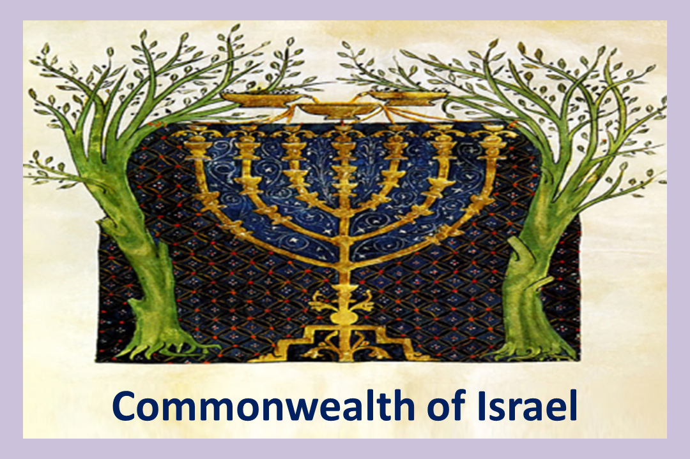
Image: Cervera Sephardi Spanish Bible, ca 1100’s

Slide 3
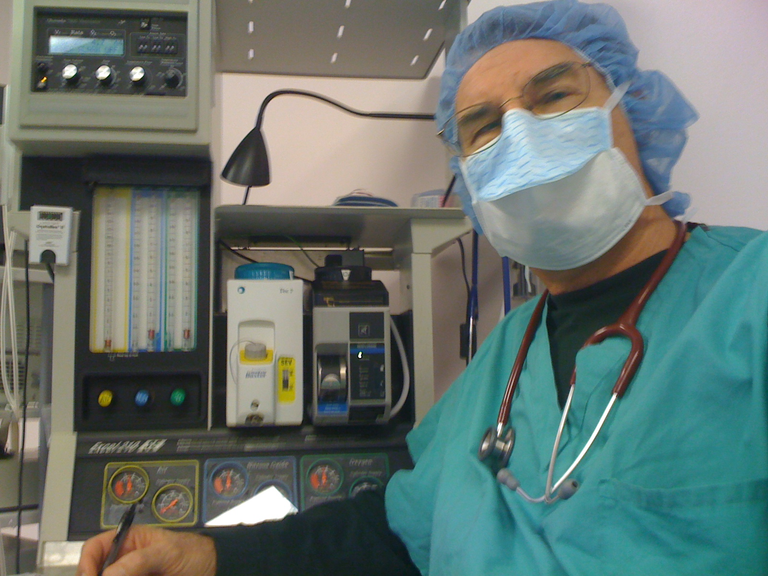

Slide 4
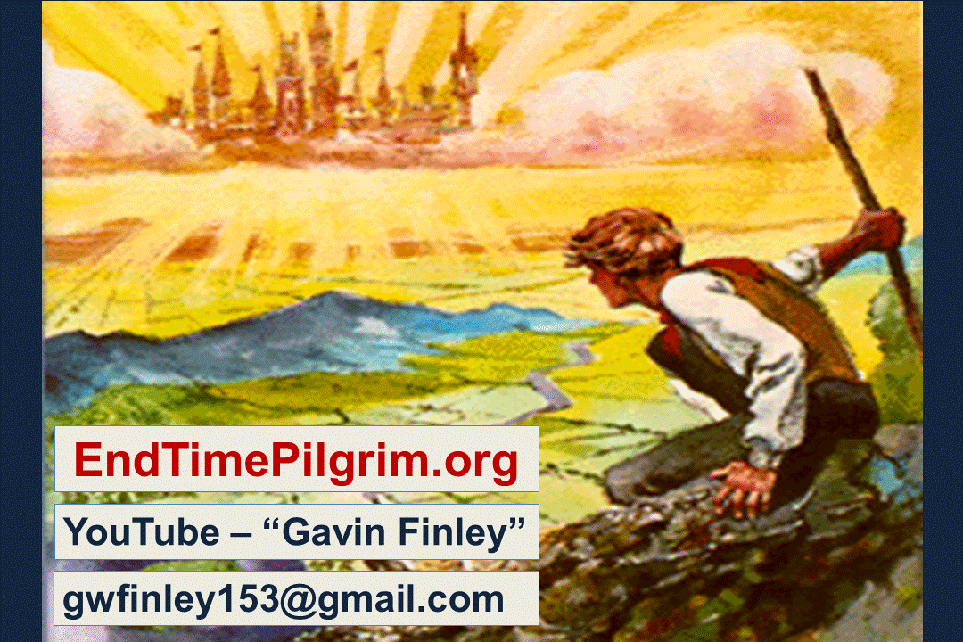

Slide 5


Slide 6
Today we’ll take a look at how God will wrap
up His end-time agenda and the reconciliation, reunion, and restoration of ALL Israel, ALL His covenant people. So here is a quick question, and a teaser to start things off. Who were
the two people who gave us most of Bible prophecy? Who in the Old Testament gave
us the lions share of Scripture concerning
the events of the latter days?

Slide 7
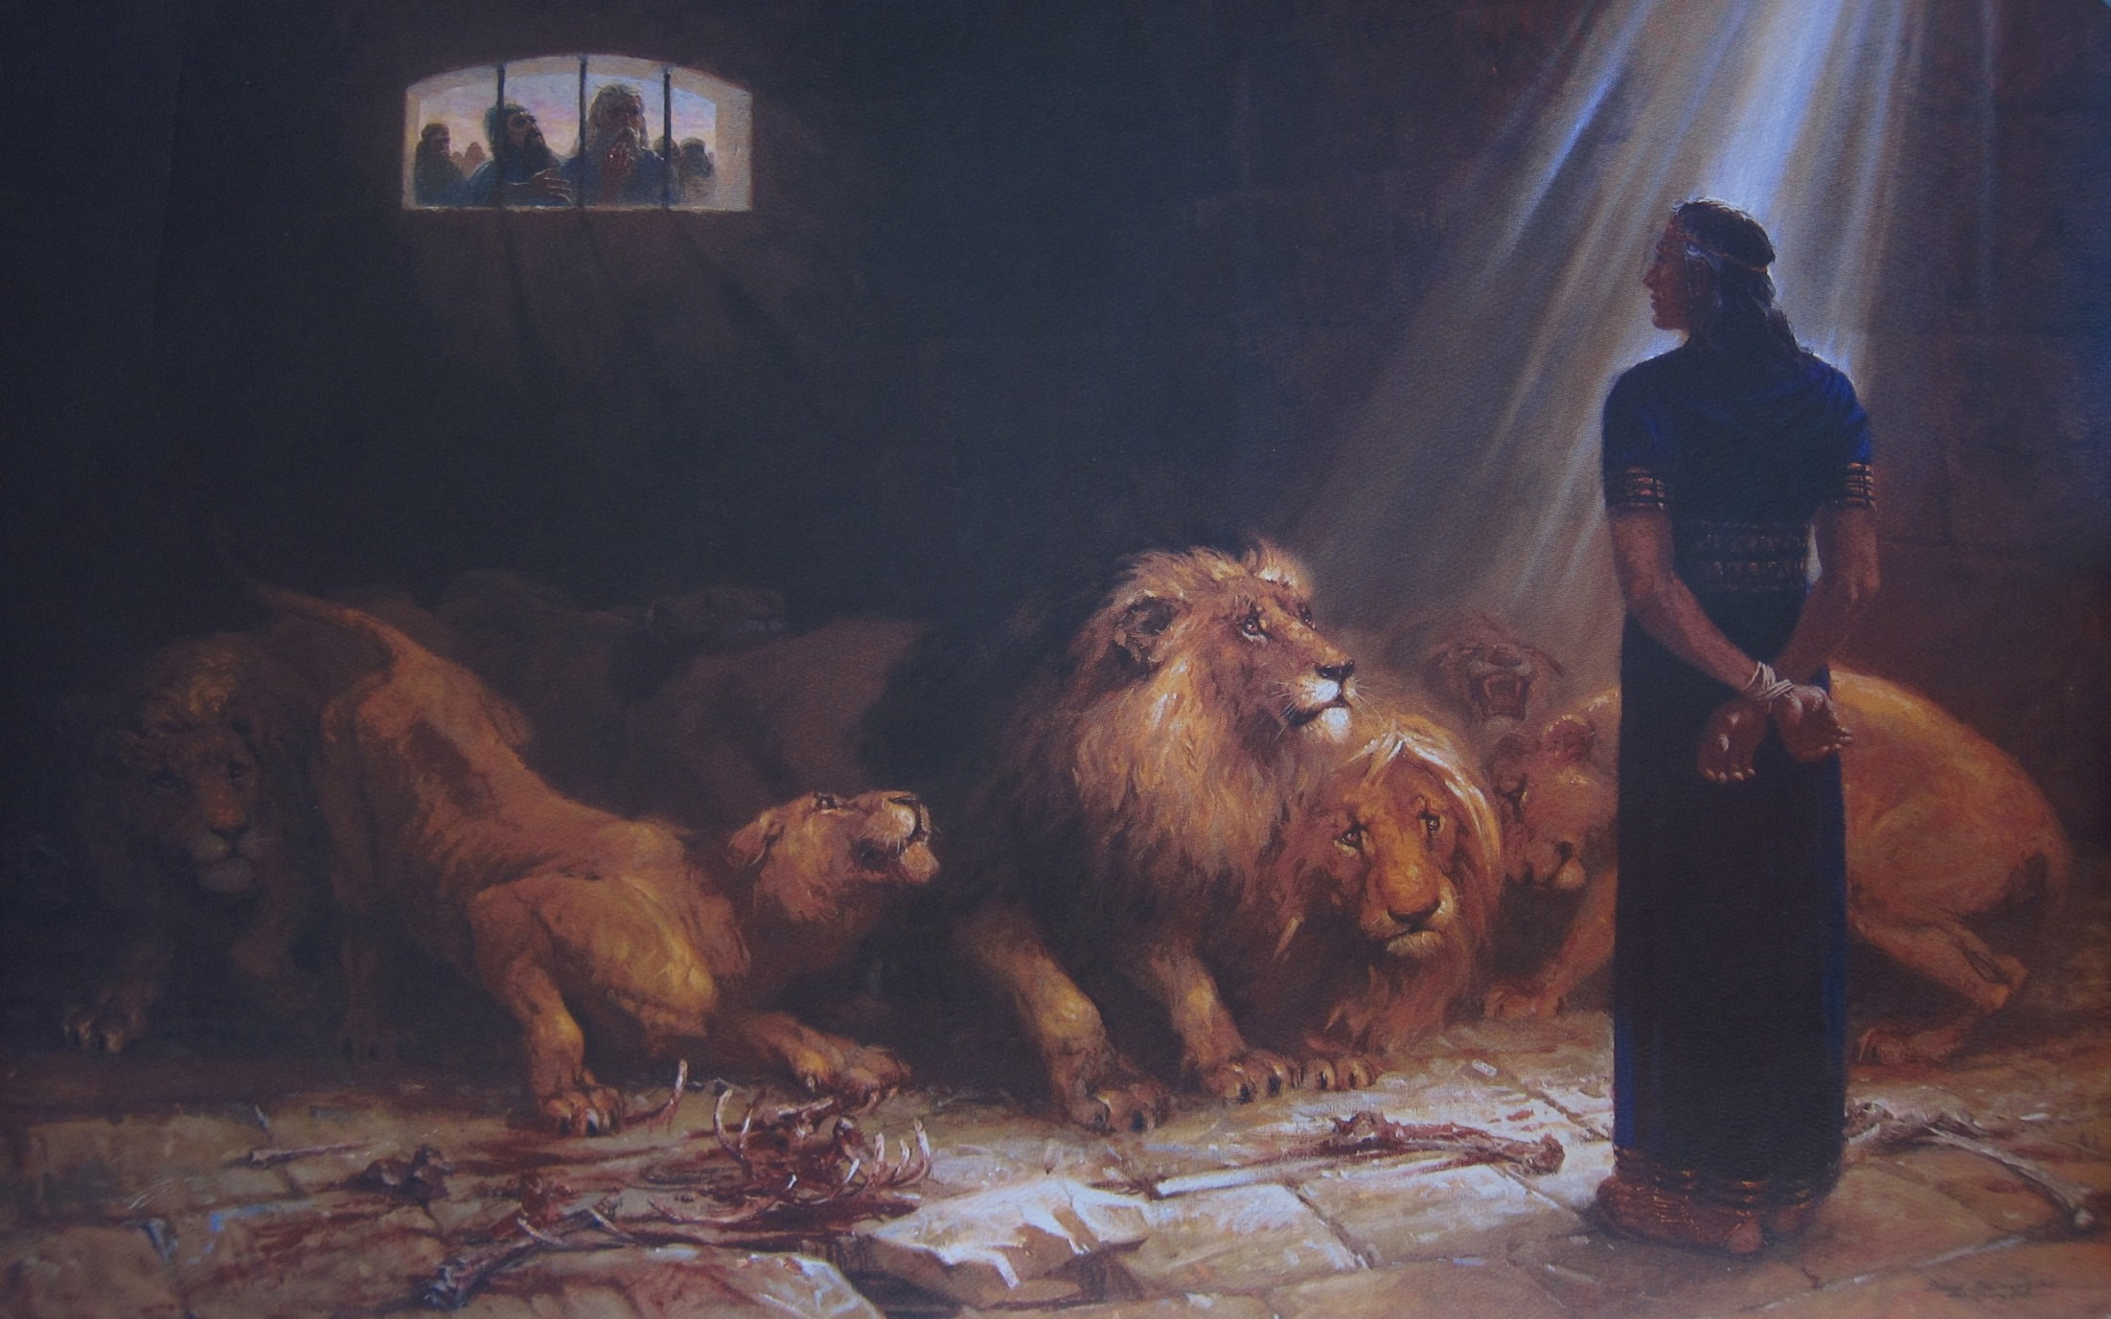
Daniel the prophet

Slide 8
God has an agenda for the total reconciliation of all of His Elect
at the consummation of the age.
Who in the New Testament gave
us most of the prophetic Biblical information to inform, explain,
and equip His covenant people?

Slide 9
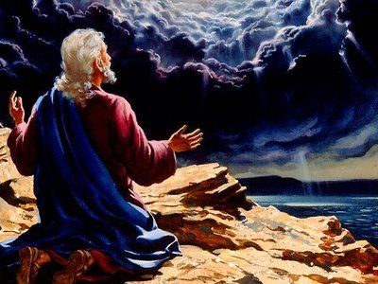
John
the Apostle
Writer of the book
of Revelation

Slide 10

And WHY were these two men entrusted with
the Word of God concerning end-time events?

Slide 11
Here is a clue.
“O man, greatly beloved”
- Dan. 10:19
“The disciple whom
Jesus loved.”
- John 13:23

Slide 12
It relates to love and devotion.
“O man, greatly beloved”
- Dan. 10:19
“The disciple whom
Jesus loved.”
- John 13:23

Slide 13
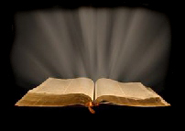
Let’s look at the Scriptures describing the
ENTRY into the COMMONWEALTH of ISRAEL

Slide 14
Ephesians 2:11
So then, remember that formerly, you, Gentiles by birth in the flesh, who are called “Uncircumcision”
by those who call themselves “the Circumcision” that is performed
in the flesh by human hands.

Slide 15
Paul is saying,
Formerly, you Gentiles, considered by the Jewish house as foreigners of other nations, based upon heritage, bloodline, DNA, ancestry and family descent and reckoned by our Jewish friends as goyim, “not one of us”.

Slide 16
Ephesians 2:12
At that time you, (that is, Gentiles, and the divorced ten tribes of the lost House of Israel mixed in with them after the Assyrian Captivity and also reckoned as Gentiles), were without Christ, aliens from the Commonwealth of Israel, strangers from the Covenants of Promise, having no hope and without God in this world.”

Slide 17

So, before our salvation in our lost, fallen, and unredeemed state
we were out here
lost - and in darkness.

Slide 18
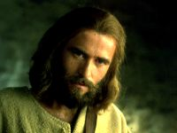
Our central problem?
We were
without Christ

Slide 19
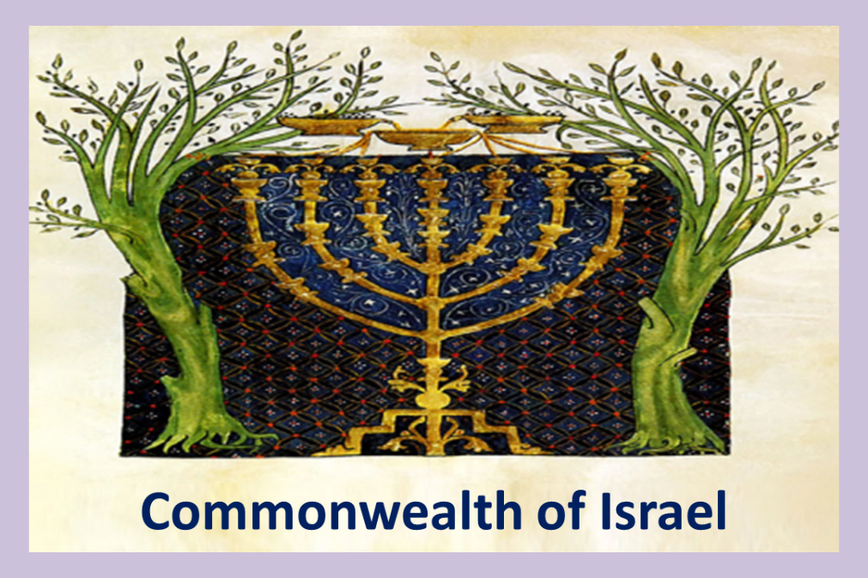
We were
Aliens from the
Commonwealth
of Israel

Slide 20
(politics)
We were
“aliens from the Gr. “politeia” of Israel”
“state or commonwealth”
“citizenship”
“government”
“administration of civil affairs”
(def.) Commonwealth – a government embracing
various other nations in common rights
and privileges of citizenship.)
Poly-TY-ya

Slide 21
We were - aliens from the Gr. “politeia” of Israel”
KJV - aliens from the Commonwealth of Israel
NIV - excluded from Citizenship in Israel.
Good News Tr. - foreigners and did not belong to God’s chosen people.
Contemp. Eng. V. – foreigners to the people of Israel.
Berean Literal V. – alienated
from the Commonwealth of Israel
Aramaic Bible in Plain English – aliens
from the government of Israel

Slide 22

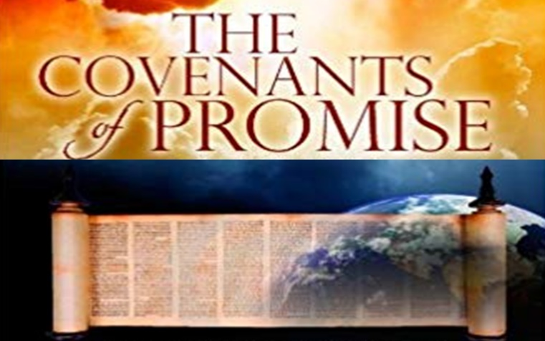
We were (also)
strangers
from the Covenants
of Promise

Slide 23

PRIESTLY
MINISTRY
of Messiah
Adamic Promise - Seed of the woman
Noahic promise of the rainbow
Abrahamic Covenant of a land/city, plus a Melo-hagoyim a myriad of descendants
(broken!)
Mosaic Covenant based on keeping the Law
New Covenant – Salvation by
grace through faith in the atoning blood of
Sacrifice Lamb, + Law inscribed in hearts

Slide 24
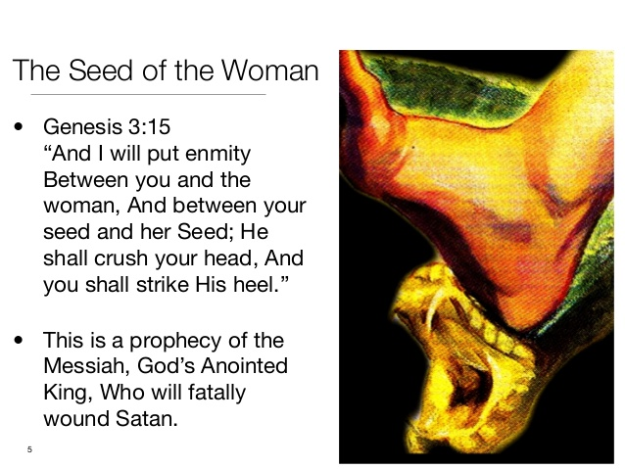
Adamic Promise

Slide 25
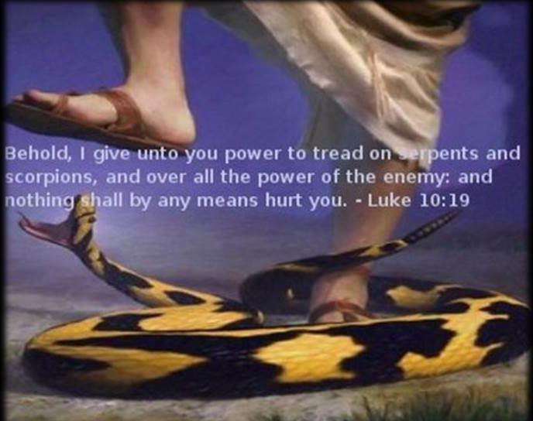

Slide 26
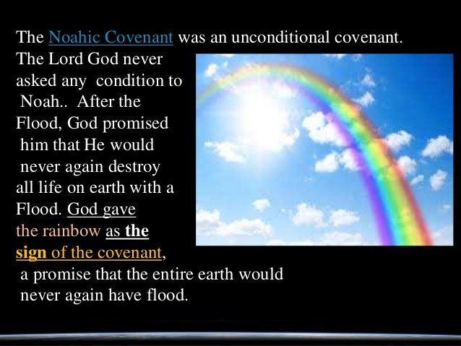
Noahic Promise

Slide 27
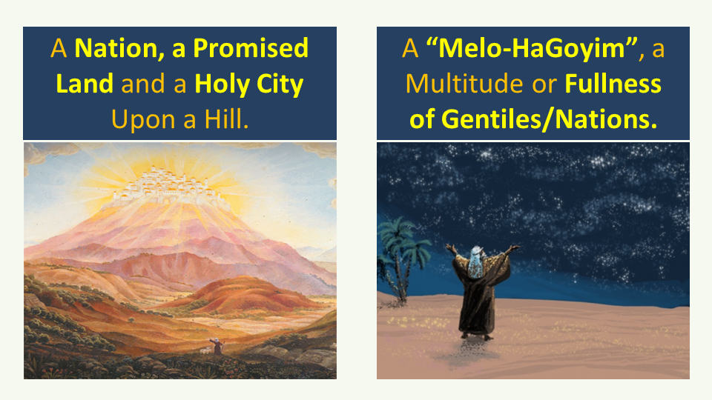
A Nation, a Promised
Land, a Holy Place, a
Holy City upon a Hill.
A Melo-ha Goyim, a
Multitude or fullness
of Gentiles/nations.
Abrahamic Covenant
Kingdom
anointing
Priestly
anointing

Slide 28
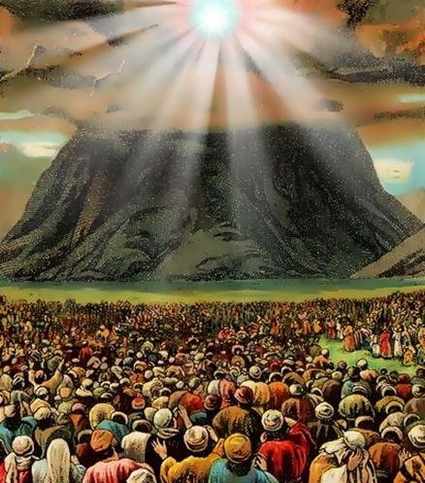
MOSAIC COVENANT
A corporate national commitment
and conditional upon obedience
BROKEN! (Jer. 31:32b)
The people all
responded together,
“We will do everything
the LORD has said.”- Ex. 19:8

Slide 29
PRIESTLY
MINISTRY
of Messiah
Edenic Promise - Seed of the woman
Noahic promise of the rainbow
Abrahamic Covenant / a land/city,
melo-hagoyim/myriad of descendants
(broken!)
Mosaic Covenant based on keeping the Law
New Covenant

Slide 30
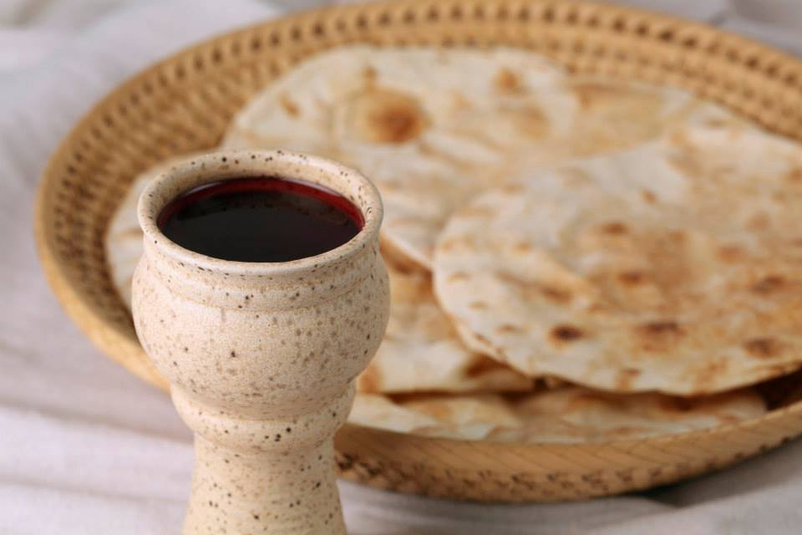
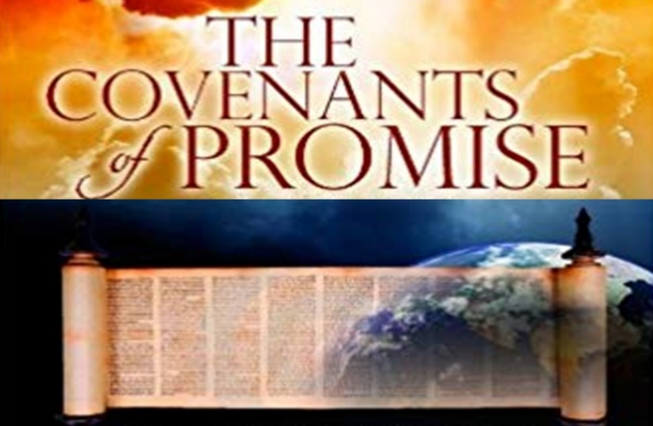
New Covenant
(Personal)

Slide 31
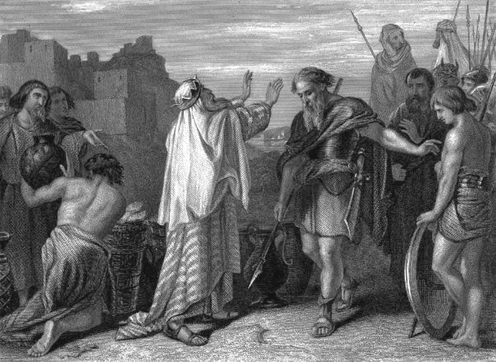
We first saw the bread and the wine showcased
in the manner of a covenant when Melchizedek brought these elements to celebrate with Abraham.

Slide 32
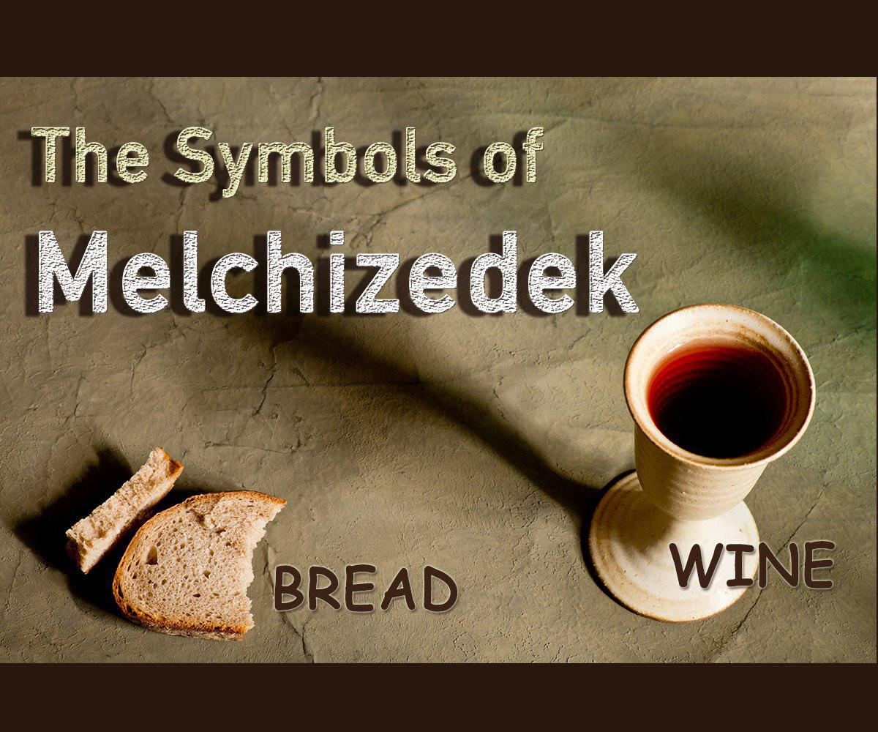
Our key to understanding
the New Covenant in Christ.

Slide 33
Melchizedek brought Bread and Wine
in a communion with Abraham
Genesis 18
14. And Melchizedek KING of Salem brought forth bread and wine: and he was the PRIEST of the Most High God. 15. And he blessed him, and said, Blessed be Abram of the Most High God, possessor of heaven and earth: 20. And blessed be the Most High God, which hath delivered thine enemies into thy hand. And he gave him tithes of all.

Slide 34
New Covenant
MINISTRY
of MESSIAH
as REDEEMER
and HIGH
PRIEST of God
MOST HIGH

Slide 35
New Covenant
KINGDOM
of MESSIAH,
as
KING of SALEM,
/ PRINCE of PEACE

Slide 36
So when we take communion, do we not identify with Christ as Savior AND as King?

Slide 37
So when was this New Covenant first
spoken about specifically in Scripture?

Slide 38
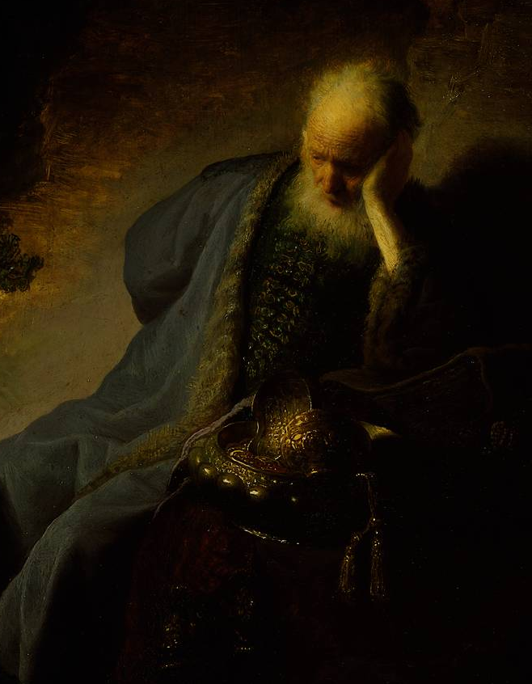
Jeremiah 31:31-32
A New Covenant with the lost House of Israel and with the Jewish House of Judah
³¹ Behold, the days come, saith the Lord, that I will make a New Covenant with the House of Israel, and with the house of Judah:

Slide 39
Jeremiah 31:32
A New Covenant with the (lost) House of Israel and with the (Jewish) House of Judah
³² Not according to the covenant that I made with their fathers in the day that I took them by the hand to bring them out of the land of Egypt; which my covenant they broke, although I was an husband unto them,
saith Yehovah-Almighty God:

Slide 40
Jeremiah 31:33
A New Covenant with the lost House of Israel and with the Jewish House of Judah
³³ But this shall be the covenant that I will make with the house of Israel;
After those days, saith the Lord,

Slide 41
Jeremiah 31:33
I will put my law in their inward parts, and write it in their hearts; and I will be their God, and they shall be my people.

Slide 42
The New Covenant PERSONAL faith
SAVING GRACE in the atoning blood of Israel’s Promised Sacrifice Lamb,
and the
LAW / TEACHINGS
are inscribed
in the hearts
Jeremiah 31:31-32

Slide 43

When was this New Covenant
made manifest in holy history?

Slide 44
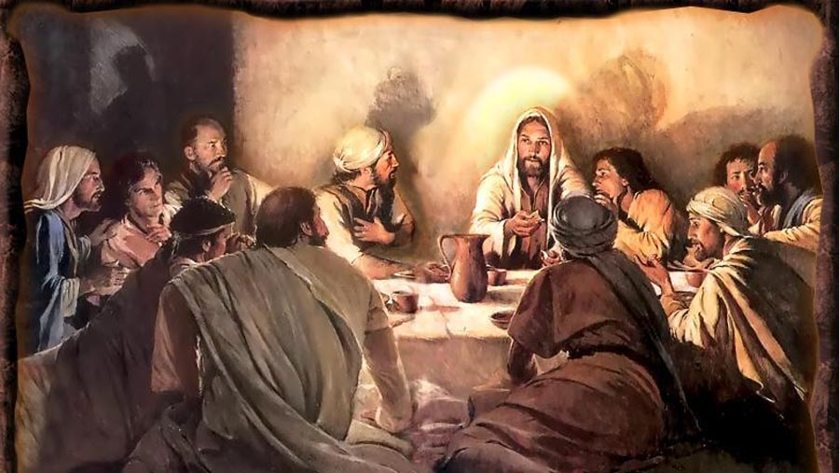
And he took the cup, and gave thanks, and gave it to them, saying, “This cup is the New Covenant in my blood, which is shed for you, -- shed for many. Drink ye all of it.”

Slide 45
So formerly,
we were in
a lost state.

Slide 46
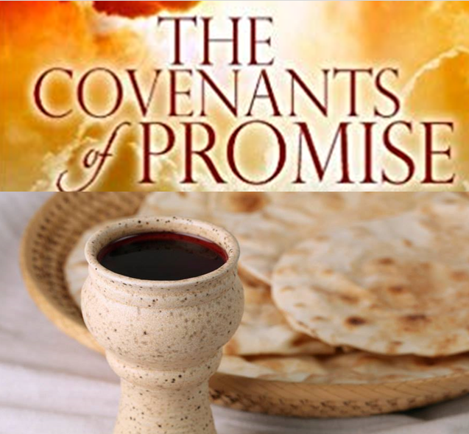
Ephesians 2:12
In your heathen Gentile state, we were without Christ, aliens from the Commonwealth / Citizenship of Israel, strangers from the Covenants
of Promise,

Slide 47
We had no hope
and we were
without God
in this world.

Slide 48
Ephesians 2:13
BUT NOW!
through
Christ Jesus,
Yeshua Hamashiach

Slide 49
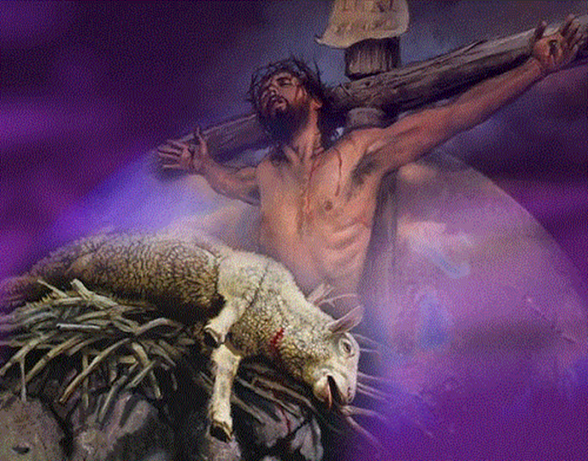


You who sometimes were afar off, are brought near by the
blood of Christ.

Slide 50
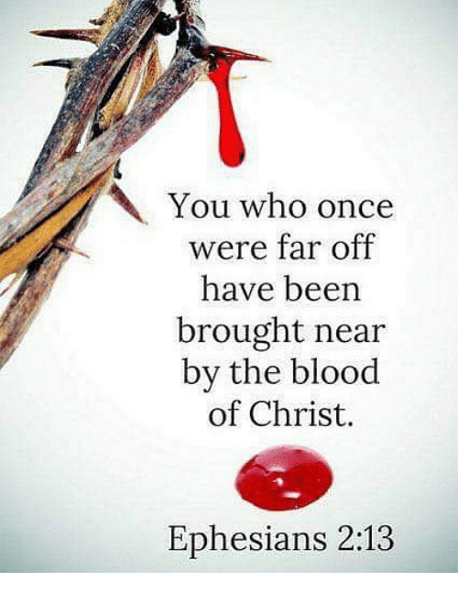
Brought near?
In the context
brought near
to WHOM?
And to WHAT?

Slide 51

brought near to Jesus?
.
.
Yes.
But,
that does that exhaust the full content of the message?

Slide 52
Brought near?
In the context
brought near
to WHOM?
And
brought near
to WHAT?

Slide 53

Brought near
to Christ? OK.
Near the Covenants
of Promise? OK.
But being brought near the COMMONWEALTH /
CITIZENSHIP of ISRAEL? ?
(Christians under the princes of this world have some problems with that.)

Slide 54
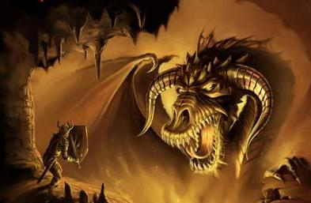
What? You think you belong to
the Commonwealth of Israel!
This question of
“who is Israel” is
highly contested and
heavily guarded by
political and religious
trolling spirits. These
angelic rulers, the
Principalities and
Powers rule over and
feed disinformation to
BOTH houses of Israel.
The must be evicted.
This

Slide 55

Yes, there
is a dual heritage in
the blood
of Christ through which we now become recipients.

Slide 56
Through the blood of Christ the redeemed are brought
near to Christ, . . . AND near to
His Covenants of Promise

Slide 57
And through the blood of Christ the redeemed are brought
near to Christ, . . . AND near to His
Commonwealth / Citizenship of Israel

Slide 58

The BLOOD of MESSIAH
The Righteous Rule of Law, Christ in the hearts, the indwelling Living Torah, the teachings,
anointing of JUDAH.
The shepherd ministry of redemption and salvation by Grace through Faith, the indwelling Christ, the anointing of JOSEPH.

Slide 59
The BLOOD of MESSIAH
National sovereignty, a scepter and a throne, CITIZENSHIP in the COMMONWEALTH
of ISRAEL
Redemption, salvation, a priesthood of believers
MEMBERSHIP in the
CONGREGATION
of ISRAEL

Slide 60
Brought near
to Christ? OK.
Near the Covenants
of Promise? OK.
But being brought near the COMMONWEALTH /
CITIZENSHIP of ISRAEL? ?
(Christians under the princes of this world have some problems with that.)

Slide 61
Brought near
to Christ? OK.
Near the Covenants
of Promise? OK.
But being brought near the COMMONWEALTH /
CITIZENSHIP of ISRAEL? ?
(Christians under the princes of this world have some problems with that.)

Slide 62

What? Saved Christians belong to Israel?

Slide 63
What? You think you belong to
the Commonwealth of Israel!
This question of
“who is Israel” is
highly contested and
heavily guarded by
political and religious
trolling spirits. These
angelic rulers, the
Principalities and
Powers rule over and
feed disinformation to
BOTH houses of Israel.
The must be evicted.
This

Slide 64
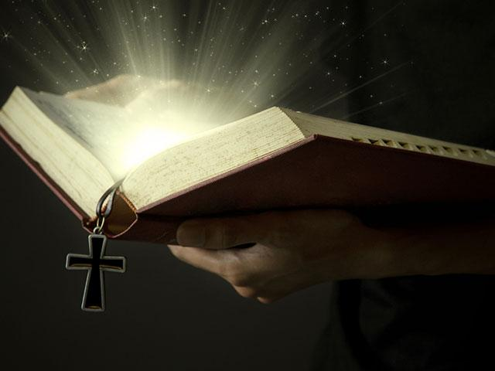
We may be
incredulous,
have our
misgivings,
and even suffer
from cognitive dissonance.
But the Word
of God is sure.
It is established
in the heavens.

Slide 65
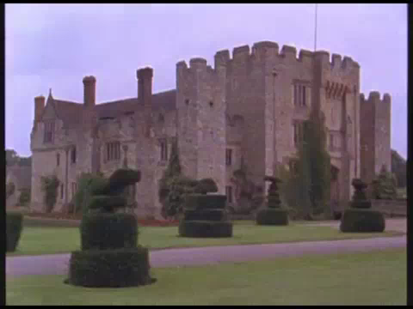

Slide 66
The dual office of
High Priest of God Most High, (or High Priest of Almighty God),
and
King of Salem in the Order of Melchizedek

Slide 67

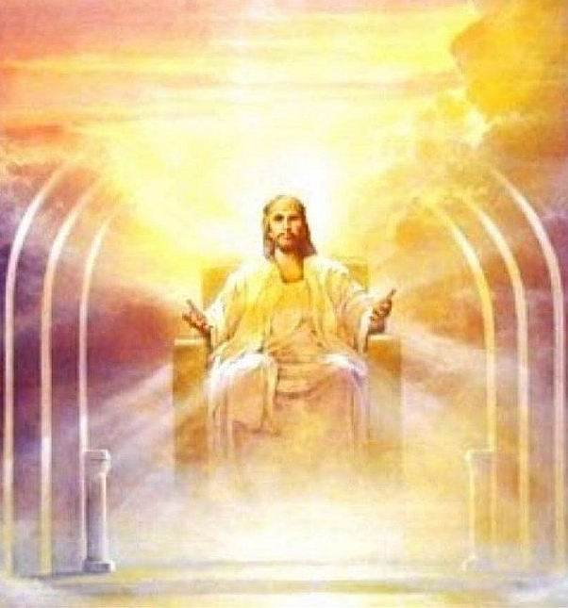
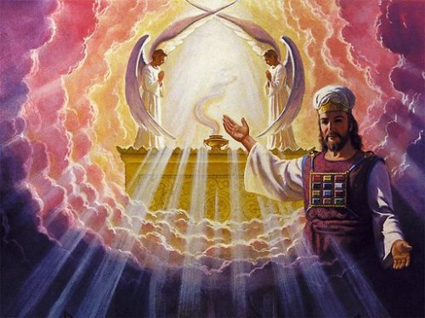
Let the Lord
of Glory be
the ruler
of my
heart . .
Throne
Altar
High Priest
King

Slide 68
So through the blood of Christ the redeemed
are brought
near to Christ, . . . AND near to
His Covenants of Promise

Slide 69

And through the blood of Messiah
Christian believers are given
Citizenship in
the Kingdom / Commonwealth
of Israel
CITIZENSHIP

Slide 70

Ephesians 2:19
“So then you are
no longer strangers and aliens, but FELLOW CITIZENS with the saints,
and are of God's household, . . . . “
CITIZENSHIP
Solid
written
legal
standing

Slide 71
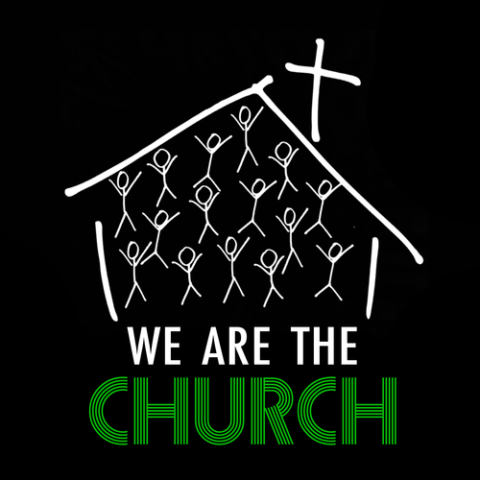
Our present
mindset
is this
So that’s all we need to know!

Slide 72
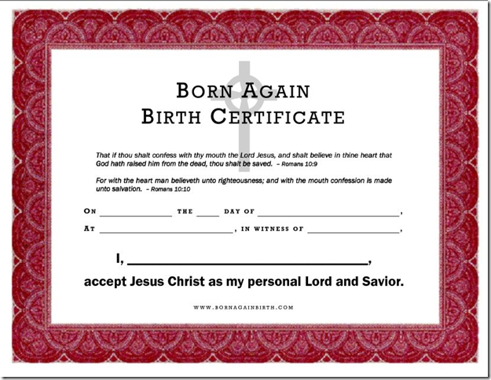

Slide 73
As Christians We have our church membership and say, “I am happy with things as they are.

Slide 74
A voice beside us says, “Do you want to know what is on the other side of your certificate of salvation?
Just turn it over.

Slide 75
We might be inclined to say,
“I don’t WANT to turn it over!”

Slide 76
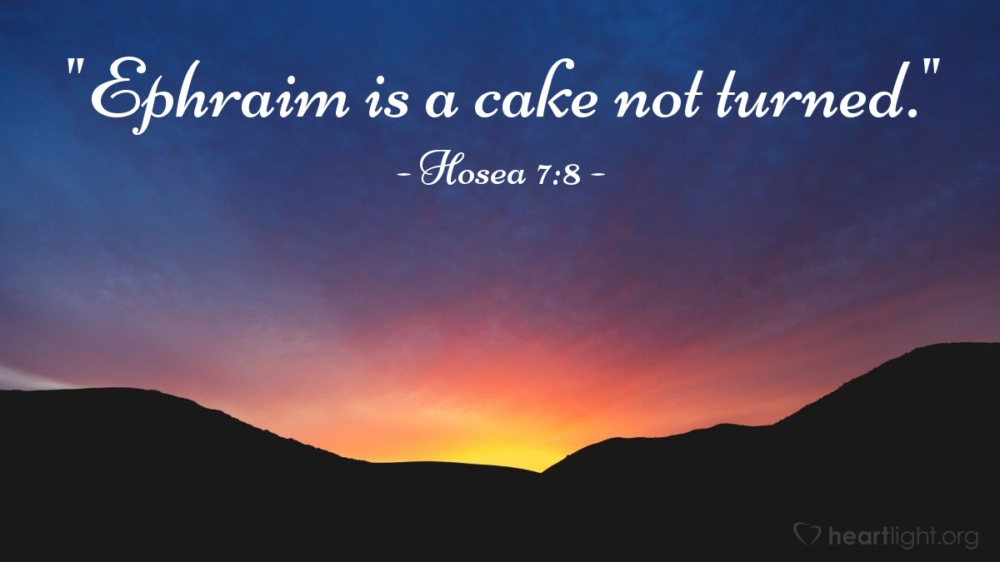
Come on Ephraim. You know what
the prophet Hosea said about you.

Slide 77

Come on Ephraim. You know what
the prophet Hosea said about you.

Slide 81
If we were to take
our certificate of
the New Birth, our personal commitment to Messiah and turn it over, then what might we find on
the other side?

Slide 82
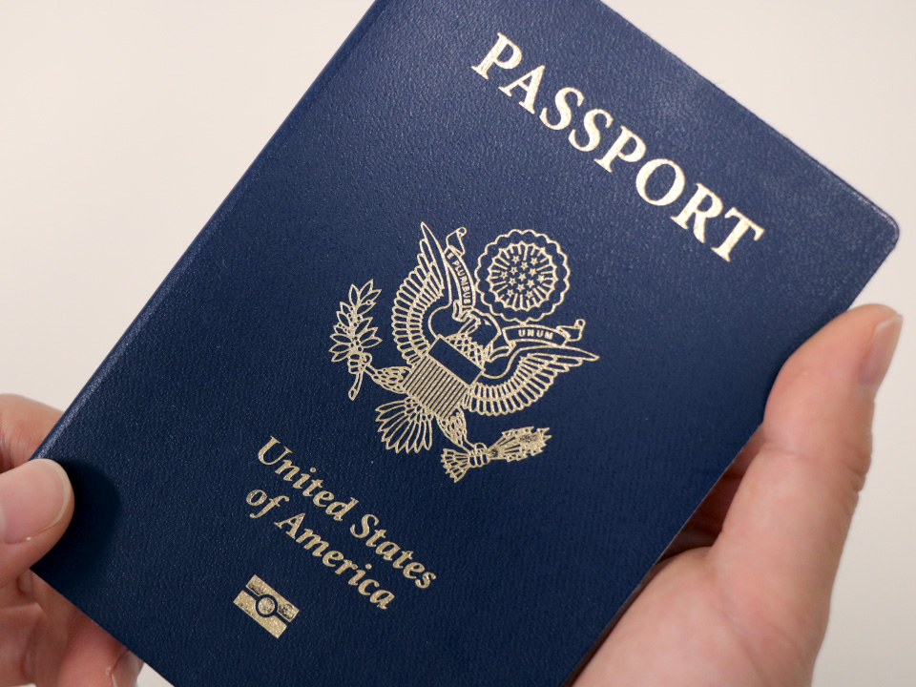

Might we find THIS?

Slide 83
Wow! Where did that come from?

Slide 84
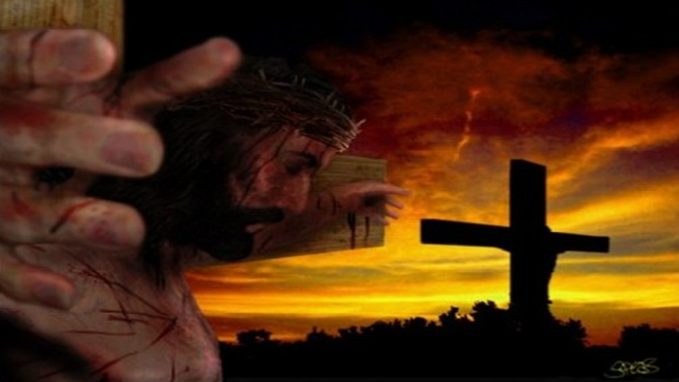
This is where
it came from.

Slide 85
Through the
blood of Messiah
we are afforded
Salvation, and membership
in the Church or Congregation of Israel’s Messiah
SALVATION
How might we picture the CONGREGATION / CHURCH of MESSIAH?

Slide 86
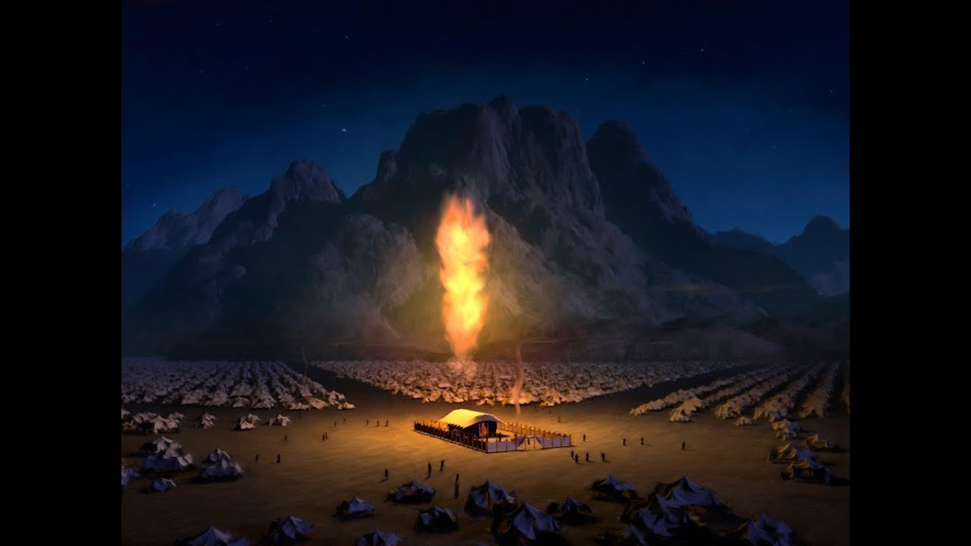
How might we picture the
CONGREGATION / CHURCH of MESSIAH?
The Church in the Wilderness
Acts 7:38 KJV

Slide 87
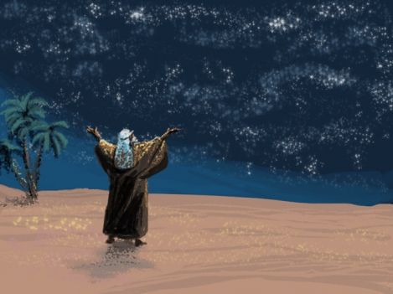
How might we picture the ultimate CONGREGATION / EKKLESIA of MESSIAH?
The melo-hagoyim,
the myriad company,
the promised Seed
of Abraham.
And He took him outside and said, "Now look toward the heavens, and count the stars, if you are able to count them." And He said to him, "So shall your descendants be.“
And he believed in the LORD and it was accounted to him for righteousness. - Genesis 15:5-6 NASB

Slide 88
How might we picture the multicultural CONGREGATION / CHURCH of MESSIAH?
The melo-hagoyim,
the myriad company,
the promised Seed
of Abraham.
For ye are all the children of God by faith in Christ Jesus. For as many of you as have been baptized into Christ have put on Christ. There is neither Jew nor Greek, there is neither bond nor free, there is neither male nor female: for ye are all one in Christ Jesus. – Galatians 3:26-28

Slide 89
How might we picture the Abrahamic Seed CONGREGATION / CHURCH of MESSIAH?
The melo-hagoyim,
the myriad company,
the promised Seed
of Abraham.
And if ye be Christ's, then are ye, (y’all) Abraham’s Seed,
and heirs according to the promise.
– Galatians 3:29

Slide 90
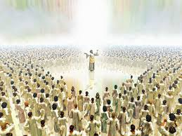
How might we picture the ultimate heavenly CONGREGATION / CHURCH of MESSIAH?
9 After this I beheld, and, behold, a great multitude, which no man could number, of all nations, and kindreds, and people, and tongues, stood before the throne, and before the Lamb, clothed with white robes, and palms in their hands; 10 And cried with a loud voice, saying, Salvation to our God who sits upon the throne,
and unto the Lamb. - Revelation 7:9-10

Slide 91
And through the
blood of Messiah
Christian believers are given
Citizenship in
the Kingdom / Commonwealth
of Israel
CITIZENSHIP

Slide 92


CITIZENSHIP
in a KINGDOM
So from the blood of Christ
we are
given a
DUAL ANOINTING
SALVATION in a
CONGREGATION
Church and State /
Politics and Religion

Slide 93
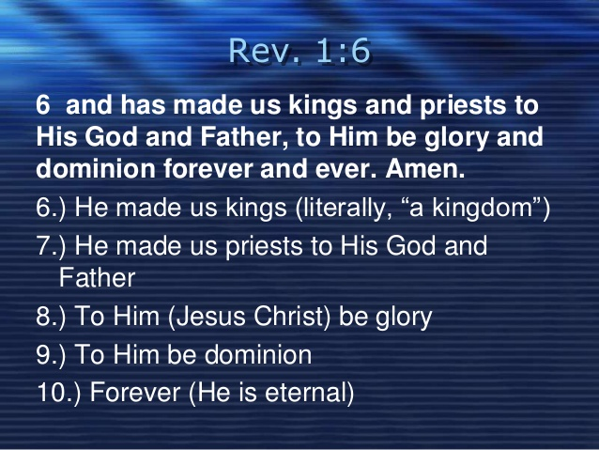

Slide 94
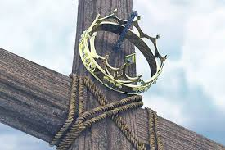
Lest we get haughty
about what being
a king or a priest
unto God might
actually mean.
This is where
Christ, our
sacred Head
went as
Servant of
God Most High

Slide 95
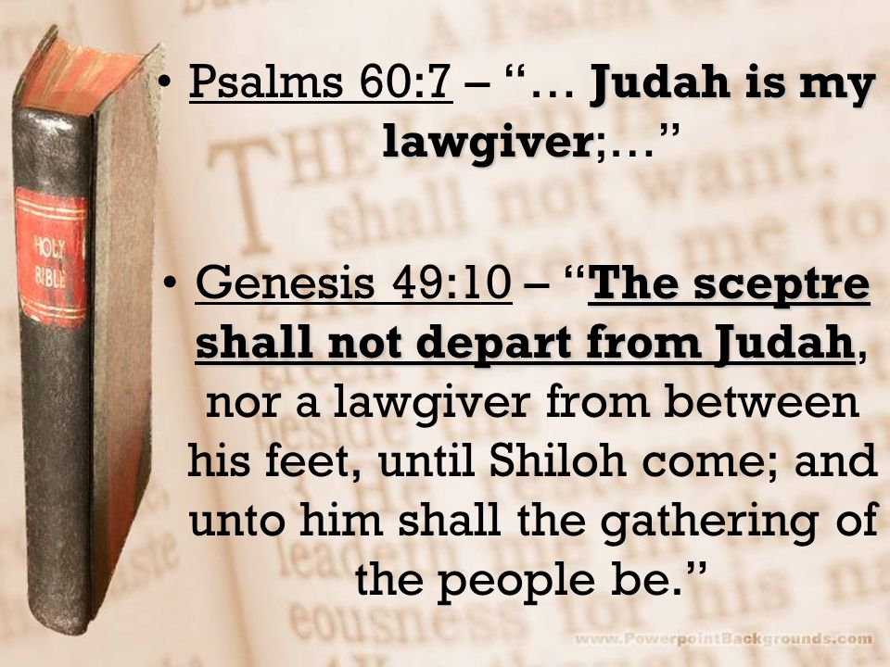
We must also welcome our
saved Jewish brethren, who
with Christ in
their hearts
bring gracious service in the righteous Law
of the Lion of
the royal tribe
of Judah.

Slide 96
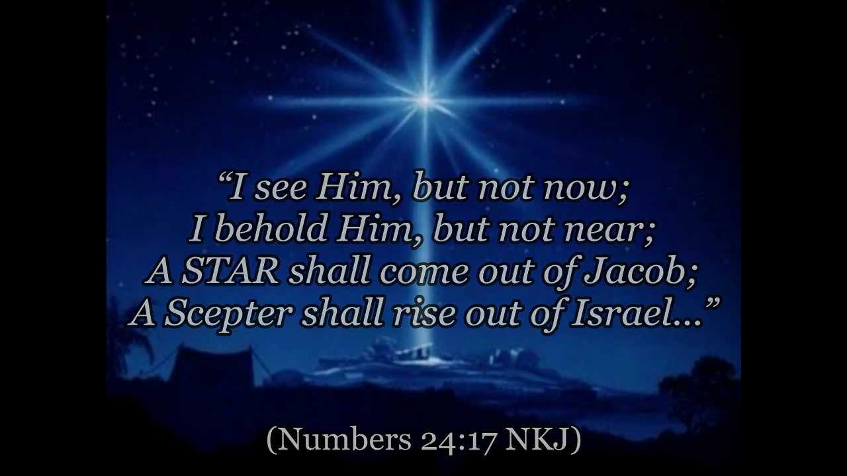
Jesus Christ,
Yeshua Hamashiach,
is the Son of David, the Lion of the (royal Jewish) Tribe of Judah, who sits upon the throne of David as King of kings,in
the coming glorious Millennium of Messiah

Slide 97
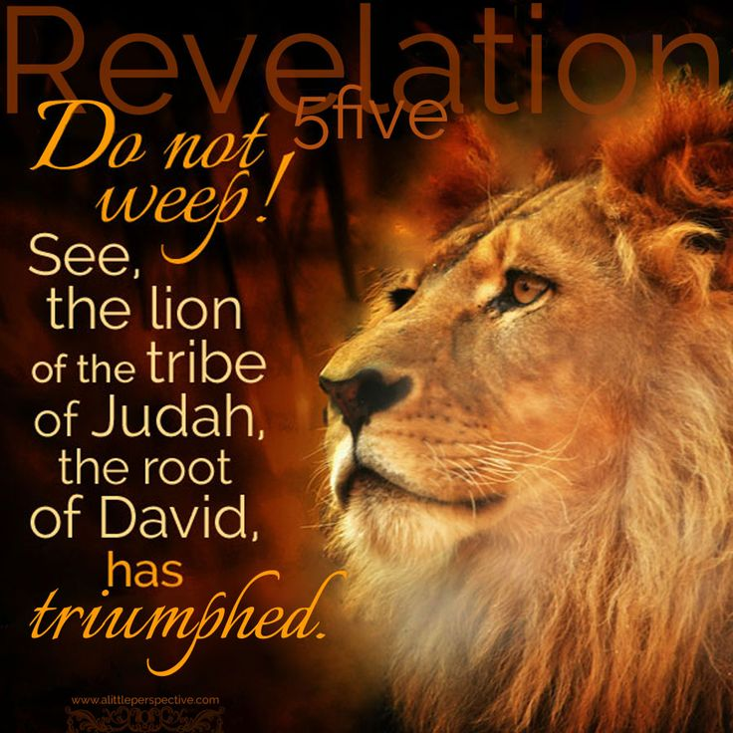
Gen. 49:10
“The (royal) scepter shall not depart from (the Jewish house of) Judah,
. . . . . And unto Him
shall the gathering , (the assembly, congregation, the churching of the people be.”

Slide 98
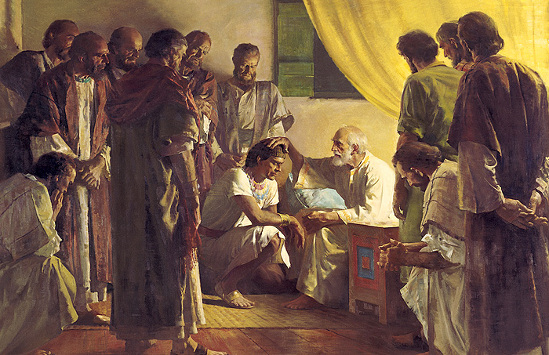
Jacob’s blessing
over
Joseph
Joseph
is very involved in the
end-time gathering of Israel
as well.

Slide 99
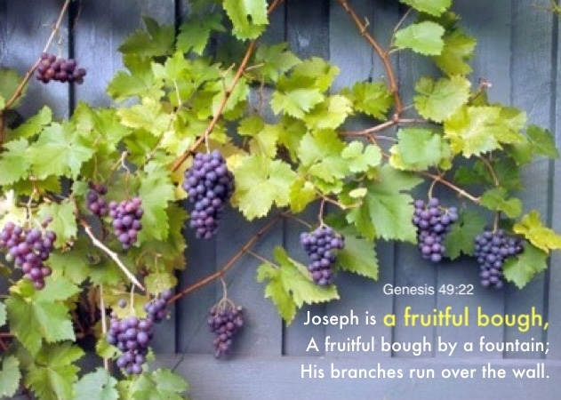
Joseph is a fruitful bough
by a well, . . .his branches
run over the wall.

Slide 100
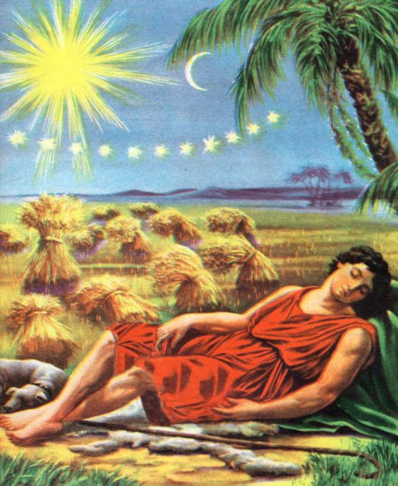
Joseph dreams of his
future prominent role, of responsibility and authority -- above his brothers, -- and even over his father Jacob and his mother Rachel. So his brothers hated
and persecuted him.

Slide 101
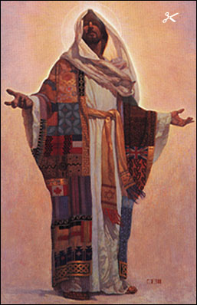
Joseph was given a
“coat of many colors”,
as of many flags, banners, standards, that we see flying
over many nations.

Slide 102
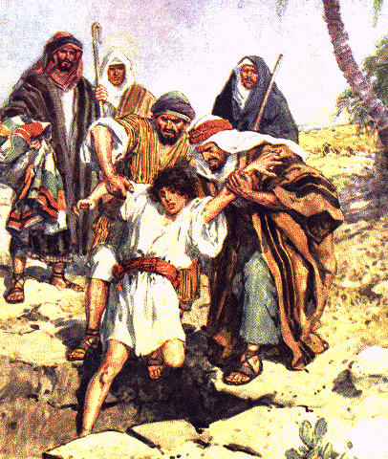
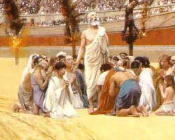
Joseph is threatened with death at the hands of
his brothers, thrown into a pit, -- as were others.
Christians in the arena in Rome – 2nd Century C.E.

Slide 103
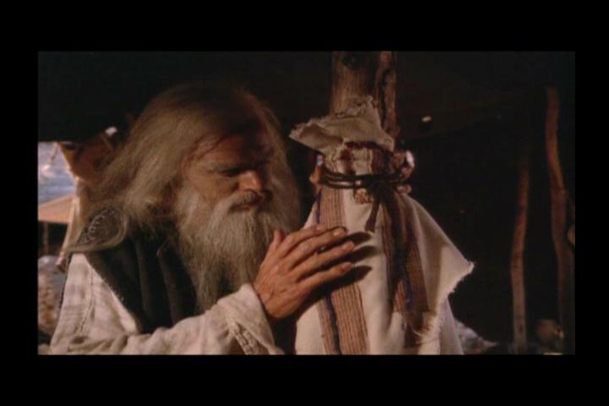
Joseph’s bloodied
coat of many colors

Slide 104
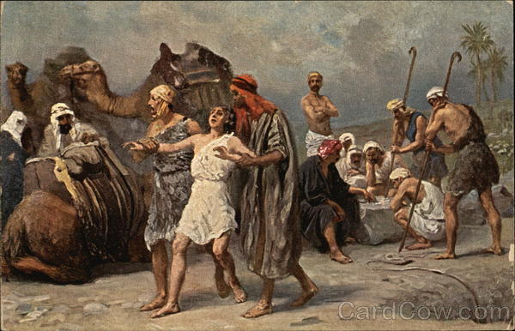
Joseph is sold into slavery; transported with the
Balm of Gilead, - separated from his brethren.
A past and future prophetic reality?

Slide 105
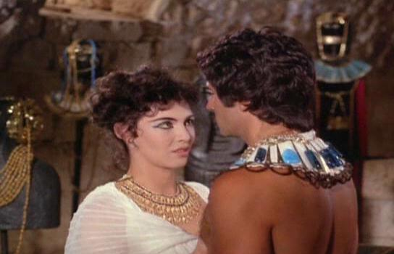
Joseph resists the seductions
of the harlot wife of
the chief executioner.
A past and future prophetic reality?

Slide 106

Joseph, falsely accused of rape, not executed, thrown
into prison, an excellent spirit, the doer of everything,
interprets the dreams of the cupbearer and the baker.

Slide 107

Joseph is summoned before the king. He interprets
the dreams of the Pharaoh of 7 years of famine.

Slide 108

Joseph opens
the storehouses
feeds the world
the Bread of Life.

Slide 109

Joseph sees his brothers,
out shopping for grain.
Gives them a hard time.

Slide 110

Joseph knows his brothers but they do
not know him. He
sets the table for his brothers according
to their birth order.
He feeds portions
to them from
his table.

Slide 111

Joseph’s cup. . found in Benjamin’s sack

Slide 112

Joseph calls his brothers back to responsibility and to their God given destiny.

Slide 113
Only when Judah stands up and takes responsibility for Benjamin does Joseph reveal who he is to his brothers.

Slide 114

“Now these things happened to them as examples for us. They are types and shadows, written down for our admonition. They are instructive warnings for us, the people on whom the ends of the earth, even the culmination
of the ages, has come.”
- 1Cor. 10:11 – GWF paraphrase
Our Apostle Paul

Slide 115

And in Ezekiel 37 we see
the two sticks that become one in Messiah and the promise of an end-time unity to be established in this
dual anointing in the two houses. One is in the royal Jewish House of Judah.
The other is in the
House of Joseph.

Slide 116
If we understand the truth of the dual anointing and how it is to be found in our identification with the blood of Messiah will that help us in our ministry of reconciliation, and restoration and peace in this troubled and fearful world? We know that he blood of Christ brings salvation and deliverance. But it seems the blood of Christ also provides us with an assured citizenship in
a kingdom and a Commonwealth that is
as glorious as it is everlasting.

Slide 117

Where else in Scripture do we see the promise of this dual anointing?

Slide 118
A Nation, a Promised
Land, a Holy Place, a
Holy City upon a Hill.
A Melo-ha Goyim, a
Multitude or fullness
of Gentiles/nations.
Abrahamic Covenant
Kingdom
anointing
Priestly
anointing

Slide 119

The first coming of Messiah - His priestly role as Lamb of God,
then returning as King of kings, the Lion of the tribe of Judah.
(Yom Teruah)

Slide 120

The dual anointing and office of Messiah
Jesus Christ,
Yeshua Hamashiach,
Sacrifice Lamb,
AND the
Lion of Judah
(the Jewish tribe)

Slide 121
The dual anointing and office of Messiah
Scriptures describe the
Suffering Servant,
AND the
returning
Conquering
King.
The dual anointing and office of Messiah

Slide 122
Messiah
ministers
at the
Mercy
Seat
High Priest

Slide 123

Messiah rules from
the Throne of David
King of kings

Slide 124
Let the Lord
of Glory be
the ruler
of my
heart . .
Throne
Altar
High Priest
King

Slide 125


Slide 126

The Two Olive Trees - Zechariah. 4:13-14
13 So he answered me, saying, "Do you not know what these are?" And I said, "No, my lord." 14 Then he answered, “These are the two anointed ones who stand before the God of the whole earth. -
The King
The Scepter
Sovereignty
High Priest
The Ministry
The Cup
Notes:
Christians need to be aware that ultimately in Christ we really belong to the Commonwealth of Israel and that the redeemed of the Lord shall return, not to London, Berlin, Washington D.C. or Canberra but to Zion.. We need to avoid making the same mistakes the previous superpowers made when they came to the peak of their power.
In Ephesians 2:12-13 our Apostle Paul indicates that in the blood of Christ we are no longer heathen gentiles. His blood brings us into the Commonwealth of Israel.

Slide 127

Two witnesses
stand before the God of the earth.
Are they represented in the angelic realm here?

Slide 128
In the Seventy Weeks Prophecy
²⁴Seventy weeks are determined
upon thy (Holy) People
and upon thy Holy City,
God’s Holy People
2. God’s Holy City

Slide 129


The Two Witnesses
Revelation 11
3. And I will give power unto my two witnesses, and they shall prophesy 1260 days, clothed in sackcloth.
4. These are the two olive trees, and the two candlesticks standing before the God of the earth.

Slide 130
Revelation 11:4
. . Two candlesticks, Two witnesses
who stand before the God of the earth.

Slide 131

Friday night
at sunset
the Jewish
ladies light
two candles
for Shabbat.

Slide 132

Two candles are often seen at the altar of churches.

Slide 133

Two candles
can often
be seen
at dinner
tables across
Western
Christendom

Slide 134

The Angel of the LORD
comes down to judge Sodom. He brings His
two witnesses

Slide 135
We see the dual office of High Priest and King in the Order of Melchizedek

Slide 136

Melchizedek was both
High Priest and King of Salem, Prince of Peace.
He prefigures the
fully integrated,
fully complementary,
fully harmonized
dual office of Messiah in
the Order of Melchizedek.

Slide 137
Psalm 110
2 The LORD shall send the rod of thy strength out of Zion: rule thou in the midst of thine enemies. 3 Thy people shall be willing, (volunteers), in the day of thy power, in the beauties of holiness from the womb of the morning: thou hast the dew of thy youth.
4 The LORD hath sworn, and will not repent,
“Thou art a priest forever after
the Order of Melchizedek.”

Slide 138
Messiah
ministers
at the
Mercy
Seat
High Priest

Slide 139
Messiah rules from
the Throne of David
King of kings

Slide 140

Mercy Seat
For
God’s
GRACE
Judgment Seat
For
God’s
LAW
Messiah RULES as KING and MINISTERS as HIGH PRIEST.
in the dual office of the ORDER of MELCHIZEDEK

Slide 141


LAW vs. GRACE
“Jewish Israel” – ”the Church”
Notes:
Greetings and welcome. My name is Gavin Finley and in this video we shall be considering the rather daunting, multi-facetted problematical matter of Israel and the Church.
There are two groups of people who have a good claim to be the “called out ones”, the ekklesia,
the Chosen People, the Elect.
We see our Jewish brethren in one box.
And we see Christians in the other box.
Both worship the same God, the God of Israel.
Each company thinks that their party has it all.
Each company thinks that they don’t need the other.
One party vexes or troubles the other.
And the other party gets jealous and persecutes the other.
Clearly these behaviors are not pleasing to the God of Israel.
Of course we are jumping ahead of our discussion here.
But if there is some good news then we should be appraised of it.
If God has promised something good should we not know about it?
Because the prophet Isaiah in Isaiah 11:13 says that there will come a time when this strife will cease.
So why do they continue to feud and squabble?
Why hasn’t each party repented of their wrongs and found Grace and Shalom with Messiah?
When will they be reconciled with their brethren in Grace and Peace?
And when will holy history see Israel as a Nation and Israel as a Congregation, restored in the Peace of Jerusalem?
Well, we are going to find out.

Slide 142


So do we bring
dishonor to
Yehovah - the
Holy One of
Israel by dividing Him asunder, by playing favorites with the two main elements
of His character?
Meshiach
ben Joseph
Meshiach
ben David

Slide 143
Where did this
acrimonious
LAW vs. GRACE schism begin?
Does the Biblical narrative present evidence of such
a faction causing
a split in God’s covenant people?

Slide 144

A critical fracture line in Israel, a
fault line, did happen right here.
932 B.C.
The Breach
of Jeroboam

Slide 145
“My father made your yoke heavy, but I will add more to your yoke. My father chastised you with whips,
King Rehoboam
lays down the LAW!
But I will chastise you with scorpions!” - 1Kings 12:14

Slide 146
"What share have we in David?
We have no inheritance in the on of Jesse!
To your tents
O Israel!”
Jeroboam
rebels and walks out!
Now, see to your own house, O David!”

Slide 147
In rebelling against the rule of the Throne of David did the lost ten tribes of Israel choose a path that would lead them into hardening or partial blindness?
Was the revolt justified, or just lawless? How much did it a contribute
to the 2900 year old blood feud between the two houses of Israel?

Slide 148
In their failure to rule in GRACE over the ten tribes of the House of Israel did the Jewish House of David in Judah push both companies into partial blindness or partial hardening?
Was this Machiavellian misrule? How much did it contribute to the 2900 year old blood feud between the Israel’s two houses?

Slide 149
Was the main cause of the Breach of
Jeroboam this issue of LAW vs. GRACE?
Root Cause
Analysis

Slide 150
If kingdom issues and the anointing of a king relates to God’s righteous LAW
And the High Priestly issues and anointing relates to God’s GRACE and Mercy might we not be surprised to see a false dichotomy arise?

Slide 151
How well has this group-think served us?
Israel
Church
OT Earthly
People of
God’s LAW
NT Spiritual
People of
God’s GRACE

Slide 152


Pentecost 32 A.D. The Congregation / Church of Israel - 100% Jewish
Council of Nicaea
325 A.D. - 0% - No Jewish Churches allowed!

Slide 153
So when did the Congregation of Israel get it’s downgraded non-descript, generic name,
THE “CHURCH”?
(That word just means “assembly”)
Notes:
It is helpful if we take a long walk far away from Church tradition and the ministries we see in the West to day and ask a fundamental question.
WHAT IS THE CHURCH?
The word “Church” comes from the Greek word “ekklesia”.
It is important for us to know that this word “ekklesia” has no special or holy meaning in itself.
It is a common Greek word which merely means
“called out assembly”
or “congregation”.

Slide 154
The Council of Nicaea, 325 A.D.. The dominant Gentile elements of the church find protection under Constantine, and the princes of Europe.

Slide 155
At Nicaea the Jewish Congregations are nowhere to be seen. Everything Jewish is outlawed. So begins the 1700 year Church-State system of Constantine.

Slide 156
After Nicaea the Church seemed to forget her blood covenant faith connection to Abraham and her memory of once having belonged to Israel.

Slide 157
After Nicaea the Congregation of Israel’s Messiah, the Congregation of Israel, is hypnotically and magically transformed into the ”Church of Rome”.

Slide 158
The question still remains,
TO WHOM is the
”CALLED OUT” EKKLESIA, or CONGREGATION, being
CALLED OUT or GATHERED?
Notes:
If the church is a “called out company” or a
“called out assembly” or “congregation” then the word “Church” in itself does not tell us anything. It can mean just about anything and nowadays it does mean just about anything.
The real question we then need to ask is this.
If the Church is a “called out assembly” WHO is it that is “calling out”
the called out this Congregation

Slide 159


This one?

Slide 160

This one?

Slide 161
Both factions have their favorite view of Messiah. But both still claim the same God.
Does this qualify as a FAMILY FEUD?
We are the
Chosen People!
We are the
Chosen People!
We are the
Chosen People!
Notes:
Greetings and welcome. My name is Gavin Finley and in this video we shall be considering the rather daunting, multi-facetted problematical matter of Israel and the Church.
There are two groups of people who have a good claim to be the “called out ones”, the ekklesia,
the Chosen People, the Elect.
We see our Jewish brethren in one box.
And we see Christians in the other box.
Both worship the same God, the God of Israel.
Each company thinks that their party has it all.
Each company thinks that they don’t need the other.
One party vexes or troubles the other.
And the other party gets jealous and persecutes the other.
Clearly these behaviors are not pleasing to the God of Israel.
Of course we are jumping ahead of our discussion here.
But if there is some good news then we should be appraised of it.
If God has promised something good should we not know about it?
Because the prophet Isaiah in Isaiah 11:13 says that there will come a time when this strife will cease.
So why do they continue to feud and squabble?
Why hasn’t each party repented of their wrongs and found Grace and Shalom with Messiah?
When will they be reconciled with their brethren in Grace and Peace?
And when will holy history see Israel as a Nation and Israel as a Congregation, restored in the Peace of Jerusalem?
Well, we are going to find out.

Slide 162

Forgotten traumatic memories, angst, existential emptiness, a deep sense of loss over something that has been forgotten. Sad and remote histories lie hidden in the mists of time. We as Caucasians do not even remember in our histories, the Caucasus Mountains
we crossed or passed by.
We have amnesia!

Slide 163

Are there traumatic memories in both
Houses of Israel?
Have they
caused our
amnesia?

Slide 164
Can evil
trolling
religious
Spirits
spook us
to cause
Cognitive dissonance?

Slide 165
Can evil
trolling
religious
Spirits
block us from “seeing” what
is written in
Holy Scripture?

Slide 166
Romans 11
Partial blindness, in both houses of Israel,
until the Fullness of the Gentiles is brought in.
²⁵ For I would not, brethren, that ye should be ignorant of this mystery, lest ye should be wise in your own conceits; that blindness in part is happened to Israel, until the fulness of the Gentiles be come in.
²⁶ And so all Israel shall be saved: as it is written, There shall come out of Zion the Deliverer, and shall turn away ungodliness from Jacob:

Slide 167

“We are ALL there is to Israel”
Keep the Noahide Laws and you may come in with us in Israel … … but in a
lower grade category.
The Lawless, Gentile, Torah rejecting, Church
OUT!

Slide 168

“The Church is the New Israel of God”
Jewish Israel is
now Irrelevant
We are the New Israel!
Seems like this
Is permanent
OUT!

Slide 169
This is our current situation. The Two Houses of Israel are still locked in a FAMILY FEUD!
How did all this begin?
We are the
Chosen People!
We are the
Chosen People!
We are the
Chosen People!

Slide 170
This mutual harassment is a grievous matter! How did this schism begin? The Church began so well when the Holy Spirit came and the Congregation
of Messiah overflowed Israel
on the Day of Pentecost.

Slide 171
Here was the
Congregation of Israel’s Messiah
on the Day of
Pentecost
32. A.D. in
Jerusalem
ONE UNITED Church
(100% Jewish)

Slide 172
Council of Nicaea – 325 A.D. - No Jewish Churches allowed!
Jews evicted out of 109 countries since A.D. 250.

Slide 173
So is it possible that the feud arose because each company favored one anointed office to the detriment of the other ?
We favor
God’s
Righteous
LAW!
We favor
God’s
GRACE!

Slide 174

Is it time for a
ROOT CAUSE ANALYSIS?
Tree of trouble
between Jewish and Christian houses?

Slide 175

Some big event
must have caused
this break-up of
Israel into a
NORTHERN KINGDOM
and a
SOUTHERN KINGDOM.
What was it?

Slide 176
Was this not the original cause of the break-up 2950 years ago, this issue of LAW vs. GRACE?
The Breach
of Jeroboam

Slide 177
If so, then how will the Breach of Jeroboam
be repaired, both houses reconciled, and reunited, and ALL ISRAEL restored?

Slide 178
Will the Seven Feasts of Israel see ALL ISRAEL
reunited, reconciled, regathered, and restored?
(Yom Teruah)

Slide 179
First coming of Messiah? In His priestly role as the Lamb of God.
Second coming? As King of kings, the Lion of the tribe of Judah.
(Yom Teruah)

Slide 180


GRACE - Priesthood
1st Coming
Israel’s Sacrifice Lamb?

Slide 181


LAW - Kingdom
2nd Coming
The Lion of the Tribe of Judah?

Slide 182


Slide 183

Day of
Atonement
Judgment Day

Slide 184
If Kingdom issues relate
to God’s Righteous LAW
And High Priestly issues relate to His GRACE and Mercy then we can expect that MESSIAH HIMSELF will resolve the Family Feud
in the ORDER OF
MELCHIZEDEK.

Slide 185

L ’Abri in Switzerland was retreat or a study place for theologically undernourished evangelicals. As an author
and a speaker Dr. Francis Schaeffer was a champion
apologist for Biblical Christians back in the 70’s.

Slide 186

LAW
----------
GRACE
This the
fracture line
in Theology
Francis Schaeffer

Slide 187
LAW
----------
GRACE
Is it the
fracture line
in Israel?
Francis Schaeffer

Slide 188
We see throughout the prophetic Scriptures
that there will be a reconciliation and a FULL SPIRITUAL RESTORATION of ALL ISRAEL
Isaiah 11
13. Also the envy of Ephraim shall depart,
And the adversaries of Judah shall be cut off; Ephraim, (in Christendom),
shall not envy (the Jewish House of) Judah,
And Judah shall not harass Ephraim.

Slide 189
Scriptures on the Latter Day Regathering, Reunion,
Reconciliation, and Restoration of ALL Israel
Isaiah 49:6
Ezekiel 37
Jeremiah 23, Jeremiah 31:31
Romans 11
Revelation 7

Slide 190

God’s Plan is restoration of 12 Tribes of Israel
Isaiah 49:6
And he said, It is too small, too light, (too trifling), a thing that you should be my servant (just) to raise up the tribes of Jacob, and to restore the preserved of Israel:

Slide 191
God’s Plan is to extend His salvation to a wider body of people beyond Israel’s racial descendants.
Isaiah 49:6
I will also give you for
a light to the Gentiles, that you may be my salvation unto the
ends of the earth.

Slide 192
The FULL SPIRITUAL RESTORATION of ALL ISRAEL
the salvation of the Jewish house of Judah,
and the lost house of Israel
2. the reconciliation and reunion of both houses,
3. The eventual regathering of all 12 tribes of Israel with their companions, a multinational company from every nation, race, and tribe.

Slide 193
Companions
Commonwealth and
Congregation of Israel
Jewish
House
of Judah
House of Israel
- 10 Tribes
including the adopted Companions
grafted in from the Gentile nations

Slide 194

The natural
branches of
Israel who
received
Messiah.
Wild branches
grafted into
Israel who
received
Messiah.
Natural
branches
broken off
through unbelief.
The Olive Tree
of ALL Israel
- Romans 11

Slide 195

The Temple as it was,
except its placement was
probably further to the north. Notice the HUGE
areas allotted for the Court of the Gentiles.
As we saw in Isaiah 49:6, God’s original plan was expansive beyond Israel
as a single nation and a single race of people.

Slide 196

The
Court of the
Gentiles is huge!

Slide 197

Ezekiel 37 – The Sequential Salvation of the whole House of Israel. First the Bones come together.
1. The hand of the Lord was upon me, and carried me out in the spirit of the Lord, and set me down in the midst of the valley which was full of bones,
3. And he said unto me,
“Son of dust, can these bones live?”
4. Again he said unto me,
Prophesy upon these bones, and say unto them,
“O ye dry bones, hear the Word of the Lord.”
7. So I prophesied as I was commanded: and as I prophesied, there was a noise, and behold a shaking, and the bones came together, bone to his bone.

Slide 198
Ezekiel 37 – A Sequential Regeneration of Israel
Then the flesh and sinews,
-- and then the skin covering them.
8. And when I beheld, lo, the sinews and the flesh came up upon them, and the skin covered them above: but there was no breath in them.
9. Then said he unto me, Prophesy unto the wind, prophesy, son of man, and say to the wind, Thus saith the Lord God; Come from the four winds, O breath, and breathe upon these slain, that they may live.

Slide 199
Ezekiel 37 – Salvation, Spiritual Regeneration,
of the whole House of Israel
The final part, the breath
of Life, the Spirit of God
came into them.
10. So I prophesied as he commanded
me, and the breath came into them,
and they lived, and stood up upon
their feet, an exceeding great army.

Slide 200
Ezekiel 37 –
Deliverance, and the Spiritual Transformation, of “All Israel”
The final part, the breath of Life, the Holy Spirit of God
This is a picture of the End-Time Revival and ultimately, the Resurrection-Rapture and the birth
of the man-child by the woman of Revelation 12 at the consummation,
at the Last Day at the end of this age.

Slide 201

Zechariah 6:12
And speak unto him, saying,
Thus speaks the LORD of hosts,
saying,
“Behold the Man whose name is
The BRANCH;
and he shall grow up out of his place,
and he shall build the temple
of the LORD:”

Slide 202
Zechariah 6:13
. . . . And He shall bear the GLORY, and
He shall sit and RULE upon His THRONE.
And He shall be a PRIEST upon His throne.
And the Counsel of PEACE
Shall be between them BOTH.

Slide 203
Revelation 11:4
So what will happen with this dual anointing
- and the two witnesses who stand before God?

Slide 204
They will be witness to the
repairing of the breach
The Breach - HEALED!
The Breach
of Jeroboam

Slide 205


Slide 206
So we can fully expect that this family feud will be healed and reconciliation will come in the New Covenant by Grace and by the real-time Indwelling Living Torah, our Messiah.
We favor
God’s
Righteous
LAW!
We favor
God’s
GRACE!

Slide 207


And ye shall be unto me a kingdom of priests, and an holy nation. These are the words which thou shalt speak unto the children of Israel. - Exodus 19:6
But ye are a chosen generation, a royal priesthood, an holy nation, a peculiar people; that ye should shew forth the praises of him who hath called you out of darkness into his marvelous light: - 1Peter 2:9

Slide 208
A kingdom of priests, and an holy nation. - Exodus 19:6
A royal priesthood,
and a holy nation,
1Peter 2:9

Slide 209
UN-RESTORED ISRAEL
ROYAL NATION?
(Jewish
Israel)
HOLY
PRIESTHOOD? (the Church)
Notes:
Moses and the Apostle Peter did not prophesy of a royal nation Israel and a holy priesthood church.
Do we see any Biblical mention of
A. A royal nation of RIGHTEOUS RULE AND LAW? (lets say the Jews?) and
B. A holy priesthood of GRACE AND MERCY? (let’s say the Church)?
No we do not.
But after Augustine and Origen applied a Hellenized compartmentalizing pigeon-holing mindset
to the Church-Israel problem this was what they came up with.
It is a non.Biblical humanistic man-centered man-reasoned solution to the problem.

Slide 210
RESTORED ISRAEL
(Biblical model)
  ROYAL
  PRIESTHOOD
HOLY
NATION
Notes:
Instead, what do we see?
Moses in Exodus 19:6 and the Apostle Peter and 1Peter 2:9 both spoke of the very same thing.
They spoke of a cross-linked royal priesthood, (or kingdom of Priests), and a holy nation.

Slide 211

Rev. 7 - FULL RESTORATION of ALL Israel

Slide 212

Hebrews 11
By faith Abraham, looked for a city which hath foundations, not made with hands, whose builder and maker is God.

Slide 213

Revelation 21
John saw the holy city, New Jerusalem, coming down from God out of heaven, prepared as a bride adorned for her husband. A great voice out of heaven said, “Behold, the tabernacle of God is with men, and he will dwell with them, and they shall be his people, and God himself shall be with them, and be their God.”

Slide 214
Ezekiel 37
The Two Sticks become One
in Messiah’s Hand
Here we see a prophecy of an eventual united authority to be forged out of two tribal anointings in Israel.
One is in the royal Jewish tribe of Judah.
The other is in Joseph.

Slide 215

The Dual Anointing
ROYAL
PRIESTHOOD
HOLY
NATION
Notes:
What the Holy Spirit is spelling our for us is a crosslinking union of the nation and the priesthood.
We see the national virtue of royalty applied to the priesthood.
And we see the priestly virtue of holiness applied to the nation.
This is very very wonderful.
There is no chance of a dichotomy here at all.
And no more two kingdoms and two feuding parties.
YHVH-God is going to draw His elect from both.
Then he is going to wrap us all together as one remnant Elect.
We shall be a royal priesthood and holy nation just as Moses and the apostle Peter said.
We’ve arrived home at last!

Slide 216
Mercy Seat
For
God’s
GRACE
Judgment Seat
For
God’s
LAW
Both houses are reconciled in Messiah

Slide 217


Slide 218


Slide 219

- Joel’s
Outpouring

Slide 222
History of Israel

Slide 223
The NORTHERN KINGDOM
under King Jeroboam included the ten rebelling and divorced lost tribes of the House of Israel.
The SOUTHERN KINGDOM under King Rehoboam included the royal Jewish House of Judah with Benjamin and the capital, Jerusalem, the Holy City.

Slide 224

722 B.C.
587 B.C.

Slide 225

Hosea 1
1 The word of the LORD that came unto Hosea, the son of Beeri, in the days of Uzziah, Jotham, Ahaz, and Hezekiah, kings of Judah, and in the days of Jeroboam the son of Joash, king of Israel. 2 . . . . . And the LORD said to Hosea, “Go, take unto thee a wife of whoredoms and children of whoredoms: for the land hath committed great whoredom, departing from the LORD.”

Slide 226
3 So he went and took Gomer the daughter of Diblaim; which conceived, and bare him a son. 4 And the LORD said unto him, Call his name Jezreel; for yet a little while, and I will avenge the blood of Jezreel upon the house of Jehu, and will cause to cease the kingdom of the house of Israel. 5 And it shall come to pass at that day, that I will break the bow of Israel in the valley of Jezreel.

Slide 227
6 And she conceived again, and bare a daughter. And God said unto him, Call her name Loruhamah: for I will no more have mercy upon the house of Israel; but I will utterly take them away. 7 But I will have mercy upon the house
of Judah, and will save them by the LORD their God, and will not save them by bow, nor by sword, nor by battle, by horses, nor by horsemen.
8 Now when she had weaned Loruhamah, she conceived, and bare a son. 9 Then said God, Call his name Loammi:
for ye are not my people, and I will not be your God.

Slide 228
10 Yet the number of the children
of Israel shall be as the sand of the sea, which cannot be measured nor numbered; and it shall come to pass, that in the place where it was said unto them, Ye are not my people,
there it shall be said unto them,
“Ye are the sons of the living God.”

Slide 229
11 Then shall the children of Judah and the children of Israel be gathered together, and appoint themselves one head, and they shall come up out of the land: for great shall be the day of Jezreel.

Slide 230
Jeremiah 5:11
The house of Israel and the house of Judah
have dealt very treacherously against me,
saith the LORD.
Jeremiah 11:10
They are turned back to the iniquities of their forefathers, which refused to hear my words;
and they went after other gods to serve them:
the house of Israel and the house of Judah have
broken my covenant which I made with their fathers.

Slide 231
Jeremiah 34
⁸ This is the word that came unto Jeremiah from the Lord, after that the king Zedekiah had made a covenant with all the people which were at Jerusalem, to proclaim liberty unto them;
⁹ That every man should let his manservant, and every man his maidservant, being an Hebrew or an Hebrewess, go free; that none should serve himself of them, to wit, of a Jew his brother.
First mention
of the word
Jew

Slide 232


Slide 233

Only the royal Jewish House of Judah made returns to Jerusalem in sovereign numbers. Zerubbabel after 538 B.C., Ezra in 457 B.C.
and Nehemiah in 445 B.C..
The lost ten tribes were long gone. They were scattered in 722 B.C. and throughout their histories were migrating west.

Slide 234

The Northern Kingdom of the Ten Tribes is taken captive by the Assyrians in 722 B.C.. They are mixed in with other nations. They never returned to Israel in numbers. At the Breach they had lost their sovereign status.
The Southern Kingdom , the Jewish House of Judah is taken captive by the Babylonians in 605 - 586B.C. Judah returns to Jerusalem and to the land after the 70 years captivity.

Slide 235


734-722 B.C. - - - - - - - - - - - - - - - -.
445 B.C.
The Northern Ten Tribes of the House of Israel are taken captive by the Assyrians and mixed in with other nations.

Slide 236
722 B.C.
587 B.C.

Slide 237

*

Slide 238

After 70 A.D.
Josephus (Ant., 11:133) states as a fact
"the ten tribes are beyond the Euphrates till now, and are an immense multitude and not to be
estimated in numbers."

Slide 239

*

Slide 240


Slide 241

Yair Davidiy - Britam.org
Contact person in the USA
for Yair’s books
Stephen
Mathe
Notes:
This is Mr. Yair Davidiy, a noted Orthodox Jewish scholar, researcher and author of several books on the subject of the lost ten tribes of Israel. His website is BRITAM.ORG
Yair has produced conclusive proof that the lost ten tribes of Israel migrated west and gathered in their tribal groups to form the nations of Western Europe, the British Isles, and America.
Sad to say the tendency by Churchmen, historians, anthropologists, and even by the History Channel is to minimize or belittle the story or produce some pipsqueak substitute story to keep people who might be interested amused or bored. It is amazing. People are interested in looking for remnants of the lost ten tribes in the most obscure tribal groups.
I had the privilege of interviewing Yair during Succot in the fall of 2007. The interview is in several parts and is up on YouTube and GodTube.com
Just go to YouTube and put Yair’s name in the search box and you will come to the interviews.

Slide 242

Steven Collins - stevenmcollins.com

Slide 243

The steppe
Vast treeless grasslands
east of European lands
and stretching clear
across to Mongolia.

Slide 244

The Lost Tribes of Israel, were among the Scythians and Cimmerians in the
steppes after the Assyrian captivity. Josephus reported that they had gathered
in huge numbers north
of the Black Sea. Then
they pushed westwards
into the European regions.

Slide 245
Ephesians 2:13
But now, in Christ Jesus,
you who once were far off,
have been brought near
by the blood of Christ.“
How were they “brought near”?

Slide 246
Jeremiah 23
The Son of David will rule. The Jewish House of Judah saved : Israel will dwell safely
Behold, the days come, saith the Lord,
that I will raise unto David a righteous Branch,
and a King shall reign and prosper, and shall execute judgment and justice in the earth.
⁶ In his days Judah shall be saved, and Israel shall dwell safely: and this is his name whereby he shall be called, The Lord Our Righteousness.

Slide 247
The fulfillment of the fourth Feast of Israel, in the New Covenant came on the Day of Pentecost, the fiftieth day counted out from the Firstfruits Resurrection of Messiah. This outpouring
of the Holy Spirit took New Covenant Gospel message out from Jerusalem,
to Judea and Samaria,
and to the uttermost
parts of the earth.

Slide 248


Slide 249

Acts 16
8 So they passed by Mysia and went down to Troas. 9 During the night Paul had a vision of a man of Macedonia standing and pleading with him,
“Come over to Macedonia, and help us”.

Slide 250


Slide 251
The
Day of
Pentecost
32. A.D. in
Jerusalem
ONE Church
(100%
Jewish)

Slide 252

Destruction of Jerusalem
by the Romans. - 70 A.D.
The end of the
Congregation
of Messiah in
in Jerusalem

Slide 253


Slide 254
Council of Nicaea – 325 A.D. - No Jewish Churches.
Jews evicted out of 109 countries since A.D. 250.

