Slide 1
The Fall Feasts of Israel; their Meaning, their
Purpose, and their
Final Fulfillment.

Slide 2
Hello and welcome to this excursion into Bible prophecy. This video is entitled,
The Fall Feasts of Israel;
their Meaning, their Purpose,
and their Final Fulfillment.

Slide 3
The Fall Feasts of Israel; their Meaning, their Purpose, and their
Final Fulfillment.

Slide 4
Before we focus on the Fall Feasts lets take a quick overview of all seven feasts. These are the holidays, holy convocations, moeds, appointed times, or the feasts of the Lord. These are celebrations and rehearsals of seven divinely appointed events. Four of them have already broken into holy history in times past. The remaining three will erupt into their monumental fulfillments in times to come.

Slide 5
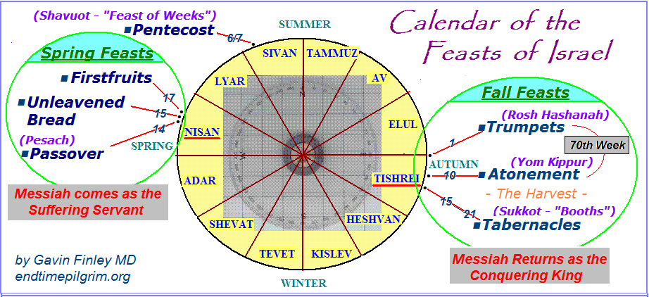
THE FIRST FOUR FEASTS HAVE BEEN FULFILLED. THE THREE FALL FEASTS
ARE NOW AWAITING FULFILLMENT.

Slide 6
The seven feasts were ordained by God and received by Moses at Sinai. They have been celebrated and rehearsed, (after a fashion),
ever since those former times.

Slide 7
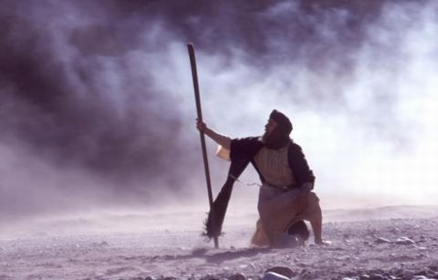

Slide 8
So how about these feasts? Are they just annual Jewish festivals that hark back to a bygone era? Are they just ancient Jewish lore and ritual?
The Bible calls them the Feasts
of the Lord. So can we really say
that they are irrelevant?

Slide 9
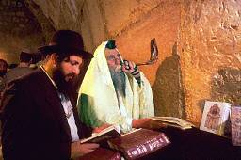

Slide 10
The Fall Feasts are signposts on a roadmap for the pilgrims as they journey towards the Holy City.
They are provided for ALL of the Elect of God including Christian believers.

Slide 11
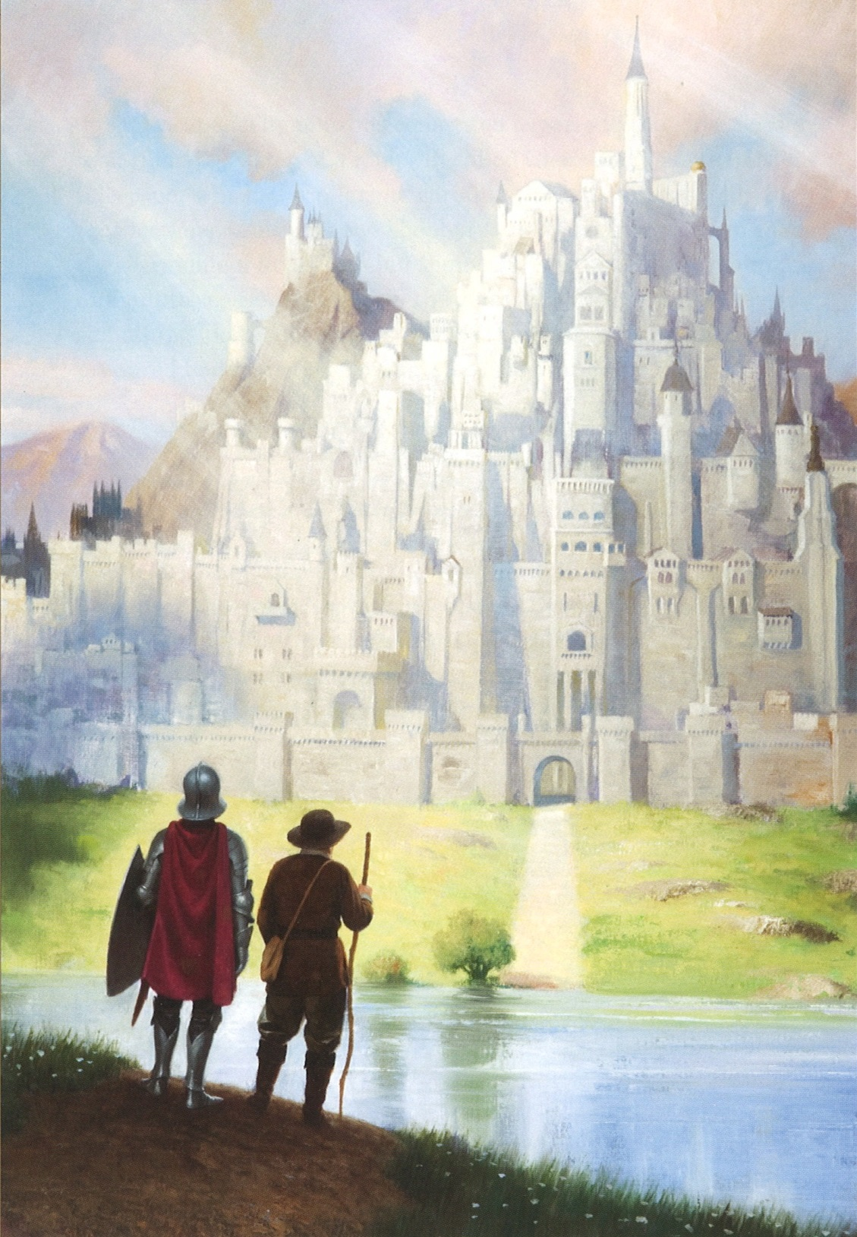

Slide 12
But the Fall Feasts are more than this. They were given to us as a timepiece to track God’s unfolding agenda in the latter days. This is important. Our journey through those final seven years takes us right on up to the midnight hour.

Slide 13
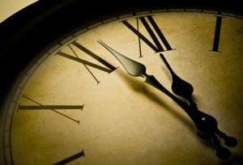
”these things happened
unto them for examples; and they were written for our admonition, upon whom
the ends of the world are come”. 1Cor. 10:11

Slide 14
And why are the Fall Feasts so important? Because they usher us into 7 years that will lead up to Judgment Day. All of us have a sure and certain divine appointment with our Messiah. A search through the Holy Scriptures of such phrases as ”appointed time”, “set time”, or “that Day” points to
the climax of the age. Messiah will return at the time of the harvest. We’ll talk about that later in this video.

Slide 15
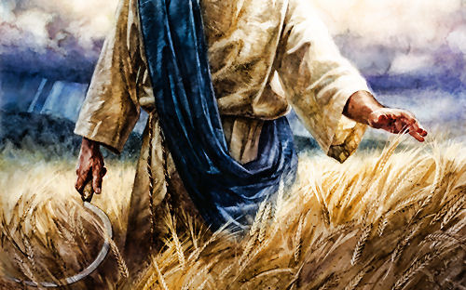

Slide 16
But typically Christians will say, “What’s
this Seven Feast business? Hey, this is Old Testament Jewish stuff. That’s for Israel isn’t it? Hey, we are the Church! We are different from Israel. We are the people of grace, not the people of the law. We have an entirely separate deal. And you say the Fall Feasts are important for me to know about?
Who me?”

Slide 17
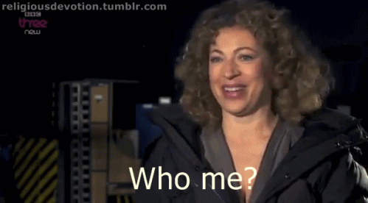

Slide 18
In the Fall Feasts we see a sovereign
God at work. The broad sweep of history, from eternity past to eternity future was written by Him before the foundation of the world. There is a set time for His agenda to open up in the latter days and a set time for His final judgment. Both
of them are in our future. And they
may come sooner than we think.

Slide 19
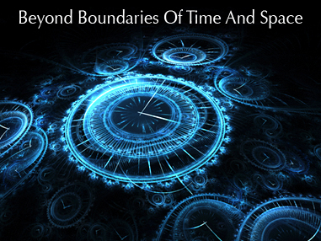

Slide 20
Holy History plays out according to God’s over-arching plan. He officiates over the end-time drama, decreeing what is to be from His courts above. In Daniel 7 we see the Ancient of Days presiding in judgment over unfolding events during the Great Tribulation.

Slide 21
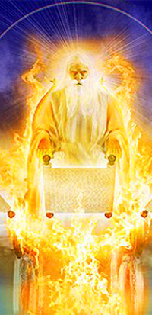
Daniel 7
10. “As I looked, thrones were placed, and the Ancient of Days took his seat; his clothing was white as snow, and the hair of his head like pure wool; his throne was fiery flames; its wheels were burning fire. 10. A stream of fire issued and came out from before him; a thousand thousands served him, and ten thousand times ten thousand stood before him; the court sat in judgment, and the books were opened.

Slide 22
God’s end-time agenda has been determined. And it has been written down. His acts of kindness are not random. They are very deliberate and ordered. And He knows the hearts of men. Einstein was right. God does not play dice with the Universe.

Slide 23
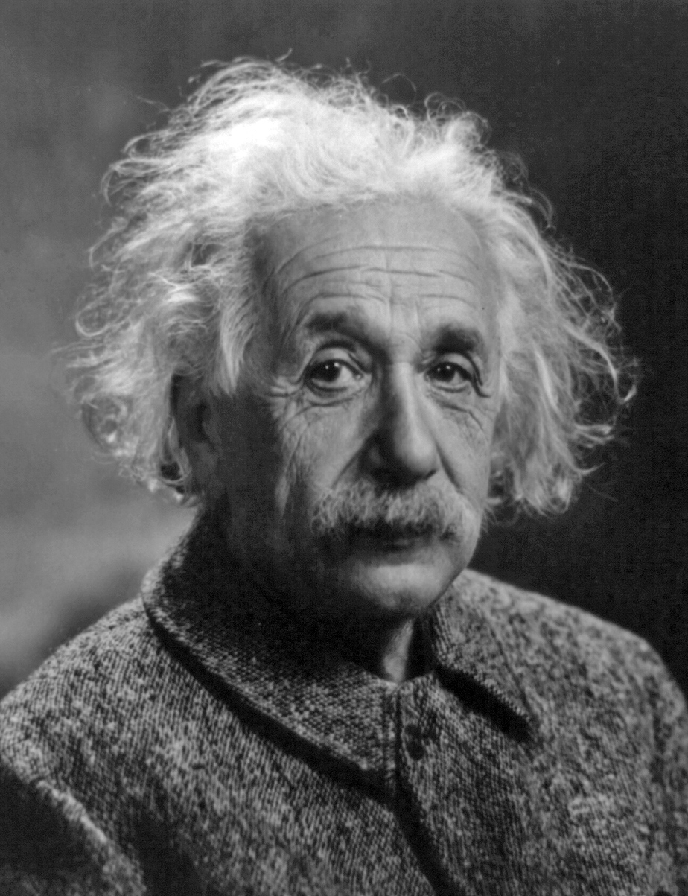
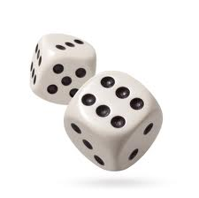
“God does not play dice with the universe.”
Albert Einstein

Slide 24
The Fall Feasts were instituted by God. He gave them to Moses back
at Sinai. Moses came down the mountain and handed them to us. The feasts are for all the people of His adoption, the ones adopted into His family back then and the ones being adopted into His family today.

Slide 25
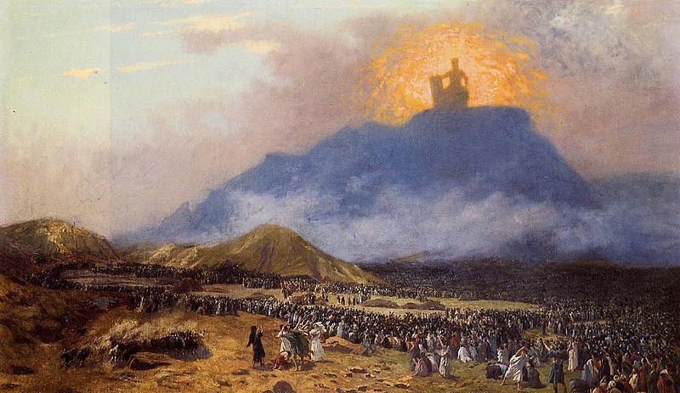

Slide 26
So here are the three Spring feasts
Moses gave us, over on the left. They are Passover, Unleavened Bread, and Firstfruits. They were fulfilled 2,000 years ago; And precisely on the dates
to which they belonged. And just how were those Spring Feasts fulfilled?
Well. In some very Christian ways.

Slide 27
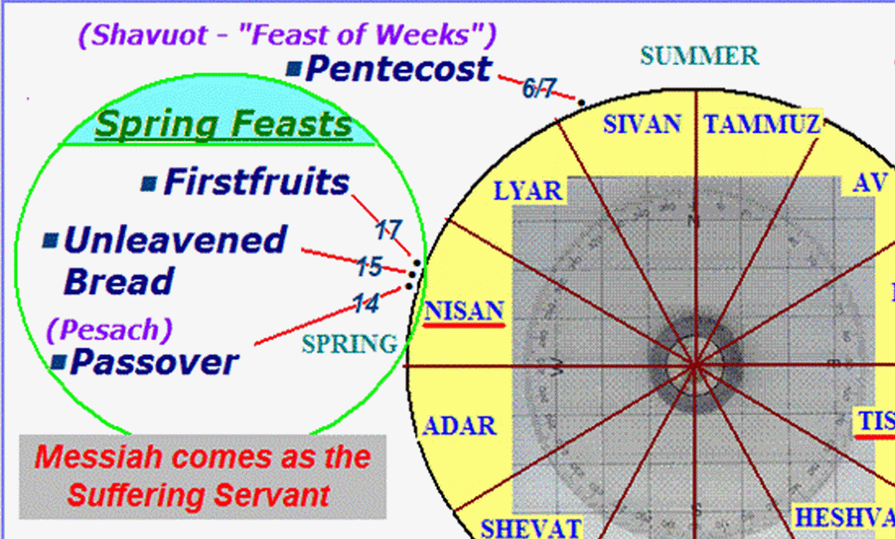

Slide 28
Briefly stated, they were
fulfilled in the death, burial,
and resurrection of Jesus. These
three pivotal events erupted into holy history precisely on the very Hebrew calendar feast dates to which they belonged.

Slide 29
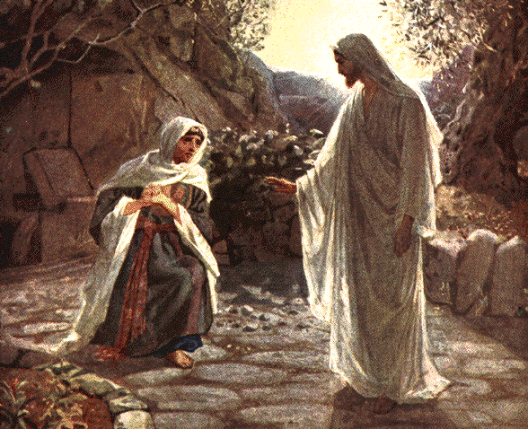
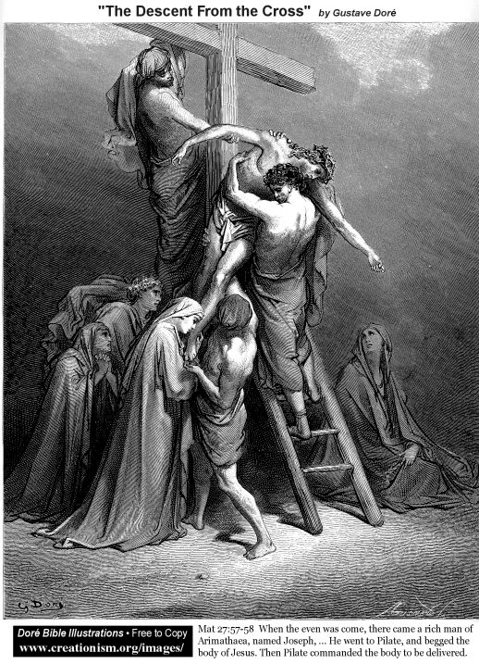
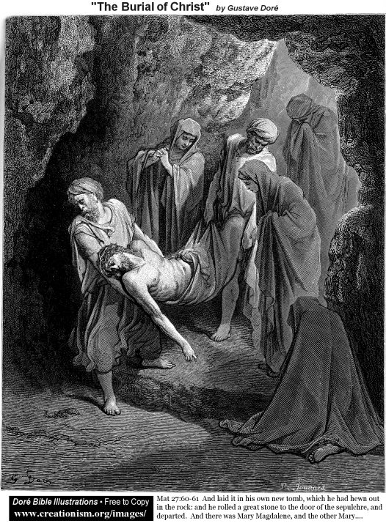
The Three Spring Feasts, fulfilled!
Resurrected as the Firstfruits from
the dead on the morrow after the Sabbath on the Feast of Firstfruits
Crucified on Nisan 14
Passover
Buried on Nisan 15
Unleavened
Bread

Slide 30
The three Fall Feasts over on the right are yet to be fulfilled. Our Jewish friends have remembered and preserved these Holy Days for us. And thank God they did. Because we sure didn’t. And we are not remembering them now. They rehearse them every year and right at
the appointed times. God bless them for this. We are a careless and forgetful people. These are dates on the Hebrew calendar in which certain epic events are yet to occur. And we are not interested!!! The three Fall Feasts are sitting there. Sooner or later Christian believers will wake up, smell the coffee, and study them. Each Fall Feast is awaiting its appointed time and its final fulfillment.

Slide 31
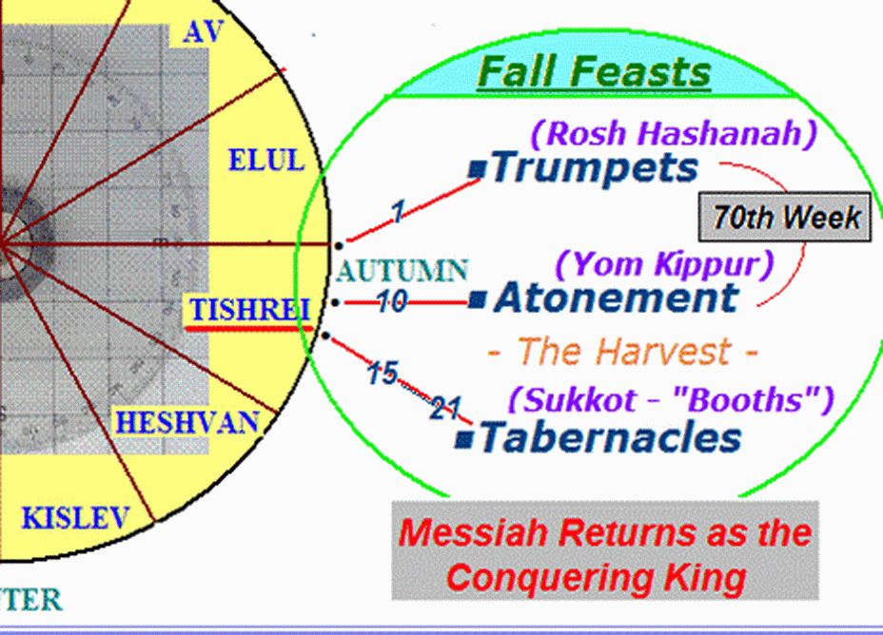
Yom Teruah

Slide 32
In this video we’ll focus on the first two
of those Fall Feasts. What is the spirit and character of each one? As we study them
let’s ask God to explain to us their deeper meaning. How are they celebrated today? And how is their future fulfillment being rehearsed? Just what will God be doing
when each divine appointment is fulfilled
in times to come? And let’s not forget to
ask this question. Why will He be doing it?

Slide 33
Yom Teruah

Slide 34
The first Fall Feast is the Feast
of Trumpets. The more Biblically
based name for this holiday or
moed from Leviticus 23:24, 25
is Yom Teruah.

Slide 35
Yom Teruah

Slide 36
And if we put an “e”
at the end of the word
Yom
we’ll be prompted
to pronounce it right.
It is pronounced
Yome Teruah

Slide 37
Yom Teruah
- pronounced
Yome Teruah.

Slide 38
The next divine appointment
after Yom Teruah is the Day of Atonement. Our Jewish friends
call it Yome Kippur from the
Hebrew word “kapparah” which
means to cover or to protect.

Slide 39
Yom Teruah

Slide 40
It is now becoming quite apparent that these two Fall Feasts are very important. In a time future and right on these Hebrew calendar dates God’s covenant people will find themselves facing world events of Biblical proportions. Those who sincerely seek the face of God are now beginning to study these feasts. There are big issues here and we must face up to them faithfully and responsibly.

Slide 41
Yom Teruah

Slide 42
Here’s a simple question.
Will these seven divine appointments continue to
unfold in the sequence God
has laid out in Leviticus 23?

Slide 43
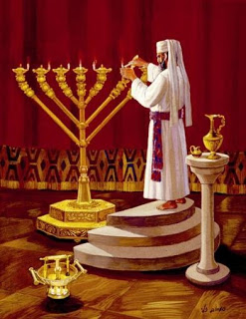
1 2 3 4 - - -

Slide 44
Well if we look at what
has happened so far we can
be sure that they will.

Slide 45
The Three Spring Feasts, fulfilled!
Resurrected as the Firstfruits from
the dead on the morrow after the Sabbath on the Feast of Firstfruits
Crucified on Nisan 14
Passover
Buried on Nisan 15
Unleavened
Bread

Slide 46
In a previous video entitled, ”The Fall Feasts
and the Timeline of the Final 7 Years of this Age” we saw that the Feast of Trumpets, (aka Yom Teruah), and the Day of Atonement (or Yom Kippur), appear to be bookends staking out the final seven years of this age. There is a precisely fitted 2550 day timeline here. It encompasses the 70th Week of Daniel and goes on to terminate
on the Day of Atonement which in turn,
ushers in the Day of the Lord .

Slide 47
The first two Fall Feasts are yet to be fulfilled.
They will encompass the 70th Week of Daniel and
initiate and terminate the final seven years of this age.
Feast of
Trumpets
Tishrei 1
Day of
Atonement
Tishrei 10
7 years
2550 days which equals 86 moons + 10 days inclusive
1260 days (Harlot rule)
1260 days (Beast AC rule)
30
d
1260 days (Harlot rule)
1260 + 30 = 1290 days
1260 + 1290 = 2550 days days (inclusive)
Copyright free
Gavin Finley MD
EndTimePilgrim.org
YouTube – GavinFinley
Abomination
of Desolation
Trumpets of Jubilee
Day of the Lord

Slide 48
As we have seen in that earlier study, most of the future seven year timelines that bridge the Fall Feasts across seven years, (timeline’s that embrace 86 moons and not 87 moons), are time periods of 2550 days. This is the exact day-count
for the final 7 years of this age.

Slide 49
Some upcoming inclusive day counts between Trumpets
and Atonement for some future seven year time spans.
Sept. 7, 2013 to Sept. 28, 2020 is 2579 days
Sept. 26, 2014 to Sept. 18, 2021 is 2550 days *
Sept. 15, 2015 to Oct. 7, 2022 is 2580 days
Sept. 3, 2016 to Sept. 26, 2023 is 2580 days
Sept. 22, 2017 to Sept. 14, 2024 is 2550 days *
Sept. 11, 2018 to Oct. 3, 2025 is 2580 days
Sept. 1, 2019 to Sept. 22, 2026 is 2579 days
Sept. 19, 2020 to Sept. 11, 2027 is 2550 days * *
Sept.9, 2021 to Sept. 30, 2028 is 2579 days
Sept. 28, 2022 to Sept. 19, 2029 is 2549 days
Sept. 17, 2023 to Oct. 9, 2030 is 2580 days
Sept. 5, 2024 to Sept. 28, 2031 is 2580 days
Sept. 24, 2025 to Sept. 16, 2032 is 2550 days *

Slide 50
This is pretty remarkable.
The two timelines measure
out to precisely 2550 days.
Is this likely to be
just a coincidence?
Probably not!

Slide 51
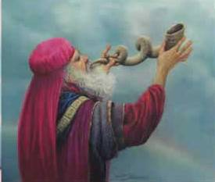
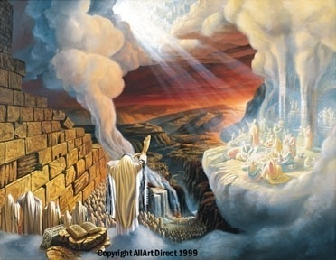
The Final 7 Years of this age
= 1260 + 1290 = 2550 days
Day
Of
The
Lord
Feast of Trumpets
Tishrei 1
Day of Atonement
Tishrei 10
7 years
apart
The inclusive Timeline bridging the Fall Feasts is also precisely 2550 DAYS!

Slide 52
Now we go on to address the main purpose of this video and ask this question. What is the spirit, nature, and purpose of these two upcoming appointed times? By what events and in what manner will they come into their divine fulfillments? (Ken Burns effect)

Slide 53
Yom Teruah

Slide 54
A few Christian and Messianic believers are now beginning to realize that the Fall Feasts must see their ultimate fulfillment in two highly significant future events. These feasts should be the object of diligent inquiry. But alas, this is not happening. The great truths of the latter days they open up for us still remain hidden. Messianic rabbis still insist on keeping the Fall Feasts cloaked, even swaddled, in Jewish tradition. Most Christian churchmen ignore the feasts. Others hijack the Yom Teruah, Feast of Trumpets to support popular and lucrative end-time teachings.

Slide 55
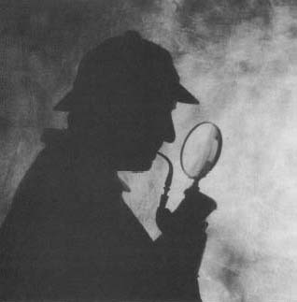
The Mystery
of the Teruah.
“Study to show yourself approved unto God,
a workman that need not to be ashamed,
rightly dividing the word of truth.” - 2 Tim. 2:15

Slide 56
So let’s start with this. Does Yom Teruah fit the spirit and character of the Resurrection-Rapture? Does the broken noted Teruah shofar blast exhibit the note of finalty we might expect to hear at the Last Trump? Let’s examine the evidence and look more carefully into this matter. Because
Yom Teruah as it is rehearsed in the Jewish house ushers us
into a season of repentance known as the Days of Awe.
A trumpet call to assembly in repentance is one thing. And a trumpet blast proclaiming the grand finale of the age, the final glorification, the Resurrection-Rapture of the Elect, is quite another. These events would seem to call for quite distinct and different shofar sounds. Which shofar blast fits and matches which occasion? Let’s look into this matter.

Slide 57
A Period of DEEP REPENTANCE
Day
Of
The
Lord
Yom Teruah
Tishrei 1
DAYS
of AWE
Day of Atonement
Tishrei 10
The inclusive Timeline bridging those
Fall Feasts is precisely 2550 DAYS!

Slide 58
Motivational speakers intent on pushing a “positive” or
“upbeat” message now dominate Christian pulpits in the West. They promote a popular mythology called “self esteem” which
is an oxymoron at best or a gateway to self-honoring egoism
or Luciferian self-worship at worst. So repentance is now out
of favor. Pulpiteers deem it unnecessary, unbecoming, even “negative” and neglect it. So as a result we are not hearing about the Feast of Trumpets being a call to repentance. Nor are we hearing about it being an alarm and a call to assembly before God. Nor are we hearing the truth that Yom Teruah will initiate the final seven years leading up to our final exam, Judgment Day, the Day of Atonement. But if Yom Teruah is indeed a call
to assemble before God for fasting and repentance, as we see
in Joel 2 would not the sharply chopped notes of the Teruah
be the appropriate shofar blast for such an occasion?

Slide 59
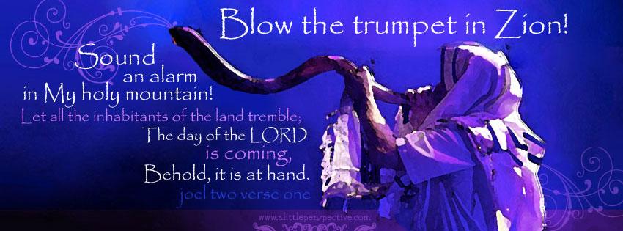
15. Blow the trumpet in Zion, declare a holy fast, call a sacred assembly. 16. Gather the people, consecrate the assembly; bring together the elders,gather the children, those nursing
at the breast. Let the bridegroom leave his room and the
bride her chamber. 17. Let the priests, who minister before the Lord, weep between the portico and the altar.

Slide 60
Here is another matter for us to consider. Is all of God’s work really done here below? Has the fullness of the Gentiles been brought in? In Ezekiel 34 has not God said, “Woe to the shepherds who feed themselves and do not feed my sheep!” And did not the Shepherd of Israel say that in the latter days He will personally go out on a dark and cloudy day to seek his lost sheep, to call His sheep by name and to gather them to Himself. And if such is the case why are we planning on skipping out during the last 7 years and deserting. Or why are we neglecting the true calling of our Messiah to seek our own comfort and our own dominion? Might we do better repenting from all this religious foolishness and turning around? Why are we not coming to Him and seeking His face and desiring His truth? Why are we insisting on escaping from our end-time responsibilities? Why are we seeking to dominate the world and bring in the Kingdom Now our own way?

Slide 61
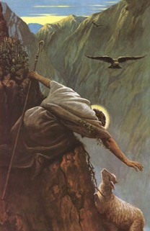
As a shepherd seeketh out his flock in the day that he is among his sheep that are scattered; so will I seek out my sheep, and will deliver them out of all places where they have been scattered in the cloudy and dark day.

Slide 62
Now let us take a look at the terminus of
those final 7 years. Yom Kippur or the Day
of Atonement is a rehearsal for Judgment Day. The book of Revelation can be seen as a divine court case coming to a climax in Judgment on Judgment Day. In Revelation 4 we see Messiah will preside as Judge and He will execute His Judgment on the Day of the Lord, the Day of His revelation. Our Messiah will oversee the entire end-time agenda. He sets the limits on events
as the epic saga plays out here below.

Slide 63
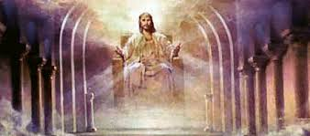
4 After this I looked, and, behold, a door was opened in heaven: and the first
voice which I heard was as it were of a trumpet talking with me; which said, “Come
up hither, and I will shew thee things which must be hereafter.” ² And immediately I was in the spirit: and, behold, a throne was set in heaven, and one sat on the throne. ³ And he that sat was to look upon like a jasper and a sardine stone: and there was a rainbow round about the throne, in sight like unto an emerald.

Slide 64
And what else might we expect to happen on that epic future Day
of Atonement? In Leviticus 25 God through Moses ordained that the trumpets of Jubilee were to sound every 49 years on a certain high holy day. And what day might that be?

Slide 65
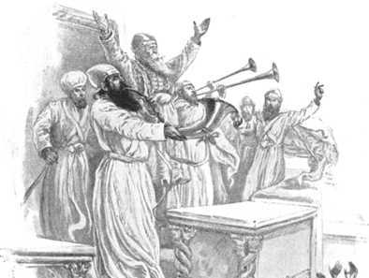

Slide 68
That day is Tishri 10, the Day of Atonement. So might we not expect that the trumpets sounding on that final wrap-up Day of Accounting will also be announcing that long awaited climactic Jubilee of Messiah? For more on this see the YouTube video entitled, “The Day of Atonement at the Last Day and the Jubilee of Messiah”. This awesome future Day of Atonement would not only mark the terminus of this present evil age.
It would also usher us into the next age, the glorious Millennium of Messiah.

Slide 69
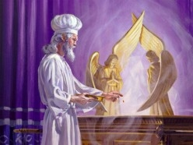
The Year of Jubilee is proclaimed on Tishrei 10
The Day of
Atonement is on
Tishrei 10

Slide 70
So we are looking here at a watershed
in world history, a transitional event of Biblical proportions. And who are the people who need to know this? Should
it not be the nations in the driver’s seat of world history? Should it not be the Judeo-Christian people of the West?

Slide 71
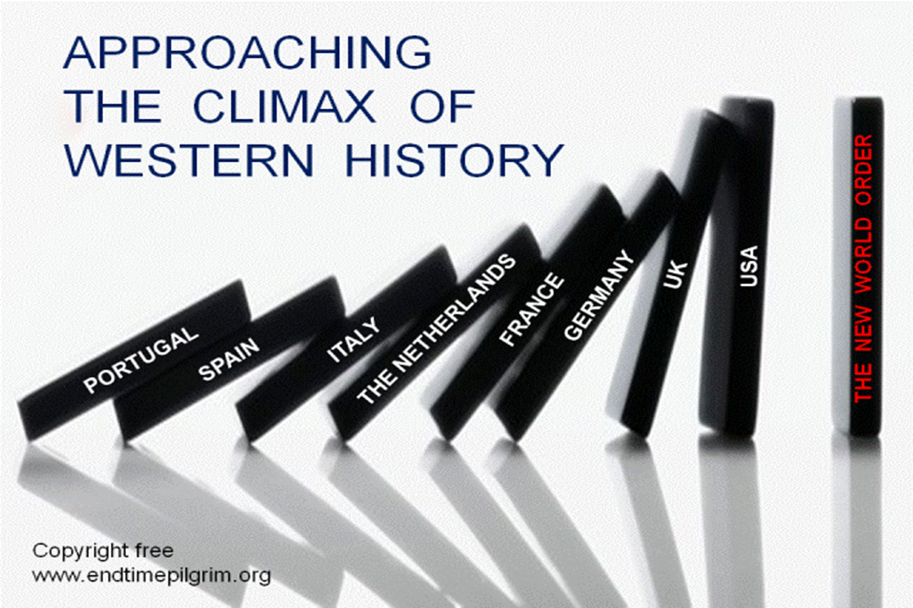

Slide 72
There is now an upwelling of interest in the Feasts of the Lord among Christians and Jews. The moeds are the appointed times
of Yehovah the Almighty Eternal God.
This makes for some very interesting discussions. Right now God’s called-out people are divided. They are in two estranged and sometimes feuding camps.

Slide 73
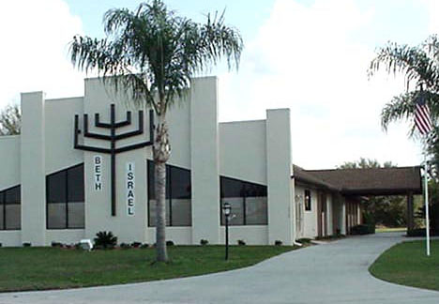
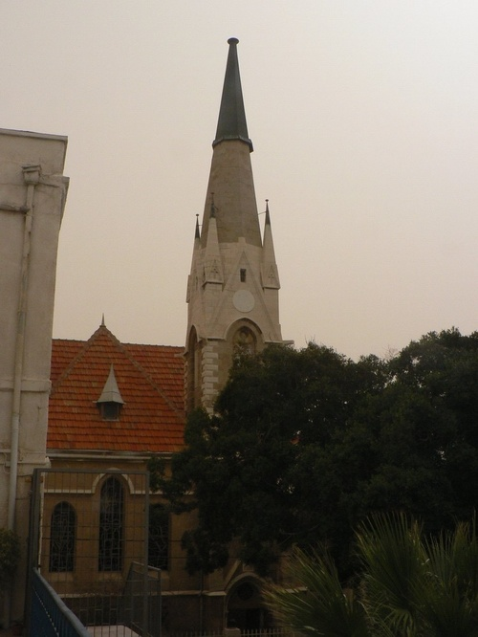
ISRAEL and the CHURCH
Notes:
Greetings and welcome. My name is Gavin Finley and in this video we shall be considering the rather daunting, multi-facetted problematical matter of Israel and the Church.
There are two groups of people who have a good claim to be the “called out ones”, the ekklesia,
the Chosen People, the Elect.
We see our Jewish brethren in one box.
And we see Christians in the other box.
Both worship the same God, the God of Israel.
Each company thinks that their party has it all.
Each company thinks that they don’t need the other.
One party vexes or troubles the other.
And the other party gets jealous and persecutes the other.
Clearly these behaviors are not pleasing to the God of Israel.
Of course we are jumping ahead of our discussion here.
But if there is some good news then we should be appraised of it.
If God has promised something good should we not know about it?
Because the prophet Isaiah in Isaiah 11:13 says that there will come a time when this strife will cease.
So why do they continue to feud and squabble?
Why hasn’t each party repented of their wrongs and found Grace and Shalom with Messiah?
When will they be reconciled with their brethren in Grace and Peace?
And when will holy history see Israel as a Nation and Israel as a Congregation, restored in the Peace of Jerusalem?
Well, we are going to find out.

Slide 74
But we need to remember this.
Back at the last feast, the Feast
of Pentecost, did we not see
two LEAVENED loaves lifted up? Leaven is a type of sin, is it not?

Slide 75
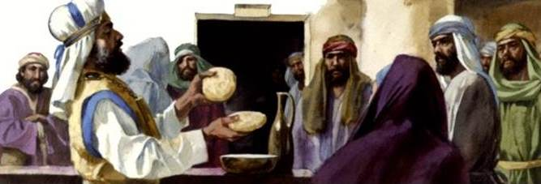
¹⁵ ‘You shall also count for yourselves from the day after the Sabbath, from the day when you brought in the sheaf of the wave offering; there shall be seven complete Sabbaths. ¹⁶ You shall count fifty days to the day after the seventh Sabbath; then you shall present a new grain offering to the Lord.
¹⁷ You shall bring in from your dwelling places two loaves of bread for a wave offering, made of two-tenths of an ephah; they shall be of a fine
flour, baked with leaven as first fruits to the Lord. - Lev. 23:15-17

Slide 76
So Pentecost, great blessing that this has been, will not take us to the end of our journey. By itself it will not deliver. God obviously has some further dealings with all His covenant people.

Slide 77
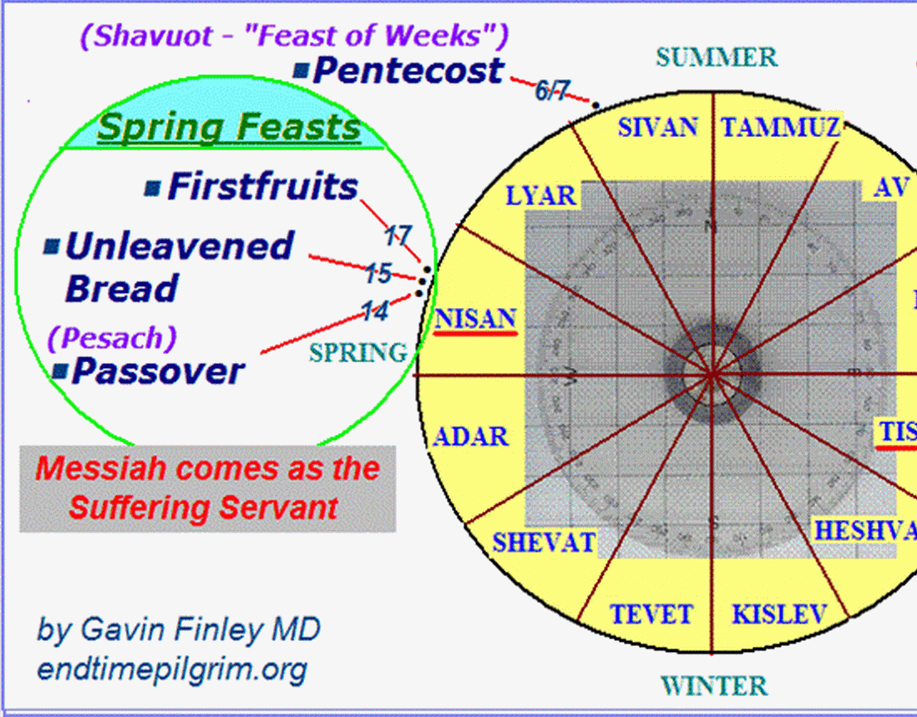

Slide 78
So, if we expect our God to
take us on to glory would it
not be reasonable to expect
that it might be by way of
the upcoming Fall Feasts?

Slide 79
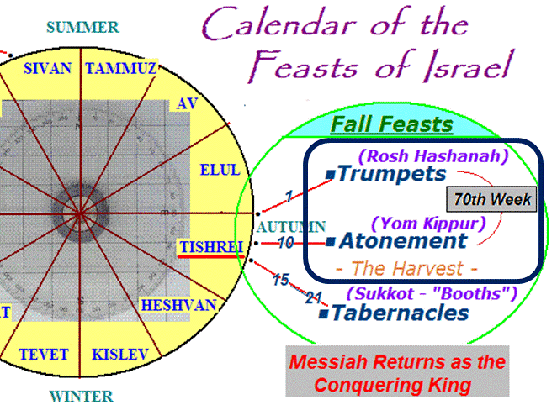
(Yom Teruah)

Slide 80
We are going to discover as we go along that in Christ, in our Messiah we are more connected to Israel than the princes of this world allow. But the final wrap-up awaits the re-gathering, the repentance, the refining, the reunion, and the restoration of all Israel. This is what God will be doing in the latter days. All the mysteries will be revealed. Even now, as holy history unfolds positive things are happening. Each faction is finding themselves strangely blessed by the other. We are in fact seeing the early stirrings of the epic latter day restoration of all Israel. How wonderful is that?

Slide 81
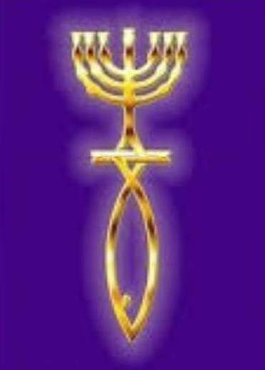
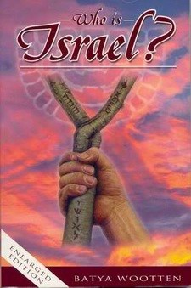
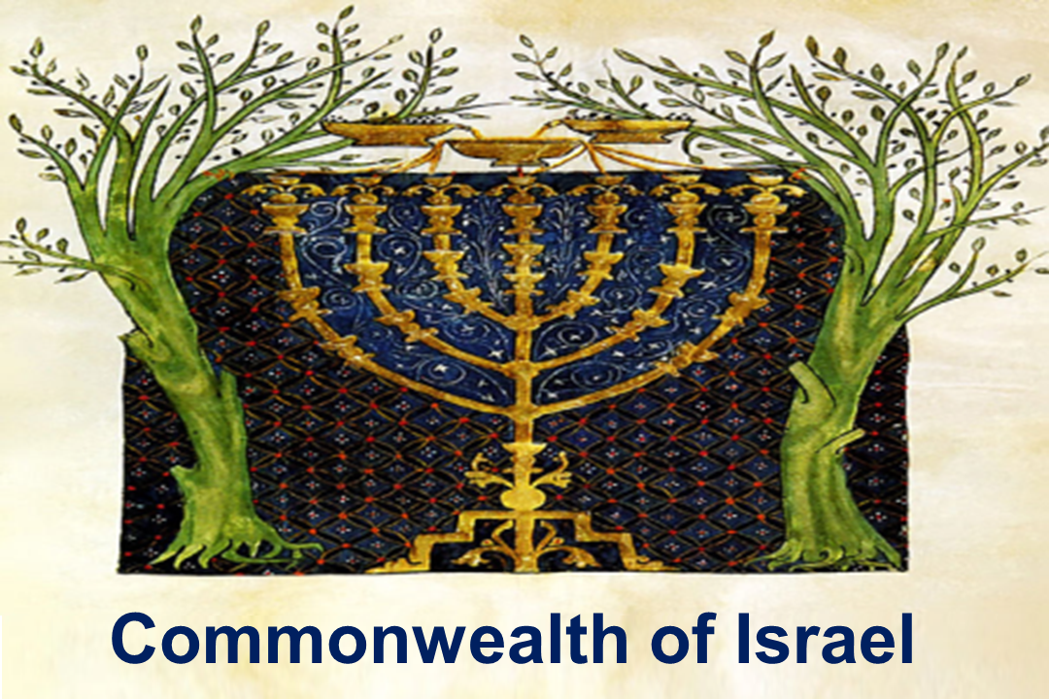
Israel includes both the nation, (or the scepter of Israel in the royal throne of David in the Jewish house of Judah) and the Congregation of Israel or as we call it “the Church”. In Ezekiel 37 the prophet saw the two separated entities as two sticks that were to be re-united. The two estranged houses of Israel are to be restored to each other at the climax of the age and will become one. The Apostle Paul spoke of those who are saved under the atoning blood of Christ, (Israel’s promised Sacrifice Lamb), as entering into the Commonwealth of Israel. This reunion will surely happen. But both parties are in partial blindness
to these things at this point in time.

Slide 82
Scales are now coming off the eyes. Christians are now starting to see that Yom Teruah, AKA the Feast of Trumpets, is for them too. It is not just a Jewish holiday. And our Jewish friends are now beginning to see that the divine appointment they rehearse every year is more than just a time for dipping apples in honey and saying “Have a sweet New Year”. As we saw in our other videos, the Teruah shofar blast is an urgent awakening. It is the Voice of God, a summons to all His covenant people to fasting, prayer, and to repentance. It is also the day of the “joyful sound”. So this future Day of the Teruah
must be a very important day up there in our future.

Slide 83
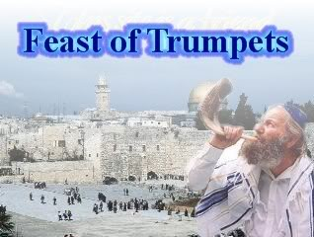

Slide 84
As we shared in a previous video on Yom Teruah, there are four classic Hebrew shofar blasts. This traditional sequence goes back into antiquity. The Teruah shofar blast is not the last trumpet
in the sequence. It is the third. And as we have seen, the Teruah gives Yom Teruah its name.
It is the trumpet of alarm, an awakening, a
revival, a call to repentance, and a summons
to assembly before God. It is a remembrance
of God. And in the shout and in the trumpet
blast we cry out to Him to remember us.

Slide 85
1. Tekia
2. Shevarim
3. Teruah
4. Tekia
Gedolah
Yom Teruah
or
Feast of
Trumpets

Slide 86
The Teruah shofar blast has a certain musical character. It also has within it an inherent two
way communication in the Eternal Covenant. Whenever God’s people are in a state of distress and brokenness the sharply chopped notes sound the alarm along with an urgent appeal for assistance. And in that same Teruah trumpet blast or shout the anointed Presence of God echoes back to His people with an inspiring summons to assemble before Him to deal with the issues.

Slide 87
The Teruah
- - - - - - - - -
Tut Tut Tut Tut Tut Tut Tut Tut Tut
(Broken notes)
Yom Teruah
(Feast of
Trumpets).

Slide 88
So what is God’s purpose in that future epic Yom Teruah? What will happen when His covenant people hear the call on that awesome future day when the 7 year covenant of Daniel 9:27 is confirmed? There will be an awakening and a wave of repentance. Will the Holy Spirit be there to comfort, strengthen, and guide the covenant people of God? Will the great End Time Revival spoken about by Joel, Isaiah, Hosea, and all the other prophets come? Will the true and genuine Latter Rain outpouring be here at last?

Slide 89
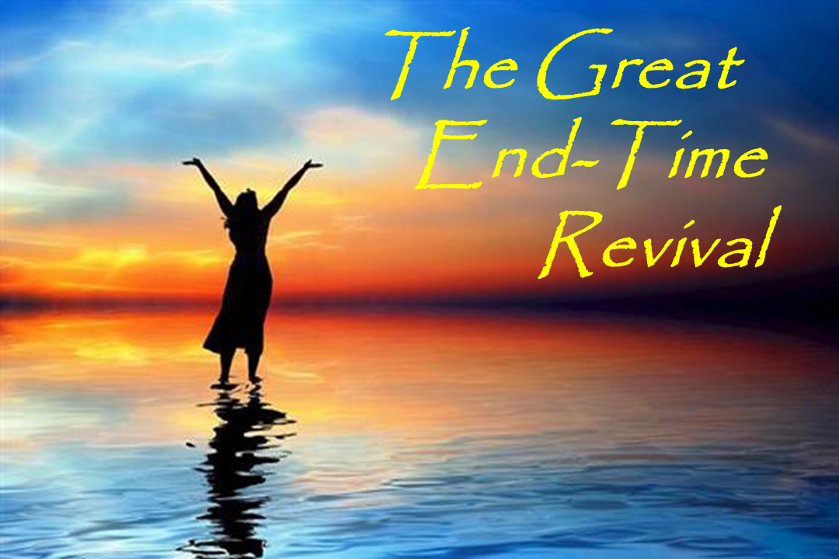

Slide 90
If this is so then what would be God’s purpose in Yom Teruah? Would not the Holy Spirit Outpouring be given to guide and to empower His saints as they make their stand for Him in the latter days? But wait a minute. If there is to be an End-Time Revival among God’s covenant people will that be happening at the very same time as the Great End-Time Falling Away? Quite possibly so.

Slide 91
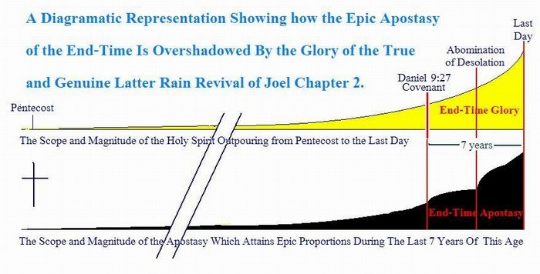

Slide 92
But what if the people falling away from the faith through fear greatly outnumber the saints who are responding in faith and awakening to His Teruah? And did not the prophets of old say that as we came to the end of the story “a remnant shall return”?

Slide 93
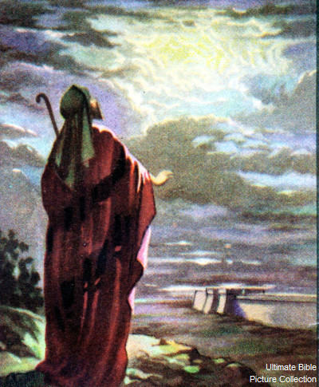
“For though thy people Israel
be as the sand
of the sea, yet a remnant
of them
shall return:
- Isaiah 10:22

Slide 94
Have we not seen that same pattern of events in the pages
of Holy Scripture? Did we not
see a great falling away with the whittling down of Gideon’s army from 30,000 to 300, and all this apparently by God’s direction?

Slide 95
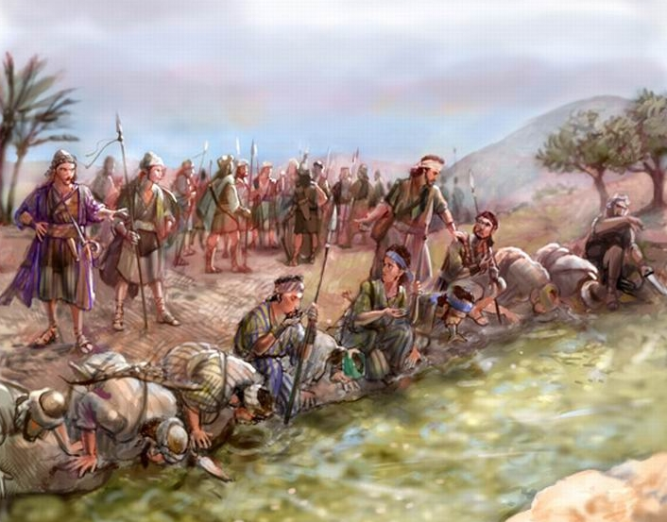

Slide 96
And what was the outcome of this great falling away? Just how bad a military decision was this rejection by Gideon of the many and the commissioning of the few? Did we not see a small remnant, even a fully committed broken vessel company of unarmed men take the stage of holy history? And as they blew their trumpets and boldly shone their lights into the darkness did we not see this small company lead Israel on to a great victory?

Slide 97
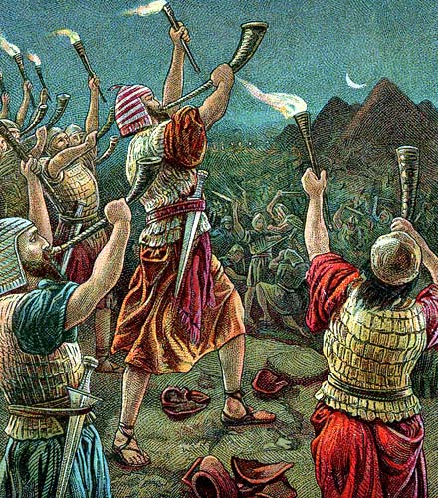

Slide 98
In Leviticus 23 the God of Israel through Moses lays out Yom Teruah as a “Day of Blowing” as of trumpets. It is also stated
to be a memorial day. Why is Yom Teruah
to be a memorial? This will surely be a day in which God’s people remember their God. And in the covenant they will certainly be calling out to Him to remember them.
But is there more to the story?

Slide 99
Leviticus 23
24. Speak ¹⁶⁹⁶ unto the children ¹¹²¹ of Israel ³⁴⁷⁸, saying ⁵⁵⁹ , In the seventh ⁷⁶³⁷ month ²³²⁰, in the first ²⁵⁹ [day] of the month ²³²⁰, shall ye have a sabbath ⁷⁶⁷⁷, a memorial ²¹⁴⁶ of blowing ⁸⁶⁴³ of trumpets, an holy ⁶⁹⁴⁴ convocation ⁴⁷⁴⁴.
25. Ye shall do ⁶²¹³ no servile ⁵⁶⁵⁶ work ⁴³⁹⁹ [therein]: but ye shall offer ⁷¹²⁶ an offering made by fire ⁸⁰¹ unto the LORD ³⁰⁶⁸.

Slide 100
This memorial issue is a big lead worthy of our study. On that epic future Yom Teruah the people of the eternal covenant will stop in their tracks. They will remember their God in a very public way. At the sounding of the Teruah His covenant people will be calling upon their God to re-member them, His dis-membered people in their hour of need. This two way calling to re-membrance between God and
His called out people is a consequence of the Everlasting Covenant. The Abrahamic covenant
blossoms forth in the New Covenant.

Slide 102
There is yet another more somber reason why Yom Teruah may become a memorial day with the blowing of trumpets. A good investigator taps into leads such as this one. Because we are looking at a memorial that according to Psalm 81 occurs on a new moon and on a solemn feast day. But we shall
have to pursue this clue in another video.

Slide 103
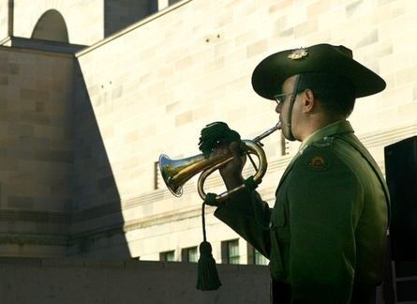

Slide 104
The word Teruah does not mean trumpet. This is our big neglected clue. The Teruah is the divine “wake-up call” of God. It is His Voice, His inspiration coming to us IN the blowing of the trumpet, IN the shout, IN the joyful sound etc.. So it seems that on some awesome future Jewish New Year Someone will be speaking to His people and through His people and rather loudly. God will be calling out in and to His people in and through all these many and varied expressions of the Teruah.

Slide 105
Strong’s
# H8643
Teruah
Blowing, (as of trumpets)
Shouting,
ALARM!,
Joyful sound,
(assoc. with) Tumult.

Slide 106
The Teruah is a wellspring in which flows the divine Presence of God. He speaks to us IN the trumpet blast, IN the shout, IN the call to attention, and
IN the call to repentance and IN the proclaiming
of a soon coming King. He IS the awakening in the trumpet blast, He IS the joy in the joyful sound.
He IS the exaltation in the clashing of cymbals.
He IS the One who overflows by His Holy Spirit.
He IS the Holy One of Israel who in His Person wells up IN His people through all of these
manifold expressions of the Teruah.

Slide 107

The Blowing
The Teruah
The Shout
The Alarm!
The High Sounding Cymbals
The Joyful Sound

Slide 108
Yom Teruah is most often referred to as Rosh Hashanah,
the Jewish New Year. Christians use the term Feast of Trumpets. But the Biblical name for the feast, has been neglected. The phrase Yom Teruah just gets a mere 1%
of the Google inquiries. And yet the word Teruah is all through the Scriptures. It occurs 33 times in the King James Bible. Sadly, there is almost no Bible teaching on the word Teruah. So the true meaning of the feast remains hidden. So lets look at these passages to see
how the word Teruah is used throughout the Bible.
This will give us further insight into what will actually
be happening on that momentous future Yom Teruah.

Slide 109
The Hebrew word TERUAH signifies REVIVAL & EXALTATION!
Lev. 23:24 “the blowing of trumpets.”
Num. 10:5 & 5 “blow an alarm.”
Num. 23:21 “the shout of a king.”
Num. 29:1 “the blowing of trumpets.”
Jos. 6:5 “a great shout and the wall will come down”.
2Chr. 13:12 “priests with sounding trumpets to cry alarm.”
Ezr. 3:12 “the foundation laid, .. many shouted aloud for joy.”
Psa. 27:6 “I will offer, ..sacrifices of joy, …I will sing praises.”
Psa. 33:3 “sing .. a new song, .. skilfully with a loud noise.”
Psa. 89:15 “Blessed are the people who know the joyful sound.”
Psa. 150:5 “praise Him upon the high sounding cymbals.”
Jer. 4:19 “the sound of the trumpet, the alarm of war.”
Amos 2:2 “Moab shall die with tumult, with shouting,”
Zep. 1:16 “the trumpet and alarm against the fenced cities,”,

Slide 110
God’s covenant people enjoy a two way communication with Him. In response to an unprecedented turn events they will be crying out to their God. And He will be answering by His divine Presence. Yom Teruah is the next blow-out event in future holy history. God’s people will be in a crisis. They’ll be facing a political and a religious bust. The national sovereignty of their country will be in jeopardy along with their personal freedom. Many will be angry at God for not rapturing them. Many will fall away in apostasy. But as the shofars sound the Elect will look up and remember their God. Their eyes will be upon Him and Him alone. On that day as they remember the eternal covenant a wave of repentance will break forth. Prayers and supplications will go up to heaven. The true and genuine latter rain will fall and the Holy Spirit will begin to flow in a glorious flooding wave that will keep building and finally break at the last Day as Messiah returns.

Slide 111
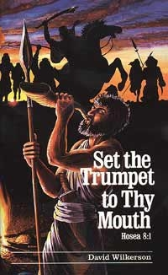
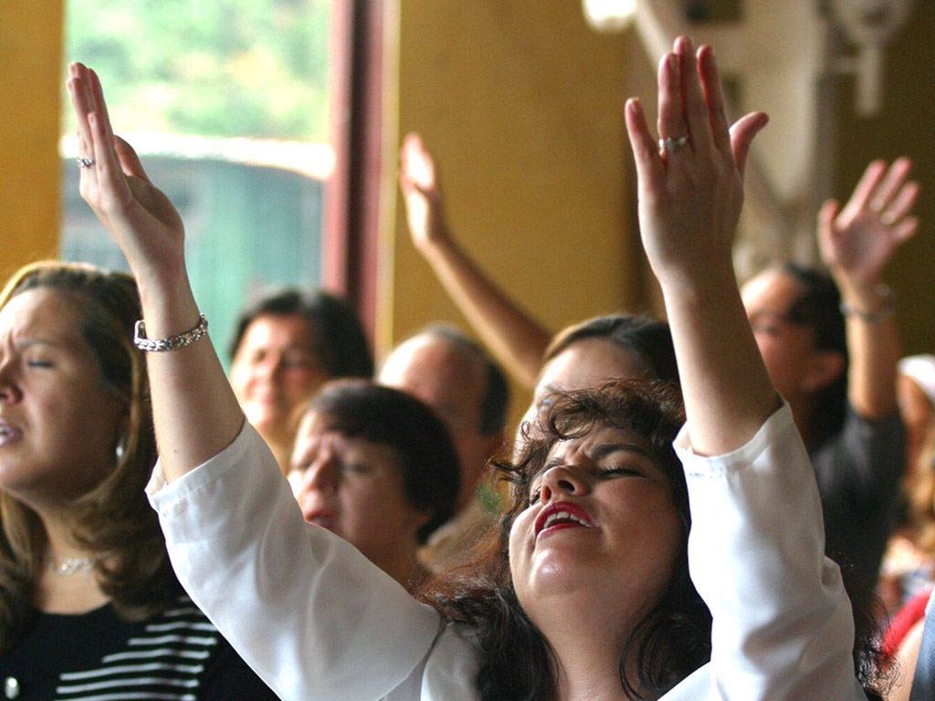
Blow the trumpet in Zion! Sound the alarm
on my holy mountain. Call a solemn assembly!
Sanctify a fast. Consecrate the people. Let the priests/pastors weep between the porch and the altar.

Slide 112
Yom Teruah carries with it another major clue. Our Jewish friends know
full well that this feast does not herald the closure of the age. Rather, it is an opener into a time of refining called
the days of awe. Then we have
another big clue to consider.
The Teruah shofar blast is only the
third of the four classic shofar sounds.

Slide 113
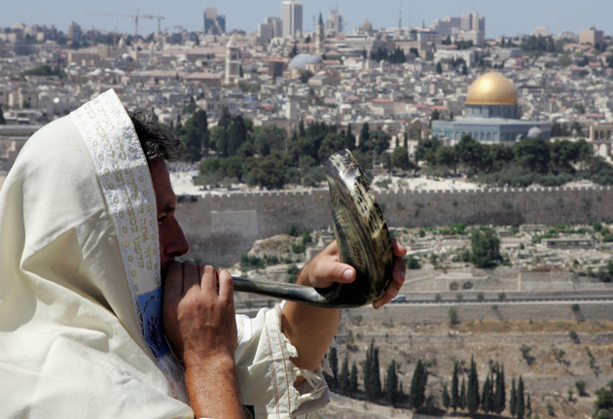
1. Tekia,
2. Shevarim,
3. Teruah,
4. Tekia Gedolah.

Slide 114
The Feast of Trumpets is an opener into the days of awe, days of fasting and prayer, days of deep brokenness and repentance. These days are set aside for God’s people to face the soon coming Day of Atonement. Yom Kippur is a rehearsal of the Judgment at the last day which in turn ushers in the Day of the Lord, which closes out this age and ushers in the next. The days of awe are preparation days for this. This applies to all of God’s covenant people in both houses of Israel.

Slide 115
A Period of DEEP REPENTANCE
Day
Of
The
Lord
Yom Teruah
Tishrei 1
DAYS
of AWE
Day of Atonement
Tishrei 10
The inclusive Timeline bridging those
Fall Feasts is precisely 2550 DAYS!

Slide 116
The fact is Yom Teruah is an entre’ into a time of refinement, even as gold or silver is refined. The Feast of Trumpets is a lead-in to a period set aside for some deep processing of the soul. That is how Yom Teruah was laid out, the way it has always been rehearsed, and how it will always be remembered in times to come.
Notes:
The fact is Yom Teruah is an entrance into a time of refinement, an entre’ into a processing period of the soul. We can take that fact to the bank. So we should be suspicious when churchmen who are not diligent in the Holy Scriptures play loose and fast with the Feast of Trumpets/Yom Teruah. Our Hebrew roots are the holy things of God. They are to be respected, not twisted and exploited for profane purposes. The main bulk of Christendom is carnal. So we have OUR ideas about what WE THINK will be the event that will fulfill Yom Teruah. And we should be especially wary of buying into a line of preaching that is fondly held, popular, and lucrative

Slide 117
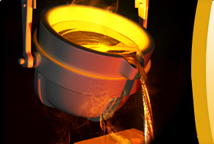
I will bring that group through the fire and make them pure. I will refine them like silver and purify them like gold. They will call on my name, and I will answer them. I will say, 'These are my people and they will say, 'The LORD is our God.‘ – Zech. 13:9 NLB

Slide 118
Semi-committed middle of the road Christians are not viewing Yom Teruah, the Feast of Trumpets, as a call to repentance. Instead they have been offered another more appealing alternative as a fulfillment for the feast. So we should be suspicious when churchmen, many of whom are not diligent in the Holy Scriptures, tell us what they know that we will want to hear. They tell us of a certain big imminent event coming seven years before the Second Coming of Messiah.
Notes:
The fact is Yom Teruah is an entrance into a time of refinement, an entre’ into a processing period of the soul. We can take that fact to the bank. So we should be suspicious when churchmen who are not diligent in the Holy Scriptures play loose and fast with the Feast of Trumpets/Yom Teruah. Our Hebrew roots are the holy things of God. They are to be respected, not twisted and exploited for profane purposes. The main bulk of Christendom is carnal. So we have OUR ideas about what WE THINK will be the event that will fulfill Yom Teruah. And we should be especially wary of buying into a line of preaching that is fondly held, popular, and lucrative

Slide 119
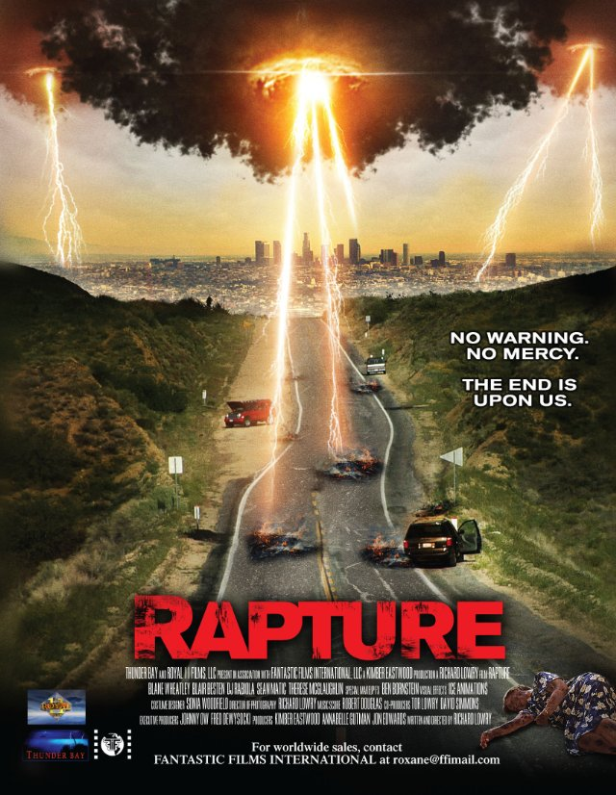

Slide 120
In the fall of 2008 the Bible prophecy discussion forums were abuzz with speculation of an imminent Rapture. A highly unusual tetrad of lunar eclipses had been discovered impacting Passover and Tabernacles in
2014 and 2015. They were given the label, “blood moons”. This was an unfortunate misnomer. The eclipses may prove to be a significant omen. But they do not fit the Biblical description of the true and genuine blood moon, one of three cosmic signs, spoken of by the prophet Joel in Joel 2:28-32, Jesus in Matthew 24:29-31, and the apostle John in Revelation 6:12-17. But when scriptures referring to the true blood moon that marks the end of the age were applied to these eclipses there arose a wave of speculation that the Rapture would come seven years before 2015 on Yom Teruah of 2008. The day came and went. It was just another false alarm. This sort of conjecture may fire up the masses and sell books and DVD’s. But sloppy eschatology combined with date-setting does a disservice to our Lord Jesus Christ. We should be especially wary of buying into a line
of preaching that is fondly held, popular, and lucrative.
Notes:
The fact is Yom Teruah is an entrance into a time of refinement, an entre’ into a processing period of the soul. We can take that fact to the bank. So we should be suspicious when churchmen who are not diligent in the Holy Scriptures play loose and fast with the Feast of Trumpets/Yom Teruah. Our Hebrew roots are the holy things of God. They are to be respected, not twisted and exploited for profane purposes. The main bulk of Christendom is carnal. So we have OUR ideas about what WE THINK will be the event that will fulfill Yom Teruah. And we should be especially wary of buying into a line of preaching that is fondly held, popular, and lucrative

Slide 121
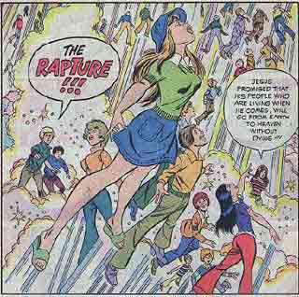
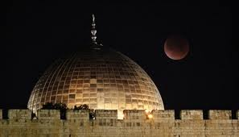
Yom Teruah = RAPTURE!
2008?
The Big
Speculation
of 2008!
End of Age
2015??
BLOOD
MOONS!!
Eclipses! =
Final seven years of the age?
Not!

Slide 122
The Fall Feasts of God are more serious than most carnal Christians care to know about. These are holy days. They are to be respected and treated with reverence. Biblical truths are not to be twisted by Christian or Messianic Bible prophecy populists and exploited for less than holy purposes. Bible truths are be handled with fear and trembling. Our Jewish brethren will tell us what the Teruah in Yom Teruah really means. They will also help us to understand just how serious are the life and death issues of repentance they themselves face up to in between those Fall Feasts during the days of awe, . . . if we take the time to ask them.
Notes:
The fact is Yom Teruah is an entrance into a time of refinement, an entre’ into a processing period of the soul. We can take that fact to the bank. So we should be suspicious when churchmen who are not diligent in the Holy Scriptures play loose and fast with the Feast of Trumpets/Yom Teruah. Our Hebrew roots are the holy things of God. They are to be respected, not twisted and exploited for profane purposes. The main bulk of Christendom is carnal. So we have OUR ideas about what WE THINK will be the event that will fulfill Yom Teruah. And we should be especially wary of buying into a line of preaching that is fondly held, popular, and lucrative

Slide 123
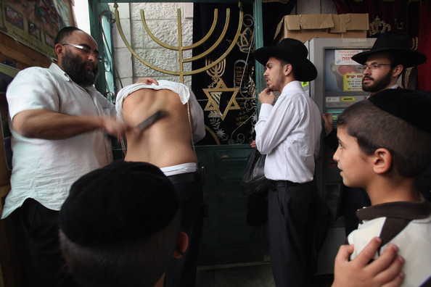

Slide 124
And so will our Bible Lexicon,
which is readily available online.
The Blue letter Bible is an excellent resource for the personal Bible study.
Notes:
The fact is Yom Teruah is an entrance into a time of refinement, an entre’ into a processing period of the soul. We can take that fact to the bank. So we should be suspicious when churchmen who are not diligent in the Holy Scriptures play loose and fast with the Feast of Trumpets/Yom Teruah. Our Hebrew roots are the holy things of God. They are to be respected, not twisted and exploited for profane purposes. The main bulk of Christendom is carnal. So we have OUR ideas about what WE THINK will be the event that will fulfill Yom Teruah. And we should be especially wary of buying into a line of preaching that is fondly held, popular, and lucrative

Slide 125


Slide 126
Every Christian believer is called to “study to show yourself approved unto God.”
Notes:
The fact is Yom Teruah is an entrance into a time of refinement, an entre’ into a processing period of the soul. We can take that fact to the bank. So we should be suspicious when churchmen who are not diligent in the Holy Scriptures play loose and fast with the Feast of Trumpets/Yom Teruah. Our Hebrew roots are the holy things of God. They are to be respected, not twisted and exploited for profane purposes. The main bulk of Christendom is carnal. So we have OUR ideas about what WE THINK will be the event that will fulfill Yom Teruah. And we should be especially wary of buying into a line of preaching that is fondly held, popular, and lucrative

Slide 127
“Study to shew thyself approved unto God, a workman that needeth
not to be ashamed, rightly
dividing the word of truth.”
- 2Tim. 2:15
Notes:
The fact is Yom Teruah is an entrance into a time of refinement, an entre’ into a processing period of the soul. We can take that fact to the bank. So we should be suspicious when churchmen who are not diligent in the Holy Scriptures play loose and fast with the Feast of Trumpets/Yom Teruah. Our Hebrew roots are the holy things of God. They are to be respected, not twisted and exploited for profane purposes. The main bulk of Christendom is carnal. So we have OUR ideas about what WE THINK will be the event that will fulfill Yom Teruah. And we should be especially wary of buying into a line of preaching that is fondly held, popular, and lucrative

Slide 128
So let’s face the truth. The Teruah is an alarm, a call to assembly before God. The Teruah, blown on Yom Teruah, takes us into the season of repentance. The purpose of Yom Teruah is very clear. It is a calling to assembly before God to prepare us for the final Day of Accounting up ahead As we listen to the Teruah shofar blast does it sound like the last call, the last trump? Does it convey any sense of climax or closure? No it does not. So if the Teruah is not the last trumpet blast then where
DO we hear that sense of climax and closure?

Slide 129


Tekia
Shevarim
Tekia Gedolah
Teruah!

Slide 130
Let’s stop here and listen again to
the Teruah. (Sound the Teruah)

Slide 131
(Sound the Teruah)

Slide 132
Now let’s ask ourselves this question. In those broken staccato notes of alarm, do we discern a spirit of finality, of closure? And in the musical character of the Teruah, do we sense the last call, the grand climax, the arrival of the Prince of Peace from heaven? And if not, is there another shofar blast that might fit the occasion better?

Slide 133
The Teruah
- - - - - - - - -
Tut Tut Tut Tut Tut Tut Tut Tut Tut
(Broken notes)
Yom Teruah
(Feast of
Trumpets).

Slide 134
Might it be in that fourth and final shofar blast, that long exhausting
and exhaustive great Tekia Gedolah?

Slide 135

Tekia
Tekia Gedolah!
Shevarim
Teruah

Slide 138
If we are honest with ourselves we have to conclude that the Teruah does not sound like the last trump. It is not the proper herald for the occasion. The highly broken staccato trumpet sound of the Teruah penetrates the soul like nothing else. It is an alarm, an urgent call to wake up, to assemble before God for a briefing. It is a call to repent, to change our mind, to prepare for a challenge that is now upon us. Biblically and historically the Teruah was blown in response to a clear and present danger or a major security threat. God has always used the Teruah to call His people
to Himself to prepare them to face a very significant turn
of events and to deliver them from an approaching enemy.

Slide 140
Elements of the Teruah are still with us today. They can be heard in our military bugle calls. These sharply disjointed notes signal the very same sense of alarm. They are a warning, a call to muster, to assembly, a call to prepare to take action, a call to a spiritual battle. See the previous video entitled. “Yom Teruah is an alarm!” Can
we really identify it with the Last Trump?

Slide 141




Slide 142
And what might be the cause for the sounding of such an alarm? Why the call to assembly before God? Well, as we know, the future 70th Week of Daniel is the most important future prophecy. So we definitely need to look there. Because Yom Teruah in the Fall season must be fulfilled for a reason.

Slide 143


Tenth Jubilee of the 70 Sevens
1st Coming
Look Here!
2nd Coming
2,000 Year Gap
*
Ju
Year of Jubilee

Slide 144
There is a HUGE campaign of disinformation set to cloak, to obfuscate, and to place a religious smoke-screen over the future 70th Week of Daniel. As we see
in Psalm 2, the nations will be raging as we approach the climax of the age. Quite clearly, the principalities and powers are terrified. These angelic rulers dread the end-time witness of the saints. And they tremble at the coming Judgment Day as Messiah returns at the end
of this age. So they storm violently at Daniel 9:27 and anxiously prod their human religious underlings to
block God’s message. They are desperate to make
the future 70th Week of Daniel “go away”.

Slide 145


Slide 146
Those final seven years are set to begin in some future year. God’s covenant people in both the Jewish and non-Jewish houses of Israel are simply not aware of this. They are either not tuned in to God’s program or they are asleep. So, all that being understood, might Yom Teruah be a time when the watchmen will blow the trumpet,
raise a shout, sound the alarm?

Slide 147
SOUND THE ALARM!!!
Yom Teruah
Tishrei 1
DAYS
of AWE
Day of Atonement
Tishrei 10
7
YEARS

Slide 148
Here outlined in Daniel 9:27 we can clearly see an occasion for an alarm. Those final seven years will be initiated by the confirmation of a seven year “covenant with many”.

Slide 149
“And he, (the prince), shall confirm the covenant with many for one week, (“one seven”), . . . .” - Dan. 9:27
The 70th Week of Daniel
Seven Biblical (360 day) years
Dan. 9:27
covenant confirmed

Slide 150
Daniel 9:27 is that fourth and final verse of Daniel’s prophecy of the 70 weeks. There we see that the starting gun for the final seven years will be the confirmation of a seven year covenant. This covenant, (or treaty), will be unprecedented. It will be a global agreement brokered between a
certain “prince” and “many”.

Slide 151

Daniel 9:27:
The confirmation
of a seven year
“covenant with many”.

Slide 152
Will this be an occasion for an alarm and a
“come to Jesus” meeting. We had better believe
it. Because Jesus tells us something about this “prince”. In John 5:43 Jesus declares that he will “come in his own name”. National Israel and the G-7 nations will confirm a seven year covenant with a man who is a consummate humanist, a narcissist, who cares not a whit about the Judeo-Christian God of Christendom or the God of Israel. Nor will he respect any loyalty to Christian nations or to “God and country”.

Slide 153

John 5:43
“I have come in my Father's name,
and you do not receive me.
If another comes in his own name,
Him you will receive.”

Slide 154
Our national leaders will have just signed away their national sovereignty to a global mega-dealer. Initially he will come onto the scene as a peacemaker. For three and a half years he will remain in the background until the time comes for him to be revealed for who he truly is.

Slide 155


Slide 156
Shadows of this appear in Greek and Roman pagan mythology. In Europe today we see frequent imagery of an ancient legend, the rape of Europa.

Slide 157



Slide 158
The woman, representing European peoples, is seen being carried off by
the chief of the pagan gods who
comes in the form of a bull.

Slide 159





Slide 160
The bull is an icon. But it
is not confined to Europe.
This bull is an ocean away,
enshrined by the mavens
of money on Wall Street.

Slide 161


Slide 162
The New World Order will initially be covered over and cloaked in a big show of materialism and religion. John saw a woman riding, but not on a bull. He saw a woman, a harlot, riding a
red colored beast with ten horns.
This was the same ten-horned beast
of the latter days that the prophet
Daniel had seen 600 years before.

Slide 163

Revelation 17 ³ I saw a woman sit upon a scarlet colored beast, full of names of blasphemy, having seven heads and ten horns. ⁴ And the woman was arrayed in purple and scarlet color, and decked with gold and precious stones and pearls, having a golden cup in her hand full of abominations and filthiness of her fornication: ⁵ And upon her forehead was a name written, Mystery, Babylon The Great,
The Mother Of Harlots And Abominations Of The Earth. ⁶ And I saw the woman drunken with the blood of the saints, and with the blood of the martyrs of Jesus:

Slide 164
John described what he saw in
Revelation 17. He was absolutely astounded at what he was seeing.

Slide 165


Slide 166
John saw the Harlot ruling, or trying
to rule the thing. This would have to
be during those first 1260 days of the
final seven years of the age. She rules during those first 3.5 years BEFORE
the abomination of desolation
starts the Great Tribulation.

Slide 167

The Harlot Years
1260 days
The Great Tribulation
1260 days
Abomination
of Desolation
Day 1260

Slide 168
Three and a half years after the 7 year covenant is confirmed the prince will be possessed by the beast demon of the Abyss, commit the abomination that makes desolate, and unseat the harlot. Then he will be revealed as the 666 Antichrist, a godless self-worshipping Luciferian. The hideous blasphemer against the God of heaven will then rule in his own right.

Slide 169


The Harlot Years
1260 days
The Great Tribulation
1260 days
Dan. 9:27
7 year
Covenant
confirmed
Abomination
of Desolation
Day 1260

Slide 171
So the significance of this momentous future seven year covenant of Daniel 9:27 cannot be overstated. This will
be an unprecedented national and international sovereignty sharing deal. For the first time in world history a
single man will confirm a covenant,
making a binding worldwide treaty.
So it must involve the G-8 nations!

Slide 172

Daniel 9:27
The New World Order
“And he will confirm a covenant with many for
one week, one seven, one sabbatical, (7 years).

Slide 173
If there is ever to be an epic awakening and a summons
sent out to all God’s covenant people to assembly before
Him then this day will certainly
be the one that calls for it.

Slide 174
15. Blow the trumpet in Zion, declare a holy fast, call a sacred assembly. 16. Gather the people, consecrate the assembly; bring together the elders,gather the children, those nursing
at the breast. Let the bridegroom leave his room and the
bride her chamber. 17. Let the priests, who minister before the Lord, weep between the portico and the altar.

Slide 175
We know that this megadeal will involve the nation of Israel because it is at the center of Bible prophecy. Presently this tiny little nation has been at the center of a maelstrom of anti-Semitic hatred, particularly from surrounding Islamic nations under the King of the South. Here shown in green is the principality of that wild green horse or pale horse rider, the one who hates Israel and loves death.

Slide 176


Slide 177
And here is a map of the Western NATO powers north of Israel, north of the Med. Western Christendom now dominates the G-7 nation group currently holding global rule. Will
this NWO deal involve Great Britain, Western Europe, and the USA?

Slide 178


Slide 179
Well let’s answer these questions. Is not the USA the current superpower? And does it not look like it is to be the last superpower to arise in Western Christendom before the New World Order rises up during those 7 years before Messiah comes?

Slide 181
And does not the Battle hymn of
the Republic show an abutment
of American history into the
Apocalypse of Messiah?

Slide 182


Slide 183
Our churchmen pat our shoulders and tell us no. America is not specifically mentioned by name in the Bible. End-time events will leave the US out of the picture, they say. And even if America was involved Christians are going to be raptured “outta here” before any untoward events take place. That’s what we are hearing. But look at this map of airline traffic right now. Just how involved is America and Western Europe, the NATO alliance, as we approach the latter days? Are we as Western Christians
really “not in the picture” as we are being told?

Slide 184


Slide 185
Look at this histogram of military expenditures. The top nation spends more money on its military than all the other nations in the world put together.

Slide 186


Slide 187
And there is no doubt about which
nation we are talking about here.
So are our Bible teachers correct?
Are the Western nations really
“not in the picture”
as they affirm?

Slide 188


Slide 192
Nebuchadnezzar's dream of the image with ten toes was interpreted by the prophet Daniel. Both Daniel and the Apostle John in the Book of Revelation saw the same beast, a beast with ten horns. Horns in Biblical symbolism speak of powers. What’s that all about?

Slide 193


Ten Toes
Daniel 2:33-34
Ten Horns
Daniel 7:7
Revelation 13:1
Revelation 17:3

Slide 194
Could it be this, a world divided into ten geo-political regions? We say our God declares the end from the beginning. Can awesome truths, even today’s news, be revealed in an ancient book? The Book
of Daniel is a virtual time-bomb of Biblical information. And for those who have
eyes to see, it is exploding in our time.

Slide 195


Slide 196
Our God knows all about us. He even knows all about the character of the countries we live in. We sing about our God being an awesome God. But in our hearts and minds and in the devotion that directs our will, just how awesome are
we willing for Him to be?

Slide 197

NWO Beast
France?
Germany
Russia
USA
Right Wing
USA
Left Wing
Great
Britain

Slide 199
Regrettably God’s covenant people are not taught to respect and study Bible prophecy. We are just not studying God’s Holy Word for ourselves. Many great end-time truths are sitting right there in front of us. But we are not awake enough to see them. The Western Church is asleep. She is in fact the quintessential Sleeping Beauty of literature, legend, and lore. And the poisoned apple of false religion is there in her mouth, doping her into a senseless state, lest she awaken to her glorious high calling.

Slide 200


Slide 201
So as we are beginning to see, we, as Western Christians, are out to lunch. So this Day of the Teruah, this wake-up call will be a very necessary one. The Feast of Trumpets will herald the beginning of the final seven years of this present evil age. This in turn
will lead up to the Day of Atonement.
Then follows Apocalypse, or unveiling
of Messiah in the Day of the Lord.

Slide 202


7 year
Covenant!
Dan. 9:27
The Last Day
Yom Kippur
Judgment Day
Day
Of
The
Lord
Wake up
time!
Yom Teruah
Day of Atonement
The Final 7 Years of This Age

Slide 203
We suffer from other big disconnects as well. Our Bible teachers tell us that the future time of Jacob’s trouble is just for Israel. Similarly they say that the Seventy Weeks prophecy was a message for “Daniel’s people”, i.e. the Jews. But Biblical prophecy is not limited to the royal Jewish house of Judah or just the land of Israel as we have being told. Daniel’s people are a much bigger company. The promise given to Abraham was that His Seed (singular), (who is Christ), would become a ”melo-hagoyim”, a huge multitude of Gentiles or nations more numerous than the stars of heaven.

Slide 204

^{Gen. 17:3-5}
³ And Abram fell on his face: and God talked with
him, saying, ^{4 ”}As for me, behold, my covenant is
with thee, and thou shalt be a father of many
nations. ⁵ Neither shall thy name any more be
called Abram, but thy name shall be Abraham;
for a father of many nations have I made thee.”

Slide 205
In Galatians 3:29 our Apostle Paul confirms this identification. He says quite plainly that those who are
in Christ are by virtue of their union with Him now Abraham’s Seed.
They have become “heirs
according to the promise.”

Slide 206
Galatians 3:29 King James Version
“And if ye be Christ's, then are ye Abraham's
seed, and heirs according to the promise..”
Young’s Literal Translation
And if ye are of Christ then of Abraham ye are
seed, and according to promise -- heirs.
Aramaic Bible in Plain English
And if you are of The Messiah, you are therefore
the seed of Abraham and heirs by The Promise.

Slide 207
That promise given to Abraham was of a land with a Holy City not made with hands, and a multitude of descendants. Abraham was given that promise right back at the beginning. If
we are ”in Christ” then we are the children of Abraham and just as much a part of Daniel’s people as the people of faith who went before us. If Christ, the Seed of Abraham, is within us, then that promise and the responsibility
that goes with it too!, is ours.

Slide 208

A melo-hagoyim,
a multitude of descendants..
A Land, and a Holy City
not made with hands.
²⁹ And if ye be Christ's, then are ye Abraham's seed, and heirs according to the promise. - Galatians 3:29

Slide 209
Our apostle Paul unveils our identity in Christ even further in Ephesians 2:12-13. There we read that through the atoning
blood of Christ people from any
nation, race, or tribe come into the Commonwealth or citizenship of Israel.

Slide 210


Slide 211
So even if our country is dissolved in
a New World Order or we are exiled,
or worse, we are not without hope. Because in Christ we do in fact belong to another country. We can even be issued with a new and very wonderful passport. And our pilgrimage towards that ultimate “city upon a hill” goes on.

Slide 212


Slide 213
Here is that hidden scripture
outlining the basis for our citizenship in Israel. It comes through the blood
of Christ. This is something no-one wants to talk about. If you wish you can pause the video and take a close look at what God is telling us here.

Slide 214
¹² That at that time ye were without Christ, being aliens from the commonwealth / citizenship of Israel, and strangers from the covenants of promise, having no hope, and without God in the world:
¹³ But now in Christ Jesus ye who sometimes were far off are made nigh by the blood of Christ. - Ephesians 2:12-13.

Slide 215
In Isaiah 49:6 we read that Greater
Israel is destined to become a huge international company. Daniel’s people include all who have seen the Light, and been apprehended by the Servant of Israel. Christ is that Light to the Gentiles. The Light shines in the darkness, across space and time to the ends of the
earth and to the end of the age.

Slide 216
⁶ And he said, It is a light thing that thou shouldest be my servant to raise up the (12) tribes of Jacob, and to restore the preserved of Israel: I
will also give thee for a light to the Gentiles, that thou mayest be my salvation unto the end of the earth.
- Isaiah 49:6

Slide 217
In Revelation chapter 7 John sees the 12 tribes of Israel restored and a special company of 144,000. Then the spotlight moves on to the Tribulation Saints, and an innumerable multitude from every nation, race and tribe. All of them
are wearing white robes.

Slide 218


Slide 219
So Christ our Messiah will be gathering in
all who are His at the end of the age. And
as we have seen, the timeline of the final seven years fits precisely between those first two Fall Feasts. From ancient times
the days between these two feasts have been called the days of awe. They cap
off the season of repentance our Jewish friends rehearse every year.

Slide 220
The Final 7 Years of this age
= 1260 + 1290 = 2550 days
Feast of Trumpets
Tishrei 1
Day of Atonement
Tishrei 10
Days of Awe
(7 years)
The inclusive Timeline bridging those Fall Feasts is also precisely 2550 DAYS!

Slide 221
Those ten days between the feasts are
a season of fasting and sanctification. And from Yom Teruah, or the Feast of Trumpets, the Days of Awe
run up to peak on Yom Kippur,
the Day of Atonement.

Slide 222
Yom Teruah
Tishrei 1
TEN DAYS
of AWE
Day of Atonement
Tishrei 10
A Period of DEEP REPENTANCE

Slide 223
So might those final seven years bridging these feasts also be a period of soul searching and of deep repentance, perhaps the ultimate Days of Awe?

Slide 224
Yom Teruah
Tishrei 1
DAYS
of AWE
Day of Atonement
Tishrei 10
7 Years of DEEP REPENTANCE

Slide 225
God states that the 70 Weeks of Daniel are the times He Himself
has determined, made holy, or cut out of time. So the final 7 years of the prophecy have been set apart for dealings related to both His
Holy City and His Holy People.

Slide 226
Daniel 9:24
Seventy weeks are determined upon thy people and upon thy holy city

Slide 227
Repentance may not be popular but it is very necessary. God chastens us. He wants to develop His character in us. Will we wrestle with God over the same issues our father Jacob did? Probably so. The issues of the latter days are monumental. But these trials and tribulations are not the wrath of God upon us. They bring the very necessary refining to change us from shifty dodgy Jacob to Israel, one who has contended and become a prince with God. Back in the former time Jacob underwent this character change through wrestling with the Angel of the Lord. He struggled with Him all through a dark night of the soul. For us, it will be no different. Because we, the Judeo-Christian people, (and not just our Jewish brethren), are that tricky shyster Jacob. That state of affairs has to change. And by the prophesied trials, tribulations, and refining it will change.

Slide 228


Slide 229
So why is God doing all this? If we look at the burdens of the 70 Weeks prophecy we find out. The final seven years will come to their appointed climax. And just what will God have achieved in and through His covenant people by their witness and by His climactic return? Here are the bullet points that will wrap up God’s agenda. When these jobs are done our Messiah will have returned and be all set to establish His Millennial Kingdom.

Slide 230
1. to finish the transgression,
2. to make an end of sins,
3. to make reconciliation for iniquity,
4. to bring in everlasting righteousness,
5. to seal up the vision and prophecy,
6. and to anoint the most Holy.
- Dan. 9:25

Slide 231
So the days of awe, this season of
soul searching and repentance is
very necessary. And it begins on
Yom Teruah, the Feast of Trumpets.
It runs on up through the days of
awe to terminate on the ultimate
Day of Atonement, Yom Kippur,
at the end of this age.

Slide 232

³¹ The sun shall be turned into darkness, and the moon into blood, before the great and terrible day of the Lord come.
³² And it shall come to pass, that whosoever shall call on the name of the Lord shall be saved / delivered: for in mount Zion and in Jerusalem shall be deliverance, as the Lord hath said, and in the remnant whom the Lord shall call.
Joel 2:31-32
The Days of Awe

Slide 233
Now let’s look at another big clue to understanding the Feast of Trumpets.
Going back to the former times Yom
Teruah has been referred to by the idiom, “the opening of the gates”.

Slide 234

Yom Teruah
The Feast of Trumpets
The
Opening
of the
Gates

Slide 235
The God of the Bible talks a lot about entering into His gates. And there are lots of sacred songs about this. Who are these people who will enter in through the gates? Here in this verse the God of Israel through the prophet Isaiah in
Isaiah 26:2 says that
“the righteous nation that preserves
and upholds the truth will enter in.”

Slide 236

Open ye the gates that
the righteous nation which keepeth the truth may
enter in.
- Isa. 26:2

Slide 237
In the book of Lamentations the prophet Jeremiah laments the destruction of Jerusalem He especially laments God’s covenant people being cut-off from the feasts.

Slide 238

“The ways of Zion do mourn, because none come to the solemn feasts: all her gates are desolate: her priests sigh, her virgins are afflicted, and she is in bitterness.”
- Lam. 1:4
The Prophet Jeremiah

Slide 239
2600 years later this same lament is still just as applicable to us today. And here we are. Nothing much has changed since Jeremiah made that statement. And even today with the best churches and speakers that money can buy how many of God’s people gathered in big mega-churches like
this are being properly prepared for the latter days? How many even open up their Bibles or access the free online Lexicons to learn about the momentous future fulfillment of Yom Teruah?

Slide 240


Slide 241
Well, our God, the God of Israel is well aware of this and about to change all that. He is about to open up the gates. He wants to invite His covenant people to walk on in fellowship with Him. But it is a strait and narrow gate. Our entry will require some adjustments on our part. So who is going to help us here?

Slide 242


Slide 243
It seems the Holy One of Israel has made some special arrangements for us. With the Teruah there is good news. This sad state of affairs is about to change. On a blockbuster future
Feast of Trumpets, Yom Teruah
the watchmen will sound the call.

Slide 244


Slide 245
God will give His people strength for the journey and grace for the trials. He will provide help from above, unfailing sympathy, undying love.
All this will happen, as they answer the call and assemble before Him,
. . and Him alone.

Slide 246


Slide 247
On that spellbinding future Yom Teruah He will be opening wide the gates! He will be calling all men to His great salvation and preparing them for their great
and glorious calling.

Slide 248
Yom Teruah
The Feast of Trumpets
The
Opening
of the
Gates

Slide 249
But what happens when God’s people are overwhelmed. What do they do when they burnout and can’t go on in their own strength? Well here Christian and Messianic believers are blessed. They are under the unconditional Abrahamic covenant. So He will be carrying them across the thresholds of their lives just as He took the burden for our Father Abraham when he and God made covenant together. He will carry them
across the threshold and on towards their
glorious eternal destiny with Him.

Slide 250


Slide 251
The scriptures tell of people from many heathen Gentile nations
coming up to Jerusalem. They are received in the court of the Gentiles.

Slide 252

Therefore thy gates shall be open continually; they shall not be shut day nor night; that men may bring unto thee
the forces of the Gentiles,
- Isaiah 60:11

Slide 253
Then they go on to enter into the court of Israel where they see the brazen altar and the brass laver. How then can they go through that inner gate to be admitted into the sanctuary? How are they adopted into that one single righteous nation Israel, a nation that keeps the truth?

Slide 255
Apparently there is some sifting and some refining going on in the outer court of the Gentiles. The brass altar is out there, and the brazen laver for the washing of feet and hands. The prophet Ezekiel tells of a people then passing through an inner gate into the inner court. This inner court is variously described as the Court of Priests or the Court of Israel.

Slide 256


Slide 257
This scripture passage from
Ezekiel 44:17 describes the
future Millennial Temple. It speaks of linen garments and sheds some further light on this subject.

Slide 258
“And it shall come to pass, that when they enter in at the gates of the inner court, they shall be clothed with linen garments; and no wool shall come
upon them whilst they minister in the gates of the inner court, and within”.
(i.e. the sanctuary).
- Ezekiel 44:17

Slide 259
And why are these people inside
the court of Israel all wearing fine
raiment or white linen garments?
What is the meaning of fine white linen raiment in Biblical symbology? This is clearly interpreted for us in Revelation 19:8. The fine linen is
the righteousness of the saints.

Slide 260
And to her was granted that she should be arrayed in fine linen, clean and white: for the fine linen
is the righteousness of the saints.
- Revelation 19:8

Slide 261
And in the previous verse, Revelation 19:7 we see another clue that helps us understand the meaning of the “fine linen, clean and white.” It seems to be a picture of the white raiment worn by a bride as she prepares to go to her wedding. The imagery here is showing the ultimate holy or set-apart state of God’s covenant people as they go out through a dark night to meet the Bridegroom.

Slide 262

“Let us be glad and rejoice, and give honour to him: for the marriage of the Lamb is come, and his wife hath made herself ready.”
- Revelation 19:7

Slide 263
We get another view of this matter of preparation with the story Jesus told us of a wedding party preparing to go out to meet the Bridegroom. It is the parable of the ten virgins. Some were prepared. And some were not.

Slide 264


Slide 265
In Revelation 21 we see the Bride of the Lamb positively identified for us as the Holy City, the New Jerusalem, and within the City all her People.

Slide 266


Slide 267
The City is built of living stones not made with hands. John is told of things beyond the three dimensions. He tells of spiritual realities we do
not yet comprehend or understand.

Slide 269
So Yom Teruah is an entrée into a time of refinement and consecration. There is a major clue to Yom Teruah in Joel chapter 2. The God of Israel is calling all His people to assembly. So during those final seven years the God of Israel will be gathering His Elect. He will be calling all His people to sanctify themselves before Him because He will soon be returning as King of kings. True priests and ministers will be like the rest of us. They will be repenting, weeping between the porch and the altar.

Slide 270
Joel 2: ¹⁵ Blow the trumpet in Zion, sanctify a fast, call a solemn assembly: ¹⁶ Gather the people, sanctify the congregation, assemble the elders, gather the children, and those that suck the breasts: let the bridegroom go forth of his chamber, and the bride out of her closet. ¹⁷ Let the priests, the ministers of the Lord, weep between the porch and the altar,

Slide 271
A time of refining is not as “negative” as
we might think. And God’s true covenant people will not fall away in anger. For
them it may be a season of good grief but not bad grief. The refining will be as the refining of linen, like a heckling of flax with a heckle. The impurities are removed to make fine linen for white raiment.

Slide 272


Slide 273
Our verse in Joel 2 speaks of the
Trumpet being blown on “a day of clouds and thick darkness”. Have
we heard any mention of a day of
clouds and thick darkness before?

Slide 274
“Blow ye the trumpet in Zion, and sound an alarm in my holy mountain: let all the inhabitants of the land tremble: for the Day of the LORD cometh, for it is nigh at hand; A day
of darkness and of gloominess, a day of clouds and of thick darkness, . .”
- Joel 2:1-2a

Slide 275
Indeed we have. In Ezekiel 34:12 we read, “As a shepherd seeks out his flock in the day that he is among his sheep that are scattered; so will I seek out my sheep, and will deliver them out of all places where they have been scattered in the cloudy and dark day.” This is our God of mercy at work. This is what He will be doing even in the midst of the Great Tribulation as the dreadful Day of the Lord draws near.

Slide 276
As a shepherd seeketh out his flock in the day that he is among his sheep that are scattered; so will I seek out my sheep, and will deliver them out of all places where they have been scattered in the cloudy and dark day.

Slide 277
So why is the Holy One of Israel opening the gates and bidding His people to go through the gates at the time of Yom Teruah? In Isaiah 62 we see He is clearing a highway. He is lifting up a standard for the people. It seems that He wants to gather in as many people as possible into His arena of sancti-fication and refinement. Because the end of the age draws near. And with it comes the Judgment. On the Day of Atonement time will have run out. Then the Day of the Lord will open up and He will loose and send forth the angels of the harvest.

Slide 278
Go through, go through the gates; prepare ye the way of the people; cast up, cast up the highway; gather
out the stones;
lift up a standard
for the people.
- Isa. 62:10

Slide 279
The song
“Go through the gates”

Slide 280
So will the Feast of Trumpets herald the Resurrection-Rapture as most of our dispensational churchmen are saying? At
this point in our study we see no evidence
for that. It seems that a day is coming that will shake all nations. In the Teruah shofar blasts God will be calling all men to be holy or “set apart” to Him. Like a loving father with His children, our God wants to gather and spend some “quality time” with His covenant people.

Slide 281


Slide 282
If God wants to save as many people as He can why are we, His people, destined for a rough passage? Perhaps He needs us. Perhaps He wants all hands on deck, even as a captain needs his crew to stay with him during a tempest. Acts 27 describes the shipwreck of the Apostle Paul. The ship was in a tempest and caught against a lee shore. Four anchors from the stern barely held the ship. At midnight Paul saw a strange sight. The crew were furtively lowering the lifeboat. The voyage was coming to its final frightening climax. And they were deserting to save their lives. The Apostle Paul took a dim view of this. He alerted the captain who put a stop to the cowardly act. The crew had been commissioned to serve to the end of the journey.

Slide 283


Slide 284
How about us as born-again
Biblical Christians? When does
our journey end? When does
our commission expire? Is it at the
end of the age? Or is it seven years before that? Should we take this document, the Great Commission, to our lawyer and ask him to tell us? Or can we read what is written ourselves?

Slide 285
The Great
Commission
¹⁹ Go therefore
and make disciples
of all the nations,
baptizing them in the name of the Father, the Son, and the Holy Spirit, ²⁰ teaching them to observe
all that I commanded you;. And Lo, I am with you always, even to the end of the age. - Mat. 28:19-20

Slide 286
“The opening of the gates” is a time of soul searching, tears, and repentance. But there is joy as well. In the Psalms we read the songs of ascent. We sing about entering His gates with thanksgiving in our hearts and entering His courts with praise. Just as Hosea did with wayward Gomer, God is wooing us back to Himself. He is drawing us, calling us to go up on that highway of holiness and to meet with Him in His sanctuary. In the Hebrew dancing we hear songs of joyful invitation to “Go through the gates”, and “prepare the way of the people”. The God of Israel is throwing open the gates to His Holy Place. He wants us go up to Zion in joyful praise. This is another wonderful item of Hebrew art by Yossi Rosenstein. His works can be found online at art.com.

Slide 287


Slide 288
By now we are starting to get an idea of where this all ends. The days of awe come to a climax and end on Yom Kippur, the Day of Atonement. In Hebrew tradition this is the last chance to repent for that year. As the sun sets on this Day of Reckoning this awesome moment of closure is referred to by the well known Hebrew idiom, “the closing of the gates”.

Slide 289

Yom Kippur
The Day of
Atonement
The
Closing
of the
Gates

Slide 290
Now lets take a closer look at the terminus of those 7 years. That
fearful final Day of Atonement.

Slide 291
The Final 7 Years of this age
= 1260 + 1290 = 2550 days
Feast of Trumpets
Tishrei 1
Day of Atonement
Tishrei 10
Days of Awe
(7 years)
The inclusive Timeline bridging those Fall Feasts is also precisely 2550 DAYS!

Slide 292
This is also referred to and alluded to
in Scripture as the Day of Reckoning,
Day of Sentencing, Day of Pardoning,
Day of Accounting, Day of Reconciliation,
or in other words, Judgment Day!

Slide 293


Slide 294
Our search for the true meaning and the fulfillment of the Day of Atonement takes us to the synagogue.
Our Jewish friends rehearse that ultimate fulfillment during the annual celebration of Yom Kippur. The final service of Yom Kippur taking place towards sunset is called the Neilah. Rabbis say that as the awesome day of Yom Kippur comes to a close their future is being sealed. They turn to God to accept their sincere repentance and new resolutions. They ask that He seal them in the Book of Life, granting them a new year replete with goodness and happiness.

Slide 295


Slide 296
The Ark housing the Torah scrolls remains open right up until the end of the Neilah service, signifying that the Gates of Heaven are still wide open for prayers
and entreaties.

Slide 297


Slide 298
After a final declaration of faith, the shofar sounds climactically with the Tekia Gedolah. Then after some closing prayers the service ends with an awesome moment of closure. Neilah means "closing the gate." As the Neilah service ends the doors to the ark are closed. At that point the clock has run out. There is no more time to have your name inscribed in the Book of Life. As the sun sets on this awesome Day of Judgment those present in the synagogue feel the weight of this awesome moment of finality. Yom Kippur is a rehearsal for that ultimate future Judgment Day when on the last day of this age we stand face to face with God. This an aspect of our Hebrew roots well worth knowing about and actually experiencing.

Slide 299


Slide 300
So here we have some more pieces of the puzzle indicating very strongly that the Fall Feasts do in fact initiate and terminate a very significant future time period marked by repentance. It begins with Yom Teruah which is linked to the “opening of the gates” and ends with the Day of Atonement, or Yom Kippur which features the “closing of the gates”. This is further strong evidence that these two yet to be fulfilled Fall Feasts do provide the appropriate settings for these epic future events as well as mark out a precise timeline for the final 7 years of this age.

Slide 301

The Final 7 Years of this age
Yom Teruah
Tishrei 1
(The Ultimate
“Days of Awe”)
Day of Atonement
Tishrei 10
7 years
The
Opening
of the
Gates
The
Closing
of the
Gates

Slide 302
Now let’s look at the Day of Atonement as a LEGAL MATTER. This final judgment will be handed down by Christ our Messiah and nobody else. So then, is this not the Judgment Seat of Christ? As we saw, Yom Kippur is a rehearsal for a final Judgment Day. And in some future year the tenth day of Tishri will in fact erupt into holy history and world history as the long awaited Day of Reckoning.

Slide 304
As we have seen, the Day of Atonement is looking very much like it will be the last day of this present evil age. Most would agree that the very idea of Judgment Day conveys a definite sense of finality and closure. And when the sun sets on the Day of Accounting the Day of the Lord will then open up to EXECUTE the Judgment. With this will
come our transport and our assignment
to a new destiny, hopefully a good one.

Slide 305
7 year
Covenant!
Dan. 9:27
The Last Day
Yom Kippur
Judgment Day
The
Day
of
the
Lord and
the Harvest
Yom Teruah
- Trumpets
Day of Atonement
The Final 7 Years of This Age

Slide 306
Yes, Judgment Day is the end of the road for this age, the end of the term, and
the final exam the day in which we pass or fail. After this school “breaks up”. It is very important for us to understand that
there are two parts to a judgment. The first part is the legal judgment or the
verdict handed down by the court.

Slide 307

The Judgment:
Step 1
The
Legal
Decision,
the
Judgment,
or Verdict

Slide 308
We all stand guilty before God. Without a an atonement, without someone standing in the gap for us on That Day we will be of all men most miserable.

Slide 309


Slide 310
Without a personal covering for sin
on that ultimate Day of Reckoning
our guilty state before a holy God will condemn us to eternal damnation.

Slide 311

The Judgment:
Step 1
The
Legal
Decision,
Judgment,
or Verdict
Condemned!

Slide 312
The Scriptures are very plain here. “How shall we escape, if we neglect so great a salvation.”
- Heb. 2:3

Slide 313


Slide 314
On that future Day of Accounting those who know Messiah as Savior and Lord will be justified. This justification is not based upon
any good works we have done.
So how then can we be saved?

Slide 315
The Judgment:
Step 1
The
Legal
Decision,
Judgment,
or Verdict
Justified!

Slide 316
The Elect, the Chosen people from both sides of Calvary, are all saved the same way. They are saved by God’s grace through their faith in the shed blood of Israel’s promised Sacrifice Lamb. This is the blood we saw featured back in the Spring Feast of Passover. The blood of Israel’s Sacrifice Lamb is ultimate and final blood of atonement. That blood was shed 2000 years
ago by our Messiah in His first coming in
His priestly role as the Suffering Servant.

Slide 317


Slide 318
Judgment Day will surely come, for all of us. For some the verdict will be “guilty as charged”. For others the verdict will be “not guilty”. Then we come to Step 2 which is the EXECUTION of that judgment. Those who have been justified by faith in our Lord Jesus will be released to Eternal Life. Those who have rejected or neglected Him will be condemned to death
and to eternal separation from God.

Slide 319

Step 1
The Legal
Judgment
Step 2
EXECUTION of Judgment
Life
Death

Slide 320
We see these same two stages of a judgment in our courts here below. First comes the legal judgment or sentencing then comes the execution of that legal judgment. How is a judgment executed? In blood covenant cases the person standing trial will either be pardoned or condemned. The execution of the judgment will be either the release of the person or death.

Slide 321

Step 1
The Legal
Judgment
Step 2
EXECUTION of Judgment
Life
Death

Slide 322
Here on the left is a legal judgment concluding with a verdict and a sentencing handed down by the court. This was one of the Nurenberg trials for a Nazi war criminal. The legal judgment is over on the left. This officer was found guilty of war crimes and sentenced to death. Over on the right we see the execution of that prior judgment. The condemned man was taken out to the gallows and hanged.

Slide 323

Step 1
The Judgment
(Sentencing)
Step 2
The Execution
(of Sentence)

Slide 324
So. We have a legal judgment and we have a an execution of that judgment. Which one comes first? And which one comes after it?
We all should know the answer to that question. In point of fact we all do know it. We know it very well.

Slide 325
Step 1
The Judgment
(Sentencing)
Step 2
The Execution
(of Sentence)

Slide 326
Here we have a happier legal judgment and after that we have a much happier execution of that judgment. In this case a man charged with a crime was found “not guilty”. Evidence involving blood and DNA had proven him innocent and he was pardoned. So here the execution of a judgment was the release of the prisoner. This was a touching story. The previously condemned man and the advocate who had worked tirelessly to secure his justification and release fell in love with each other and married. Wouldn’t it be wonderful if Christians fell in love with the Advocate who has loved them and saved them.

Slide 327


Step 1
The Legal
Judgment
Step 2
The Execution
of the Judgment

Slide 328
So does an execution of a judgment precede the judgment? Does a man’s hanging or his being set free come before his day in court or after his day in court? Well we know the answer to that question very well. An execution should always follow a proper legal judgment, right? This is the normal procedure of righteous law. We have seen this sequence played out many times.

Slide 329
Step 1
The Legal
Judgment
Step 2
EXECUTION of Judgment
Life
Death

Slide 330
OK, now, let’s look at our own day in court, our own Judgment Day. Our Judgment and that of everyone else will come down on the Day of Atonement, on the last day of this age. Let’s consider the sequence we should expect for Judgment Day. Then lets ask ourselves when we might reasonably expect the execution of that judgment.

Slide 332
The execution of all the verdicts handed down at Judgment Day will follow quickly. At sunset of that last day of this age the Day of the Lord will open up. The heavens will unfold as a scroll, space-time will unzip and a vortex will open up between heaven and earth. This will be the opening of the Day of the Lord. Out of this portal his will come angels of the Harvest Jesus spoke about in Matthew 13.

Slide 333


Slide 334
We are ALL going before the throne
of God on that last day to face the Judgment. An idiom for the Day of Atonement is this matter of being “face to face” with God. No one passes into their eternal destiny without passing by Messiah at the Judgment Seat of Christ.

Slide 335


Slide 336
The Bible lays this out very clearly.
In 1Corinthians 5:10 we read; “For we must ALL appear before the judgment seat of Christ, that everyone may be recompensed for the things done in His body, according to what he has done, whether it be good or bad.”

Slide 337
“For we must ALL appear before the judgment seat of Christ, that everyone may be recompensed for the things done in His body, according to what he has done, whether it be good or bad.”

Slide 338
And no unsaved adult living mortal person alive on this earth at the end of this age will enter the Millennium of Messiah without going through the
Sheep-Goat Judgment.

Slide 339


Slide 340
So the Judgment will come at the end of this age. After the judgment comes the execution of that judgment. This is precisely the same sequence of events we see in courts all around the world. It is the pattern we have seen since ancient times. After Messiah renders His judgment the harvest angels will be loosed to execute the judgment.

Slide 342
How will Messiah judge us? Will it be on the basis of the preponderance of our good works? No, every person falls short there. As the Scriptures declare, “All have sinned and come short of the glory of God” and “There are none righteous, no not one” and “All our works of righteousness are as filthy rags.” So then. By what means then can we hope to be justified before a holy God?

Slide 343


Slide 344
The Bible declares that it is
“Not by works
of righteousness
that we have done
but according to His
mercy He saves us.”

Slide 345


Slide 346
So then, just how are we to avail ourselves of God’s mercy? How are we
to be saved from the wrath to come?
In Ephesians 2:8-9 our Apostle Paul declares, “For it is by grace that you have been saved, through faith, and that not of yourselves, it is the gift of God, not
of works, lest any man should boast.”

Slide 347


Slide 348
So God has extended His grace to us. But how can a just God let us off the hook? The wages of sin is death. And all of us are guilty sinners. Who is going to be covering for us here?

Slide 349


Slide 350
It is a fearful thing to fall into
the hands of the Living God. Remember what happened back
at Sinai? Moses had to put up boundary markers to protect the children of Israel lest God’s wrath flash out. They could not even approach the mountain of God.

Slide 351


Slide 352
This wonderful image is by the
Jewish artist Eizen. I purchased a print of this from Dov at the bookstore in the Jewish quarter of Jerusalem.
Prints like this and many others are available online at art.com.

Slide 353


Slide 354
So how can we come face to face with the Judge of the Universe given our sinful fallen state? How are we to be justified before a righteous holy God? Who is covering for us here? And just how is our Savior covering for us on Judgment Day?

Slide 356
Covering is the key to our understanding. The Day of Atonement is a Day of Covering for sin. This is a kippah, in Jewish tradition and symbology it is a covering for the head. This is a wonderful reminder for us of our sinful condition before a holy God and our need for a covering before Him. But on that awesome Day of Reckoning, Day of Reconciliation of Accounts, Day of Atonement, we are going to need more than a kippah. How then can we
hope to be saved from the wrath of God?

Slide 357


Slide 358
We find our answer here. The Ark of the Covenant was showcased in the former times under Moses and under the Levitical priesthood. The High Priest went into the Holy of Holies to minister here once a year. That day happened to be the Day of Atonement, Yom Kippur, the Day of Covering. The two angels are looking down at the mercy seat that sits atop the Ark. Are these the two witnesses that before the Lord of the earth? Certainly they are shown here being witness to a climactic blood atonement that will ultimately unfold up in the heavenly sanctuary.

Slide 359


Slide 360
And this is where that blood of atonement came from. Our Savior was Israel’s promised Sacrifice Lamb, slain from the foundation of the world. This blood, shed at Calvary on Passover by the sinless spotless Lamb of God purchased our salvation. This blood is the only blood that can cleanse us from sin. This blood is the only blood covering acceptable for that ultimate atonement. Was the blood shed back at Calvary applied to the mercy seat right then and there? Was the blood of atonement applied to the mercy seat when we were saved? No it was not. This ultimate final service performed by our High Priest awaits the final ingathering, and the ultimate Day of Atonement.

Slide 361


Slide 362
We can trace the blood of the Lamb of God in the Seventy Weeks prophecy from the terminus of the 69 weeks and Calvary and then onward across
a gap of 2,000 odd years. The future 70th Week will end and on the Day of Atonement the blood of atonement will be applied to the mercy seat.

Slide 363

10th Jubilee cycle of the 70 Weeks
The Blood is shed
The Blood Applied
2,000 Year Gap
Ju
Jubilee Year

Slide 364
And similarly in the layout of the Tabernacle we can see at the altar the Lamb of God slain from the foundation of the world. And on the Yom Kippur service showcased there we see the blood of the Sacrifice Lamb as it is carried on into the Sanctuary, through the veil, and into the Holy of holies to the Ark and the mercy seat.

Slide 365

The Melchizedek Priesthood
overlays the Levitical Priesthood.
1st Coming
2nd Coming
On a future Day of Atonement in the heavenly Tabernacle the blood of Jesus our Messiah, Israel’s promised Sacrifice Lamb will be sprinkled on the mercy seat atop the Ark of the Covenant.
Follow the blood of the Sacrifice Lamb from the Brazen Altar and at Calvary and on into the Holy of Holies.

Slide 366
Every year the High Priest entered beyond the veil into the most Holy Place. We need to be respectful of God’s order of things. There is only one day in the year in which the blood of atonement could pass through curtain and into the Holy of Holies. That Day is Yom Kippur. God is telling us something here. Yeshua’s High Priestly ministry at the Holy of Holies cannot happen on just any old day. The final atonement must occur on the Day of Atonement! This is the set time, the appointed time when the Presence of God is manifest over the Mercy Seat in the Holy of Holies.

Slide 367

Tishri 10
Yom Kippur
The Day of Atonement
The high priest enters the Holy of holies.

Slide 368
The general theme and an idiom for the Day of Atonement is this matter of coming face to face with God. At the end of the age we must all present ourselves before the Ancient of Days. But we cannot even hope to approach Him without a covering, an atonement for sin. The name, Yom Kippur, Day of Covering, points to the necessity of a person being covered on that awesome day

Slide 369


Slide 370
If we are to come before God face to face without His covering then our sins, our debts, our transgressions will be our doom. Unless an intermediary, Somebody who is without sin, provides a blood covering for our sin, God’s wrath will surely fall on us and we shall be totally and absolutely damned!

Slide 371


Slide 372
But for those who have by faith surrendered themselves to Jesus / Yeshua the judgment will be a happier one. Because Jesus is our High Priest after the Order of Melchizedek. And on an epic future Yom Kippur He will provide that blood covering for all of us. On that Day our Messiah will sprinkle His own blood, the ultimate blood covering on the mercy seat in the Heavenly Sanctuary.

Slide 373


Slide 374
And on That Day, all the previous blood sacrifices offered up by faith to God in all the times past before and under the Levitical Priesthood will be covered. Under the Old Covenant the children of the faith of Abraham were saved just as people are saved today. They were justified by faith, faith in God and in what He had spoken. And for those who believed it was counted for them as righteousness. People were never saved by the blood of these animal sacrifices per se. These were a show-and-tell of an ultimate sacrifice yet to come. It was not by the keeping of the law but by God’s grace through faith that they were saved. The ultimate blood covering and the final atonement
for sin, was to be provided in a time yet future.

Slide 375


Slide 376
God was not looking for the blood of bulls and goats and sheep. And with His friend Abraham God was not looking for the blood of Isaac to be shed. He was looking for a sacrificial willingness of heart and a declaration of faith in his partner Abraham. God asked him to surrender up the very thing most
dear to his heart, his only son. When God saw that Abraham was willing to do this it was enough.
He sent the angel to stop the sacrifice. In the two way but unconditional Abrahamic Covenant, God would then send His son to be our Sacrifice Lamb.
Notes:
Raham

Slide 377


Slide 378
Abraham was then given a wonderful promise, that great salvation verse from the Old Testament. He was told, “God will provide HIMSELF, a Lamb.” He looked around and saw the lamb caught in the briars. The thorns were wrapped around His head. This was a foreshadowing of the ultimate future Sacrifice Lamb.

Slide 379

⁷ And Isaac spoke to Abraham his father, and said, “My father:” and he said, “Here am I, my son.” And he said, “Behold the fire and the wood: but where is the lamb for a burnt offering?” ⁸ And Abraham said, “My son, God will provide HIMSELF a lamb . . .” ¹³ And Abraham lifted up his eyes, and looked, and behold behind him a ram caught in a thicket by his horns: and Abraham went and took the ram, and offered him up for a burnt offering in the stead of his son.

Slide 380
At the set time the spotless Lamb of God was provided from heaven. As was foreshadowed the thorns were wrapped around His head. Our Lord Jesus would shoulder the cost of our redemption. His blood would purchase salvation for the sinners that we all are. This blood of the Lamb covers and justifies us before a holy God. Only by this blood can
we face the Judge and hope to have Him hand down to us a verdict of “not guilty”.

Slide 381


Slide 382
The cutting of a covenant brings the blood of atonement. This brings peace between God and man. Men of faith have always known that through the blood God will provide for them. The patriarchs of old all understood by. It is a central theme throughout Holy Scripture. Our spiritual father Abraham showcased this blood covenant with Yehovah-God 4,000 years ago. It was an unconditional blood covenant cut between God and Abraham’s family of faith. This faith in the atoning blood of Israel’s Promised Sacrifice Lamb
is the essence of the New Covenant.

Slide 383


Slide 384
Faith in the God who provides the ultimate blood of atonement is the foundation for the Everlasting Covenant. The blood of the animals was never the object. The sacrifices served only to showcase the gravity of our transgressions. Before we can walk with God we need to see the terrible consequences of our sin. We need to ponder the cost of our reconciliation before a holy God. The ultimate and final and acceptable blood of atonement was shed at Calvary. This blood covers our sin and restores the fellowship between God and His people.
Out of this realization comes a broken and contrite
heart. This in turn brings us into a deep fellowship
with the one who made the sacrifice for us.

Slide 385
Psalm 51
17. For thou desirest not sacrifice; else would I give it: thou delightest not in burnt offering. 18. The sacrifices of God are a broken spirit: a broken and a contrite heart, O God, thou wilt not despise.

Slide 386
So out of the promises of Abraham and from the faith that calls out to God from a broken and penitent heart comes our great salvation. The promised Seed of Abraham, the Lamb of God, came to us as Immanuel, God with us, God incarnate, God in the flesh. Israel’s Suffering Servant came to this earth to fulfill the role as our Redeemer. He walked among us. Then He offered Himself up, shedding His
blood to provide the ultimate and final atonement for sin.
He explained all this to His disciples at the Last Supper. Even now He is calling all who will hear His voice to
come into His great salvation and follow Him.

Slide 387


Slide 388
And on a future epic Day of Atonement
this same Jesus/Yeshua our High Priest
of the high Order of Melchizedek will minister in the new covenant on our behalf up in the heavenly sanctuary. On That Day He will sprinkle His own blood, the ultimate blood of Atonement upon
the mercy seat. This is described in the Book of Hebrews, chapter 7, 8 & 9.

Slide 390
The timing of this future atonement and covering for sin is laid out for us in Hebrews
9. This Scripture couldn’t be clearer. The atonement will occur at the end of the age. This ultimate atonement will be witnessed,
at the Ark of the covenant in the heavenly sanctuary. On That Day, and not before, the sacrifice will be accepted and our justification ratified before God and His courts above.

Slide 391
23 It was therefore necessary that the patterns of things in the heavens should be purified with these; but the heavenly things themselves with better sacrifices than these. 24 For Christ is not entered into the holy places made with hands, which are the figures of the true; but into heaven itself, now to appear in the presence of God for us: 25 Nor yet that he should offer himself often, as the high priest entereth into the holy place every year with blood of others; 26 For then must he often have suffered since the foundation of the world: BUT NOW, ONCE, in the END OF THE WORLD / AGE hath he appeared to put away sin by the sacrifice of himself.” - Hebrews 9:23-26

Slide 392
Let’s read what is written in the Scriptures.
BUT NOW, ONCE, in the END OF THE WORLD / END OF THE AGE hath he appeared to put away sin by the SACRIFICE OF HIMSELF.” - Hebrews 9:23-26

Slide 393
BUT NOW,
ONCE,
in the END OF THE WORLD
(END OF THE AGE)
hath he appeared
to put away sin by the
SACRIFICE OF HIMSELF.”
- Hebrews 9:23-26

Slide 394
The two angels will be there to witness this ultimate Yom Kippur. One of these angels is a witness to God’s Grace and Mercy such as we see in the Gospel. The other angel is a witness to the fulfillment of His righteousness in the Law. Jesus/Yeshua, our High Priest and coming King, will satisfy both. His blood will cover the sins of all the Elect coming from both sides of Calvary. And on That Day all who have lived and died in the faith will be justified.

Slide 396
The Ark of the Covenant was revered as the very Throne
of Yehovah, the Eternal
Almighty God. God was
envisioned by Israel as sitting enthroned upon the Mercy Seat with the two angels by His side.

Slide 398
As our Scripture passage from Hebrews 9:27 goes on to say,
“It is appointed unto men once to
die, and after this, the Judgment.”
So whether we pass from this life
by death or we live here on earth right up to the last day of the age we shall still arrive here, at the Judgment.

Slide 399

“It is appointed unto men once to die, and after this, the Judgment.” Heb. 9:27

Slide 400
The Day of Judgment is the final Day of Atonement. It is the ultimate Yom Kippur, the conclusive Day of Covering. All who have known and trusted Christ our coming Messiah will be blessed. They will see Him ”face to face” and they will live and not die. The Elect will be glorified, passing beyond the veil of flesh on into Life eternal.

Slide 402
So as we can see, the Day of Atonement is a very somber moment of closure for all who live upon this earth. When the sun sets on that final Yom Kippur of all Yom Kippurs it will truly be the last chance to repent. As we have seen, an idiom for the Day of Atonement and the meaning of the word Neilah is ”closing of the gates”. For those who would seek reconciliation with God the time has run out. Would that not be a suitable and auspicious time for the Last Trumpet to sound?

Slide 403
Yom Kippur
The Day of
Atonement
The
Closing
of the
Gates

Slide 404
Revelation 10:7 and 11:15 are the two references
to the 7th Trumpet. This is a single trumpet blast
As we see, it will be sounded by an angel and
not by men. The two verses here tell the story.
And the time reference here could not be clearer.
The 7th trumpet marks the time when
the mystery of God is finished and
2. the kingdoms of this world become
the kingdoms of our Lord and of His Messiah.
So if the 7th Trumpet sounds at the consummation
of the age then it is indeed the last trumpet.

Slide 405
The 7th Trumpet is the Last Trump
Revelation 10:7 (KJV)
But in the days of the voice of the seventh angel, when he shall begin to sound, the mystery of God should be finished, as he hath declared to his servants the prophets.
Revelation 11:15 (KJV)
And the seventh angel sounded; and there were great voices in heaven, saying, The kingdoms of this world are become the kingdoms of our Lord, and of his Christ; and he shall reign for ever and ever.

Slide 406
So now we come to this question. Might this Last Trumpet sound be the one rehearsed and featured by our Jewish friends at the final Neilah service on Yom Kippur? Will it be the great long Tekia Gedolah? After all, this is the last of the four classic shofar blasts. And on top of that, the spirit of climax and closure we hear in the great Tekia Gedolah does match that sense of finality we might expect to hear in the Last Trump. Let’s listen.

Slide 407
1. The Tekia,
2. Shevarim,
3. The Teruah,
4. The Great Tekia Gedolah

Slide 408
Here sound the long great climactic
Tekia Gedolah!

Slide 409
So as we can tell, the great long Tekia Gedolah is quite different from the broken staccato trumpet blast of alarm we hear in the Teruah. The shouting and the blowing of multiple trumpets by men and women all over the world will break out dramatically on a future Yom Teruah. But that single long unbroken trumpet blast is quite a different sound. Will the Last Trump sounded by an angel at the end of the age be the great long drawn-out Tekia Gedolah?

Slide 410
Tekia
Tekia Gedolah!
Shevarim
Teruah

Slide 411
When the verdicts of Judgment Day have been handed down the Last Trumpet will sound. And when the sun sets on that final Day of Accounting space-time will be unzipped. The heavens will roll back for the unveiling or Apocalypse of Messiah in the
Day of the Lord. And right inside the Day
of the Lord will come the execution of the Judgment by the angels of the Harvest.

Slide 412
Dan. 9:27
Yom Teruah
Alarm!
The Last Day
Yom Kippur
Judgment Day
The
Harvest
Executes
the
Judgment
in
the
Day
of
the
Lord
(The
Ultimate
“Days of Awe”)
Teruah
- Trumpets
7th Trumpet
Last Trump
The Final 7 Years of This Age

Slide 413
Ah yes.
The dreaded
Day of the Lord;
and
The Harvest!
Let’s talk about that.

Slide 414


Slide 415
Jesus said in His parable of the wheat and the tares that the Harvest is the
end of the age. The harvest is spoken of throughout Holy Scripture. In particular we hear of a harvest in which the
sheaves are reaped and brought in.

Slide 416


Slide 417
The sheaves are featured in
Joseph’s dream. He dreamed of
the sheaves of his brothers all
bowing down to his sheave.

Slide 418


Slide 419
That dream caused his brothers such anger that they sought to kill him. Apparently the House and gate of Joseph has a prominent part to play in the end-time harvest of the wheat. During a 7 year famine when people thought they were all going to die Joseph was feeding the world the Bread of Life. He had a coat of many colors, many flags, many nations. Pharaoh gave Joseph a special name that means “treasure of the glorious rest”. But this is another story for another time.

Slide 420


Slide 421
Another description of the end-time harvest come from the words of Jesus in His parable of the dragnet. Many fish are caught in the net and brought in from the sea. The first job of the fishermen is to pluck out the bad fish and throw them away. Jesus tells us very plainly that this is how it is going to be at the harvest at the end of the age.

Slide 422


Slide 423
This same theme of the dragnet was picked
up and featured by a popular TV series back
in the 60’s. Los Angeles police sergeant Joe Friday was the man who was coming around. And yes, he was sifting through everyone he saw in his dragnet. Was he out to identify
and collar the good people? No, he was not.
He was out to identify, pluck out, and
put away the BAD people.

Slide 424


Slide 425
In the parable of the wheat and the tares
We see a similar story. The tares, the wicked, are plucked up first. Here we are given some very valuable information as to what will happen after the judgment. The judgment will be executed in the harvest at the end of the age.

Slide 426


Slide 427
In Matthew 13:36-42 Jesus states quite categorically that the angels
of the harvest would be loosed at
the end of world. In the Greek it is end of the “eon”, or in other words the end of the age. You can pause the video here and read what He said.

Slide 428
Matthew 13:36-42
“Then Jesus sent the multitude away, . . . and his disciples came unto him, saying, Declare unto us the parable of the tares of the field. He answered and said unto them,
He that soweth the good seed is the Son of man; The field is the world; the good seed are the children of the kingdom; but the tares are the children of the wicked one; The enemy that sowed them is the devil; the harvest is the end of the world; and the reapers are the angels. As therefore the tares are gathered and burned in the fire; so shall it be in the end of this world. The Son of man shall send forth his angels, and they shall gather out of his kingdom all things that offend, and them which do iniquity; And shall cast them into a furnace of fire: there shall be wailing and gnashing of teeth.”

Slide 429
In both of these harvest parables we
see the same pattern and sequence of events. People at the end of the age
are gathered together, tested by various trials, and then judged. Then with the harvest comes the execution of the judgment. The wicked are dealt with first. They are plucked up, dispatched, and carried away to a place of death.

Slide 430


Step 1
Judgment:
Condemnation
Step 2
Execution: The
Wicked Dispatched

Slide 431
In the Olivet Discourse Jesus speaks of this initial rapture event, the rapture or plucking up of the wicked. He tells of two men working in the field. Then again He tells of two women grinding grain in the mill. One is taken, the other left.

Slide 432
Luke 17: 34-37
One shall be taken;
The other left.
³⁴ I tell you, in that night there shall be two men in one bed; the one shall be taken, and the other shall be left. ³⁵ Two women shall be grinding together; the one shall be taken, and the other left. ³⁶ Two men shall be in the field; the one shall be taken, and the other left.

Slide 433
Who is taken? Is it the righteous or the wicked? The late Dr. John Walvoord of Dallas Theological Seminary, the recognized dean of the Pre-Trib Rapture doctrine, states that the ones taken first are the wicked. They are taken off and killed. This is just the opposite of what
is taught in the “Left Behind” books.

Slide 434

The longtime No. 1 pretrib rapture authority, the late Dr. John Walvoord of Dallas Seminary,
has written that the "Left Behind" books and movies have a NON-BIBLICAL foundation! In his book "The Rapture Question," p. 169, Dr. Walvoord states that the ones "taken" first in Matt. 24 are the wicked. They are judged and killed, and the ones "left" behind are the righteous. This is just the OPPOSITE of what "Left Behind" books and films portray!

Slide 435
The words of Jesus affirm the truth of what Dr. Walvoord stated. In the Olivet Discourse Jesus’s disciples ask Him where these people will be carried off to. The place Jesus tells them about is absolutely horrific.

Slide 436


Slide 437
Jesus says it is a place where eagles and other raptors gather, a place where birds of prey gather around carcasses to pluck off the flesh.
This is definitely not the rapture
event we should be hoping for.

Slide 438
Luke 17: 34-37
One shall be taken;
The other left.
³⁷ And they answered and said unto him, Where, Lord? And he said unto them, Wheresoever the body is,
thither will the eagles be gathered together.

Slide 439
He says where the carcasses are the eagles, or some translations say vultures, will gather, presumably to eat the prey.
So the wicked are taken off to a place where raptors gather to pluck off the flesh. So this first catching away is in fact a rapture of the wicked. It is definitely not the blessed hope, the glorious Resurrection-Rapture of the Elect.

Slide 440


Slide 441
In Psalm 91, that wonderful comforting Psalm of protection, King David under the inspiration of the Holy Spirit makes an interesting statement. He says “You will see the reward of the wicked.” Could this passage have an application for the Harvest? Was David alluding to the protection God will afford His saints in the Day of the Lord when the wrath of God falls personally and specifically upon wicked people who might be standing, sitting, or lying right next to them?

Slide 442

⁷ A thousand shall fall at thy side, and ten thousand at thy right hand; but it shall not come nigh thee.⁸ Only with thine eyes shalt thou behold and see the reward of the wicked. ⁹ Because thou hast made the Lord, which is my refuge, even the most High, thy habitation; ¹⁰ There shall no evil befall thee, neither shall any plague come nigh thy dwelling.
¹¹ For he shall give his angels charge over thee, to keep thee
in all thy ways.

Slide 443
When the sun sets on the Last Day of
this age the Day of the Lord will open up. Then the angels of the harvest will go out to execute the Judgment. In Matthew 13:30 Jesus tells us quite plainly that
the tares will be gathered first.

Slide 444

The wicked
The righteous

Slide 445
Like the weeds, the tares, the rebels,
the supplanters, and the usurpers who presume to live and lord over the field belonging to the Master will be bundled
up and carried off to be burned in the fires. And so there should be no argument about this at all. If Jesus tells us that terrible harvest of the wicked will come first then that is precisely what is going to happen.

Slide 446


Slide 447
We read of evil angels in Psalm 78. The angels of death passed over Egypt during that first Passover and struck down the firstborn of Egypt and those among God’s called out people who did not have a blood covering. These are the sort of angels that will be loosed for the harvest of the wicked. This is not spoken about in our churches or synagogues. But the artists, as usual, have picked up on this theme, portraying quite faithfully and graphically the awful destiny of the wicked.

Slide 448


Slide 449
Bible prophecy teachers never speak of the Rapture of the wicked. But Jesus did. The evil angels loosed at the harvest will not be like the cutesy ones sold in the Christian bookstore. The angels of wrath will be hideous messengers of sheer horror. The wicked will be carried off kicking and screaming. Rebels will be bundled up for the fires. As usual, the artists have been the first to pick up on this dramatic apocalyptic event. Churchmen have either lost the plot or they are reluctant to talk about it. But profane artists in the tattoo parlors have been very graphic in portraying the sheer horror of this terrible end-time harvest. The grim reapers are keen to go out and gather up THEIR people! Should we not then warn the spiritually careless of this coming horror? Dear people. If you are not saved do not neglect the
call of God on your life. Today is the day of salvation!

Slide 450


Slide 451
Those who are in Christ will be justified before His court. The righteous have a far brighter future. After the Judgment at the Last Day, whether they be dead or alive,
they will be caught up to meet the Lord in the air in the glorious Resurrection-Rapture.

Slide 452

Step 1
Judgment:
Pardoning
Step 2
Execution: The
Resurrection-Rapture

Slide 453
In 1Corinthians 15:51 we see this
same magnificent and unprecedented Resurrection-Rapture of the Elect. We also see it will be heralded by the Last Trump. In the Day of the Lord at a time unknown they will be changed in the twinkling of an eye. They will be clothed with new spiritual bodies that will travel through space and time and last for all eternity.

Slide 454
1 Corinthians 15:51-52 (KJV)
⁵¹ Behold, I shew you a mystery;
We shall not all sleep, but we shall all be changed,
⁵² In a moment, in the twinkling of an eye, at the last trump: for the trumpet shall sound, and the dead shall be raised incorruptible, and we shall be changed.

Slide 455
There is a Blessed Hope. After the Judgment, that last and final Day of Atonement, the saved will be caught up to meet Messiah as He returns. From 1Thes. 4 we see this includes both the living and the dead. The dead are raised first, then the living. We should always speak of a Resurrection-Rapture and not just a bare Rapture. Back in the 19th century religious elites divided the Rapture of the living from the Resurrection of the righteous dead. They had no right to do that. God put them together in Holy Scripture. And so what God has joined together let no man put asunder. But they succeeded in their plan. They got us to talk about just a bare Rapture. These men were either deceived themselves or deliberately obfuscating the truth in order to promote a popular but flawed eschatology.

Slide 456
1 Thessalonians 4:15-17 (KJV)
¹⁵ For this we say unto you by the word of the Lord, that we which are alive and remain unto the coming of the Lord shall not prevent, (or precede), them which are asleep, (have died).¹⁶ For the Lord himself shall descend from heaven with a shout, with the voice of the archangel, and with the trump of God: and the dead in Christ shall rise first: ¹⁷ Then we which are alive and remain shall be caught up together with them in the clouds, to meet the Lord in the air: and so shall we ever be with the Lord.

Slide 457
Because the harpazo event, the Resurrection-Rapture also cross-references with that inspiring vision of the resurrection and restoration of the whole House of Israel. This was seen by the prophet Ezekiel and described in Ezekiel 37. Ezekiel saw the entire House of Israel being raised back to life out of the Valley of Dry Bones.

Slide 458


Slide 459
And in the Olivet Discourse Jesus said that “after the tribulation” His holy angels will gather His entire undivided Elect from the four winds of heaven. So His Elect, all of them, will be caught up from across space and time, the living and the dead, from all across this world and from both sides of Calvary.

Slide 460
The Olivet Discourse
Matthew 24:29-32
³¹ And he shall send his angels
with a great sound of a trumpet,
and they shall gather together
his elect from the four winds, from
one end of heaven to the other.

Slide 461
So even in a future time of severe trial our God has outlined a very positive plan. The blowing of the trumpets on Yom Teruah, the Feast of Trumpets, is a very necessary awakening alarm. With it comes a summons to assemble before God, and Him alone. This is outlined very clearly in Joel chapter 2. The ultimate days of awe are up there in our future. They will be characterized by an unprecedented call to repentance and end gloriously with a magnificent End-Time Revival.

Slide 462



God and country - gone!
A false messiah!
No pre-trib rapture!
And we are unprepared!
It is time to repent.
Time to cry out to God!

Slide 463
But some may ask, “Are we as Western Christians really in need of repentance? Where are we falling short of the mark? Do we have to wait for the fullness of the Gentiles to be brought in? And that restoration of Israel? What’s that got
to do with us? And look, we have our own personal ticket to heaven.
Isn’t that enough?

Slide 464


Slide 465
Well we may well have our personal ticket to heaven. But we are part of a grand company. God is calling us to come up to a higher blood covenant corporate or kingdom level of responsibility. Through a process of sanctification our great salvation will blossom into its ultimate fullness in His glory. The virtue of this process of sanctification and refinement of spirit and character is not yet appreciated by Western Christian believers. But we have a sacred destiny more wonderful than we know. We have been asked to finish the race of Hebrews 12:1. The overcomers will run this race not just for themselves but on behalf of all the saints who have run before them. This final leg of the relay race is our high calling. Are we interested?

Slide 466

Therefore we also, since we are surrounded by so great a cloud of witnesses, let us lay aside every weight, and the sin which so easily besets us, and let us run with endurance the race that is set before us,
looking unto Jesus, the author and finisher of our faith, who for the
joy that was set before Him endured the cross, despising the shame,
and has sat down at the right hand of the throne of God. - Heb. 12:1-2

Slide 467
We are in a war, a spiritual war. It is an information war, an epic battle for the souls of men. God has laid the lines for us very beautifully in the Fall Feasts. And since we are His witnesses to the ends of the earth we have been written into the story. But has the Western Church been readied for this? In the legend Rip Van Winkle slept through the revolution. He missed his chance to be a part of a glorious campaign. It seems that many of us are about to act out the very same story. God’s covenant people are asleep.

Slide 468


Slide 469
But God loves His people. He loves us enough to lay out His agenda quite precisely for us. Think of it! He has not only
given us a roadmap for end-
time events but also a very precise timeline for the final seven years of this age.

Slide 470
The Final 7 Years of this age
= 1260 + 1290 = 2550 days
Feast of Trumpets
Tishrei 1
Day of Atonement
Tishrei 10
Days of Awe
(7 years)
The inclusive Timeline bridging those Fall Feasts is also precisely 2550 DAYS!

Slide 471
And on an epic future Yom Teruah
He has made special arrangements for us to get a “wake-up call”.

Slide 472


Slide 473
On that awesome future
Feast of Trumpets the shofars
will be sounding, and by men
and women of flesh and blood.

Slide 474


Slide 475
Seven years later on Yom Kippur it will be the last call. The passage here in 1Corinthians 15 tells us that the Last Trump will be sounded. As we can see in the passage here this will
be the occasion of the combined undivided Resurrection-Rapture.

Slide 476
1 Corinthians 15:51-52 (KJV)
⁵¹ Behold, I shew you a mystery;
We shall not all sleep, but we shall all be changed,
⁵² In a moment, in the twinkling of an eye, at the last trump: for the trumpet shall sound, and the dead shall be raised incorruptible, and we shall be changed.

Slide 477
Yes, it will be the last call. In the Olivet Discourse Jesus says that His Elect will
be gathered after the Tribulation and
in association with what He calls
the great sound of a trumpet.

Slide 478
Matthew 24:29-31 (KJV) ²⁹ Immediately after the tribulation of
those days shall the sun be darkened, and the moon shall not give her light, and the stars shall fall from heaven, and the powers of the heavens shall be shaken: ³⁰ And then shall appear the sign of the Son of man in heaven: and then shall all the tribes of the earth mourn, and they shall see the Son of man coming in the clouds of heaven with power and great glory. ³¹ And he shall send his angels with a great sound of a trumpet, and they shall gather together his elect from the four winds, from one end of heaven to the other.

Slide 479
We could be forgiven for thinking
that this would be the fourth and final,
climactic and exhaustive trumpet blast,
the great Tekia Gedolah.

Slide 480
Tekia
Tekia Gedolah!
Shevarim
Teruah

Slide 481
So here we stand. Up ahead lies a difficult passage through a strait gate and down, through, and out of,
a dark valley of decision.

Slide 482


Slide 483
This time it is not a warring against other people. The battle is for our souls and the souls of others. It is not fought in the flesh. Eventually, like Jacob at the Jabbok River we shall see that We shall realize that in all our strivings and our efforts at self-preservation we have been wrestling with God Himself.

Slide 484


Slide 485
For Pilgrims in the latter days there are no military or political solutions for us. As David laments in the Song of the Bow, “The beauty of Israel lies slain upon her high places. How the mighty have fallen”. This is a prophetic song. All the earthly strivings of God’s people, and all their efforts in the flesh will not bring in the ultimate victory. But nevertheless, at the end of the story, the Holy One of Israel will have His overcomers. Their victory will come by their pressing in to Him, because He is the Breaker. And though His holy people the end-time witness will go out to the ends of the earth.

Slide 486


Slide 487
Puritans may be the hammer and battle axe of God. But Pilgrims know that ultimately the war will not be won
by military power, nor by politics,
or compromise. The struggle
goes on the point of surrender.
Then they see eternity, from the
heights of a bended knee.

Slide 489
our victory will come with our surrendering of our will to God’s will. Suddenly the dawning light will come.

Slide 490
We are told that the arm of flesh will fail us. The angel Gabriel told the prophet Daniel in Daniel 12 that the power of the holy people will be completely shattered. So if this will
be the case then we are done for, right? We are promised an end-time victory. But how is that possible?

Slide 491

⁵ Then I, Daniel, looked and behold, two others were standing, one on this bank of the river and the other on that bank of the river, ⁶And one said to the man
dressed in linen, who was above the waters of the river, “How long will it be until the end of these wonders?” ⁷ I heard . .. . .“ it shall be for a time, times, and an half; and when he shall have accomplished to scatter the power of the holy people, all these things shall be finished. Dan. 12:5-10

Slide 492
And where will the power come
from to finish this race and to
see it through to the end.

Slide 494
The prophet Zechariah declared,
“Not by might, nor by power,
but by my Spirit saith the Lord.”

Slide 495


Slide 496
It seems God’s covenant people will become overcomers even in a time of trial and tribulation. But how? How will God empower His chosen ones through that? The prophet Joel is just one of many of the prophets who spoke of an climactic Holy Spirit outpouring, and End-Time Revival.

Slide 497
²⁸ And it shall come to pass afterward, that I will pour out my spirit upon all flesh; and your sons and your daughters shall prophesy, your old men shall dream dreams, your young men shall see visions: ²⁹ And also upon the servants and upon the handmaids in those days will I pour out my spirit.
- Joel 2:28-29 (KJV)

Slide 498
We have all been to the fireworks displays. When is the glorious crescendo? Is it at the beginning, midway through, or at the end?

Slide 500
Joel saw this blow-out latter rain downpour after the Great Tribulation during the 6th seal and accompanied by the cosmic signs of a darkened sun, a bloody moon, and meteor showers like stars falling. The Holy Spirit outpouring will come to a peak as Messiah returns at the end of this age.

Slide 501

³¹ The sun shall be turned into darkness, and the moon into blood, before the great and terrible day of the LORD come. ³² And it shall come to pass, that whosoever shall call on the name of the Lord shall be delivered: Joel 2:31-32

Slide 502
So as we can see, the Holy Spirit will be with us during those final seven years after all. He is omnipresent everywhere. In His role in the Godhead the Holy Spirit is never “taken out of the way” as our Bible teachers tell us. This teaching is not just erroneous. It is demoralizing to tell the saints who will be going up to witness in the latter days that the Holy Spirit will desert them in their hour of need. Just look at what David says in Psalm 139.

Slide 503
Psalm 139:7-10
⁷ Whither shall I go from thy spirit? or whither shall I flee from thy presence?
⁸ If I ascend up into heaven, thou art there: if I make my bed in hell, behold, thou art there. ⁹ If I take the wings of the morning, and dwell in the uttermost parts of the sea; ¹⁰ Even there shall thy hand lead me, and thy right hand shall hold me.

Slide 504
Yes, there is a lot of good news in the wonderful prophetic poetic imagery of the latter days. The inspiring stories are many. Joseph will reveal his hidden identity to his brothers.

Slide 505


Slide 506
The Prodigal son will be coming
home at last, to the joy of his father.
A great reunion party will be
held to celebrate his return.

Slide 507


Slide 508
The woman of wonder we see in Revelation chapter 12 is now crowned with Israel’s diadem of 12 stars and shining in the glory of her Heavenly Father. Yes, she is in travail, but that will not last forever. As the saga ends she will surely be delivered, and the man-child, fully restored Israel, will be born in a day.

Slide 509


Slide 510
Here Ezekiel sees the House of Israel lying slain in deathly silence in the Valley of dry bones. As he watches the bones come together with a rattling sound. The flesh and sinews appear, and a covering of skin.
But still no revival; no resurrection. Ezekiel is told to call for the four winds to breath upon the slain. Then in wonder he sees them stand on their feet, an exceedingly great army.

Slide 512
Jesus tells the parable of the ten virgins. Five are wise, five foolish. The midnight cry resounds through the night, “Behold the Bridegroom cometh, Go ye out to meet Him. The wise virgins have a source of oil outside of the lamps of their own souls, will have gone out in a passage through the darkness.

Slide 513


Slide 514
They will be arriving at the banqueting hall amidst scenes of great joy and celebration.

Slide 515


Slide 516
There will be a Marriage Supper.

Slide 517
So yes, there will be a true and genuine Latter Rain outpouring.
And for those who have decided
to follow Jesus, come what may,
the promised End-time Revival
will surely come.

Slide 519
I hope you are finding these videos helpful. The website for articles on
this and other related subjects is
EndTimePilgrim.org

Slide 520


Slide 521
And the You Tube channel for other videos on The 70 Weeks Prophecy, The Feast of Trumpets, and the Fall Feasts of Israel can be found under the user name GavinFinley.

Slide 522

YouTube channel
GavinFinley
The Routeburn Track
New Zealand, South Island

Slide 523
The highway of holiness
leads onwards and upwards.
Towards the gates of glory.
Grace and shalom to all.

Slide 524


