Slide 1
The True Apocalyptic Blood Moon and the other Cosmic Signs according to
Jesus, Joel, and John.

Slide 2
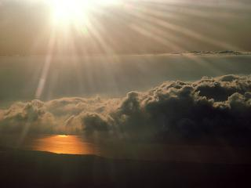

Slide 3
Hello and welcome to this excursion into Bible prophecy. In this video we shall take a close look into this matter of the blood moon. We might entitle
it, “The True Apocalyptic Blood Moon and the other Cosmic Signs according
to Jesus, Joel, and John.”

Slide 4
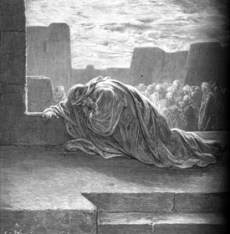
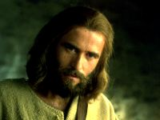
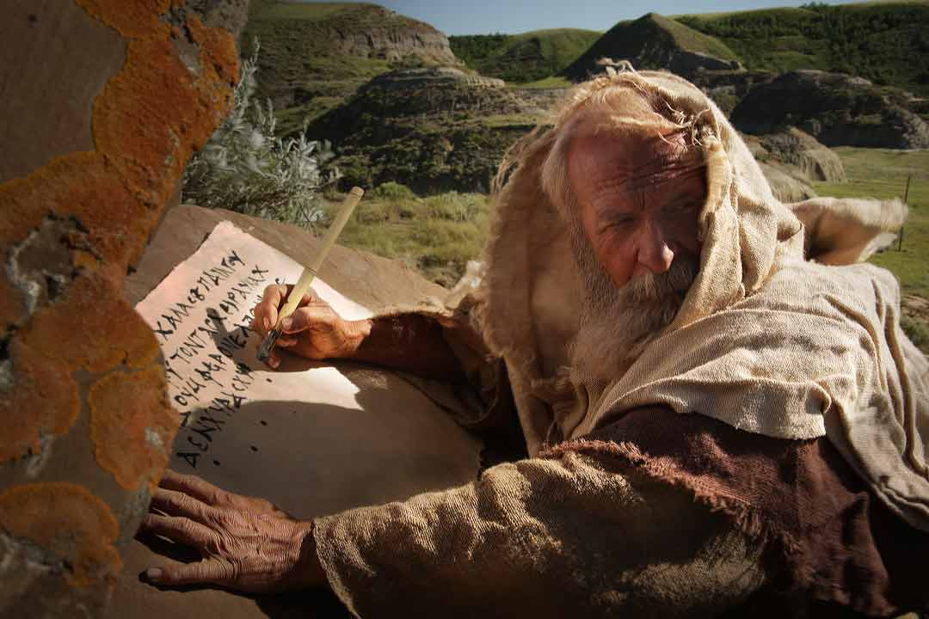
The True Apocalyptic Blood Moon and the other Cosmic Signs according to Jesus, Joel, and John.

Slide 5
In this study we shall look into this matter of the blood moon. And as we open the pages of Holy Scripture the true story begins to emerge. Up
there in our future in a time frame lasting some weeks the moon will turn blood red. This will be accompanied by two other signs in the heavens. They are a darkened sun, and meteor showers
that appear as stars falling. So this triad of signs involves the sun, the moon, and the stars. These three cosmic signs are prophesied to occur in a very late time window in the shadow of the apocalypse.

Slide 6
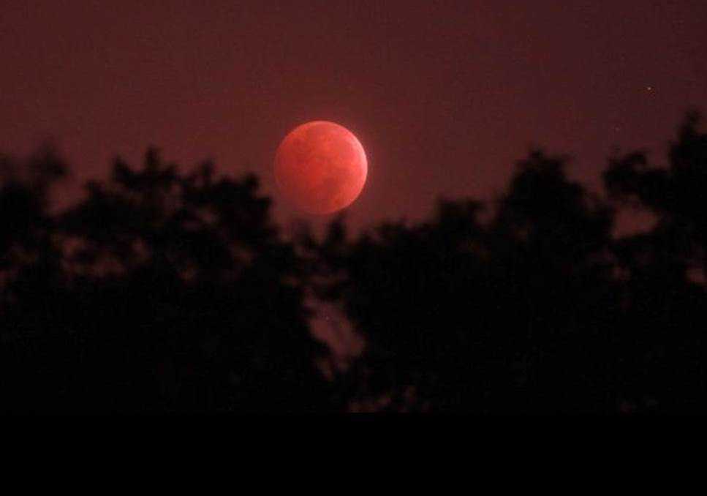
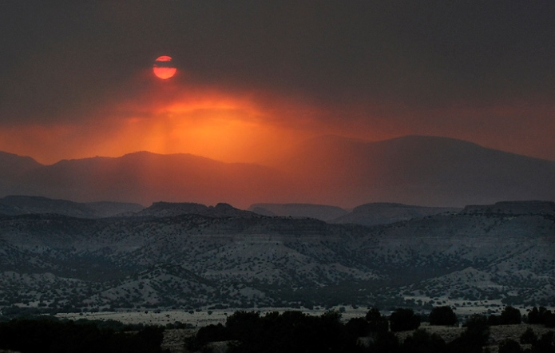
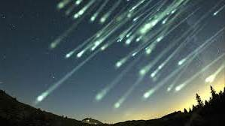
The True Apocalyptic Blood Moon and the other Cosmic Signs according to Jesus, Joel, and John.

Slide 7
So the blood moon is part of a package of signs, signs
in the sun, moon, and stars. These cosmic signs are
first described by the prophet Joel, then by Jesus in
the Olivet Discourse, and then by John the apostle, the writer of the book of Revelation. These three heavenly signs are bundled together by the Holy Spirit. Look at the passages here below. The tri-part message is presented very clearly to us by these people and others in the pages of Holy Scripture. So who are we to split them off? They should be studied together in context. We’ll be looking at those Scriptures in this video as we
track down this story of the true blood moon.

Slide 8
“The sun shall turn to darkness and the moon to blood BEFORE the great and terrible Day of the Lord come.” Joel 2:31
”Immediately AFTER the tribulation of those days shall the sun be
darkened, and the moon shall not give her light, and the stars shall fall
from heaven, and the powers of the heavens shall be shaken.” Mat. 24:29
¹² And I beheld when he had opened the sixth seal, and, lo, there was a great earthquake; and the sun became black as sackcloth of hair, and the moon became as blood; ¹³ And the stars of heaven fell unto the earth, Rev. 6:12,13

Slide 9
Interestingly these diminishments of the sun, moon, and stars parallel that of the bowing down of the sun, moon, and stars in Joseph’s dream. When Joseph described the dream to his brothers they became angry. Joseph’s father Jacob interpreted the dream but pondered the matter. For those who study the Scriptures in their themes, types, and shadows, as well as verse by verse this end-time connection to Joseph is a fascinating new lead. But that
story will have to wait for another time.

Slide 10
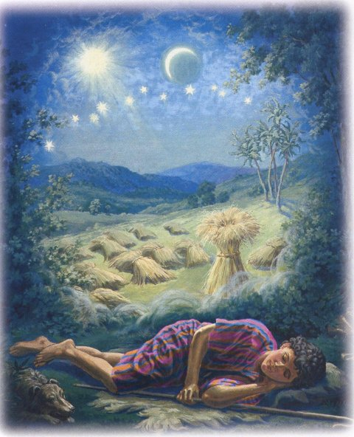

Slide 11
A proper Biblical inquiry into the blood moon is now becoming very important. Because it has now come to be identified with a very unusual tetrad of lunar eclipses. In both 2014 and 2015 four lunar eclipses will darken the full moon of Passover and Tabernacles. Pastor Mark Biltz made this intriguing discovery back in 2008. There is quite a buzz of discussion going on about this among Bible believing Christians. And quite rightly so. This very unusual eclipse cluster will probably turn out to be very important.

Slide 12
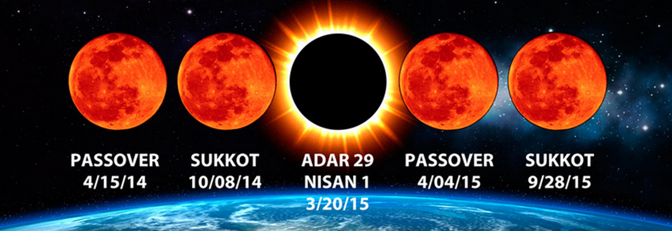
The Eclipse Cluster of 2014-2015
includes a rare Lunar Eclipse Tetrad
falling on Passover and Tabernacles.

Slide 13
But, we have to be very careful here. This tetrad of lunar eclipses have been given the name “blood moons”, (plural). As a result of this labeling and in the resulting hubbub of discussion there has been a muddying of the waters. Are these lunar eclipses the blood moon described in the Bible? What is their divine purpose? And where do we place them on the timeline
of the final 7 years of this age?
Notes:
This is absolutely critical because there is another story, a second story that deserves our most diligent and careful investigation and it has been given the plural label, “blood moons”. In both 2014 and 2015 a very unusual tetrad of four lunar eclipses are blotting out the full moon of Passover and Tabernacles. Pastor Mark Biltz made this wonderful and important discovery in 2008 and there are many YouTube videos in which he tells how this came about. This very unusual upcoming eclipse cluster is now getting a lot of attention, and rightly so.

Slide 14
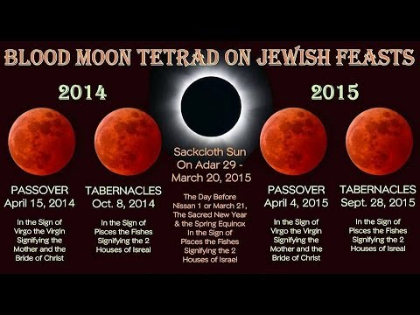

Slide 15
Let’s look now at the full package of all the eclipses being talked about. In both 2014 and 2015 the
earth will overshadow the full moon of Passover
and Tabernacles in a rare tetrad of lunar eclipses. The penumbra phase, which occurs with every lunar eclipse, will cause a reddish moon for an hour
or so. Then in the spring of 2015, as the Hebrew religious year begins, the astronomical new moon
of the month of Nisan will block the sun with a total solar eclipse. Later in the Fall of 2015 as the Hebrew civil new year begins, the new moon of the month
of Tishri will cause a partial solar eclipse.

Slide 16
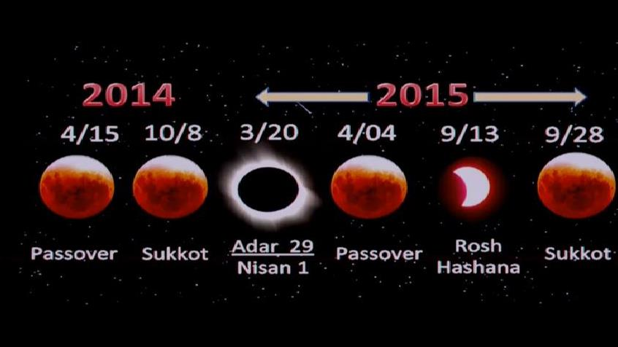
A tetrad of four lunar eclipses and two solar eclipses
mark significant Hebrew holy days in 2014 and 2015.
Yom
Teruah
Tabernacles
Tabernacles
Religious
New Year
Civil
New Year

Slide 17
Lunar eclipse tetrads occurring on auspicious Hebrew calendar feast dates like this have occurred just seven times in the past 2,000 years. And as we look back in time they have been portents, signs, heralds of epic historical events for God’s covenant people in both houses of Israel, both before events and as they were occurring. Another lunar eclipse tetrad will not be seen again for quite some time. So, just like the ones that came before them, we have every reason to believe that the lunar eclipse tetrad of 2014 and
2015 will probably turn out to be very significant.

Slide 18
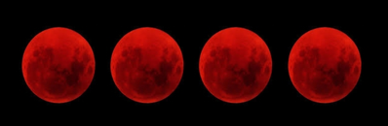
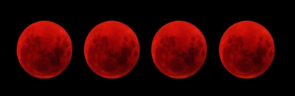
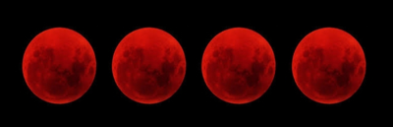
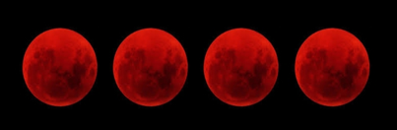
162 + 163 A.D. – 4th Persecution; Marcus Aurelius
641 + 642 A.D. – Islam conquers Coptic Egypt, N. Africa
795 + 796 A.D. – Charlemagne; Holy Roman Empire
842 + 843 A.D. – Muslims sack Rome; naval battles
1493 - 1494 – Jews expelled; Sp. Inquisition; Columbus
1949 + 1950 - Israel’s constitution; nations start raging
1967 + 1968 A.D. – 6 day War – Israel takes Jerusalem
2014-2015 - An omen? A herald to Daniel’s 70th Week?

Slide 19
Pastors presenting this information have stated that another lunar eclipse tetrad will not be seen again for another 100 years or more. But when we look at the NASA lunar eclipse data we see that there is another total lunar eclipse tetrad coming up in 2061 and 2062 that will land on the four holy days. The eclipse dates of April 4th in 2061 and March 25th in 2062 are clearly the first full moons after the March 20 vernal equinox. So these are definitely Nisan Passover lunar eclipses. Both are followed six months later by lunar eclipses occurring
on the full moon of Tishri for the Feast of Tabernacles.

Slide 20
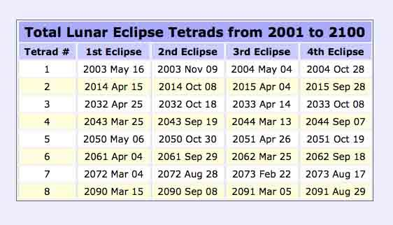

Slide 21
Astronomers appreciate that lunar eclipse tetrads blocking the full moons of Passover and Tabernacles are rare. They also understand how past lunar eclipse tetrads occurring on these holy days could have been omens of significant historical events and how that could be of interest to Christian and Messianic believers. But they are a bit puzzled as to why our religious leaders have decided to call these eclipses “blood moons”. Some have suggested this naming might be for dramatic effect or for sensationalism.

Slide 22
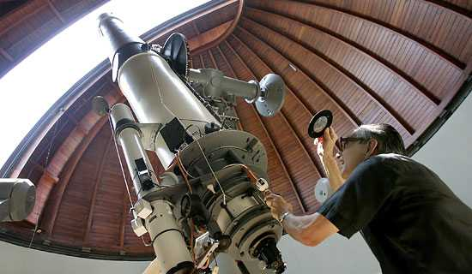

Slide 23
Lunar eclipses are common. In any lunar eclipse the moon can take on varying shades of coppery red to gray for perhaps an hour or so. So why then have these four lunar eclipses in 2014 and 2015 been called “blood moons”?

Slide 24
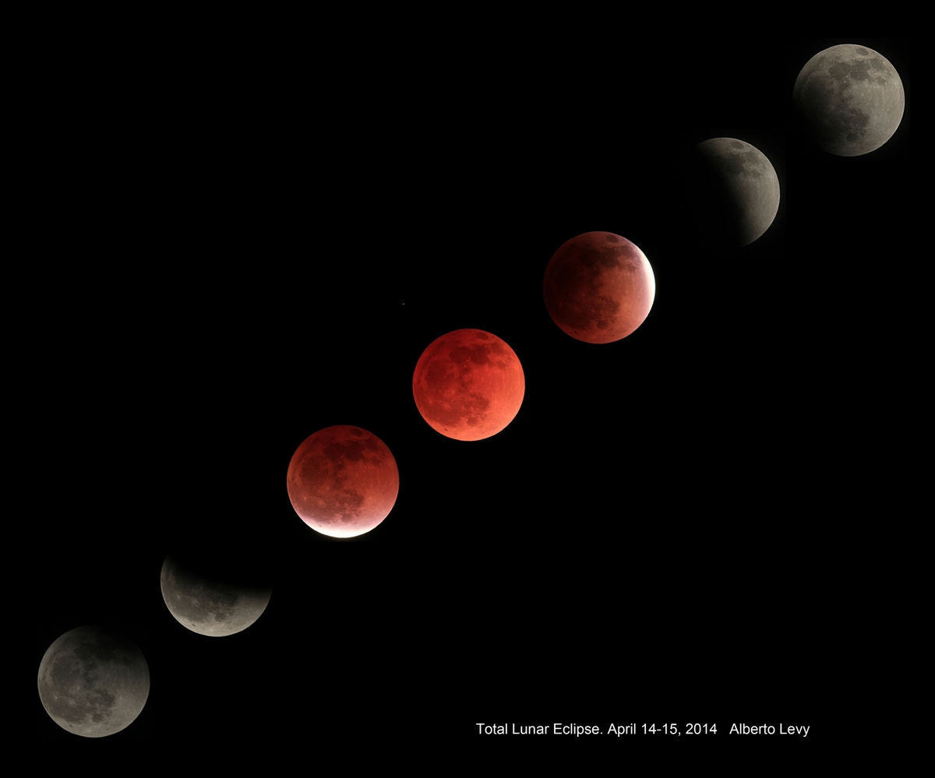

Slide 25
As we can see, lunar eclipses occurring on Passover and Tabernacles two years in a row have had a remarkable track record as omens. In past centuries and twice in the 20th Century they have signaled winds of change and major upheavals for both Jews and true Christians. And right now we are in the midst of another holy day lunar eclipse tetrad unfolding in 2014 and 2015.

Slide 26
162 + 163 A.D. – 4th Persecution; Marcus Aurelius
641 + 642 A.D. – Islam conquers Coptic Egypt, N. Africa
795 + 796 A.D. – Charlemagne; Holy Roman Empire
842 + 843 A.D. – Muslims sack Rome; naval battles
1493 - 1494 – Jews expelled; Sp. Inquisition; Columbus
1949 + 1950 - Israel’s constitution; nations start raging
1967 + 1968 A.D. – 6 day War – Israel takes Jerusalem
2014-2015 - An omen? A herald to Daniel’s 70th Week?

Slide 27
Obviously we should be sitting up
and paying attention here. And no doubt some dramatic preaching
is definitely in order. But should
these four lunar eclipses have
been called “blood moons”?

Slide 28
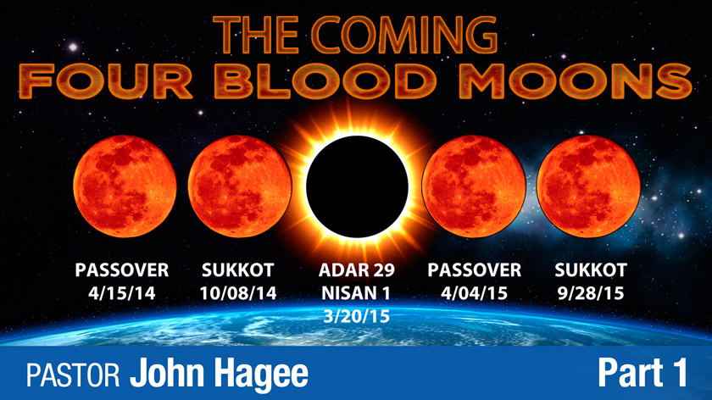

Slide 29
Lets start with some questions that may help to clarify matters. The Bible describes an event during which the moon turns to blood. Do these eclipses answer to the “blood moon” we see described in Scripture? If so, then are these eclipses
ALL that there is to the blood moon? Do the lunar eclipses fulfill and exhaust the
key Bible prophecies that refer to a blood moon or a moon not giving her light?

Slide 30
The Eclipse Cluster of 2014-2015
includes a rare Lunar Eclipse Tetrad
falling on Passover and Tabernacles.

Slide 31
And if not, of If, (as seems likely), they are not the true blood moon of the Bible then what is their significance? Is it possible that they are a signpost pointing to significant upcoming events, . . . . perhaps even heralding the upcoming 70th Week of Daniel, the final 7 years of this age?

Slide 32
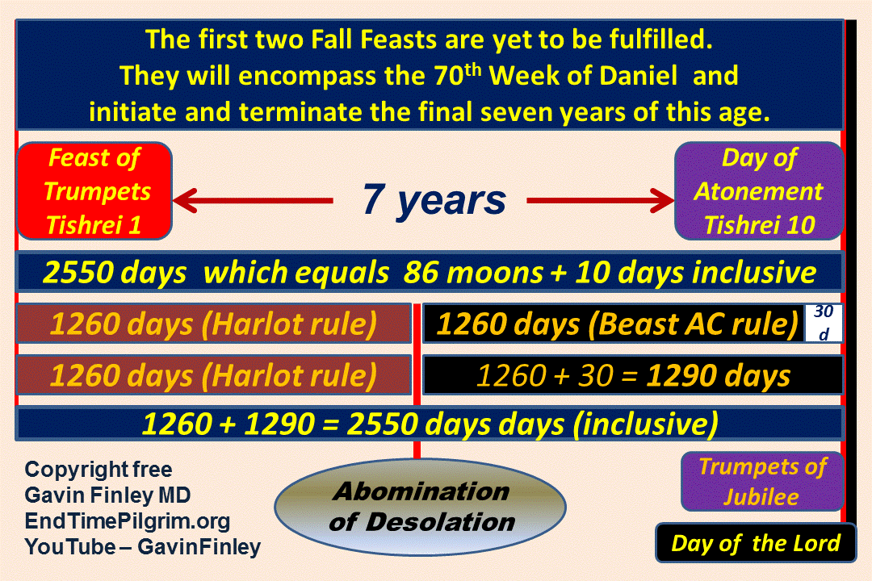
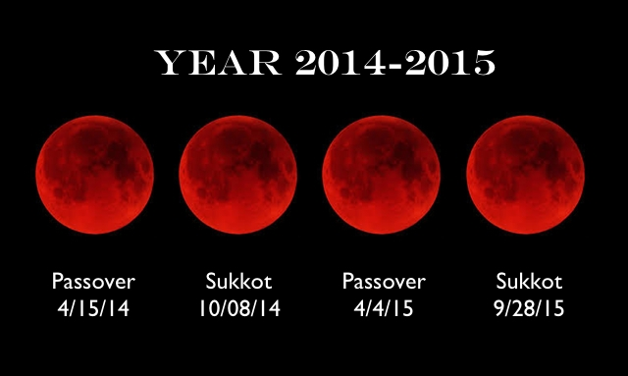
The Lunar
Eclipse
Tetrad
The 70th Week of Daniel, &
final seven years of this age.
Is it an omen of
things to come?
?

Slide 33
If they are not the blood moon we see in Scripture then what are they doing being tagged with the name “blood moons”? Is it possible that a mislabeling of these eclipses might be a source of confusion? Could the lunar eclipse tetrads of 2014-2015, these so-called “blood moons” obfuscate, cloak, or steal the show from the true apocalyptic blood moon that will be occurring later?

Slide 34
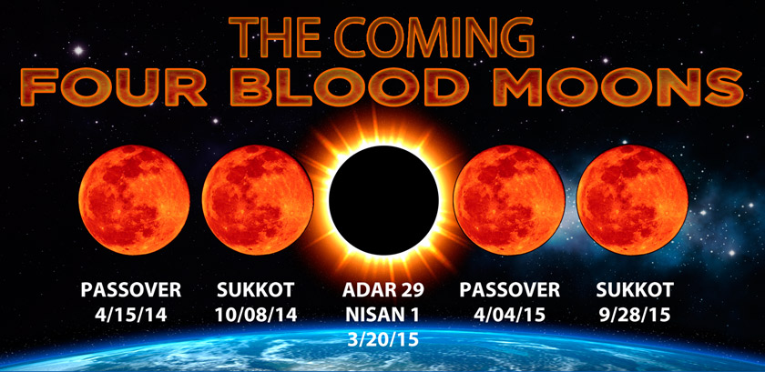
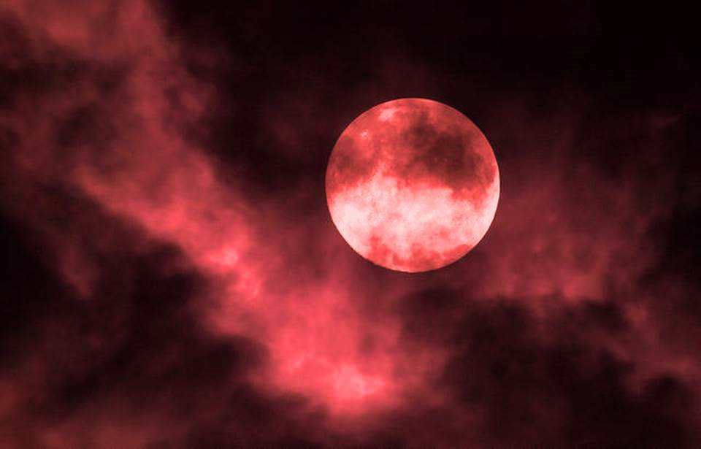
The Apocalyptic Blood Moon

Slide 35
What could happen if the lunar eclipses are an omen
of something further along and 2015 passes by without incident? Would that last eclipse bring closure to this whole blood moon discussion? Would pagans and Bible critics then mock Bible believers as they did after the Y2K and 2012 Mayan calendar hoaxes? Will they say, “That’s all folks! Nothing further to see here! Show’s over! You can all go home now!” Would disillusioned Christians then slink off and say, “Well, I guess that’s
it for blood moons.” That would be very sad, wouldn’t it? The four lunar eclipses are sign posts in the sky.
Are we aware of what they may be pointing to?

Slide 36
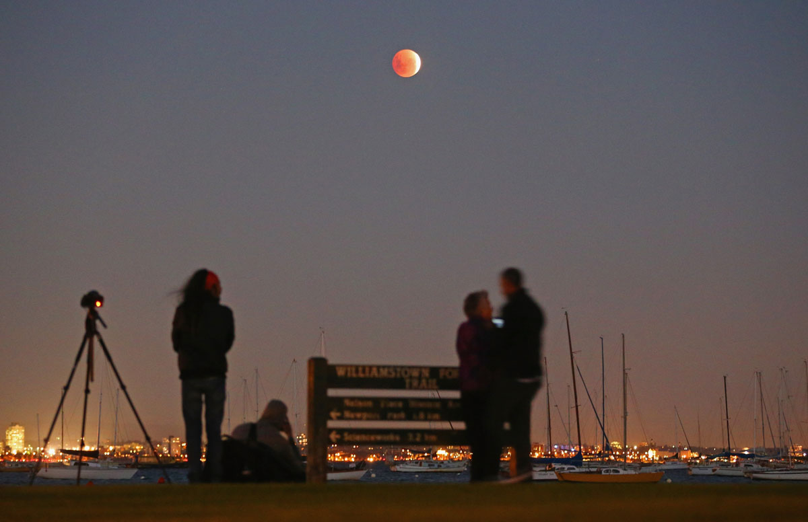
The second so-called
“blood moon” as it
was observed from
Williamstown Pier.
Melbourne, Australia,
October 8th, 2014

Slide 37
Is it possible that these eclipses are omens, portents, or signs, all pointing towards the 70th Week of Daniel and the blood moon event that will occur on the tail end of the final 7 years of this age? Are they heavenly signposts pointing on to that climactic end-time apocalyptic blood moon (singular)
we see laid out in Holy Scripture? We’re going to look into that possibility.

Slide 38
The Lunar
Eclipse
Tetrad
The Ultimate
Apocalyptic
Blood Moon
Is it an omen of
things to come?
?
Final seven years

Slide 39
Lets start our investigation and see
where the evidence is leading. Our apostle Paul exhorts us to “study to
show ourselves approved unto God.”
We serve a holy God who does not suffer foolishness

Slide 40
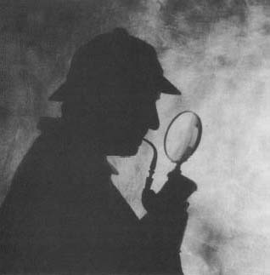
When shall we see the true
Blood Moon?
“Study to shew thyself approved unto God, a workman that needeth not to be ashamed, rightly dividing the word of truth.” 2 Timothy 2:15

Slide 41
We need to listen critically to
what churchmen are telling us
and check the truth of their message by the Holy Scriptures.
In the Olivet Discourse Jesus
repeats this word of warning,
“see that you are not deceived!”
We serve a holy God who does not suffer foolishness

Slide 42
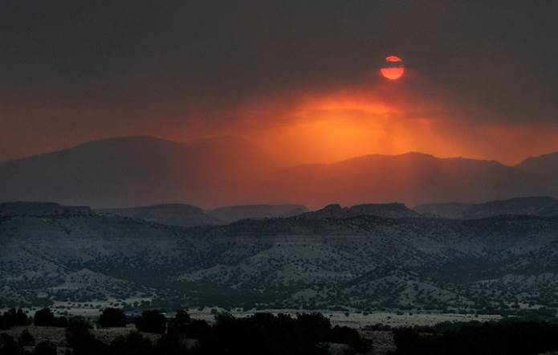
“SEE THAT YOU ARE NOT DECEIVED!”
- Luke 21:8, Mat. 24:4

Slide 43
True believers do not have a choice here. Deception is everywhere, confusion reigns, and the hour
is late. So this is something we
must all look into personally.
We serve a holy God who does not suffer foolishness

Slide 44
CONFUSION REIGNS!
?
?
?
The Apocalyptic Blood Moon of
the Bible
The Lunar eclipse tetrad of 2014-2015
?

Slide 45
We serve a holy God who does not suffer foolishness. So it is up to each one of us to examine the Biblical evidence for ourselves. Each of us needs to make a diligent Berean style investigation of the blood moon. Our apostle Paul exhorts us to prove all things and to hold fast to that which is good. So with that in mind let’s carry on with our study here.

Slide 46
When shall we see the true
Blood Moon?
“Prove all things;
hold fast to that
which is good.”
– 1 Thessalonians 5:21

Slide 47
There are three solid Bible references to the blood moon. Others are scattered throughout the Scriptures and a word study will find them. We soon discover that the “blood moon” or “moon not giving her light” is not a series of events at all. The lunar event is singular. It is accompanied by two other cosmic events involving the sun and the stars. The prophet Joel, Jesus, and John all describe a discrete time period with signs in the sun, moon, stars. As we go forward in this study we shall discover that ALL of them are presented together and in an apocalyptic time frame. These cosmic signs will occur during those few days before the close of the age. So let’s open our Bibles and look, listen, and learn what the Holy Spirit is showing us.

Slide 48
“The sun shall turn to darkness and the moon to blood BEFORE the great and terrible Day of the LORD, Day of Yehovah come.” Joel 2:31
”Immediately AFTER the tribulation of those days shall the sun be
darkened, and the moon shall not give her light, and the stars shall fall
from heaven, and the powers of the heavens shall be shaken.” Mat. 24:29
¹² And I beheld when he had opened the sixth seal, and, lo, there was a great earthquake; and the sun became black as sackcloth of hair, and the moon became as blood; ¹³ And the stars of heaven fell unto the earth, Rev. 6:12,13

Slide 49
We’ll start by taking a close look at what the prophet Joel had to say. In Joel 2:23 he begins to speak of the Latter Rain. This Latter Rain is something that should be of great interest to us. It should be of great encouragement to those faithful Christians who are doing the right thing and preparing for their vital role of witness inside the last 7 years of this age.

Slide 50
Joel 2:23
^{23 ”}Be glad then, ye children of Zion, and rejoice in the Lord your God: for he hath given you the former rain moderately, and he will cause to come down for you the rain, the former rain, and the latter rain in the first month.”

Slide 51
In Joel 2:28 & 29 Joel tells us what
will be happening afterward when
this epic Holy Spirit outpouring comes
to its appointed blowout climax.

Slide 52
Joel 2:28-29
^{28 ”}And it shall come to pass afterward, that I will pour out my spirit upon all flesh; and your sons and your daughters shall prophesy, your old men shall dream dreams, your young men shall see visions: ²⁹ And also upon the servants and upon the handmaids in those days will I pour out my spirit.

Slide 53
Now let’s step back 2,000 years to that upper room in Jerusalem and
get some added perspective on this. Fifty days after the Resurrection of our Messiah and right on the Day of Pentecost, the Holy Spirit fell upon the 120. They were not drunk.
It was 9 o’clock in the morning.

Slide 54
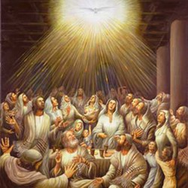
Pentecost
32 A.D.
Acts
Ch. 2

Slide 55
When the apostle Peter stepped outside
and preached 3,000 were saved on the spot. Peter explained what was happening. He quoted from Joel’s prophecy in Joel chapter 2. Peter identified what they were seeing that day as belonging to the same awesome Holy Spirit outpouring the prophet Joel had seen in vision 850 years before.

Slide 56
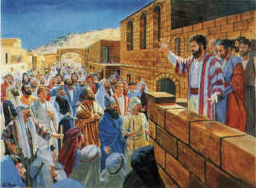

Slide 57
Peter quoted Joel’s prophecy of the last days. He said, “this is that which was spoken by the prophet Joel; ¹⁷ And it shall come to pass in
the last days, saith God, I will pour out of
my Spirit upon all flesh: ¹⁹ And I will shew wonders in heaven above, and signs in the earth beneath; blood, and fire, and vapour of smoke:²⁰ The sun shall be turned into darkness, and the moon into blood, before the great
and notable Day of the Lord come:” - Acts 2

Slide 58
“this is that which was spoken by the prophet Joel; ¹⁷ And it shall come to pass in the last days, saith God, I will pour out of my Spirit upon all flesh: ……. ¹⁹ And I will shew wonders in heaven above, and signs in the earth beneath; blood, and fire, and vapour of smoke:²⁰ The sun shall be turned into darkness, and the moon into blood, before the great and notable day of the Lord come:
Acts 2

Slide 59
Peter said that the Holy Spirit outpouring they were seeing there on the Day of Pentecost was not just a passing event. Peter was saying that the wave of Holy Spirit anointing they were seeing that day was part of the same latter day event prophesied by the prophet Joel. The Holy Spirit outpouring was destined to go the full distance, all the way through to the point where Joel saw it come to its peak
in the last days at the end of the age.

Slide 61
Many Bible prophecy teachers have used Peter’s statement to tell us the “last days” began 2,000 years ago back at Pentecost. They say that we
have been in the ”last days” ever since. But this is quite incorrect and misleading. By that interpretation all Scriptures that mention the last days are rendered meaningless. God’s message through Joel and Peter is of a wonderful Holy Spirit empowerment for the saints beginning at Pentecost and coming to a peak in the last days, at a time when He is needed most. But their interpretation would see this end-time word of encouragement ripped out of the Bible. For 2,000 years the Holy Spirit has been in action. And His Presence only gets more glorious as the Day approaches. The last days are the last days. The outpouring is the long story. Since Pentecost the Holy Spirit has been overflowing Israel as a Light to the nations. Peter was saying that the wave of anointing they were seeing back then was just the beginning. This great outpouring would carry the Congregation of Israel from Pentecost right on through to the last days where it would power
up and come to a glorious blockbuster climax at the end of the age.

Slide 62


The prophet Joel sees the distant peak of the Holy Spirit outpouring as a mountain peak viewed from afar.
The climax of the Holy Spirit
outpouring will come here in the last days
- - - - - - - - - - - - - - - - - - - - - - - - - - - - - - - - - - - - - - - - - - - - - - - - - - - - - - - - - - - - - - -
This . . belongs to . . that
Joel
Peter
.
Awakenings
The Holy Spirit outpouring
Dark ages
Pentecost
850
B.C.
32 A.D.
The Apostle Peter identifies Pentecost as
the outpouring Joel saw as it comes to its
appointed blowout climax in the last days.

Slide 63
In Romans 11, and Zechariah 12 we
find that the royal Jewish House of Judah will be wonderfully saved, the Breach of Jeroboam healed, and the fullness of the Gentiles brought in. This will complete
the salvation and restoration of all Israel
as the Commonwealth of Israel the apostle Paul spoke of in Ephesians 2:11-13.

Slide 64
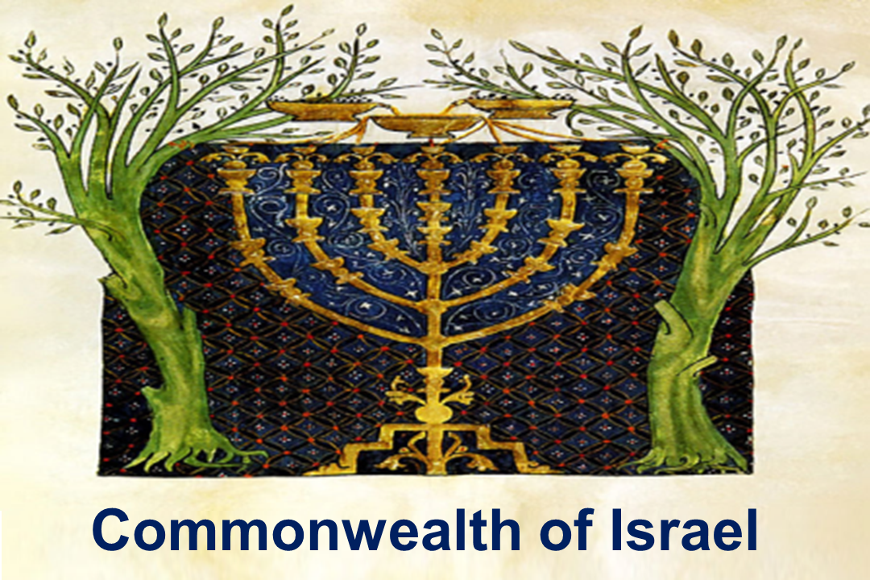

Slide 65
Will there be an end-time apostasy, a great falling away
as well? Yes, the Apostle Paul describes this in 2Thes. 2.
So we must expect that.

Slide 66
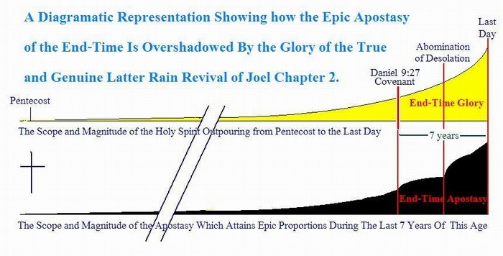
Council
of Nicaea

Slide 67
Just as Gideon saw the fearful and the uncommitted people in his army left behind many Christians will walk away from God and fall away from the faith in that great apostasy. it will be a small devoted broken vessel company that brings in the victory, . . . and not by force of arms. The exhortation given to Zechariah in Zechariah 4 was,
“Not by might, nor by power, but by my Spirit says the LORD Yehovah.”

Slide 68
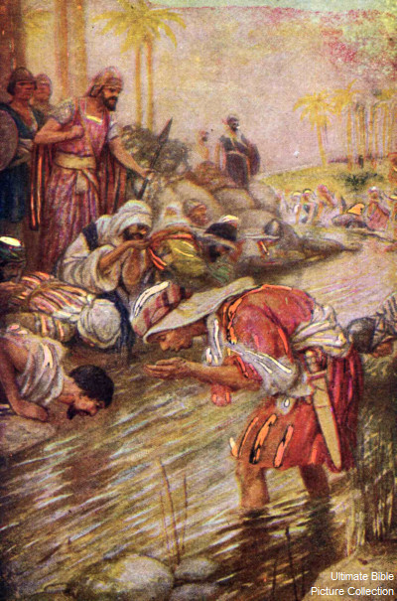
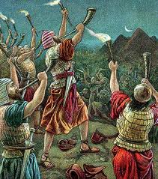

Slide 69
And in Isaiah 10
the prophet Isaiah declared,
“a remnant shall return”.

Slide 70
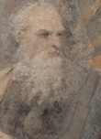
Isaiah 10
²⁰ And it shall come to pass in that day, that the remnant of Israel, and such as are escaped of the house of Jacob, shall no more again stay upon him that smote them; but shall stay upon the Lord, the Holy One of Israel, in truth. ²¹ The remnant shall return, even the remnant of Jacob, unto the mighty God. ²² For though thy people Israel be as the sand of the sea, yet a remnant of them shall return: the consumption decreed shall overflow with righteousness.

Slide 71
So when will this great Holy Spirit outpouring come to its climax? Ah, now this is where our story gets interesting. Joel tagged the peak of
this outpouring to a time period when the sun would turn to darkness and the moon to blood. He speaks of a single blood moon event accompanied by another cosmic sign, a darkened sun. This is our key to the timing of the peak of Joel’s outpouring. So just when will this blood moon and the peak of this outpouring of the Holy Spirit occur? Well, we are going to find out.

Slide 72
Joel 2:28,31
^{28 ”}And it shall come to pass afterward,
that I will pour out my spirit upon all flesh;. . . . .
³¹ The sun shall be turned into darkness,
and the moon into blood,

Slide 73
In the second part of Joel 2:31 we are presented with a very crucial piece of information for timing. The prophet Joel reports that these cosmic signs will come BEFORE the great and terrible Day of the LORD. Jewish listeners and most Biblical Christians up until the 19th Century correctly understood that the Day of the LORD
would come at the very end of the age.

Slide 74
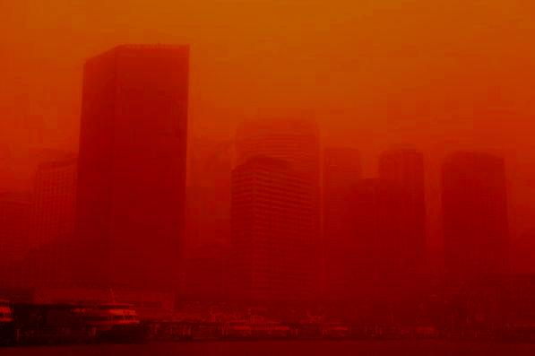
Day
Of
The
LORD
Joel 2:31
³¹The sun shall be turned into darkness,
and the moon into blood, BEFORE the
great and terrible DAY of the LORD come.

Slide 75
So this places the blood moon and the other cosmic signs in a time segment preceding the Day of the LORD. The Day of the LORD, the Day of Christ,
or the Day of Yehovah is that time unknown in which the heavens open up and the apocalypse, the unveiling, or the revelation of Jesus Christ occurs.

Slide 76
The Apocalypse in
the Day of Yehovah
Joel 2:31
³¹The sun shall be turned into darkness,
and the moon into blood, BEFORE the
great and terrible DAY of YEHOVAH come.

Slide 77
Joel very specifically links the blood moon to what appears to be an unprecedented period of repentance. The verse we see here speaks of people calling upon the Name of the LORD or the Name of Yehovah for salvation and deliverance. This occurs
in a very sobering time period before the end of this age and the opening of the
Day of the LORD or the Day of Yehovah.

Slide 78
The Apocalypse;
The Day of Yehovah
Joel 2:31-32
³¹ The sun shall be turned into darkness, and the moon into blood, before the great and terrible Day of Yehovah come. ³² And it shall come to pass, that whosoever shall call on the Name of Yehovah shall be saved/delivered.”

Slide 79
This late time window of the darkened sun and blood moon will take us right up to the last day of this present evil age. This will be the last chance for people to repent. Many will be calling upon the name of the Lord
or the name of Yehovah to be saved.
And in Jerusalem the remnant there will
be calling out to Him to deliver them.

Slide 80
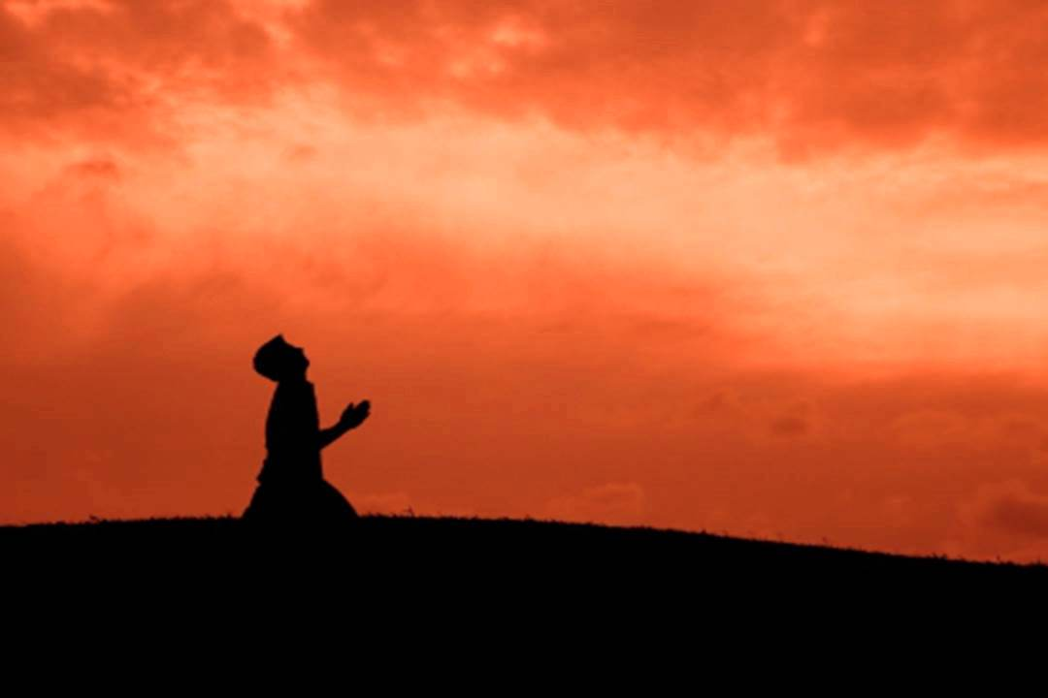
³¹ The sun shall be turned into darkness, and
the moon into blood, before the great and terrible Day of the Lord come. ³² And it shall come to pass, that whosoever shall call on the name of Yehovah shall be delivered.
- Joel 2:31-32a
The Apocalypse;
The Day of Yehovah

Slide 81
As we have seen in the previous
video on “The Fall Feasts of Israel
the Timeline of the Final 7 Years of this Age” the last day of this present evil age looks very much like it will
be that final Yom Kippur, Day of Atonement or Judgment Day.

Slide 83
And as the sun sets on that final
Day of Atonement the gates will
be closed to bring this age to its divinely appointed terminus.

Slide 84
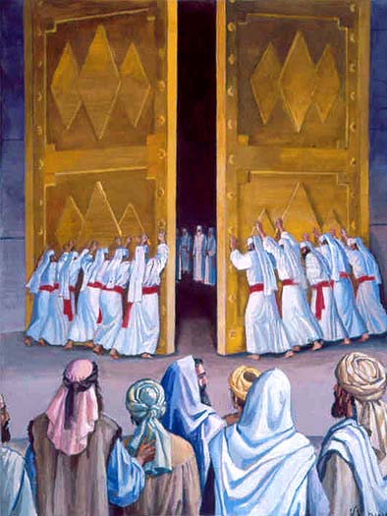
Yom Kippur
The Day of
Atonement
The
Closing
of the
Gates

Slide 85
But Joel brings us even more information. He brings a clue to the possible cause of the blood moon as well as the darkened sun. He speaks of “wonders in the heavens and in the earth”.
A wonder in the Hebrew idiom is a surprise!
It is an extraordinary event, usually something that has not been seen before. Joel sees a strange and unusual spectacle. He sees a
vision of blood, and fire, and pillars of smoke.

Slide 86
Joel 2:30
³⁰ And I will show wonders
in the heavens and in the earth,
blood, and fire, and pillars of smoke.

Slide 87
These would seem to be earthly phenomena
and limited to our atmosphere. And yet they are connected in some way to these momentous signs in the sun and moon. Joel describes fire with smoke going straight up as pillars. This speaks of a fire with enormous heat. And blood is something that must relate to humanity here on earth. So the prophet in vision saw a great and terrible earthly spectacle that involves fire, bloodshed, and pillars of smoke. This is in a time period just before the Day of the LORD opens up. So what on earth was Joel looking at?

Slide 88

Blood,
Fire,
and
Pillars
of
Smoke
?
Darkened Sun
Blood Moon

Slide 89
Could it be this? Could a terrible event such as this, the apex of human folly, and coming right at the end of the age be categorized as
a wonder on earth and a wonder in the lower heaven, our earthly atmosphere? What if there are people and cities in this terrible holocaust? Would it not fit the description
of blood, fire, and pillars of smoke as
seen in vision by the prophet Joel?

Slide 90
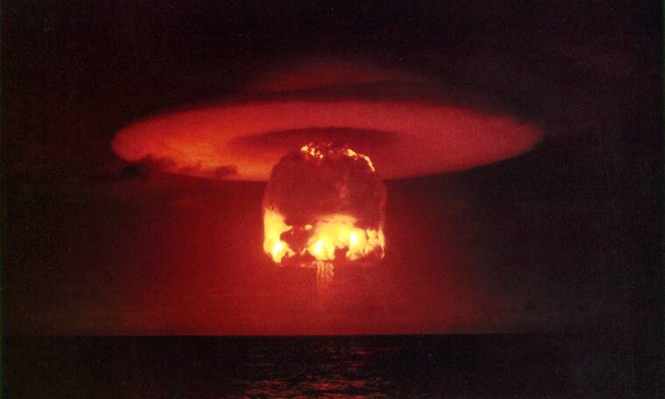
³⁰ And I will show wonders in the heavens and in the earth, blood, and fire, and pillars of smoke. – Joel 2:30

Slide 91
Joel then goes on to describe the
sun turning to darkness and the moon to blood. Atmospheric dust
on the horizon at sunset or at dawn does filter out the blue light to turn the sun or moon red. Or it may darken them completely.

Slide 92
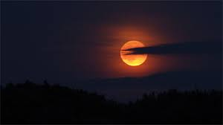

Slide 93
But apart from localized atmospheric changes due to volcanoes, bush fires, or the oil fires and dust storms like we saw in the Desert Storm War
in Iraq do we normally see the sun
or moon darken or turn red when
they are high in the sky?

Slide 94
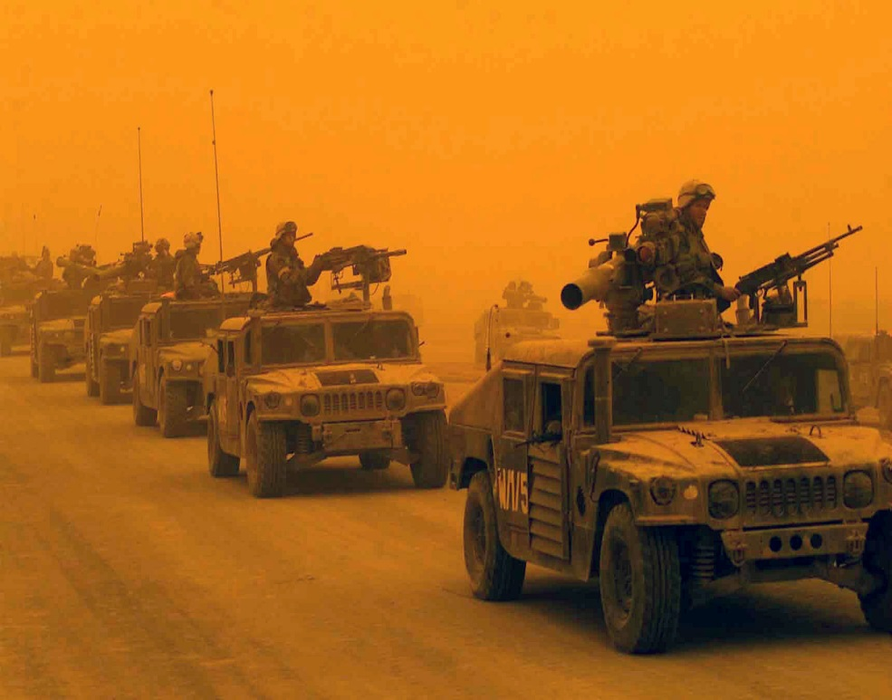
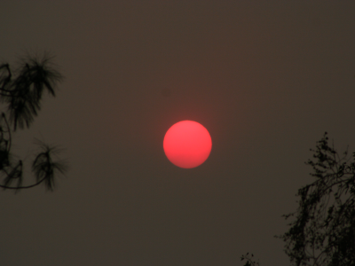
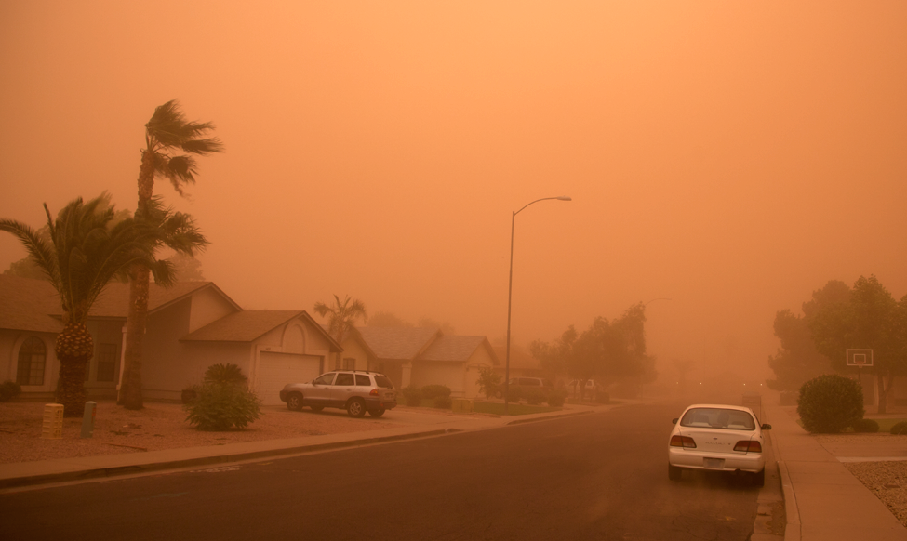

Slide 95
Could a nuclear exchange at the
end of this age pollute the earth’s atmosphere to such an extent that
it would cause this darkened sun
and the blood moon?

Slide 96
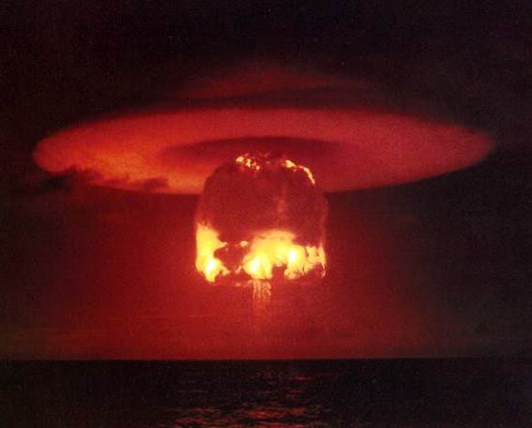
Blood, Fire,
Pillars of Smoke
Darkened Sun
Blood Moon

Slide 97
The prophet Joel brings us further Word from God on this matter. He gives us another valuable clue that positively fixes the late apocalyptic time frame of the blood moon. He specifically links the cosmic signs
of the darkened sun and the blood moon to the deliverance of Jerusalem.

Slide 98
³¹ The sun shall be turned into darkness,
and the moon into blood, before the great
and terrible Day of the Lord come. ³² And it shall come to pass, that whosoever shall call on the Name of the Lord shall be saved/delivered:
for in mount Zion and in Jerusalem shall be deliverance,
as the Lord hath said, and in the remnant
whom the Lord shall call.
- Joel 2:31-32
The Apocalypse;
The Day of the LORD

Slide 99
So we can be quite confident in saying that the blood moon and the wonders in heaven and on earth as seen by the prophet Joel will come at the very end of the age. Because Joel is referring to nothing other than the Battle of Armageddon. Most Bible students see this battle as a climactic end of age event that will see the ultimate epic intervention
in human affairs by the returning Messiah.

Slide 100
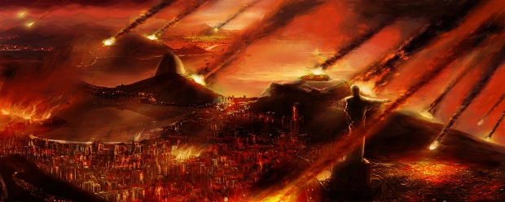
The Apocalypse;
The Day of Christ

Slide 101
Another description of the Battle of Armageddon
suggesting nuclear events comes from the prophet Zechariah in Zechariah 14:12. His description of injuries sustained by military personnel is rather sobering.
He describes pervasive soft tissue injuries occurring
inside bony structures of the body. Such injuries were impossible prior to the 20th Century and the advent of
the nuclear age. Zechariah tells of eyes consuming away their sockets and flesh dissolving away while men stand
on their feet. This suggests the disabling effects and the slow death of military personnel after irradiation by a neutron bomb attack or by those Tesla directed energy beam weapons we are just beginning to hear about.

Slide 102
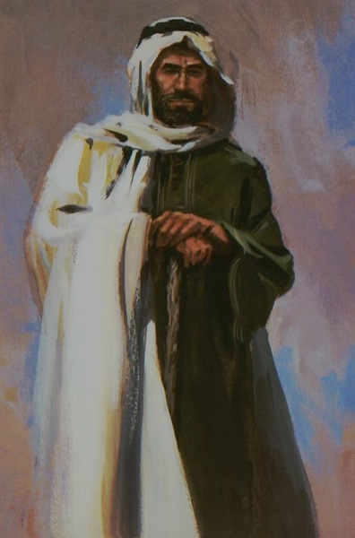
¹² And this shall be the plague wherewith the Lord will smite all the people that have fought against Jerusalem; Their flesh shall consume away while they stand upon their feet, and their eyes shall consume away in their holes, and their tongue shall consume away in their mouth. - Zech. 14:12
Zechariah

Slide 103
Whether the body is shot through by neutrons and gamma rays
from a neutron bomb or by those secret directed resonant electro-magnetic Telsa death rays the results are the same. Both weapons cause major intracellular damage. Lysosomes are found within the protoplasm of every cell. They contain digestive enzymes that break down the protein structures of cells. When a critical point of intracellular free radicle damage is reached the lysosomes burst open and release the enzymes which essentially dissolves the cell. This is the normal self-destruct mechanism for sick and dying cells. So when neutrons tear through soft tissues or resonant high energy electro-magnetic waves resonate the aqueous matter within the cells to the point of molecular dissociation the cells soon begin to dissolve into a watery mush a process that ultimately leads to death of the entire organism. This is just as Zechariah described nearly 2500 years ago.

Slide 104
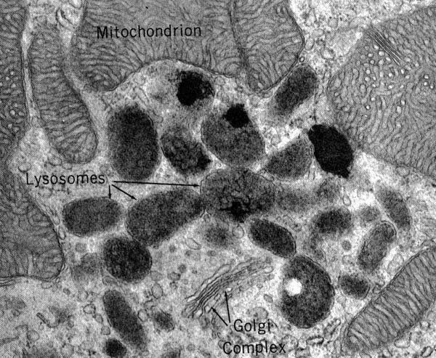

Slide 105
Small neutron bombs can now be delivered by cruise missiles, planes,
by drones, or even fired from an 8 inch artillery shell. Detonated at some altitude above an advancing army
the effects can be devastating.

Slide 106
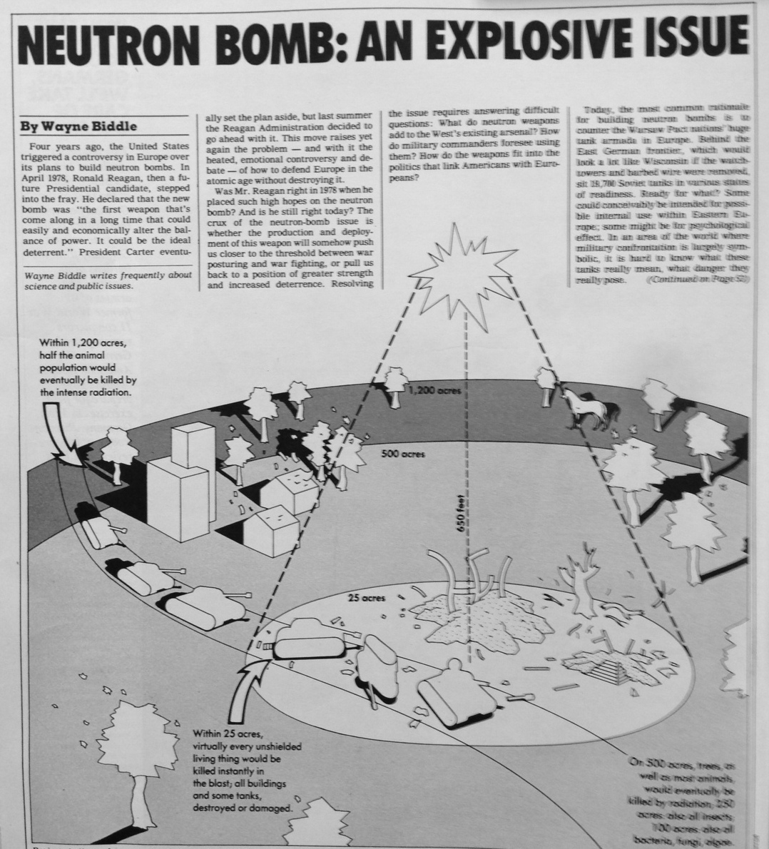

Slide 107
The neutron bomb was specifically designed to kill people inside structures. These are the sorts of weapons that might be deployed against the concentrated armored divisions coming against Israel at the Battle of Armageddon and perhaps by them against each other. The armies would be coming in from the east and west and mustering, perhaps clashing against each other here in the Valley of Jezreel just as the Bible says they will.

Slide 108
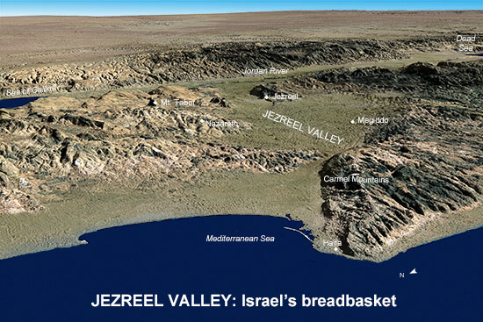

Slide 109
Tanks, vehicles, and buildings may not be damaged. But the neutron particles and gamma rays would confuse, derange, and slowly kill the military personnel inside them. Every living thing in the air or on the ground beneath the explosion for several square miles would die, slowly. As we read this scripture in Zechariah 14 we can see that the prophet is bringing us a perfect description of an army struck by a neutron bomb detonated above them. Soft tissues are dissolving away while men are standing on their feet and trying to function.

Slide 110
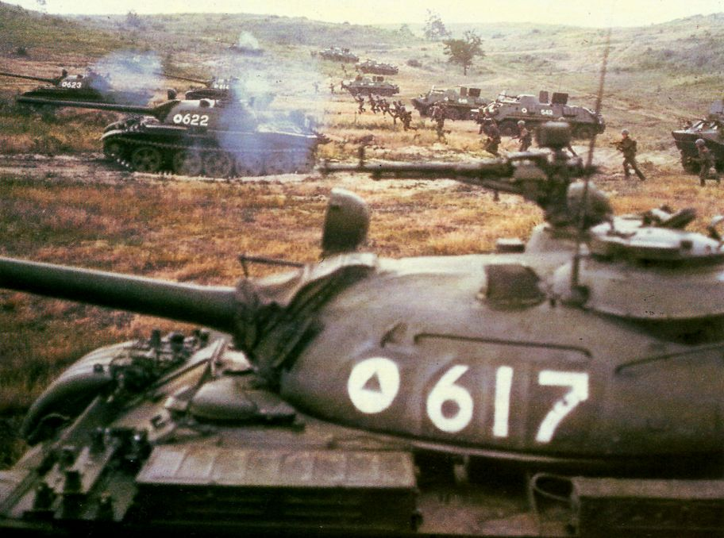

Slide 111
The scalar zero point energy beam weapons now being tested in Iraq and Afghanistan are even more deadly. They can kill soldiers instantly whether they are inside their tanks or even in bunkers underground. With all internal and external bacteria destroyed the bodies do not decay, not even after 30 days. An awesome
Day of Reckoning is coming for the nations. With weapons like this and the nuclear weapons of mass destruction is there any wonder why the cry will go out to Messiah for Him to intervene?

Slide 112
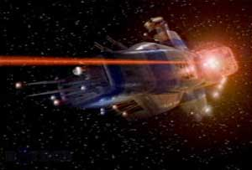
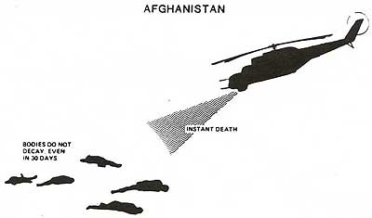


SCALAR TESLA ELECTROMAGNETIC PHASER BEAM WEAPONS
Star wars weapons are already here

Slide 113
Like Zechariah, the prophet Isaiah also gives us a vivid description of the effects of subatomic particle and resonant high energy EM beam weapons. He spoke of the instantaneous inflammatory effects on the skin and the mucosa of internal organs, the painful spasm of intestines, and the shock and amazement of the soldiers, perhaps the crews of mechanized divisions still inside their tanks. They have just been struck by a deadly invisible weapon but they are still alive. All they heard was a distant thunder. Isaiah saw them looking at one another amazed, their faces aflame, radiation burnt, and flushed red. In medical terms Isaiah is describing the primary inflammatory response. This could be caused by the neutron and gamma radiation or from those directed energy and microwave beam weapons that we are only just now beginning to learn about.

Slide 114
Isaiah 13:8 (KJV/NASB)
⁸ And they shall be afraid: pains and sorrows shall take hold of them; they shall be in pain as a woman in labor: they shall be astonished, amazed one at another; their faces shall be
as flames.

Slide 115
In the very next verse the prophet Isaiah brings us the very same message that Joel
and Jesus brought. Isaiah is our third witness time linking terrible nuclear events to the same bundle of three cosmic signs. He tells of the stars and the constellations not giving their light, the sun being darkened, and the moon not causing her light to shine. Again we get
a solid fix for the very late timing of the Battle of Armageddon. In this post trib time window God is dealing with people and with nations.

Slide 116
⁹ Behold, the Day of the Lord cometh, cruel both with wrath and fierce anger, to lay the land desolate: and he shall destroy the sinners thereof out of it.
¹⁰ For the stars of heaven and the constellations thereof shall not give their light: the sun shall be darkened in his going forth, and the moon shall not cause her light to shine.
Isaiah 13:9-10
(KJV)

Slide 117
Isaiah also brings us the same message Joel brought us. He vitally connects darkening of these cosmic disturbances to the very soon
arrival of the Day of the LORD.

Slide 118



⁹ Behold, the Day of the Lord cometh, . . . ¹⁰ For the stars of heaven and the constellations thereof shall not give their light: the sun shall be darkened in his going forth, and the moon shall not cause her light to shine.
Isaiah 13:9-10

Slide 119
In Ecclesiastes King Solomon speaks poetically of these late cosmic signs. He speaks of the sun, moon, and stars being darkened as we come towards the end of our life journey. He speaks in personal terms of those happy earlier years when in company with our fathers, our mothers, and our families the sun, moon, and stars shine upon us. King Solomon exhorts his listeners to remember our God and be established in Him early before we enter our older or later years. But his reference to a time when the sun, moon, and stars are darkened suggests a wider meaning. It alludes to that encroaching end-time celestial darkness prophesied to come over this whole world during the last days of this age.

Slide 120

1 Remember now thy Creator in the days of thy youth, while the evil days come not, nor the years draw nigh, when thou shalt say, I have no pleasure in them; 2 While the sun, or the light, or the moon, or the stars, be not darkened, - Eccl. 12:1-2
King Solomon

Slide 121
So that was Joel, Isaiah, and King Solomon. All of them place the blood moon and other cosmic signs right at the end of the age. Joseph’s dream of the bowing down of the sun, moon, and stars is still in the mystery. Now let’s see what Jesus tells us about the blood moon. In the Olivet Discourse we read of signs in the sun, moon, and stars. Jesus says that AFTER the Tribulation
1. The sun shall be darkened,
2. the moon shall not give her light, and
3. the stars shall fall from heaven.
Jesus also states that
“the powers of the heavens shall be shaken.”

Slide 122
”Immediately AFTER
the tribulation of
those days shall
the sun be darkened,
and the moon shall
not give her light,
and the stars shall
fall from heaven,
and the powers of
the heavens shall
be shaken.” Mat. 24:29
These are the cosmic signs and disturbances associated with the 6th seal and Jesus said they will come AFTER the Great Tribulation ends.

Slide 123
Like Joel Jesus tells of a darkened sun. But instead of the moon turning to blood Matthew and Mark quote Jesus as saying the moon will not give her light. This is consistent with light being filtered by atmospheric contamination. Such filtering could cause the light of the
moon turn red or darken its light partially
or entirely. In the third Gospel account by
Luke the physician he writes in more general terms of signs in the sun, moon, and stars.

Slide 124

The sun darkened
The moon shall not give her light
The sun is darkened and the moon will not give her light.

Slide 125
But wait, there is more. In the first three Gospels Jesus also adds that along with the darkened sun and moon the stars will be falling. John, the fourth Gospel writer does in fact join in to describe
the three cosmic signs. But as we shall discover, John brings out his account
of this the book of Revelation.

Slide 126
The sun darkened
The moon shall not give her light
1
2
The sun darkened, the moon not giving her light, and the stars falling.
Stars Falling
3

Slide 127
And when will these three awesome and unprecedented signs in the heavens be seen? When will the sun be darkened, the moon not
give her light, and the stars fall? Well in Matthew 24 Jesus tells us very clearly. He states that
these three cosmic signs would occur after the tribulation. Jesus is telling us outright and in no uncertain terms that the three cosmic signs will come AFTER the 70th Week of Daniel ends. So the blood moon must of necessity come in during a very late time window at the very end of the age.

Slide 128
TRIBULATION
“IMMEDIATELY AFTER THE TRIBULATION of those days shall the sun be darkened, and the moon shall not give her light, and the stars shall fall from heaven.” - Mat. 24:29
Day 1260

Slide 129
So under the authority of Holy Scripture as delivered by the prophet Joel and by Jesus Himself we can now confidently place the true apocalyptic blood moon and the full array of cosmic signs in a discrete time interval AFTER the Tribulation and BEFORE the opening of the
Day of the Lord. As we do we discover that we can now completely discount any notion whatsoever of the Day of the Lord and the Wrath of God lasting 7 years. As Christians in the West we are having some trouble with the placement of the Day of the Lord. It seems that this is yet another of those areas where we have been hypnotized. We read and hear the words of Jesus here and of the prophet Joel. But we are not connecting the dots. We are not getting the message. Brothers and sisters, we need to pause and let these words sink in for a moment.
We shall ALL appear before the Judgment Seat of Christ on That Day appointed. We shall be personally held accountable to Messiah for
how we received His words. We simply must believe what the Holy Spirit is telling us here, . . . .and let the chips fall where they may.

Slide 130
TRIBULATION
DAY OF THE LORD
“IMMEDIATELY AFTER THE TRIBULATION of those days shall the sun
be darkened, and the moon shall not give her light, and the stars shall fall from heaven, and the powers
of the heavens shall be shaken.” Matthew 24:29
³¹The sun shall be turned into darkness, and the moon into blood, BEFORE the great and terrible Day of the Lord come. - Joel 2:31

Slide 131
Now let’s take a closer look at what else
Jesus is telling us in this same verse.
He says that;
1. “the stars shall fall from heaven”
and
2. ”the powers of the heavens
shall be shaken”.
Are the two connected in some way?

Slide 132
1.“the stars shall
fall from heaven,
and
2. the powers
of the
heavens shall
be shaken.”
Mat. 24:29
These are the cosmic signs and disturbances associated with the 6th seal and Jesus said they will come AFTER the Great Tribulation ends.

Slide 133
The word powers in Scripture refers to angelic rulers, the principalities who currently bear rule over the various geographical regions of this world. At the end of this age and in the days of the true blood moon the returning Messiah will shake heaven and earth. The evil angelic rulers in the lower heaven and evil men heading up the politico-religious hierarchies here on earth will be shaken and cast down as He comes through.

Slide 134

For we wrestle not against flesh and blood,
but against principalities, against powers,
against the rulers of the darkness of this world, against spiritual wickedness in high places. - Eph. 6:12

Slide 135
The prophet Haggai prophesied concerning this shaking. The shaking of heaven and earth will come with the advent of Christ, both in His first coming, and in His second coming. ’ “6 For thus saith the LORD of hosts; Yet once, (it is a little while), and I will shake the heavens, and the earth, and the sea, and the dry land; 7 And I will shake all nations, and The Desire of All Nations shall come: and I will fill this house with glory, saith Yehovah the Lord of Hosts. - Hag. 2:6-7

Slide 136

“6 For thus saith the LORD of hosts; Yet once, (it is a little while), and I will shake the heavens, and the earth, and the sea, and the dry land; 7 And I will shake all nations, and The Desire of All Nations shall come: and I will fill this house with glory, saith Yehovah the Lord of Hosts. - Hag. 2:6-7

Slide 137
Apparently the end of the age will see
the breakout of horrendous evil here on earth. At the top the worldly hierarchies profane power-hungry men are seeking
to unify and hold court over all politics
and religion. Human compromise here below is linked to the loosing of spiritual wickedness in high places, even those high places in the second or lower heaven.

Slide 138


Slide 139
The ungodly covenants our political and religious leaders enter into may be popular, lucrative, or expedient. But they all loose the evil angelic rulers above and empower them to further their agenda here below. Evil angels preside over the hierarchies of men. They operate from out of the second heaven, a realm in the next dimension just beyond our view. These dark princes are
the ultimate puppet masters. They pull the strings of the people who belong to them.

Slide 140


Slide 141
When Jesus speaks of the powers of the heavens being shaken He is certainly not speaking of the third heaven, the place of God’s throne. So He is referring to the lower angelic realm. He is speaking of the principalities and powers, the angelic rulers there in the second heaven being shaken. This zone of angels will
be the venue of that final and climactic spiritual war. This is recorded for us by Daniel in Daniel 12 and by John in Revelation 11:15-16.

Slide 142

Daniel 12
Rev. 11

Slide 143
So as the Scriptures declare, all these unholy deals of wicked compromise will fall through. And at the Second Coming the spiritual war in the second heaven will end. The dark angelic rulers hovering over human governments and over harlot religion will be cast down. And their wicked human underlings
will be terminated along with them.

Slide 144



Slide 145
So the falling stars may be a massive meteor shower, a celestial spectacle showcasing that final battle up in the second heaven, that final shake-down that sees the evil powers brought down. The principalities and powers will be shaken yet once more. And on that one final time they will be cast down by the returning Messiah and their evil rule over mankind ended. This will be show-time. And as these last days unfold we shall see the magnificent triumph of our returning Messiah
and the ultimate victory of good over evil.

Slide 146

Heb. 12:26-27 (Hag. 2:6)
“. . . .but now he hath promised, saying, Yet once more I shake not the earth only, but also heaven.
²⁷ And this word, Yet once more, signifieth the removing of those things that are shaken, as of things that are made, that those things which cannot be shaken may remain.
the stars shall fall from heaven, and the powers
of the heavens shall be shaken.” Matthew 24:29

Slide 147
For the powers of darkness the most fearful part of end-time Bible prophecy concerns the coming spiritual war which they will lose, that awesome coming shakedown, and the coming Judgment that will condemn them. The angelic rulers hovering over corrupted politics and over compromised religion tremble and shudder when they hear of this. The powers know that when these stars fall at the end of this present evil age it will herald their doom. They will be cast down.

Slide 148


Slide 149
So even as God calls out to every human heart there are evil powers operating from up in the lower heaven who seek to misinform, to exploit, and to destroy the ones God
is calling. These are the angels of darkness our angels fight.

Slide 150


Slide 151
There is a drama involving both heaven and earth. We see it laid out for us in Daniel 10.
For three weeks Gabriel, God’s angelic messenger, struggled with the prince of Persia, the principality over the superpower of that time. Finally, Michael, the guardian angel of God’s covenant people, came to Gabriel’s assistance. This allowed Gabriel to break through and deliver the message to Daniel.

Slide 152

Art used by
permission of
artist Shelli Baker
Visit her website.

Slide 153
The rest of the story concerns the prophet Daniel. For three weeks and during the time Gabriel was held up Daniel had been interceding for his people. Most of them were still in Babylon, now under the Medo-Persian Empire. Daniel had been in prayer and fasting during those three weeks.

Slide 154


Slide 155
At the end of three weeks Daniel was down by the Tigris river. There and then the breakthrough came.
So the take-home lesson is this. A spiritual war is raging up in the lower heavenly realm. Apparently
it involves us. There is no mention here of Daniel fighting the devil nor of his naming and claiming territories here on earth. Rather, the spiritual battle being waged up there was impacted by his devotion and the confession of the sins of his people to God. Daniel’s prayer of intercession before God was on behalf of God’s Holy People and His Holy City.

Slide 156


Slide 157
The latter days will see many of the saints praying as Daniel did. The supplications to God will include
those from the Lord’s prayer,
“Deliver us from evil”.
. . And He will.

Slide 158


Slide 159
Later, in Daniel 12, the angel Gabriel told Daniel just how this spiritual war will end. There will be a massive end-time crisis. At that time, Michael, the warring archangel of God will stand up and take action. We could guess
that this will be the midpoint of the 70th Week at the abomination of desolation half way through the final 7 years of this age. This is when Satan is cast down to the earth and the beast demon of the Abyss is released to possess the Antichrist. The ensuing great war in heaven and on earth will be severe. But it will end with the deliverance of God’s holy or set-apart people. Daniel
is told that these ones whose names are written in
the Book of Life will shine as the stars forevermore.

Slide 160

12 And at that time shall Michael stand up, the great prince which standeth for the children of thy people: and there shall be a time of trouble, such as never was since there was a nation even to that same time: and at that time thy people shall be delivered, every one that shall be found written in the book.
– Dan. 12:1

Slide 161
So in the time of the true blood moon the spiritual battle will be won. Our Messiah will arrive. There will be and end-time deliverance. This is very encouraging news for us. And we know that at a certain point the Great Tribulation will be abruptly terminated. Why? What might cause that to happen? Again in the Olivet Discourse in Matthew 24 and Mark 13 we get a major clue. Jesus states that “except those days should be shortened there should no flesh be saved.

Slide 162
Mat. 24
²¹ For then shall be
great tribulation,
Such as was not
since the beginning
of the world to this time,
no, nor ever shall be.
²² And except those days
should be shortened, there should no flesh be saved:

Slide 163
Jesus then goes on to say that ”but for the Elect's sake those days shall be shortened.” So what might be the occasion for this divine intervention? What calamity threatening to destroy all flesh on this planet will be abruptly cut short? What will be halted, and just in a nick of time for the sake of God’s covenant people and for the sake of all living things on planet earth?

Slide 164
Mark 13
¹⁹ For in those days shall
be affliction, (tribulation), such as was not from the beginning of the creation which God created unto this time, neither shall be.
²⁰ And except that the Lord had shortened those days, no flesh should be saved:
but for the elect's sake, whom he hath chosen, He hath shortened the days.

Slide 165
Once again, we are led to weapons of mass destruction.
The dragon, Lucifer, the Lord of the Flies loathes and hates mankind. He is a destroyer and wants us all dead. As the 70th Week ends a nuclear exchange will have begun. But then suddenly it all comes to a halt. What if there was no divine intervention and this heinous train of destruction was not stopped? What if the powers succeeded in loosing a global holocaust upon mankind? What if this terrible outbreak of wickedness was not nipped in the bud? The ensuing nuclear exchanges would soon escalate to bring total destruction of all life on this planet. The point would
soon be reached where it would be just as Jesus says, “there should no flesh be saved”.

Slide 166
“And except those days should be shortened, there should no flesh be saved: - Mat. 24:22

Slide 167
Here are a few other Scripture passages pointing to a nuclear exchange coming towards
the end of the age.

Slide 168
Zechariah 14:12,
Ezekiel 39:6,
Isaiah 13:6-13,
Isaiah 17:1,
Revelation 16:19,
and
Revelation 17:1-18.

Slide 169
The Apostle Paul spoke also specifically about this divine intervention in the
latter days. The rule of evil worldly powers will be cut short. And the reign of the Antichrist will be terminated by returning Messiah. Here in 2Thes. 2:8 Paul says that the coming of Messiah will consume and destroy “that wicked one”, the Antichrist.

Slide 170

2Thes. 2:8
And then shall that Wicked (one) be revealed, whom the Lord will consume with the Spirit of His mouth and shall destroy with the brightness of His coming.
Art by
Pat Marvenko Smith
www.revelationillustrated.com

Slide 171
In Revelation 11:16-18 we get yet another cross-reference
telling of divine judgment meted out to those who unleash weapons of mass destruction. The ones ordering and carrying out these genocidal horrors, including the Antichrist and False Prophet will be terminated. Both these wicked leaders will be destroyed by the returning Messiah. That will end the Great Tribulation. John saw the 24 Elders seated before the heavenly throne. They were casting their crowns before Him and declaring that God was righteous in all His judgments. They made specific mention of Messiah destroying those who destroy the earth. This image is by Christian artist Pat Marvenko Smith. She has a CD with some excellent apocalyptic images at her website RevelationIllustrated.com.

Slide 172

We give thanks,. . . That thou shouldest
destroy them that destroy the earth.
- Rev. 11:16-18
Art by
Pat Marvenko Smith
www.revelationillustrated.com

Slide 173
Here below is that Scripture passage from Revelation 11 if you would like to pause the video and take a look.

Slide 174
¹⁶ And the four and twenty elders, which sat
before God on their seats, fell upon their faces,
and worshipped God, ¹⁷ Saying, We give thee thanks, O Lord God Almighty, which art, and wast, and art to come; because thou hast taken to thee thy great power, and hast reigned. ¹⁸ And the nations were angry, and thy wrath is come, and the time of the dead, that they should be judged, and that thou should give reward unto thy servants the prophets, and to the saints, and them that fear thy name, small and great; and should destroy them which destroy the earth. - Rev. 11:16-18 KJV

Slide 175
In Revelation 13 the reign of the Antichrist is given to us as 42
Biblical months or 1260 days.

Slide 176
The second span of 1260 days relates to
1. The Great Tribulation – 3.5 years. Dan.7:25
2. The scattering of the power of the holy people.
3.5 years. Dan.12:7
3. The exile of the Woman.
1260 days. Rev. 12:6
4. The exile of the Woman.
3.5 years. Rev. 12:14
5. The ministry of the two witnesses.
1260 days. Rev. 11:2
6. The trampling of Jerusalem.
42 months. Rev. 11:3
7. The reign of the Antichrist.
42 months. Rev. 13:5
Rev. 13:5 The beast was given a mouth to utter proud words and blasphemies
and to exercise its authority for
42 months.

Slide 177
The termination of the reign of
the Antichrist and his ordained religious side-kick, the False Prophet will be swift and decisive. Both
of them will be cast alive into the Lake of Fire, the first ones to go in.

Slide 178

Revelation 19:20
And the beast was taken, and with him the false prophet that wrought miracles before him, with which he deceived them that had received the mark of the beast, and them that worshipped his image. These both were cast alive into a lake of fire burning with brimstone.

Slide 179
Their human underlings
will follow them later.

Slide 181
The world of established religion is a strange business. Here with a simple little Bible study of the blood moon we discover that this world will be delivered from nuclear destruction
by our returning Lord Jesus. He
will deliver us from the worst
tyrants this world will ever see!

Slide 182


Slide 183
The end time drama was
pictured by our Creator in the constellations. The campaign
of deliverance undertaken
by our returning Messiah is
glorious beyond all telling.

Slide 184

“The Breaker”

Slide 185
In Zechariah 12 and Joel 2 we see Him delivering His people at Jerusalem
in the Battle of Armageddon.

Slide 186
The Battle of Armageddon
The Apocalypse;
The Day of Christ

Slide 187
In Micah 2 and Isaiah 63 we
see Him coming as The Breaker and delivering His people
Who have been carried on
Wings of Eagles out to the ends
of the earth at Mystery Bozrah.

Slide 188

“On Wings of Eagles”
The Flight to Mystery Bozrah
by God’s covenant people
during the Great Tribulation.
(Rev. 12:8 and 12:14)
This mage is by Australian
photographer Peter Walton.

Slide 189
Now, in this Bible study, we see He will be delivering the whole of planet earth and every living thing from nuclear destruction. But do
we hear one peep about these wonders of deliverance from our popular Bible prophecy teachers? No we do not. Why not? The End-
Time drama is full of marvelous words of encouragement. Why are we not hearing about
all this? This is another case where the world of established religion takes a big glorious story
and diminishes it to make it less than it truly is.

Slide 190
“And except those days should be shortened, there should no flesh be saved: - Mat. 24:22

Slide 191
And how about the Greenies who love nature so much? Isn’t the salvation of the ecosystems from destruction by nukes an important issue? Messiah is coming back. And when He does He will be saving the planet. Have they heard? What do they think of that? How to they feel about that?

Slide 192


Slide 193
Our next witness for the blood moon is the Apostle John. The Romans were out to kill him like all the other apostles, but they were unsuccessful. According to legend they put him in a barrel of boiling oil, a trial through which
he was miraculously protected. So then they quarantined him. They sent him off into exile on the island of Patmos. There John was caught up in vision into the eternal realms and over a course of time he wrote the book of Revelation.

Slide 195
In transport John was taken right on
into the Day of the Lord. There he was given a bird’s eye view of the events of the latter days. He was given a guided tour of the proceedings of courts of heaven. John saw Messiah overseeing the unfolding of the latter day events.
He saw some awesome things, some
of which he could not speak about.

Slide 196


Slide 197
John saw the same darkened sun and the blood moon that the prophet Joel had seen. He also saw the stars falling as Jesus had described. He saw the same diminishments of the sun, moon, and stars, that Zechariah, Isaiah, and King Solomon had spoken about and Joseph had dreamed about.

Slide 198
Blood Moon
Darkened Sun
Stars Falling

Slide 199
In Revelation 6:12-13a John gives
us the details of this vision. The
blood moon with the two other
cosmic signs came forth when Messiah opened the 6th seal.

Slide 200


Slide 201
John writes that when the 6th seal was opened there was a GREAT EARTHQUAKE; the sun became black as sackcloth of hair, the moon became as blood; and the stars of heaven fell to the earth.

Slide 202
Blood Moon
Darkened Sun
Stars Falling

Slide 203
So the apostle John sees the very
same three cosmic signs spoken
of by Joel, Jesus, and Isaiah.

Slide 204
¹² And I beheld when he had opened the sixth seal, and, lo, there was a great earthquake; and the sun became black as sackcloth of hair, and the moon became as blood; ¹³ And the stars of heaven fell unto the earth, - Rev. 6:12,13

Slide 205
So here now we have four direct Biblical references to the cosmic
signs which include the blood moon
or the moon darkened or not giving her light. These cosmic signs are all apocalyptic with their timing clearly tagged for the end of the age.

Slide 206
“The sun shall turn to darkness and the moon to blood
BEFORE the great and terrible Day of the Lord come.” Joel 2:31
“For the stars of heaven and the constellations thereof shall not give their light: the sun shall be darkened in his going forth, and the moon shall not cause her light to shine.” Isaiah 13:10
”Immediately AFTER the tribulation of those days shall the sun be darkened,
and the moon shall not give her light, and the stars shall fall from heaven,
and the powers of the heavens shall be shaken.” Mat. 24:29
¹² And I beheld when he had opened the sixth seal, and, lo, there was a great earthquake; and the sun became black as sackcloth of hair, and the moon
became as blood; ¹³ And the stars of heaven fell unto the earth, Rev. 6:12,13

Slide 207
So when can we expect to see the blood moon and all the cosmic signs of the 6th seal? If Jesus says that they will occur AFTER the Great Tribulation then they must begin at the end of the 70th Week of Daniel. This is 1260 days, 42 Biblical months, or 3.5 Biblical years out from the Abomination of Desolation. The AOD is a key reference point at the midpoint of the 70th Week. It is described by Daniel in Daniel 12:11 and referred to by Jesus in the Olivet Discourse.

Slide 208
After the Great Tribulation the sun will be turned to darkness, the moon to blood. These are the cosmic signs John in Rev. 6 identifies with the 6th seal.
The 70th Week of Daniel
7 Biblical years = 7 x 360 = 2520 days
7 Biblical years = 7 x 360 = 2520 days
Harlot Church years
1260 days
666 AC - Great Tribulation
1260 days
Copyright free
Gavin Finley MD
EndTimePilgrim.org
YouTube – GavinFinley
Abomination
of Desolation
Cosmic Signs

Slide 209
The second half of the 70th Week of Daniel
is variously described in these seven Bible verses. Two of these passages are in the Book of Daniel and five of them are in the Book of Revelation. The timeline is given to us in terms of three time units, those being 1260 days, 42 Biblical months, or 3.5 Biblical years. That is the somewhat enigmatic
“time, times, and half a time” spoken
of by both Daniel and John.

Slide 210

These seven verses,
two in the book of
Daniel and five in the book of Revelation describe the final
1260 days of the 70th Week of Daniel, the final 3.5 Biblical
years or 42 Biblical months of the age.

Slide 211
The twin account given in Revelation 12:6 and 12:14 provides a key piece of information. It is a double reference to a single time period but using two different time units.

Slide 212
These seven verses,
two in the book of
Daniel and five in the book of Revelation describe the final
1260 days of the 70th Week of Daniel, the final 3.5 Biblical
years or 42 Biblical months of the age.

Slide 213
This double reference to the exile of the covenant people of God during the Great Tribulation was noticed by Scotland Yard Inspector Sir Robert Anderson back in the 1870’s. It provides our Rosetta Stone for the 360 day Biblical year. After he connected the dots here Sir Robert Anderson was able to crack the
case of the 70 Weeks prophecy.

Slide 214

The Biblical Year = 360 days
Revelation 12
⁶ ”And the woman fled into the wilderness, where she hath a place prepared of God, that they should feed her there a thousand two hundred and threescore days.” (1260 days).
¹⁴ ”And to the woman were given two wings of a great eagle, that she might fly into the wilderness, into her place, where she is nourished for a time, and times, and half a time, (3.5 years) from the face of the serpent.”
1260 / 3.5 = 360

Slide 215
200 years before Sir Isaac Newton, probably the greatest scientist of all time, had tried to lay out the correct chronology of Daniel’s prophecy of the 70 weeks. But in adopting the Ezra decree as his starting point and in using solar years he failed. Newton spent half his lifetime studying Bible prophecy. Back in those times before Darwin men
of science were still open to God.

Slide 216


Slide 217
The flood account of Moses in Genesis 7 and 8 where 5 months = 150 days gives us our Rosetta Stone for the 30 day Biblical month. 42
of these 30 day months returns
us to the 1260 days of the Great Tribulation. For more on this see
the three videos on Biblical time.

Slide 218

The Biblical Month = 30 days
Genesis
^{7:11} In the six hundredth year of
Noah's life, in the second month,
the seventeenth day of the month, the same day were all the fountains
of the great deep broken up, and the windows of heaven were opened.
^{7:24} And the waters prevailed upon
the earth an hundred and fifty days.
^{8:3} And the waters returned from off the earth continually: and after the end of the hundred and fifty days
the waters were abated.
^{8:4} And the ark rested in the seventh month, on the seventeenth day of the month, upon the mountains of Ararat.
5 months =150 days
1month = 30 days

Slide 219
So the blood moon and other cosmic signs will be seen after the 1260 days of the Great Tribulation ends and before the Day of the Lord. This is right at the end of
the age. Now we go on to ask
the next question. Just how
long will this time period last?

Slide 220
After the Great Tribulation the sun will be turned to darkness, the moon to blood. These are the cosmic signs John in Rev. 6 identifies with the 6th seal.
?
Reign of the 666 Beast Phase Antichrist
Great Tribulation / 42 months / 1260 days
The Day of the Lord
Abomination of Desolation
5th Seal
days of
6th seal
cosmic signs
Copyright free
Gavin Finley MD
EndTimePilgrim.org
YouTube – GavinFinley

Slide 221
We find our answer in Daniel 12:11. The angel Gabriel tells the prophet Daniel, “And from the time that the daily sacrifice shall be taken away, and the abomination that makes desolate is set up, there shall be a thousand two hundred and ninety days.”

Slide 222

Daniel 12:11
“And from the time that the daily sacrifice shall be taken away, and the abomination that maketh desolate set up, there shall be
a thousand two hundred and ninety days.”

Slide 223
So does the future 70th Week completely and totally wrap up the final seven years of this age? Well from what the angel Gabriel told the prophet Daniel in Daniel 12:11 it seems that the answer is no. Here we see specific mention not of the 1260 days of the latter half of the 70th Week but of 1290 days. And as we see here from the wording of the text the 1290 days takes us right through to the very end of this present evil age.

Slide 224
“And from the time that the daily sacrifice shall
be taken away, and the abomination that maketh desolate set up, there shall be a thousand two hundred and ninety days.” - Daniel 12:11
1290 days
The Day of the LORD
Harlot years
1260 days
Great Tribulation
1260 days
X
70th Week of Daniel : 7 x 360 = 2520 days
Copyright free
Gavin Finley MD
EndTimePilgrim.org
YouTube – GavinFinley
Abomination
of Desolation
6thSeal
cosmic signs

Slide 225
So if there is a 1290 day time period extending out from the mid-70th Week Abomination of Desolation how many days will there be overlapping the 1260 days of the latter half of the 70th Week of Daniel? Well if it goes out to 1290 days we are looking at an extra 30 days.

Slide 226
“And from the time that the daily sacrifice shall
be taken away, and the abomination that maketh desolate set up, there shall be a thousand two hundred and ninety days.” - Daniel 12:11
1290 days
The Day of the LORD
Harlot years
1260 days
Great Tribulation
1260 days
X
70th Week of Daniel : 7 x 360 = 2520 days
Copyright free
Gavin Finley MD
EndTimePilgrim.org
YouTube – GavinFinley
Abomination
of Desolation
an extra
30 days

Slide 227
So we ask, what is the time period for the apocalyptic
blood moon and the other two accompanying cosmic signs?

Slide 228
So we ask, what is the time period for the apocalyptic
blood moon and the
other two accompanying
cosmic disturbances?

Slide 229
¹² And I beheld when he had opened the sixth seal, and, lo, there was a great earthquake; and the sun became black as sackcloth of hair, and the moon became as blood; ¹³ And the stars of heaven fell unto the earth, - Rev. 6:12,13

Slide 230
When we do our homework we
are bound to conclude that the
time period will be 30 days. This
30 days will encompass an awesome period of history. It’s a huge big scoop, a blockbuster story!

Slide 231
“IMMEDIATELY AFTER THE TRIBULATION of those days shall the sun
be darkened, and the moon shall not give her light, and the stars shall fall from heaven, and the powers
of the heavens shall be shaken.” Matthew 24:29
The Great Tribulation
The Day of the LORD
³¹The sun shall be turned into darkness, and the moon into blood, BEFORE the great and terrible Day of the Lord come. - Joel 2:31
30 Days
Day 1260
Day 1290

Slide 232
The true apocalyptic blood moon lasting a month is a far bigger story than the red phase of a lunar eclipse. This 30 days is a lot longer than the brief hour to an hour and a quarter or so in which the umbral phase of a lunar eclipse can cause a red moon.

Slide 234
And the 30 days in which the sun is darkened is a far bigger story than the brief few minutes in which a
solar eclipse can darken the sun.

Slide 235


Slide 236
The eclipse cluster of 2014
– 2015 is probably a very important omen and a signpost in the heavens to which we should pay special attention.

Slide 237
The Eclipse Cluster of 2014-2015
includes a rare Lunar Eclipse Tetrad
falling on Passover and Tabernacles.

Slide 238
But these transient signs are but
a prelude to the awesome cosmic disturbances that will be seen at the end of this age even as Jerusalem is surrounded by armies and God is pleading with people to repent
while there is still time

Slide 239
¹² And I beheld when he had opened the sixth seal, and, lo, there was a great earthquake; and the sun became black as sackcloth of hair, and the moon became as blood; ¹³ And the stars of heaven fell unto the earth, - Rev. 6:12,13

Slide 240
During those thirty days running up
to the end of the age the third cosmic sign will be seen as well. These falling stars will be meteor showers of startling magnitude and number.

Slide 241
Heb. 12:26-27 (Hag. 2:6)
“. . . .but now he hath promised, saying, Yet once more I shake not the earth only, but also heaven.
²⁷ And this word, Yet
once more, signifies the removing of those things that are shaken, as of things that are made, that those things which cannot be shaken may remain.
the stars shall fall from heaven, and the powers
of the heavens shall be shaken.” Matthew 24:29

Slide 242
These will herald the casting down
of the angelic rulers from out of the second heaven. The photo here was taken early in 2013 when that spectacular meteor came down
in the daytime over the southern
Ural mountain region of Russia.

Slide 243


Slide 244
So as we are beginning to see, the Biblical blood moon coming very late in this age looks like it is a very big
story with many very important
end-time ramifications.

Slide 245


Slide 246
So what is the concern over the naming of eclipses as blood moons? Two of the four lunar eclipses come on Tabernacles in close proximity to the autumn Harvest moons. The Hunter’s moon coming after this and low on the horizon is occasionally reddish has been called a blood moon. That’s rough enough isn’t it? So what seems to be the problem?

Slide 247


Slide 248
The problem is this. If the lunar eclipses do not fit or fulfill or exhaust the Scriptures that speak of the blood moon and yet they have been given the same name as the blood moon we see in Holy Scripture then we have a conflict. We now have two events with the same name. We can well expect that this will lead to confusion. And don’t we have enough confusion in Bible prophecy teachings already? And is not confusion the
name and the character of latter day Babylon?

Slide 249
CONFUSION REIGNS!
?
?
?
The Apocalyptic Blood Moon
The Lunar eclipse tetrad of 2014-2015
?

Slide 250
What if you were on a trip and looking for a certain town named “blood-moon city”. You open up the map only to find that there are two towns on the map with that same name. Now you are really confused. That would be disconcerting wouldn’t it?

Slide 251


Slide 252
Could all the discordant discussions going on around the lunar eclipse tetrad of 2014 and 2015 actually cloak, co-opt, smokescreen, obfuscate or take the spotlight away from the true end-time apocalyptic blood moon? What if the lunar eclipse tetrad takes the stage and actually hides the true blood
moon. . . . . sort of makes it “go away”?

Slide 253
The Apocalyptic Blood Moon

Slide 254
That would be sad, wouldn’t it? This would be like removing a marker; or obscuring a signpost would it not?

Slide 255


Slide 256
Well that is our present situation. We now know that the true blood moon coming at the end of those final 7 years is at least 7 years away. So we can be certain that the eclipse cluster of 2014-2015 is definitely NOT the blood moon of Holy Scripture. So if the so-called blood moons are different from the true apocalyptic blood moon then they should be given a different name, right? To simply name them “blood moons” will continue the confusion. Christians will assume that the eclipses labeled as blood moons are the true apocalyptic blood moon and belong
to the Scripture passages we have just studied.
Notes:
Went on

Slide 257
The so-called
“Blood Moons”
The True
Apocalyptic
Blood Moon
Is it an omen of the true
blood moon to come?
?
Final seven years

Slide 258
Has this mislabeling caused confusion already? Yes it has. When
the holy day lunar eclipses of 2014 and 2015 were discovered they were proclaimed as “blood moons”. Soon afterwards they were erroneously identified with true apocalyptic blood moon described in the Scriptures we have just studied and tagged for the end of the age. Then in the Fall of 2008 students of Bible prophecy counted back seven years from 2015 and started talking about a pre-tribulation rapture coming on Yom Teruah, the Feast of Trumpets 2008. A wave of rapture fever began to build and a lot of books and DVD’s cashed in on the excitement. But the Rapture date setting was flawed from the start because the 2015 lunar eclipses were falsely identified as the end of age “blood moon” we see in Holy Scripture. And so to the chagrin of many the promised 2008 Pre-Tribulation Rapture never came. So sloppy Biblical exegesis, clerical populism, and confusion over mislabeling can and does mislead God’s covenant people.
Notes:
Went on

Slide 259


Yom Teruah PRE-TRIB
RAPTURE!
of 2008?
The Big
Speculation
of 2008!
End of Age
2015! . . ?
BLOOD
MOONS!!
Not!
Eclipses! =
Final seven years of the age?

Slide 260
Do God’s Chosen people deserve better than this? Yes they do. So
would it not be better to simply call the eclipses what we suspect they might be, say, the 2014-2015
eclipse cluster omen?
Notes:
Went on

Slide 261
The Lunar
Eclipse
Omen
The True
Apocalyptic
Blood Moon
Is it an omen of the true
blood moon to come?
?
Final seven years

Slide 262
This mislabeling of the eclipse
tetrad as blood moons may seem unfortunate due to the confusion it generates. But then again, perhaps it may be fortuitous. A lot of attention is now being directed to the true apocalyptic blood moon and all
three cosmic signs. And this is good.
Notes:
Went on

Slide 263

The Lunar
Eclipse
Tetrad
Cosmic Signs
Is it an OMEN
of the true blood moon that is yet to come?
?
Final seven years

Slide 264
As we have seen, the time period in
which the Biblical blood moon and the other two cosmic signs will be seen
runs from the terminus of the Great Tribulation out thirty days to run up against the Day of the Lord. So here is an interesting question. What will happen
on the very last day of those 30 days?

Slide 265
“IMMEDIATELY AFTER THE TRIBULATION of those days shall the sun
be darkened, and the moon shall not give her light, and the stars shall fall from heaven, and the powers
of the heavens shall be shaken.” Matthew 24:29
DAY OF THE LORD
TRIBULATION
³¹The sun shall be turned into darkness, and the moon into blood, BEFORE the great and terrible Day of the Lord come.
Joel 2:31
30 days

Slide 266
In a previous video, ”The Fall Feasts and the Timeline of the Final Seven Years of the Age”, we laid out a timeline of 1260 + 1290 = 2550 days. We discovered that this timeline of 255O days bridges the
Fall Feasts precisely and terminates right on a future Yom Kippur, or Day of Atonement. This is Judgment Day and
it will usher in the Day of the Lord.

Slide 268
So the last day of those 30 days will be the final Day of Reckoning, Day of Accounting, or Judgment Day. This will be the Yom Kippur of all Yom Kippurs. And as the sun sets on that final Day of Atonement the Day of the Lord will open up to EXECUTE the Judgment for one and all.

Slide 269


The
Day
of
The
LORD
Yom Kippur
Day of Atonement
The Last Day
Joel 2:31
³¹The sun shall be turned into darkness, and the moon into blood, before the great and terrible Day of the Lord come.
Day 1290

Slide 270
So here we see the 30 days of the true blood moon. The Great Tribulation has ended, the 666 Beast and his False Prophet are in the Lake of Fire, the trampling of Jerusalem has stopped and the exile of the woman of Revelation chapter 12 is over. But the Day
of the Lord is still 30 days away. So what
is God’s purpose for this extended 30
day period? Just what will be going on
during those final 30 days of this age?

Slide 271
“IMMEDIATELY AFTER THE TRIBULATION of those days shall the sun be darkened, and the moon shall not give her light, and the stars shall fall from heaven, and the powers
of the heavens shall be shaken.” Matthew 24:29
DAY OF THE LORD
TRIBULATION
³¹The sun shall be turned into darkness, and the moon into blood, BEFORE the great and terrible
Day of the Lord come.
- Joel 2:31
30 days of the blood moon

Slide 272
In the Olivet Discourse Peter, James, John, and Andrew, Jesus’s inner circle of disciples, asked Jesus specifically about in the SIGN of His coming, and the SIGN of the end of the age. So from this question we can infer that they already knew that His coming would be at the end of the age.

Slide 273


Slide 274
They asked Him pointedly what would be the SIGN, (singular)
that would herald His return
at the end of the age.

Slide 275
“Tell us, when shall these things be?
And what shall be THE SIGN of
thy coming,
and of the
end of
the age?”
- Mat. 24:3

Slide 276
Jesus answered their question by referencing these apocalyptic cosmic disturbances and placing them in a
post-tribulation time slot. He said that “IMMEDIATELY AFTER THE TRIBULATION the sun would turn to darkness and the moon not give her light and the stars would fall. “Then,” He said, “The SIGN of the Son of Man will be seen in heaven.”

Slide 277
“IMMEDIATELY AFTER THE TRIBULATION the sun would turn to darkness and the moon not give
her light and the stars would fall. “Then,” He said,
“The SIGN
of the
Son of Man will be seen in heaven.”
-Mat. 24

Slide 278
During those 30 days running up to Judgment Day and the Day of the Lord God will be pleading with wayward mankind to repent while there is still time. For many these will be days of terrible fear and anger. Some people will be shaking their fist
at heaven and hiding under rocks or in caves or in tunnels underground. In vain they will try to hide themselves from the face of the One who sits
upon the throne. They will be seeing His SIGN
in the heaven. They will realize that the jig is
up and Judgment Day is soon to be upon them.

Slide 279


The Last Day
Yom Kippur
Day of Atonement
TRIBULATION
DAY OF THE LORD
“And said to the mountains and rocks, Fall on us, and hide us from the face of him that sitteth on the throne, and from the wrath of the Lamb:”
Revelation 6:16
30 Days of the blood moon

Slide 280
Others will be crying out to God and repenting. So here we see a major element of repentance and salvation during the days of the blood moon even
as Judgment Day, the last day of those
30 days, approaches. Because after that comes the opening of heaven in the
Day of the Lord and the harvest.

Slide 281
³¹ The sun shall be turned into darkness,
and the moon into blood, before the great
and terrible Day of the Lord come.
³² And it shall come to pass, that whosoever shall call on the Name
of the Lord shall be saved.
- Joel 2:31-32
The Apocalypse;
The Day of the LORD

Slide 282
The Day of the Lord encompasses the Harvest. Jesus laid out the order of the harvest in His parable of the wheat and the tares. He stated very clearly in Matthew 13:30 that the tares, the wicked, will be plucked
up and harvested first.

Slide 283

The wicked
The righteous
Let both grow together until the harvest: and in the time of harvest I will say to the reapers, Gather ye together FIRST the TARES/WEEDS, and bind them in bundles to burn them: but gather the wheat into my barn. - Mat.13:30

Slide 284
At that time of the Harvest the
reapers will be loosed to execute
the Judgment. Indeed the Harvest
IS the execution of that preceding Judgment, the Judgment that
came on Yom Kippur, the Day of Covering, on that last day of this age.

Slide 285

Mat. 13:30
³⁰ Let both grow together until the harvest, and at harvest time I will tell the reapers, “Gather the weeds first and tie them in bundles for burning, but bring the wheat into my barn.”

Slide 286
Jesus tells us that reapers are angels. As we know from the Scriptures, two thirds of the angels are with God. They are holy, and set apart for Him. The other third? Not so much. In Matthew 13:30 Jesus clearly states that the tares, the wicked, will be gathered first. They will be snatched up by some decidedly unpleasant players. These are not the angels we see for sale in the Christian bookstore.

Slide 287

³⁰ Let both grow together until the harvest, and at harvest time I will tell the reapers, “Gather the weeds first and tie them in bundles for burning, but bring the wheat into my barn.”’”

Slide 288
The evil angels spoken of in Psalm 78:49 will be loosed to pluck up or rapture the wicked. The rebels who belong to them will find their house broken into. The Day of the Lord will come upon them suddenly, as a thief in the night. Artists and tattooists describe the coming of these grim reapers quite well. But this is an eschatology our Bible teachers will not talk about.

Slide 289

“. . . .the day of the Lord so cometh as a thief in the night. ³ For when they shall say, “Peace and safety;” then sudden destruction cometh upon them, as travail upon a woman with child; and they shall not escape. - 1Thes. 5:2-3

Slide 290
We are told that when these raptors, the angelic reapers, arrive, the wicked will plucked up first. Where two are in the field the wicked will be taken up first and the righteous ones are left behind. Churchmen will not address this issue of the Harvest and the reapers. But profane artists and novelists tap into these Biblical themes. They sell
them to thrill seekers in the genre of horror.

Slide 291

Matthew 13:30
“Gather ye first the tares, and
bundle them up to be burned.”

Slide 292
After the Rapture of the Wicked
will come a happier catching up. On a day and hour unknown the Elect will be caught up and glorified into new spiritual bodies in the Resurrection-Rapture.

Slide 293


Slide 294
The Elect are justified by faith in Christ and reckoned as righteous before Him. This great salvation comes under the covering of His shed blood.

Slide 295


Slide 296
This harpazo event, the Resurrection-Rapture, also cross-references with that inspiring vision of the resurrection and restoration of the whole House of Israel. This was seen by the prophet Ezekiel and described in Ezekiel 37. Ezekiel saw the entire House of Israel being raised back to life out of the Valley of Dry Bones.

Slide 297


Slide 298
Bridging Yom Teruah and Yom Kippur and in the lead-up to the Judgment on Yom Kippur and the following Harvest in the Day of the Lord are the days of awe. In Hebrew tradition this is the ultimate
period of repentance. It leads up to a
grand climax on the most fearful day
on the Hebrew calendar, the
Day of Atonement.

Slide 299

A Period of DEEP REPENTANCE comes to a climax in
those final days of the true apocalyptic blood moon.
Day
Of
The
Lord
Yom Teruah
Tishrei 1
DAYS
of AWE
Day of Atonement
Tishrei 10
The inclusive Timeline bridging those
Fall Feasts is precisely 2550 DAYS!

Slide 300
The Neilah service is very instructive here. It comes on Yom Kippur at sunset. At that time our Jewish friends hope and pray that their names have been inscribed in the Book of Life.

Slide 301


Slide 302
Yom Kippur is the most solemn celebration on the Hebrew calendar, especially when the end of the Neilah service comes at sunset and that poignant moment arrives when the doors to the ark housing the Torah scrolls close. It is today, and always has been, a rehearsal for Judgment Day.

Slide 303

The Ark housing the Torah scrolls remains open right up until the end of the Neilah service, signifying that the Gates of Heaven are still wide open for prayers and entreaties.

Slide 304
Here is a closer view of that final 30
day period as it leads up to the Day of Atonement or Judgment Day and then into the Day of the Lord. We might ask, why is this 30 days even necessary? When the Tribulation ends why won’t Messiah rush to judgment? Why the delay? Why won’t He wrap things up right there at
the terminus of the 70th Week of Daniel?

Slide 305
1290 days
Day
Of
The
Lord
Dan. 12:11
Reign of the 666 Beast Phase Antichrist
42 months / 1260 days
Abomination of Desolation
30
days
cosmic signs
Copyright free
Gavin Finley MD
EndTimePilgrim.org
YouTube – GavinFinley

Slide 306
God loves His people and He is a life saver. He wants to save as many as
He can. All through the poetic and apocalyptic scriptures we see references to God pleading with people to repent and turn to Him while there is still time. So are we looking here at a 30 day
grace period? And have we heard that term 30 day grace period before?

Slide 307

³¹ The sun shall be turned into darkness,
and the moon into blood, before the great
and terrible Day of the Lord come.
³² And it shall come to pass, that whosoever shall call on the Name of the Lord shall be saved.
- Joel 2:31-32
The Apocalypse;
The Day of the LORD
Day of Atonement
Tishrei 10
30 Day Grace Period?

Slide 308
The latter days can be viewed
as a divine court case.

Slide 309


Slide 310
In the book of Daniel chapter 7 the prophet Daniel sees the new World Order beast rise up on the scene.

Slide 311


Slide 312
Immediately after this he sees the heavenly court set up and the Ancient
of Days taking His seat. Messiah is presiding and setting the limits on events as that final seven year period plays out. Proceedings will ultimately
be wrapped up on an epic future Day
of Atonement, Day of Reckoning.
Or Judgment Day.

Slide 314
Judgment Day, the Day of Sentencing, is also the Day of Pardoning. And the Judgment seat of condemnation is also the Mercy Seat that sits atop the Ark of the Covenant. This is the seat of authority upon which Messiah will judge on that awesome future Day of Atonement, Day of Accounting, Day of Reckoning, Day of Reconciliation of accounts. Is it possible then, that God has set aside these 30 days, this Biblical Month of the blood moon), for people to consider their spiritual condition, . . . . . . . . . . . . . before they see Messiah face to face?

Slide 315


Slide 316
Are these days of the ultimate blood moon an extension of time for people to settle their accounts with God? Is
it a special time set aside for people
to make reconciliation . . before the gavel falls on Judgment Day?

Slide 317


Slide 318
After the Judgment as the sun sets on that final Day of Reckoning will come something we have never seen before. Newtonian space-time will unzip, the heavens roll back,
and we shall all enter into the
Day of the Lord.

Slide 319


Slide 320
The Day of the LORD,
The Day of Yehovah,
is the
Day of Revelation of Jesus Christ,
yes, the Apocalypse!

Slide 321
1290 days
Dan. 12:11
Antichrist Reigns / Great Tribulation
1260 days
Blood
Moon
The Apocalypse
Abomination of Desolation
30 day
Grace
Period
Copyright free
Gavin Finley MD
EndTimePilgrim.org
YouTube – GavinFinley

Slide 322
When He comes back it will not be secretly or silently but noisily with the sound of the Trumpet and the voice of the archangel. Every eye shall see Him. Every eye shall
see the unveiling, the Revelation of Jesus Christ, Yeshua Hamashiach, our Deliverer, even the Conquering King, our Messiah.
This, dear friends, is the true Apocalypse.

Slide 323


Slide 324
In the popular imagination the word apocalypse conjures up scenes of mayhem, panic, and the horrific specter of mass destruction and the
“end of the world.” And yes, destructive events will surely occur and many of those who belong
to Christ will give their lives in the witness. But
as we have seen in this study of the blood moon, the apocalypse will not see this planet and all
its people destroyed. This is a campaign of disinformation, fear mongering, and terror. It has been crafted and broadcast for a specific purpose.

Slide 325





Slide 326
The principalities and powers, the rulers over the darkness of this present age are trying to scare Christians away from the end-time witness. These evil princes actually believe that God’s plan can be halted. And in the iniquity of their minds they believe their own lies.

Slide 328
The word apocalypse does not mean total destruction of planet earth and all its people and its ecosystems. Nor does the term “end of the world” we see in the King James Version mean end of this world.

Slide 329


Slide 330
The King James is the most
faithful version we have in English. But here the Greek word translated in the KJV as “world” is “aion”, (ion) which means a period of time,
an era or an age. So a better translation of the phrase
would be “end of the age”.

Slide 331
Gr. “aion”
Strong’s G165
“an age”, . . . .
“a period of time”

Slide 332
So the popular presentation of the apocalypse of Messiah as all doom and doom, total nuclear destruction, and the end of the world is a lie. This campaign of disinformation, fear mongering, and terror is a devilish plot to poison the minds of Christians and to make them believe that the Satanic powers of darkness, death, and mayhem will be victorious and have their way.

Slide 334
As we see in Psalm 2, Lucifer and His underlings are the losers. The conspiring powers of darkness, angelic and human, will NOT be victorious. They are not the Sovereign One sitting on the Throne. Are they? Wicked angels and their duped human underlings may plot and conspire. But is God worried about this? No, He is not. In fact He is laughing.

Slide 335

Psalm 2 (KJV + !)
2 Why do the heathen rage, and the people imagine a vain thing?
² The kings of the earth set themselves, and the rulers take counsel together, against the Lord, and against his anointed, saying,
³ Let us break their bands asunder, and cast away their cords from us.
⁴ He that sitteth in the heavens shall laugh: the Lord, (Yehovah), shall have them in derision!
⁵ Then shall he speak unto them in his wrath, and vex them in his sore displeasure.
⁶ Yet have I set MY KING upon my holy hill of Zion!

Slide 336
The word apocalypse comes from the Greek word apokalupsis which simply
means a revelation or an unveiling.

Slide 337
Gr. “apokalupsis”
Strong’s G602
“unveiling, revelation,”

Slide 338
In Holy Scripture the word apocalypse has a specific reference to the revelation or unveiling of Jesus Christ. And this will happen when He returns to close out this age. He will then usher in the Millennium of Messiah.

Slide 339


Slide 340
So God has not given us the book of the Apocalypse to mortify us with fear but rather to draw us to Him. He wants us to walk on with Him into the grand adventure and the romance and of the latter days.

Slide 341


Slide 342
The Second Coming in the
Day of the Lord is something we have trouble imagining because we have never seen it before.
But His hidden secrets are
glorious beyond all telling.

Slide 343


Slide 344
Untold are His magnificent works. Messiah will be glorified in and through His saints during the days that run up to His return. This is why He has declared a special blessing upon those who read
the book of Revelation.

Slide 345



Slide 346
So the blood moon is a sign of
the very soon arrival of Messiah.
We must also interpret it as
the somber sign that it is.

Slide 348
The moon reflects the greater
light of the sun. We can interpret the sign here. It is not difficult. At
a subconscious level we already know the meaning of the
blood moon. Deep down we
understand what it means.

Slide 349


Slide 350
The moon in her normal state reflects the light of the sun. The moon typifies God’s called-out people, the woman we see in Holy Scripture. When she comes into her fullness she is facing that Greater Light in the heavens.
She reflects His Light back to earth
to the people who walk in darkness.

Slide 351


Slide 352
Similarly when God’s covenant people rise and shine in a time of great darkness they are reflecting the light and the glory of God.

Slide 353


Slide 354
But the woman is destined to do even more than this. In Revelation 12 we see the woman coming into her glory. The moon is beneath her feet and she is trans illuminated in
the glorious light of the Father from the indwelling Christ within.

Slide 355

12 And there appeared a great wonder in heaven; a woman clothed with the sun, and the moon under her feet, and upon her head a crown of twelve stars:
² And she being with child cried, travailing in birth, and pained to be delivered.
³ And there appeared another wonder in heaven; and behold a great red dragon, having seven heads and ten horns, and seven crowns upon his heads.
⁴ And his tail drew the third part of the stars of heaven, and did cast them to the earth: and the dragon stood before the woman which was ready to be delivered, for to devour her child as soon as it was born.
⁵ And she brought forth a man child, who was to rule all nations with a rod of iron: and her child was caught up unto God, and to his throne.
⁶ And the woman fled into the wilderness, where she hath a place prepared of God, that they should feed her there a thousand two hundred and threescore days. Rev. 12:1-6

Slide 356
We get a glimpse of this magnificent imagery in the drama and romance of the Song of Solomon. The Shulamite had been brought into the court of King Solomon.

Slide 357


Slide 358
She was expected to join the daughters of Jerusalem and the huge harem of the powerful Solomon who in his time took Israel to superpower status. But she resisted his seductions even amidst all the material things and the worldly pleasures offered to her there in the court of King Solomon.

Slide 359


Slide 360
Solomon never forgot that girl and wrote the song about her. She was faithful to the end. Finally she was allowed to go home. And why did she resist seduction? It was because her heart was fixed on an absent shepherd, her betrothed.

Slide 361


Slide 362
As the story ends she was acclaimed for the true beauty she really was. In the Song of Songs 6:10 the daughters of Jerusalem declare,
“Who is this who arises as the dawn,
Clear and dazzling as the sun, -
Fair as the moon,
As majestic as an army with banners?”

Slide 363


Who is this who arises as the dawn,
Bright and dazzling as the sun,
Fair as the moon,
As terrible as an army with banners
- Song of Songs 6:10

Slide 364
But when the moon darkens or turns to blood this is an ominous sign.

Slide 366
It speaks of a serious diminishment
of the reflected Light of God in
His people. The blood moon
also speaks of bloodshed.

Slide 367


Slide 368
If this bloodshed is affecting the woman God loves then this immediately becomes a blood covenant issue. And, what is more,
it involves God Almighty Himself.

Slide 369

Image of Cecelia, mortally wounded
in the arena at the Coliseum in Rome.

Slide 370
If the moon turning to blood speaks
of bloodshed affecting God’s covenant people then as a direct result of this the accompanying sign of the sun turning black is signifying the fierce indignation and the jealous anger of the God who delivers His people.

Slide 371


Slide 372
There is also a thundering from heaven. John in Revelation 10:4
tells of thunders from heaven with
a proclamation so terrible that he
was told not to write it down.

Slide 373


Slide 374
And to complete the triad of apocalyptic heavenly disturbances and signs the stars of heaven fall as the Day of Vengeance approaches.

Slide 376
So who is trying to cut off the Light
of God’s Word and witness here?
Who has a track record through history of blocking the hearing of
the Holy Scriptures? And who down through time has been the culprit
in the killing of many tens of millions of Bible believing Christians?

Slide 377

William Tyndale, translator of the English Bible, Suffered under King Henry VIII and Cardinal Wolsey. Burned at the stake in 1536.

Slide 378
But the covenant people of Messiah are targeted because of the Person to whom they testify. They are persecuted because
of the message they have brought, are bringing now, and will bring in the latter days. This is a message the dark powers dread almost as much as the judgment itself. And so from their point of view
these people of the Book must be stopped.

Slide 379

William Tyndale
Translator of the English Bible

Slide 380
The latter days will see Christians go up before kings and rulers. This is an end-time prophecy Jesus told us about in Luke 21. Church leaders almost never talk about
this. But talk about it we must. Because
if Christians are not informed about this
and prepared for it they will be offended.
When the trials come they will get angry
at God and apostatize from the faith.

Slide 381

William Tyndale, translator of the English Bible, Suffered under King Henry VIII and Cardinal Wolsey. Burned at the stake in 1536.

Slide 382
The powers are in stark terror of the end-time witness of the saints. They know it will lead to their doom.
And so that is why they try to project their terror onto Christian believers, bring them into a state of fear, and neutralize their faith. They are desperate to shut down the end-time witness. But they will not succeed. Their attempt to terrorize Christianity out of existence has never worked in the past, is not working today, and it will never work in the future. And for those who have persecuted God’s precious covenant people it will not be a happy day for them when the Man comes around.

Slide 383


Slide 384
Who is darkening and bloodying the God’s Elect in the latter days? Just who is responsible for this bloody persecution against God’s holy people?

Slide 385


Slide 386
Whoever they are, they are in some very serious trouble. If rebels attack His Holy City or persecute His holy people the sun turning black as a sackcloth of hair will be the sign of God’s anger. When the sun turns to darkness their time is about up and His wrath is about to fall upon them in a very personal way. And when that dreadful Day of Reckoning comes it would be better for them if they had never been born.

Slide 388
We all know the Antichrist
will persecute the saints.

Slide 389


Slide 390
But the first offender
is not the Antichrist.
It is the Harlot, the
Whore of Babylon.

Slide 391


Slide 392
She is described by John in
Revelation chapter 17. John
in vision sees a persecuting
harlot woman bearing a
defiled cup of abominations

Slide 393


Slide 394
John saw her riding the end-time
New World Order system.
John was absolutely astounded
at what he was seeing.

Slide 395


I sit as a queen,
And will see no sorrow.
Art by
Pat Marvenko Smith
www.revelationillustrated.com

Slide 396
The persecutions of the harlot system will be unprecedented in scope but not something we haven’t seen before.

Slide 397


Slide 398
The compromise of Christian faith began a long time ago. In 325 C.E
the Council of Nicaea established
the Roman church.

Slide 399


Slide 400
It was back then, and remains
to this day, a compromised quasi-pagan religious power. She is
Christian in name, but not truly
of Christ in Spirit and in Word.
These are photos of some of the abominable gargoyles that adorn Notre Dame Cathedral in Paris.

Slide 401





Slide 402
Since the time of the Crusades
the established church has become even more wealthy and influential. Dominionist Christianity, Catholic and Protestant, continues to extend their power into the realms of education, banking, politics, and the media.

Slide 403


Slide 404
The Jesuits who now openly control the Papacy are primarily a military order.
When they get power freedom goes out the window for Biblical Christians as it
does for free-thinking liberals. The Jesuit order operates by fear, subversion and assassination. History demonstrates
time and time again that they are fully
intent upon total and absolute dominion.

Slide 405


Slide 406
From the time that Christian religion was politicized true Bible believing Christian believers have been persecuted. This image is of the Inquisition, a campaign that has never been renounced nor disbanded. The Dominicans conducting these inhuman barbarian practices were later joined by the Jesuits in their push for unity. Many tens of millions of Christians refused to submit to their wicked Nicolaitan dominion. So they were persecuted, poisoned, tortured, and killed.

Slide 407


Slide 408
Throughout the centuries many tens of millions of Bible believing Christians of simple personal faith in Christ have been persecuted to the death. There is a harlot power hungry church fully intent upon absolute unity under their Machiavellian dominion. They presume to impose their dominion over others using the real threat of death in this world and baseless threats of eternal damnation in the next.

Slide 409

The St. Bartholomew’s Day Massacre, France, 1572

Slide 410
The rivers of France were so choked with the bodies that the French would not eat fish for a year. These histories have been deleted from the history books. But the French Huguenot
history will be remembered. And as usual, the poets and artists tell the story of their faithful witness.

Slide 411


Slide 412
The poets and artists have continued to tell of the bloody sacrifices that kept happening over there in France, of wars fomented by hidden hands from occult places, and of bloodshed extending on into the 20th Century in those fields where the poppies grow.

Slide 413


Slide 414
This is that famous poem composed on the Western Front, World War 1 by Lieutenant Colonel John McCrae of the Royal Canadian Army.

Slide 415

IN FLANDERS FIELDS
Composed at the battlefront on May 3, 1915
during the second battle of Ypres, Belgium
In Flanders fields the poppies blow
Between the crosses, row on row,
That mark our place: and in the sky
The larks still bravely singing fly
Scarce heard amid the guns below.
We are the dead: Short days ago,
We lived, felt dawn, saw sunset glow,
Loved and were loved: and now we lie
In Flanders fields!
Take up our quarrel with the foe
To you, from failing hands, we throw
The torch: be yours to hold it high
If ye break faith with us who die,
We shall not sleep, though poppies grow
In Flanders fields
The World’s Most Famous
WAR MEMORIAL POEM
By Lieutenant Colonel John McCrae

Slide 416
But all these sacrifices, the wars,
the persecutions, and the exiles, will come to a climax during the Latter Days. And then with the return of Messiah all these injustices against God’s worldwide covenant people
will be brought to a sudden end.

Slide 417


Slide 418
Jesus / Yeshua told us very directly that His covenant people will suffer persecution. But He exhorted us to be of good cheer. Because we belong to Him.
And He has overcome the world.

Slide 419
³² Behold, the hour cometh, yea, is now come, that ye shall be scattered, every man
to his own, . . . . . . .
³³ These things I have spoken unto you, that in me ye might have peace. In the world ye shall have tribulation: but be of good cheer; I have overcome the world. - John 16:32-33

Slide 420
The end of the age will see fearful times. But we serve a God of love who is sovereign over all that goes on here below. Man proposes, but God disposes. God told Job that he had set the limits on the end-time raging of nations. He declared,
“Thus far you shall come,
but no further.
Here shall your proud waves stop!”

Slide 421


Job 8:11. (God tells Job.) ‘I said,
“Thus far you shall come, but no farther;
And here shall your proud waves stop!”’

Slide 422
Job suffered the loss of family and fortune. His cattle were destroyed by fire from heaven. He endured terrible physical afflictions, and the threat of death. His friends said that God was judging him because of unforgiven sin. But at the
end of it all Job emerged from all the
fear and gloom to make his marvelous
confession of the wonderful
resurrecting Life we have in our God.

Slide 423


Slide 424
He said,
²⁵ I know that my redeemer lives, and that he shall stand at the latter day upon the earth:
²⁶ And though after my skin worms destroy this body, yet in my flesh shall I see God:

Slide 425
I know that my Redeemer lives, and that He shall stand at the latter day upon the earth: And though after entering my skin worms go inside to destroy this body, yet in my flesh shall I see God:
- Job 19:25,26

Slide 426
So as we have seen, the ultimate apocalyptic blood moon has been hidden from us because
it tells of the end-time persecution of the saints. But that is not the end of the story. The blood moon will also be accompanied by a darkened sun.

Slide 427
The 6th seal will see the sun turned to darkness
and the moon to blood; this will go on for 30 days.

Slide 428
In these dark and cloudy days we can sense the rising anger of God. This
is another big clue for us.

Slide 430
In Ezekiel 34 God pronounces
”woe to the shepherds”
for feeding themselves and not feeding His people. These are ministers who have not fed
His sheep but instead made
merchandise of them.

Slide 431


Slide 432
Ezekiel goes on to prophesy that Messiah will fire the shepherds. Then on a cloudy and dark day the Shepherd of Israel will personally go out in the storm to seek out and find His scattered sheep. The Day of Atonement will be drawing near, that fearful Day when He will be taking His seat on the bench in His other role as Judge. The imagery here is clear. Our Lord Jesus wants to save as many as He can.

Slide 433

As a shepherd seeketh out his flock in the day that he is among his sheep that are scattered; so will
I seek out my sheep, and will deliver them out of all places where they have been scattered in the
cloudy and dark day.
Ezekiel 34:12

Slide 434
So in these dark and cloudy days, even in the days of the blood moon, Ezekiel saw our wonderful merciful Savior out seeking that last lost sheep. What does that tell us about our Christ? Is He not showing great patience and extending amazing grace to us, even at this late hour?

Slide 435


Slide 436
The Great Tribulation will bring some fearsome events. And those ensuing days of the apocalyptic blood moon will surely be the ultimate period of soul searching for undeclared souls.

Slide 438
Even the stoutest hearts come to the end of themselves at some point. When our lamp is about to go out and we come to the point of despair what then? Who will come and lead us out of this darkness?
Do we have a faith, a blessed hope, a love outside of our self life? Will Someone we know be there to take us personally by
the hand and lead us into the Light?

Slide 439


Slide 440
During the trials to come we shall need answers to that question. Perhaps the message King George of England brought to his people at the beginning
of World War 2 may be helpful. On that dark and somber day the king quoted from a poem by Minnie Haskins, a poet who wrote on devotional themes.

Slide 441

“I said to the man at the gate, ‘Give me a light
that I may tread safely into the unknown.’ And
he replied, ‘Go out into the darkness, and put
your hand in the hand of God. That shall be
better than light, and safer than a known way’”.
King George’s
Christmas message
to Britain at
the outset of
World War 2.

Slide 442
Brothers and sisters, there is a epic contest up ahead. We are invited to be a part. It will be difficult. But the 70th Week of Daniel, the final 7 years of this age, is not just a chamber of horrors as we have been told. God will be with us and covering us in our hour of trial. At the end will come a great victory. For those who belong to Messiah the grand finale to this present evil age is not all gloom and doom. The Light of God shines in the darkness.
And the darkness has never comprehended it,
got a handle in it, nor overcome it.

Slide 443


Slide 444
Lucifer, the who considers himself to be the ultimate light bearer and claims that the enlightenment was his doing believes his own lies. He thinks he can win this contest with Messiah. But He is up against the Master.

Slide 445


Slide 446
The fact is Lucifer was defeated at
the cross of Calvary 2,000 years ago.

Slide 447


Slide 448
The end of the Great Tribulation will
see the tribulation saints finish their witness and their testimony will be sealed for the courts above. When Messiah opens the fifth seal He will
see the record of the entire company
of the Elect from both sides of Calvary
And up to the very last tribulation saint. This will then be laid out for all to see.

Slide 450
After the Tribulation comes the 6th
seal with the cosmic signs described
by John in Revelation chapter 6. As
we have seen, the Sign of the Son of Man will be seen after the Tribulation
during this very same 30 day period.

Slide 451
The sun darkened
The moon shall not give her light
Stars Falling

Slide 452
Yes, during the same time period of the blood moon THE SIGN of the Son of Man will be seen in heaven. This
is THE SIGN that Peter, James, John,
and Andrew asked Jesus about very pointedly in the Olivet Discourse.

Slide 453
“Tell us, when shall these things be?
And what shall be THE SIGN of
thy coming,
and of the
end of
the age?”
- Mat. 24:3

Slide 454
Jesus told them THE SIGN
of the Son of Man
would be seen in heaven
after the tribulation
but He did not describe it.

Slide 455
²⁹ Immediately after the tribulation of those days shall the sun be darkened, and the moon shall not give her light, and the stars shall
fall from heaven, and the powers of the heavens shall be shaken:³⁰ And then shall appear THE SIGN of the Son of man in heaven: and then
shall all the tribes of the
earth mourn, and they
shall see the Son of man
coming in the clouds of
heaven with power and
great glory.³¹ And he
shall send his angels
with a great sound of a
trumpet, and they shall
gather together his elect
from the four winds,
from one end of heaven
to the other.
- Mat. 24:29-31

Slide 456
We have no idea what that SIGN
in the heaven will look like.

Slide 457
?

Slide 458
But at that point Lucifer together
with his entire entourage both
angelic and human is doomed.
He is just one move away
from irreversible checkmate.

Slide 460
Our Messiah wins! So we need
to come out of our fear and funk and listen to the Hallelujah chorus. Because Handel wrote
it for the glory of God and also for our encouragement.

Slide 461


Slide 462
It is as a magnificent celebration of the triumph of Messiah. And we know very well when it will happen. The final victory will come right here at the end of the age.

Slide 463


Slide 464
Hundreds of times throughout the Bible we hear God say, “fear not”.
And as we are beginning to see,

Slide 465


Slide 466
He has already made abundant provision for His holy people even in tribulation. The Holy Spirit will be pouring out. He will be there as the same Comforter, Strengthener and Guide He has always been. As we have seen, the prophet Joel tagged the climax of the Holy Spirit outpouring at the very end of the age. Even in our hour of trial we shall be covered. And there is a magnificent climax at the end. Can we be encouraged here?

Slide 467
The prophet Joel sees the distant peak of the Holy Spirit outpouring as a mountain peak viewed from afar.
The Holy Spirit
outpouring coming
to its climax in the last days
The Latter Rain
- - - - - - - - - - - - - - - - - - - - - - - - - - - - - - - - - - - - - - - - - - - - - - - - - - - - - - - - - - - - - - -
This . . belongs to . . that
Joel
Peter
.
Awakenings
Dark ages
Pentecost
850
B.C.
32 A.D.
The Apostle Peter identifies Pentecost as
the outpouring Joel saw as it comes to its
appointed blowout climax in the last days.

Slide 468
Even in our art and literature we see the
grand finale dramatically presented. The
classic fireworks display presents a vision of splendor. It always ends with a huge explosion with stars falling. Every year at many and various celebrations the end-time victory of light over darkness is showcased. And the spectacular
climax always comes at the end!

Slide 469


Slide 470
I hope you are finding these videos encouraging and helpful. The website for articles on this and related subjects is EndTimePilgrim.org. PowerPoint presentations and PDF’s of the same, with narrations are available for most of the YouTube videos. None of this material is copyrighted and you are free to download the PowerPoint files in total or in part to use for your own presentations. And I encourage you to do so. We still enjoy freedom of speech and religion. But just how much longer it will last we do not know.

Slide 471


Slide 472
And here at the You Tube channel there are a number of other videos on End-Time Bible prophecy.
They are presented in a spirit
of devotion and exhortation.
The user name is GavinFinley.

Slide 473

YouTube channel
GavinFinley
The Routeburn Track
New Zealand, South Island

Slide 474
The highway of holiness
leads onwards and upwards.
Towards the gates of glory.
Grace and shalom to all.

Slide 475


Slide 476

”And they that be wise shall shine
as the brightness of the firmament;
and they that turn many to righteousness
as the stars for ever and ever.”
– Daniel 12:3

